Slide 1
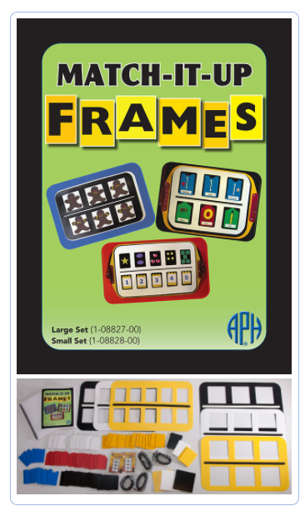


MATCH-IT-UP FRAMES
(Large Set and Small Set)
Suggested Activities

Slide 2
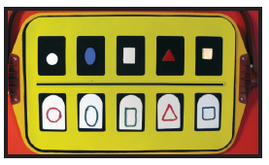
Matching by Shape
The large 5 x 2 yellow frame is positioned on the black hook-receptive side of APH’s All-In-One Board. The top row windows display five different shapes (borrowed from APH’s Picture Maker kits) including a white circle, a blue oval, a white rectangle, a red triangle, and a gold square. The bottom row windows display permanently assembled cards that show the same shapes in raised outline form (created with waxed yarn) affixed to the white mounting cards.

Slide 3
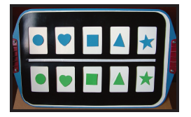
Matching by Shape
The large 5 x 2 black frame is positioned on the magnetic/dry-erase side of APH’s All-In-One Board. The top row windows display blue magnetic-backed foam shapes; shapes include a circle, a heart, a square, a triangle, and a star. The bottom row windows display green magnetic-backed foam shapes which are vertically aligned with the corresponding shapes in the top row.

Slide 4
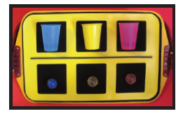
Color Matching
The large 3 x 2 yellow frame is positioned on the black hook-receptive side of APH’s All-In-One Board. Real cups are positioned within the windows of the top row. The colors of the cups, from left to right, are blue, yellow, and pink. Rubber balls, with the same corresponding colors, are positioned within the windows of the bottom row. Hook tabs have been applied to the objects to hold them securely to the hook-receptive surface.

Slide 5
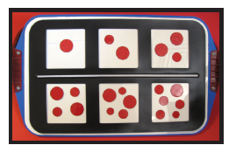
Number Sequencing
The large 3 x 2 black frame is positioned on the magnetic/dry-erase side of APH’s All-In-One Board. Magnetic red circles (borrowed from APH’s Textured Sorting Circles and Shapes kit) are displayed in order of increasing quantity (1 to 3) in the top row and continued in the bottom row. The magnetic circles are all red in color, but vary in size.

Slide 6
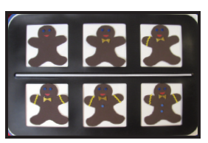
Pattern Sequencing
This example shows a pattern sequence of gingerbread men cutouts within the windows of the large 3 x 2 black frame positioned on the magnetic/dry-erase side of APH’s All-in-One Board. A new tactile/print feature (e.g., bow tie, zigzag line on arm, and button) is added from one gingerbread man to the next. The pattern begins in the top left window and continues, left to right, in the bottom row.

Slide 7
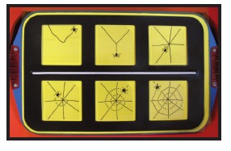
Pattern Sequencing
The large 3 x 2 black frame is positioned on the magnetic/dry-erase side of APH’s All-In-One Board. A yellow acetate sheet is positioned underneath the frame to provide extra visual contrast for the spider web cards positioned in the frames. Six spider web cards (borrowed from APH’s Sense of Science: ANIMALS kit) are shown in order of increasing size beginning in the upper row (left to right), and then continuing (left to right) within the windows of the bottom row. The cards cling to the acetate layer and are slipped behind each open window for secure placement.

Slide 8
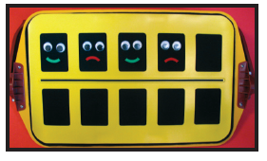
Pattern Completion
The large 5 x 2 yellow frame is positioned on the black hook-receptive side of APH’s All-In-One Board. In the first four windows of the top row, hook-backed craft eyes and curved pieces (borrowed from APH’s Picture Maker kits) are used to show a repeating pattern of alternating smiley and frowny faces. The fifth window is left blank so the student can insert a smiley face that completes the pattern. If desired, the pattern can be continued, from left to right, within the bottom row of windows.

Slide 9
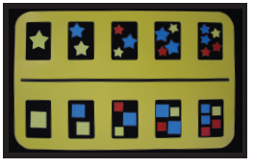
Pattern Duplication
The large 5 x 2 yellow frame is positioned on the black hook-receptive side of APH’s All-In-One Board. Textured shapes (borrowed from APH’s Textured Sorting Circles and Shapes) are placed within the open windows of the frame and displayed in order of increasing quantity (1 to 5). In the example below, stars are placed across the top row and squares in the bottom row. The color and position of the stars and squares closely mimic each other as the number of shapes increase across the frame. For example, the second window in the top row shows two stars of the same size, one blue star above a yellow star. Likewise, the second window of the bottom row displays two squares of the same size, one blue square above a yellow square.

Slide 10
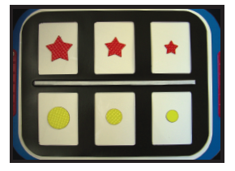
Sequencing by Size
The small 3 x 2 black frame is positioned on the magnetic/dry-erase side of APH’s Student Model All-In-One Board. Magnetic red stars in the top row and yellow circles in the bottom row are sequenced largest to smallest. The magnetic shapes are borrowed from APH’s Textured Sorting Circles and Shapes kit.

Slide 11
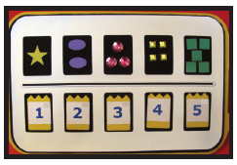
Number Concepts
The large 5 x 2 white frame is positioned on the black hook-receptive side of APH’s All-In-One Board. The bottom row windows display pre-assembled print and braille numbers including (left to right) 1, 2, 3, 4, and 5. Print/braille numbers are permanently affixed to yellow mounting cards. The top row windows display two-dimensional, textured shapes borrowed from APH’s Picture Maker kits. The number of shapes displayed in a given window corresponds with the number displayed in the window directly below it in the bottom row. The top windows, left to right, include one yellow star, two purple ovals, three pink rhinestone circles, four yellow rhinestone squares, and five green squares.

Slide 12
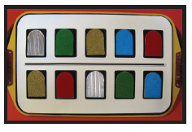
Matching by Texture
The large 5 x 2 white frame is positioned on the black hook-receptive side of APH’s All-In-One Board. The top windows display mounting cards with five different textures/colors including silver corrugated texture, green plush texture, gold glittery texture, blue bumpy texture, and red felt-like texture. The bottom row windows display the same textured/color cards but in a different order. The student can move the cards around until the corresponding textures align vertically in the top and bottom rows.

Slide 13
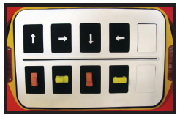
Spatial Concepts
The large 5 x 2 white frame is positioned on the black hook-receptive side of APH’s All-In-One Board. The top windows display white arrows (borrowed from APH’s Tactile Town Kit) that point in four different directions including up, right, down, and left. A white masking overlay is inserted into the fifth window of each row. The bottom row of windows display four cars (also borrowed from APH’s Tactile Town Kit) that point in the same direction as the corresponding arrows in the top row.

Slide 14
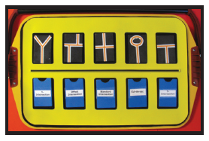
O&M Concepts
The large 5 x 2 yellow frame is positioned on the black hook-receptive side of APH’s All-In-One Board. The top window shows preassembled cards that display different types of intersections including a Y-intersection, an offset intersection, a standard intersection, a cul-de-sac, and a T-intersection. The tactile/ print intersections are created with layers of graphic art tape that are applied to the black mounting cards. The windows in the bottom row display preassembled cards with the print and braille word of the corresponding intersection types; matching cards align vertically.

Slide 15
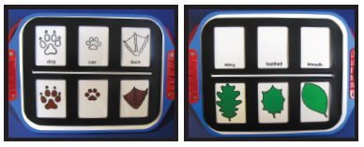
Science Concepts
The small 3 x 2 black frame is positioned on the magnetic/dry-erase side of APH’s Student Model All-In-One Board. Visual/tactile cards borrowed from APH’s Sense of Science: ANIMALS and PLANTS are utilized for matching activities. The first example shows black outlines of animal tracks (in the top row) paired vertically with their full-color counterparts (in the bottom row). The animal tracks include “dog,” “cat,” and “duck.” Cards are slipped behind each open window for secure placement. The second example shows different types of leaf margins paired vertically with their shape descriptions including “wavy,” “toothed,” and “smooth.”

Slide 16
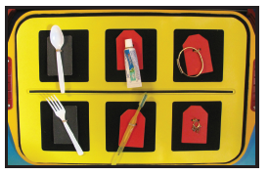
Matching Related Objects
The large 3 x 2 yellow frame is positioned on the black hook-receptive side of APH’s All-In-One Board. Preassembled matching cards are positioned within the open windows of the frame. Matching cards are built by attaching real objects to the mounting cards. The top row, left to right, shows a spoon, small toothpaste tube, and bracelet; the bottom row, left to right, displays a fork, toothbrush, and earring. The tactile cards in the top row align vertically with their related counterparts in the bottom row.

Slide 17
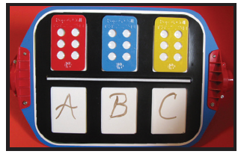
Literacy Activities
The small 3 x 2 black frame is positioned on the black hook-receptive side of APH’s Student Model All-In-One Board. APH Pop-A-Cell cards are positioned in the top row with plastic bubbles pushed upward to represent the letters A, B, and C. The corresponding print letters are written within the bottom row windows on the dry-erase surface.

Slide 18
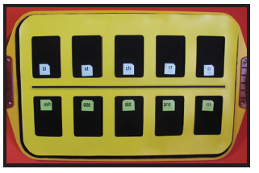
Literacy Activities
The large 5 x 2 yellow frame is positioned on the hook-receptive side of APH’s All-In-One Board. Print/braille tiles borrowed from APH’s Word PlayHouse kit are used to create words using beginning and ending sounds. The top row displays the following tiles: bl, st, ch, cr, and dr. The bottom row displays the following tiles: ush, one, ain, ane, and ink. By blending the beginning sounds in the top row with the sounds in the bottom row, the following words are formed: blush, stone, chain, crane, and drink.

Slide 19
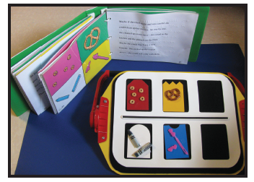
Retelling Stories
The small 3 x 2 white frame is positioned on the black hook-receptive side of APH’s Student Model All-In-One Board. Real objects of tactile/print pictures encountered on a page of APH’s storybook Jennifer’s Messes are shown within the frame’s windows. The top row features a card with real cereal and a card with a real pretzel; the bottom row features a card with a broken crayon and broken hair barrette (as shown in the storybook).

Slide 20
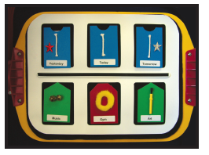
Calendar Activities
The small 3 x 2 white frame is positioned on the black hook-receptive side of APH’s Student Model All-In-One Board. Preassembled tactile communication cards are positioned within the open windows of the frame. The top row shows the tactile communication cards “Yesterday,” “Today,” and “Tomorrow.” The bottom row shows the tactile cards “Music,” “Gym,” and “Art.” Each tactile communication card aligns vertically with the card displaying the planned activity for that day.

Slide 21
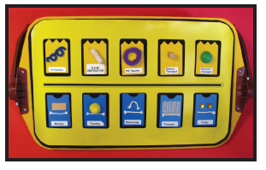
Calendar Activities
The large 5 x 2 yellow frame is positioned on the black hook-receptive side of APH’s All-In-One Board. Preassembled tactile communication cards are positioned within the open windows of the frame. The bottom row shows the tactile communication cards “Monday,” “Tuesday,” “Wednesday,” “Thursday,” and “Friday.” The top row shows the tactile communication cards “VI Teacher,” “O&M Instructor,” “PE Teacher,” “Speech Therapist,” and “Physical Therapist.” Each tactile card in the top row should align vertically with the tactile communication card displaying the day of the week that the student meets with the instructor.

Slide 22
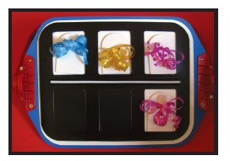
CVI Considerations
An assessment will determine the accommodations that are necessary. Students who demonstrate many CVI characteristics may need to use the black frames to ensure that their visual attention is drawn to the object, not to the frame. These students will need fewer choices presented at one time due to their need for low complexity. In this example, a color matching task is performed using mounting cards with various colors of tied-on ribbon and black frame cutouts. The small 3 x 2 black frame is positioned on the magnetic side of the Student Model All-In-One Board. Matching cards with pink ribbon align vertically above and below the raised black bar of the frame.

Slide 23
For more information about MATCH-IT-UP Frames, please visit APH’s Web site: www.aph.org
MATCH-IT-UP FRAMES
Large Set (Catalog # 1-08827-00)
Small Set (Catalog # 1-08828-00)
Presentation prepared by
Karen J. Poppe
APH Tactile Literacy Project Leader

