Slide 1

Laptime and Lullabies Sharing the Joys of Literacy with Infants, Toddlers and Very Young Children Who are Blind or Have Low Vision - Part I
Jessica Chandler
Kay Clarke
Jenni Remeis
Notes:
APH Intro

Slide 2



Presenters
Jenni Remeis
Assistant Director Statewide Services & Outreach Birth-5
OH State School for the Blind (OSSB)
Jessica Chandler
Associate Director Outreach Birth-5 –
WA State School for the Blind (WSSB)
Kay Clarke
Author, Laptime and Lullabies
Notes:
APH INTRO

Slide 3

A Warm Welcome to Laptime and Lullabies!
Over next hour...explore sampling of Laptime & Lullabies
With your input...jumpstart creative thinking
Good fit for children with combination of special needs
Notes:
KAY
Thank you, Erin and Leslie and Good Afternoon, Everyone!
I am Kay Clarke. Jessica, Jenni and I would like to extend a warm welcome to today's APH Laptime and Lullabies webinar!
Together over the next hour or so we will explore a sampling of the contents of the APH Laptime and Lullabies Kit.
With your input, we hope to jumpstart some creative thinking about the earliest stage of literacy for your infants and toddlers who are blind or have low vision.
Many ideas from Laptime and Lullabies promise to also be a good fit for slightly older children who have a combination of special needs and are beginning their literacy journey.

Slide 4
Learning Objectives
Compare and contrast the “traditional” definition of literacy with a newly “expanded” definition.
Name and briefly describe 12 major components of the earliest stage of literacy as presented in the Laptime and Lullabies Parent Handbook.
Apply at least 2 new early literacy ideas with your team and clarify how these experiences are linked with family-child interactions and relationships.
Summarize the parts of the Laptime and Lullabies Kit and explain how to access the kit.
Notes:
KAY
Thank you, Erin and Leslie and Good Afternoon, Everyone!
I am Kay Clarke. Jessica, Jenni and I would like to extend a warm welcome to today's APH Laptime and Lullabies webinar!
Together over the next hour or so we will explore a sampling of the contents of the APH Laptime and Lullabies Kit.
With your input, we hope to jumpstart some creative thinking about the earliest stage of literacy for your infants and toddlers who are blind or have low vision.
Many ideas from Laptime and Lullabies promise to also be a good fit for slightly older children who have a combination of special needs and are beginning their literacy journey.

Slide 5
Poll Question 1
What is your level of experience in parenting or serving infants and toddlers?
Notes:
KAY
BUT...Before we get started, we would like to hear a little bit MORE from [about] YOU.
(Poll Questions)
Pictured here is a large red question mark and we have two questions for you:
What is your level of experience in parenting or serving infants and toddlers who are blind or have low vision?

Slide 6
In the Chat
When you think of literacy, what words first pop into your head?
Notes:
KAY
(Please record your response in CHAT)
When you think of literacy, what words first pop into your head?
[IDEAS: Books; reading; writing; conversations; hands and touch; pictures; symbols; reading together; story time; singing; rhymes; listening; understanding; braille; library]

Slide 7

Nurturing Early Literacy...Planting a Garden
A host of skills comprise literacy
Mom and baby exploring flowering plant
Earliest stage = Like growing this plant
Notes:
KAY
From your many responses to what literacy means to you, it is clear that there are a whole lot of skills and components that comprise literacy.
Pictured here are a mom and her baby exploring a flowering plant. Mom smiles as she assists her child to reach out to touch the flowers by supporting his arm with her hand.
The earliest stage of literacy (that we will cover today) can, in fact, be a lot like growing this beautiful flowering bush.
[Seed in ground; rich soil; water; sun; wait]
Then one day out pokes a sprout that grows into a plant (signifies literacy)
Think about all that has gone on under the ground—earliest stage of literacy

Slide 8

What We Hope to Accomplish
Part I - Lay groundwork
Part II – Explore applications
Notes:
KAY
Today's session is the first of a two-part webinar.
The goal of this first part is to lay the important groundwork in order for us to understand and effectively nurture the earliest stage of literacy for very young children who are blind or have low vision.
Part 2 will explore applications of portions of Laptime and Lullabies in more detail.
Pictured here is a dad and his child reading a book in a woodsy outdoor setting. This is the type of activity we hope to nurture from birth.
So today we will:
Take a look at the more traditional definition of literacy and compare it with a more inclusive expanded definition.
Briefly review major components of the earliest stage of literacy as covered in L&L– whet your appetite for exploring L&L more fully
Share a smattering of early literacy activity ideas and highlight how they connect with family-child interactions and relationships.
Walk through the pieces of Laptime and Lullabies and how the kit may be obtained from APH.
We welcome questions and comments via Chat throughout our time together.
Ok….let’s get started!

Slide 9
What We Hope to Accomplish Today
Traditional definition of literacy vs. expanded definition
12 major components of the earliest stage of literacy as in Laptime and Lullabies
New early literacy ideas to apply with your team and through families
Parts of the Laptime and Lullabies Kit and how to access the kit
Notes:
KAY
Today's session is the first of a two-part webinar.
The goal of this first part is to lay the important groundwork in order for us to understand and effectively nurture the earliest stage of literacy for very young children who are blind or have low vision.
Part 2 will explore applications of portions of Laptime and Lullabies in more detail.
Pictured here is a dad and his child reading a book in a woodsy outdoor setting. This is the type of activity we hope to nurture from birth.
So today we will:
Take a look at the more traditional definition of literacy and compare it with a more inclusive expanded definition.
Briefly review major components of the earliest stage of literacy as covered in L&L– whet your appetite for exploring L&L more fully
Share a smattering of early literacy activity ideas and highlight how they connect with family-child interactions and relationships.
Walk through the pieces of Laptime and Lullabies and how the kit may be obtained from APH.
We welcome questions and comments via Chat throughout our time together.
Ok….let’s get started!

Slide 10
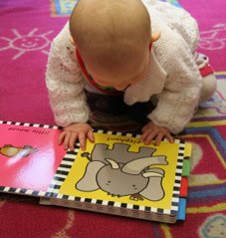
What is Literacy
Traditional definition: Read and write
Expanded definition: Read, write, speak and listen
Highlights: turning pages; new words; anticipation cues
Literacy for ALL at some level
Earliest stage of literacy: What and how?
Laptime and Lullabies Kit as framework
https://www.aph.org/product/laptime-and-lullabies/ (Handbook/Booklets)
https://www.aph.org/product/laptime-and-lullabies-storybooks. (Storybooks)
Notes:
KAY
Pictured here is an infant on her hands and knees visually exploring a simple picture of an elephant in a book. This is one facet of literacy.
Traditional definition of literacy directly relates to a person’s ability to read and write.
In more recent years, that definition has been expanded by some to encompass reading, writing, AND add the areas of speaking and listening.
It also highlights abilities such as turning pages of a book, understanding new vocabulary, and anticipating what is about to happen by using various cues (such as the jingling sound of car keys that indicate “it is time to go bye-bye”)
Undoubtedly this is a more INCLUSIVE definition, that matches the developmental levels of our youngest children as well as our children with significant combinations of disabilities—and invites them into the mix of children who are candidates for literacy learning.
Probably the two most important things for us to understand about the earliest stage of literacy are:
WHAT skills and abilities we might nurture; and
HOW to effectively reach and teach our youngest little learners.
The Laptime and Lullabies kit was developed specifically to enhance our understanding of these 2 areas—and can be used as a framework for the earliest stage of literacy.
The L&L Kit can be accessed through the 2 websites noted here.
We will pop these links into the chat now!

Slide 11
Laptime and Lullabies Parent Handbook 12 Major Components Poll Question 2 k 12 Major Components
How familiar are you with using the Laptime and Lullabies kit?
Very
Somewhat
Not at all
Notes:
From your many responses to what literacy means to you, it is clear that there are a whole lot of skills and components that comprise literacy.
Pictured here are a mom and her baby exploring a flowering plant. Mom smiles as she assists her child to reach out to touch the flowers by supporting his arm with her hand.
The earliest stage of literacy (that we will cover today) can, in fact, be a lot like growing this beautiful flowering bush.
[Seed in ground; rich soil; water; sun; wait]
Then one day out pokes a sprout that grows into a plant (signifies literacy)
Think about all that has gone on under the ground—earliest stage of literacy

Slide 12
Laptime and Lullabies Parent Handbook 12 Major Components
Establish Relationships (#2)
Share Conversations (#3)
Focus on Vision (#4)
Grow Listening Skills (#5)
Enhance Touch (#6)
Partner in Play (#7)
Explore the World (#8)
Read Together (#9)
Investigate Books (#10)
Discover Symbols (#11)
Experiment With Tools (#12)
Team Up for Literacy (#13)
***
***
Notes:
KAY
The Parent Handbook piece of Laptime and Lullabies covers 12 major components of early literacy that we will walk through first.
Before we start, it would be helpful if we have an idea of how familiar you are with the L&L Kit.
Poll Question: How familiar are you with using the Laptime and Lullabies Kit? [Please respond in CHAT]
A quick overview on this slide breaks the 12 components down by category and indicates the corresponding booklet numbers:
Establish Relationships and Share Conversations – Social aspects (Booklets 2&3)
Focus on Vision; Grow Listening Skills and Enhance Touch – Sensory areas (Booklets 4-6)
Partner in Play and Explore the World – Understanding the world components (Booklets 7&8)
Read Together, Investigate Books – Moving toward reading (9&10)
Discover Symbols, Experiment with Tools – Moving toward writing (Symbols crossover; #11 &12)
Team Up for Literacy – Building a literacy team; It takes a village (Booklet 13)
Jessica will start us off with the L&L social components of literacy.

Slide 13
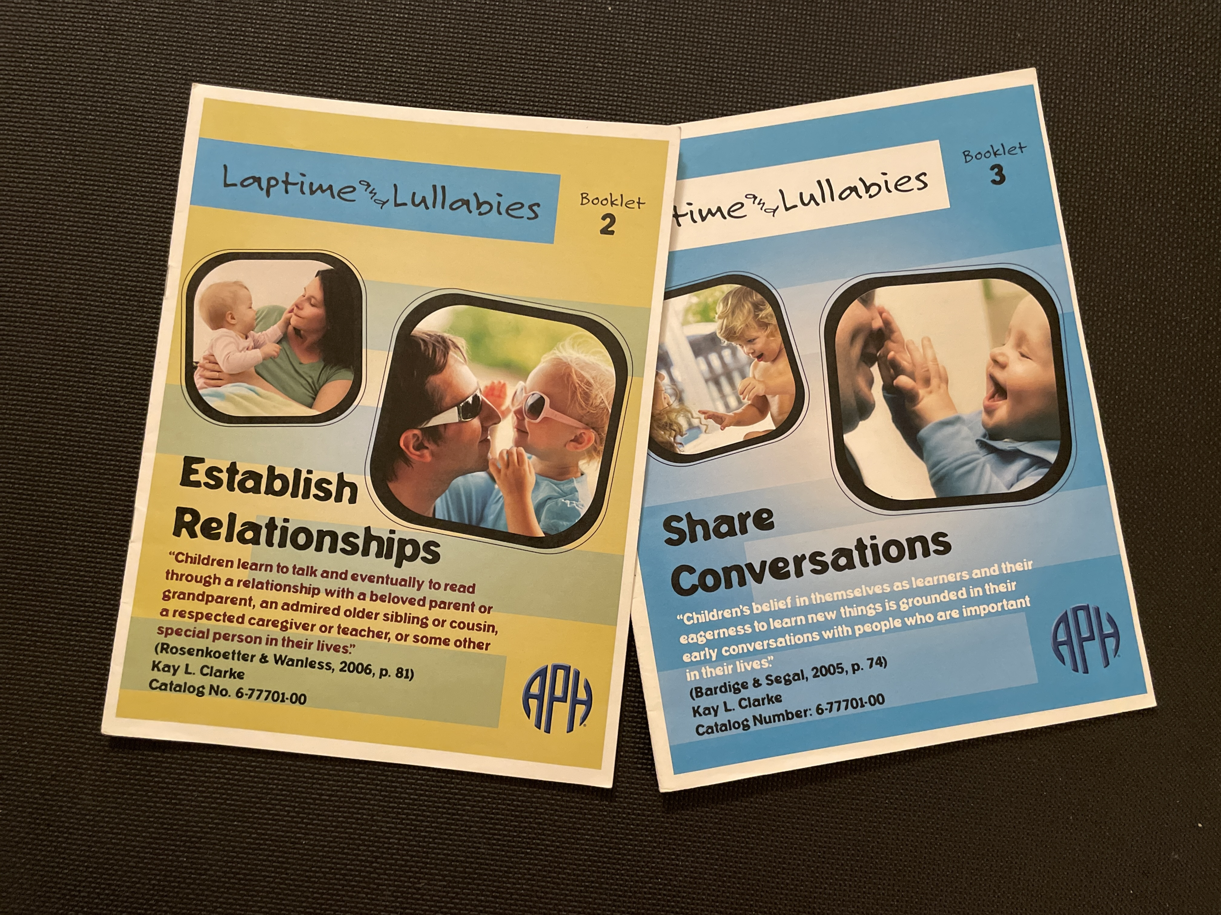
Social Aspects
Notes:
Image Description: Covers of Establish Relationships and Share Conversations Booklets

Slide 14
Establish Relationships
“Children learn to talk and eventually to read through a relationship with a beloved parent or grandparent, an admired older sibling or cousin, a respected caregiver or teacher, or some other special person in their lives.”
(Rosenkoetter & Wanless, 2006)

Slide 15

Establish Relationships
Family in “driver’s seat”
Attachment
Responsive parenting
“Partner with” child
Respectful interactions
Have fun!
Notes:
JESSICA:
Establish Relationships
“Children learn to talk and eventually to read through a relationship with a beloved parent or grandparent, an admired older sibling or cousin, a respected caregiver or teacher, or some other special person in their lives.” (Rosenkoetter & Wanless, 2006)
As Early support specialists, we acknowledge the best way a child can learn and grow is through routines and rituals with their caregivers! So putting parents in the driver’s seat and acknowledging that their positive relationship with their baby is crucial and at the heart of this kit.
Attachment:
Eye contact, smiles, loving touches, hugging and vocalizing back and forth- these are all interactions a caregiver and child might share to build a healthy emotional bond!
Responsive Parenting:
Typically a young child will experience affection through eye contact, facial expressions and smiling. Young children who are blind or have low vision rely on other senses to learn and interact with the world. By being physically nearby your young one, you can provide opportunities for hugs and touches AND your baby with vision to see your face! These opportunities might include massage, rocking, singing, using scented lotions or essential oils or introducing textures And finally, YES! Sharing a literacy experience is also a way to strengthen your relationship with your very young child! During these up close interactions, you can begin to observe and learn the big or little ways your little one might be reaching out to you!
Consider Partnering with your child to create respectful interactions:
In other words...“Do with, not for”
Partnering with your baby during routines and providing early confidence-building opportunities will help to promote increased participation in interactions and activities.
These partnered interactions are respectful and inviting…reminding your baby that together the two of you can share the work and of course share the fun too!
Image Description: A mom hugs her young child as he hugs her back

Slide 16
Share Conversations
“Children’s belief in themselves as learners and their eagerness to learn new things is grounded in their early conversations with people who are important in their lives.”
(Bardige & Segal, 2005)

Slide 17

Share Conversations
Greeting routines
Subtle attempts by child
Turn-taking
Sing / Rhymes
Signal “end”
Cues: sounds / touch / objects / smells/ routines
Notes:
JESSICA
Image Description: A baby looks content as they look towards their mom who is holding their hands and leaning over them
Share Conversations “Children’s belief in themselves as learners and their eagerness to learn new things is grounded in their early conversations with people who are important in their lives.” (Bardige & Segal, 2005)
Greeting Routines:
Building routines for greeting your child will help signal the start of a conversation. Greeting your child by name will help him know that, “Yes, she’s talking to ME!” and likewise identifying yourself to your little one will help him recognize you clearly! Soon he will begin to recognize your voice, the bracelet you let him feel during the greeting or scent of your favorite soap.
Subtle attempts:
First conversations can be short. Observe your little one's expressions. This might be crying, smiling, making noises or facial expressions. Even more subtly, their breathing might change and become faster or slower, deeper or quieter.
Turn Taking:
A true conversation involves turn-taking! Imitating the actions of a very young child, labeling those actions and waiting for them to repeat after you is a great early conversation starter! Eventually “my turn”, “your turn” phrases can be incorporated into these interactions noting that “wait time” or giving your little one about 10 seconds or so to respond might be needed!
Sing/ Rhymes:
Singing and Rhymes can also be early conversation starters! Reciting rhymes and fingerplays can capture your baby’s attention. By inserting rhyming phrases, into routines, like- “Roll over, Rover” during a diaper change, we begin to introduce letters and sounds! Making up songs during daily activities and to encourage or comment on your baby’s actions can spark conversation in a fun way!
Signal "end":
In the same spirit of creating a “greeting” routine, it is important to help your young child know when an activity is finished. By using words or gestures we can signal “all done”. Within daily routines, when an activity ends, a child might have the opportunity to put that item away back in it’s place, like a toy into a toy box. Some little ones benefit from a more concrete signal by putting the item from an activity that has just wrapped up into a special basket to signal “all done”. Signaling an end can also be used in conversations and interactions so that the adult doesn’t just “disappear”!
Finally, cues of all kinds can be used to help your young child comprehend and anticipate events during daily routines. Sound cues like shaking the bottle prior to feeding her can let her know that it is time to eat! Touch cues like gently patting the nose before a nose wipe can signal the Kleenex is on its way. Giving your child a book prior to the start of a reading activity is a great example of an object cue. Words alone, like “Uppppp” can signal to the baby she is about to be picked up and even pairing touch with words like giving a little tug under the arm and saying “Upppp” helps baby to anticipate that action. Gestures and smells can be cues as well.
Can you think of a way that a gesture might cue it’s time to leave the house? To go in the car to an appointment or the store? CHAT (15 sec)
How can a smell cue that it is bathtime? CHAT (15 sec)
Awesome ideas for cues! Jenni will now cover Sensory Areas, Jenni...

Slide 18
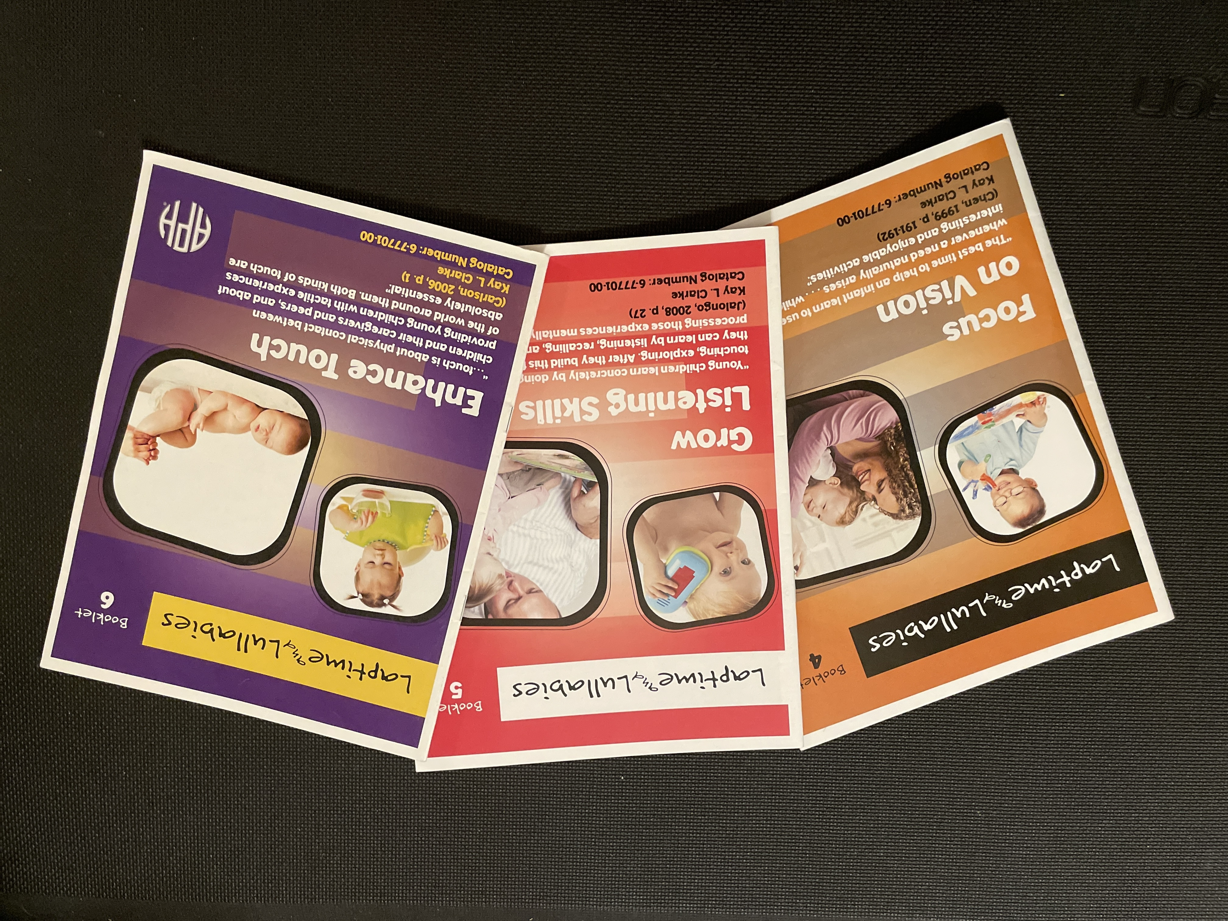
Sensory Areas
Notes:
Image Description: Covers of Focus on Vision, Grow Listening Skills and Enhance Touch Booklets
In these next slides, We are going to focus on the learning that occurs through vision, hearing and touch

Slide 19
Focus on Vision
“The best time to help an infant learn to use vision is whenever a need naturally arises…while doing interesting and enjoyable activities.”
(Chen, 1999)

Slide 20
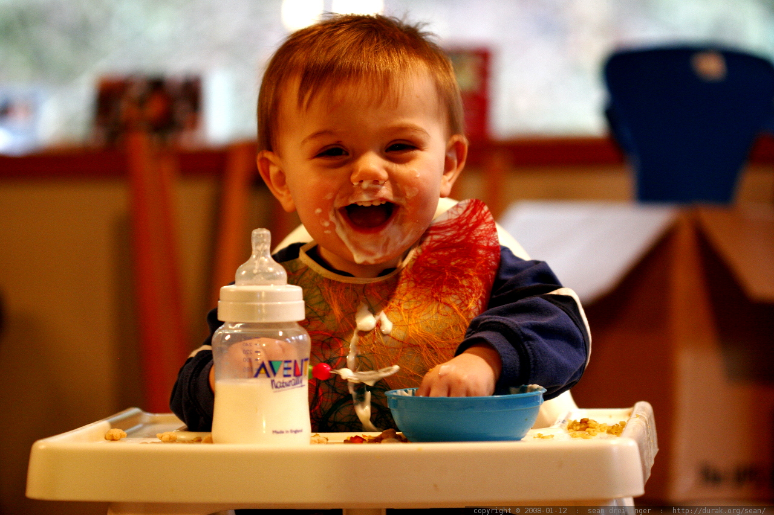
Focus on Vision
Functional vision
Lighting / Magnification
Positioning
“Glasses On!”
Book characteristics
Notes:
JENNI
Read Quote: "The best time to help an infant learn to use vision is whenever a need naturally arises... while doing interesting and enjoyable activities." (Chen, 1999)
Image Description: "the image shows a toddler sitting in a high chair. He has a bottle and a blue bowl on the tray. He holds a spoon and is reaching into the bowl with his other hand, he has a smile and a delightfully messy face!"
Most young children who are blind or visually impaired have some useable vision (Lueck & Heinze, 2004) but the quality and quantity of what they see is reduced. While we may not be able to determine exactly how much and how well our little ones see, a functional vision assessment conducted by a teacher for children with visual impairments or certified orientation and mobility specialist is an important first step to understand as much as possible. Once you know what your child’s visual needs are, it is easier to set the stage for learning.
Providing optimal light is a must, especially if there are books involved but it is important to remember that children will have different light preferences based on their eye condition, and some types of lighting can be harsh. When the opportunity arises, it is always great to take advantage of natural light. Positioning is one of the key elements so that light is used as an enhancement and not as a distractor. By positioning children with their back to windows and other light sources, the light is able to come in from behind and highlight people, toys and other visual materials in front of them. *Pay attention to the direction highchairs, or other seats are situated. In addition to natural light, you can also try some creative lighting, such as a reading light clipped to a board book with sparkly pictures or on the tray of a stander to illuminate sensory items. Backlighting from a lightbox is also a great way to highlight pictures and objects.
Magnification may also be necessary. Supervised use of a large dome magnifier, AKA "a magic window”, can be fun to glide across a book and stop on individual pictures to enlarge them.
Body position is critical to achieving the best visual potential and some children may require more support than others. Exploring a variety of different positions is also a good way to encourage looking behaviors in different visual fields, such as side-lying while playing with hanging toys on a propped light box, or maybe placing a child in a forward facing baby carrier while you prepare their meal. Rolled towels and pool noodles have been among my personal favorites to provide support in different positions.
Finding a comfortable position for children with physical limitations is often a challenge. This is a great time to consult with a physical therapist to determine what types of strategies may be helpful.
Let's talk about glasses! keeping glasses on a toddler can be a challenge and even the most diligent parent can be worn down by a persistent 2-year-old! A daily glasses routine is a great start “Get ready face, get set ears..Let’s put glasses on.” we did it…cheers!" jumping into an enjoyable hands-on activity is a great way to redirect attention and increase the chances of keeping glasses on!
It is also important to recognize signs of visual fatigue (such as rubbing eyes, fussiness, tearing etc.) identifying these signs and providing a visual break (removing glasses) prior to the child ripping them off themselves, can keep the experiences positive.
What are some other ways to help families keep glasses on their infants and toddlers? (CHAT BOX)
Finally, when introducing books for children with low vision, try to find books that have visual interest such as reflective pictures, photographs, lights or moveable parts

Slide 21
Grow Listening Skills “Young Children learn concretely by doing—feeling, touching, exploring. After they build this foundation, they can learn by listening, recalling and processing those experiences mentally.” (Jalongo, 2008)
Notes:
JENNI
Read Quote
Image Description: A toddler in a striped shirt, wears a big smile, as his caretaker whispers something into his ear
Did you know that about 50% to 90% of young children’s communication time is spent listening? Jessica highlighted the development of language and its relationship to literacy through shared conversations. As children tune in and listen to words, songs, and stories that are shared with them, through the context of daily routines, they are learning how to understand and use language.
Tuning into environmental sounds and cueing your child to “listen” as you provide descriptions, provides context and meaning. For instance, what’s that sound? can you hear it? Weeoo weeoo, it’s a fire truck! Providing additional context, maybe by looking through the window if your child is able, walking outside, or taking a trip in the community to get an up close look at a real fire truck gives greater meaning to that sound.
Incorporate word play is a fun way to help your toddler begin to understand word, syllable and letter sounds.
Before the age of 3, 3/4 of children experience at least one ear infection that temporarily affects their ability to hear. Because children with visual impairments rely greatly on sound to teach them about the environment around them, it is especially important to schedule periodic hearing tests, identify signs of infections early and protect against harmful environmental noises. Also make sure to minimize sound ”clutter” such as television, or excessive chatter that can make it difficult to "tune in".( This is something we naturally do as learners, for instance, when driving to a new place, many of us will instinctively turn off the radio and stop conversation to focus. But in our homes, we get so used to background noise, that we sometimes don't recognize their potential disruption to learning. )
If I were to belt out a toddler tune right now, chances are you would all be singing it for most of the day! I’ll spare you, but my point is that we know songs and rhymes have a way of sticking with us. The rhythms, beats, and repetitive words encourage memory, movement and reciprocal interaction. Experience with rhymes in the first 3 years of life has been linked to early awareness of word and syllable sounds. And with little learners, the sillier the better!
Finally, if we want to our children to build good listeners, it is critical that we model good listening habits ourselves. Children can sense when we are listening to them and when we are distracted. In a time of devices, this is more evident now than ever before. Making physical contact and acknowledging their communication attempts "I hear you yelling, you're angry" - this not only strengthens relationships, but it also demonstrates how to truly listen.

Slide 22

Grow Listening Skills
Communication: receptive/expressive
Environmental sounds
Letter sounds / Word play
Protect ears / minimize sound “clutter”
Songs / Rhymes
Model good listening!
Notes:
JENNI
Read Quote
Image Description: A toddler in a striped shirt, wears a big smile, as his caretaker whispers something into his ear
Did you know that about 50% to 90% of young children’s communication time is spent listening? Jessica highlighted the development of language and its relationship to literacy through shared conversations. As children tune in and listen to words, songs, and stories that are shared with them, through the context of daily routines, they are learning how to understand and use language.
Tuning into environmental sounds and cueing your child to “listen” as you provide descriptions, provides context and meaning. For instance, what’s that sound? can you hear it? Weeoo weeoo, it’s a fire truck! Providing additional context, maybe by looking through the window if your child is able, walking outside, or taking a trip in the community to get an up close look at a real fire truck gives greater meaning to that sound.
Incorporate word play is a fun way to help your toddler begin to understand word, syllable and letter sounds.
Before the age of 3, 3/4 of children experience at least one ear infection that temporarily affects their ability to hear. Because children with visual impairments rely greatly on sound to teach them about the environment around them, it is especially important to schedule periodic hearing tests, identify signs of infections early and protect against harmful environmental noises. Also make sure to minimize sound ”clutter” such as television, or excessive chatter that can make it difficult to "tune in".( This is something we naturally do as learners, for instance, when driving to a new place, many of us will instinctively turn off the radio and stop conversation to focus. But in our homes, we get so used to background noise, that we sometimes don't recognize their potential disruption to learning. )
If I were to belt out a toddler tune right now, chances are you would all be singing it for most of the day! I’ll spare you, but my point is that we know songs and rhymes have a way of sticking with us. The rhythms, beats, and repetitive words encourage memory, movement and reciprocal interaction. Experience with rhymes in the first 3 years of life has been linked to early awareness of word and syllable sounds. And with little learners, the sillier the better!
Finally, if we want to our children to build good listeners, it is critical that we model good listening habits ourselves. Children can sense when we are listening to them and when we are distracted. In a time of devices, this is more evident now than ever before. Making physical contact and acknowledging their communication attempts "I hear you yelling, you're angry" - this not only strengthens relationships, but it also demonstrates how to truly listen.

Slide 23
Enhance Touch “…touch is about physical contact between children and their caregivers and peers, and about providing young children with tactile experiences of the world around them. Both kinds of touch are absolutely essential.” (Carlson, 2006)
Notes:
JENNI
Read quote "touch is about physical contact between children and their caregivers and peers, and about providing young children with tactile experiences of the world around them. Both kinds of touch are absolutely essential." (Carlson, 2006)
Image Description: A chubby child's hand is seen against the background of their blue checkered shirt and green pants
Touch contributes to young children’s emergent literacy in many ways. And for children with vision loss, tactile exploration plays a key role in providing contextual information. This is especially important for children who may become braille readers and writers.
It is a big responsibility as an adult in your child’s life, to develop trusting relationships through respectful touch. A child who has positive experiences with touch is more likely to take risks and explore without fear. For instance, by using hand under hand guidance to lead your child’s hand to a new texture, you are letting them know they can “ride along” but still maintain the control to exit the ride if it gets a little scary!
Incorporating touch cues is a great way to aide in communication and language development. For instance, a gentle tap to the side of your child’s temple as you say “glasses on” can help them anticipate their glasses being placed on their face.
Young children explore their sense of touch in a variety of ways. A baby toy hasn’t been truly loved until it has been sufficiently covered in baby slobber! Infants and toddlers love to use their mouths to compare textures, and for children with vision loss, it is typical for this stage to lasts a bit longer. It is also very common for toddlers with low vision to preview textures with their feet, or maybe an elbow before they are ready to use their hands.
One of the best ways to encourage touching with hands is through tummy time and floor play. While a child presses her hands to the floor to support her upper body, she is also increasing the strength to her hands, arms and shoulders.
As you help your child sweep their hands from left to right across their highchair tray to locate small pieces of food, you are also modeling the same movements they will use to locate tactile pictures or braille on page.
It is important to pay attention to non-verbal cues, such crying or even gagging, that may indicate a certain type of touch is uncomfortable.

Slide 24
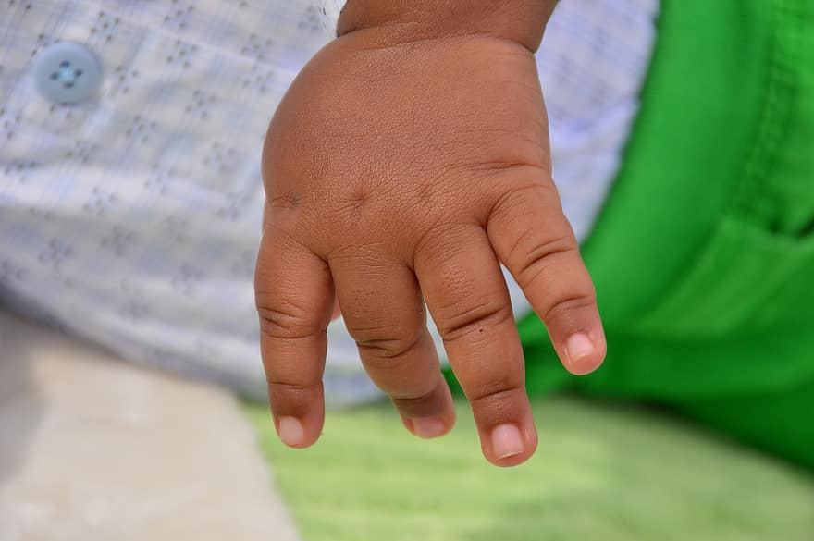
Enhance Touch
Respectful touch by others
Communicate by touch
Mouth / Whole Body / Hands
Strength and dexterity
Hand search
Uncomfortable touch
Notes:
JENNI
Read quote "touch is about physical contact between children and their caregivers and peers, and about providing young children with tactile experiences of the world around them. Both kinds of touch are absolutely essential." (Carlson, 2006)
Image Description: A chubby child's hand is seen against the background of their blue checkered shirt and green pants
Touch contributes to young children’s emergent literacy in many ways. And for children with vision loss, tactile exploration plays a key role in providing contextual information. This is especially important for children who may become braille readers and writers.
It is a big responsibility as an adult in your child’s life, to develop trusting relationships through respectful touch. A child who has positive experiences with touch is more likely to take risks and explore without fear. For instance, by using hand under hand guidance to lead your child’s hand to a new texture, you are letting them know they can “ride along” but still maintain the control to exit the ride if it gets a little scary!
Incorporating touch cues is a great way to aide in communication and language development. For instance, a gentle tap to the side of your child’s temple as you say “glasses on” can help them anticipate their glasses being placed on their face.
Young children explore their sense of touch in a variety of ways. A baby toy hasn’t been truly loved until it has been sufficiently covered in baby slobber! Infants and toddlers love to use their mouths to compare textures, and for children with vision loss, it is typical for this stage to lasts a bit longer. It is also very common for toddlers with low vision to preview textures with their feet, or maybe an elbow before they are ready to use their hands.
One of the best ways to encourage touching with hands is through tummy time and floor play. While a child presses her hands to the floor to support her upper body, she is also increasing the strength to her hands, arms and shoulders.
As you help your child sweep their hands from left to right across their highchair tray to locate small pieces of food, you are also modeling the same movements they will use to locate tactile pictures or braille on page.
It is important to pay attention to non-verbal cues, such crying or even gagging, that may indicate a certain type of touch is uncomfortable.

Slide 25
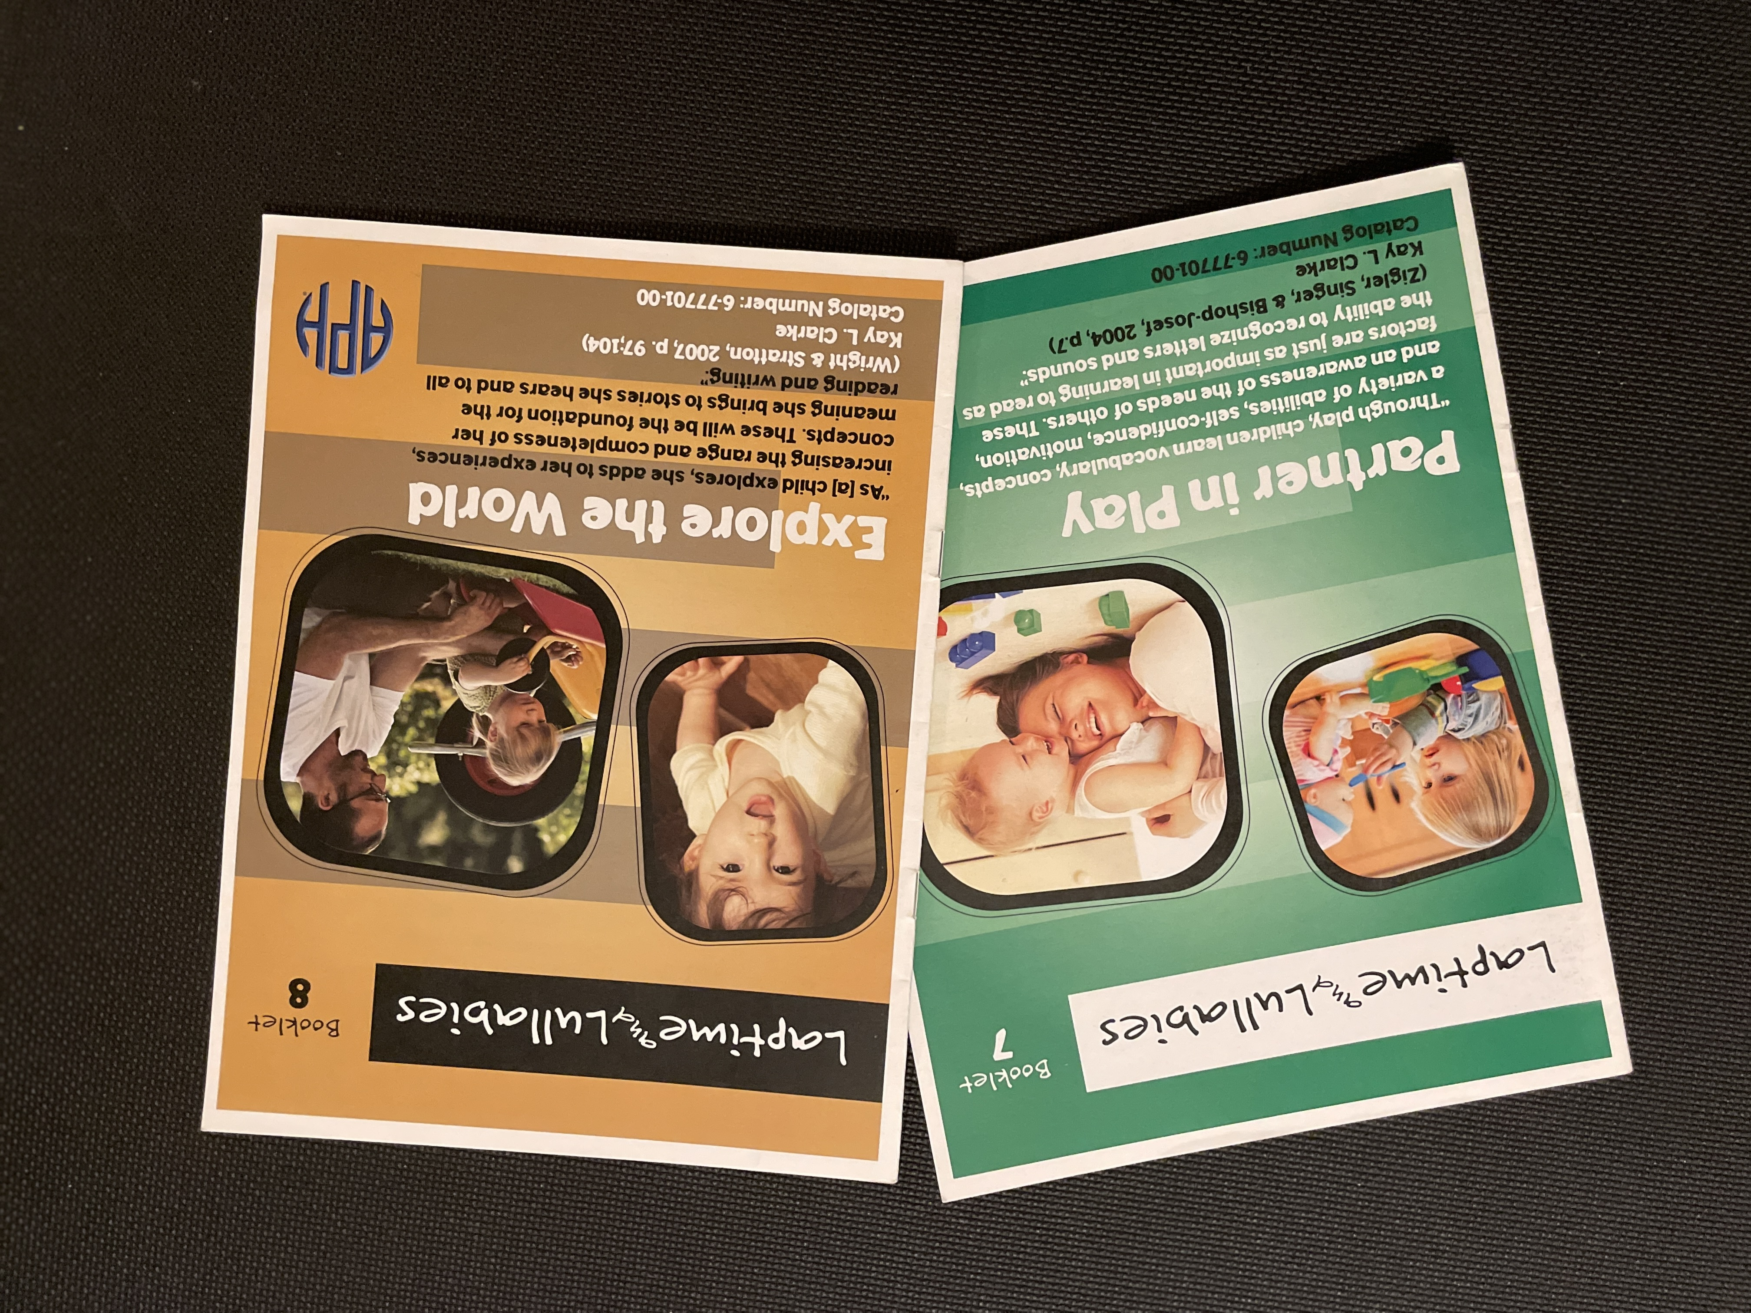
Understanding the World
Notes:
KAY
Pictured here are the Partner in Play and Explore the World Booklets – Vehicles for Understanding the World

Slide 26
Partner in Play "Through play, children learn vocabulary, concepts, a variety of abilities, self-confidence, motivation, and an awareness of the needs of others. These factors are just as important in learning to read as the ability to recognize letters and sounds.” (Zigler, Singer & Bishop-Josef, 2004)
Notes:
KAY
Read Quote: Through play, children learn vocabulary, concepts, a variety of abilities, self-confidence, motivation, and an awareness of the needs of others. These factors are just as important in learning to read as the ability to recognize letters and sounds.” (Zigler, Singer & Bishop-Josef, 2004)
We know that very young children learn best through play—where learning is fun and there is no "right or wrong"
Play skills may be impacted by vision loss –more limited ability to visually access and imitate what others are doing
May stall or perseverate at certain level
Adult modeling important for ALL children’s play skills (Hmmm...What ALL can we do with this?) IF ADULTS INVOLVED, CHILDREN'S PLAY IS RICHER
Tap into child’s interests and then join in, gradually modeling (visually/tactually) different ways to use objects in play.
For example:
TURN-TAKING; HAND TOY TO CHILD UPSIDE DOWN; FROM SPINNING WHEELS TO ROLLING TOY CAR
Welcome young children to participate in a host of play experiences and set them up.
What are some types of play that come to mind for you? PLEASE THROW OUT SOME IDEAS IN THE CHAT BOX.
[Examples: Sensory; Object; Motor; Social; Construction; all the way up to Pretend (precursor to learning about symbolism and symbols)
Expose children to enriched play spaces that are a good match for their developmental levels [size of space; items in space]
Allow them to access the space as independently as possible [display a few toys on low open shelves rather than in a toy basket or box so they can find them
Keep toys in consistent locations and consider setting up play space in center of family's activity.
Implement Lilli Nielsen: Active Learning and Stay-Put Play Spaces for very young and children and those with significant combinations of disabilities
For example: Pictured here is a young infant watching as she bats at toys suspended above her within reach.
Try different types of playthings with varied sensory qualities: visual; sound; tactile; vibratory
Assess individual child’s interest
REAL OBJECTS for play (fruit; kitchen items)
Good developmental match
Introduce Infant-Toddler books about play for read-together time. – Based on child’s personal experiences and interests
EXAMPLE PICTURED HERE: Pots and Pans by Patricia Hubbell

Slide 27
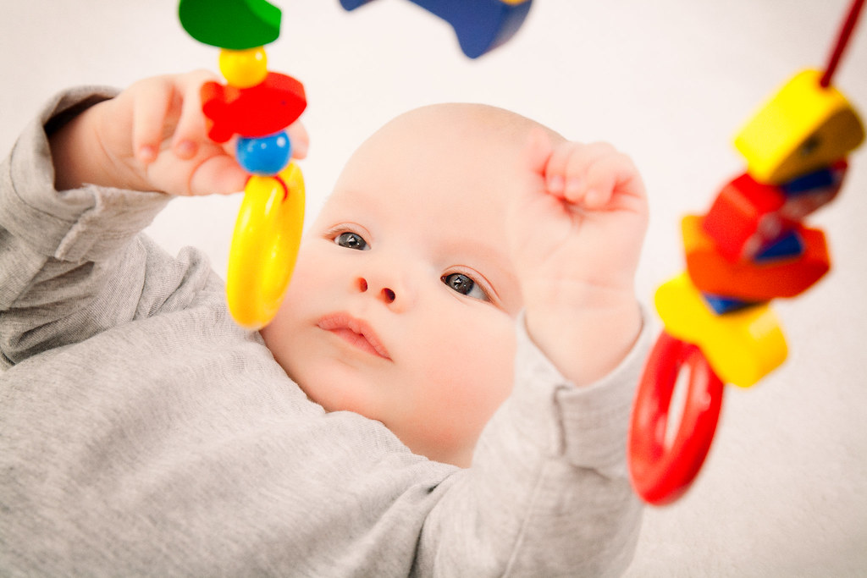
Partner in Play
Learning through play – fun; no right/wrong
Potential impact of vision loss
Take child's lead / model and expand
*Welcome children to all kinds of play
Play environments / stay-put play spaces https://activelearningspace.org
Playthings: interesting; sensory; real objects
Books about play: Pots & Pans - Hubbell
Notes:
KAY
Read Quote: Through play, children learn vocabulary, concepts, a variety of abilities, self-confidence, motivation, and an awareness of the needs of others. These factors are just as important in learning to read as the ability to recognize letters and sounds.” (Zigler, Singer & Bishop-Josef, 2004)
We know that very young children learn best through play—where learning is fun and there is no "right or wrong"
Play skills may be impacted by vision loss –more limited ability to visually access and imitate what others are doing
May stall or perseverate at certain level
Adult modeling important for ALL children’s play skills (Hmmm...What ALL can we do with this?) IF ADULTS INVOLVED, CHILDREN'S PLAY IS RICHER
Tap into child’s interests and then join in, gradually modeling (visually/tactually) different ways to use objects in play.
For example:
TURN-TAKING; HAND TOY TO CHILD UPSIDE DOWN; FROM SPINNING WHEELS TO ROLLING TOY CAR
Welcome young children to participate in a host of play experiences and set them up.
What are some types of play that come to mind for you? PLEASE THROW OUT SOME IDEAS IN THE CHAT BOX.
[Examples: Sensory; Object; Motor; Social; Construction; all the way up to Pretend (precursor to learning about symbolism and symbols)
Expose children to enriched play spaces that are a good match for their developmental levels [size of space; items in space]
Allow them to access the space as independently as possible [display a few toys on low open shelves rather than in a toy basket or box so they can find them
Keep toys in consistent locations and consider setting up play space in center of family's activity.
Implement Lilli Nielsen: Active Learning and Stay-Put Play Spaces for very young and children and those with significant combinations of disabilities
For example: Pictured here is a young infant watching as she bats at toys suspended above her within reach.
Try different types of playthings with varied sensory qualities: visual; sound; tactile; vibratory
Assess individual child’s interest
REAL OBJECTS for play (fruit; kitchen items)
Good developmental match
Introduce Infant-Toddler books about play for read-together time. – Based on child’s personal experiences and interests
EXAMPLE PICTURED HERE: Pots and Pans by Patricia Hubbell

Slide 28
Explore the World “As [a] child explores, she adds to her experiences, increasing the range and completeness of her concepts. These will be the foundation for the meaning she brings to stories she hears and to all reading and writing.” (Wright & Stratton, 2007)
Notes:
KAY
Read quote: “As [a] child explores, she adds to her experiences, increasing the range and completeness of her concepts. These will be the foundation for the meaning she brings to stories she hears and to all reading and writing.” (Wright & Stratton, 2007)
Certified Orientation & Mobility specialist – important person on team for this purpose AND for many children a Physical Therapist to enhance quality of gross motor skills
Exploration begins with child’s own body: bring hands together; grab clothes/hair; chew on toes – Understanding of body is foundation for exploring the larger world
Indoor exploration: from crib space to “Room Detectives” (what goes where; including ceiling)
“Experiments” (ice cube melts)
Simple cooking activities (shaker pudding; raw vs. Cooked egg)
Side-stepping “trailing”
Outdoor exploration - Home environment/yard
Begin by taking favorite daily routine indoor activities outside (“picnic”; play on blanket; swing)
Community exploration – mini-fieldtrips (Neighborhood walks; All-weather walks; Park; Library)
Safety considerations – Tricky balance
“Protective hands”
Human guide (times when adult may need to take control for safety reasons)
CHILD-PROOF environments: gated stairs/steps; caps for outlets; pad sharp edges
JESSICA WILL NOW MOVE US ON A LITTLE CLOSER TO TRADITIONAL READING

Slide 29

Explore the World
COMS / PT on team
Own body: hands; clothes; feet
Indoor exploration: crib to "room explorers"; experiments; cooking; side-step trailing
Outdoor exploration: favorite indoor activity
Community exploration: mini-fieldtrips
Safety considerations:
protective hands;
human guide;
child-proof environment
***
Notes:
KAY
Read quote: “As [a] child explores, she adds to her experiences, increasing the range and completeness of her concepts. These will be the foundation for the meaning she brings to stories she hears and to all reading and writing.” (Wright & Stratton, 2007)
Certified Orientation & Mobility specialist – important person on team for this purpose AND for many children a Physical Therapist to enhance quality of gross motor skills
Exploration begins with child’s own body: bring hands together; grab clothes/hair; chew on toes – Understanding of body is foundation for exploring the larger world
Indoor exploration: from crib space to “Room Detectives” (what goes where; including ceiling)
“Experiments” (ice cube melts)
Simple cooking activities (shaker pudding; raw vs. Cooked egg)
Side-stepping “trailing”
Outdoor exploration - Home environment/yard
Begin by taking favorite daily routine indoor activities outside (“picnic”; play on blanket; swing)
Community exploration – mini-fieldtrips (Neighborhood walks; All-weather walks; Park; Library)
Safety considerations – Tricky balance
“Protective hands”
Human guide (times when adult may need to take control for safety reasons)
CHILD-PROOF environments: gated stairs/steps; caps for outlets; pad sharp edges
JESSICA WILL NOW MOVE US ON A LITTLE CLOSER TO TRADITIONAL READING

Slide 30
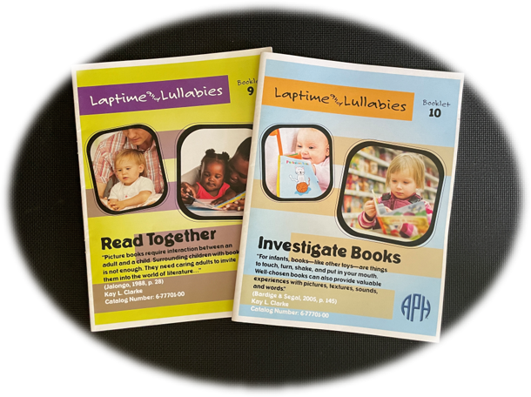
Moving Toward Reading
Notes:
Image Description: Covers of Read Together, Investigate Books, and Discover Symbols Booklets

Slide 31
Read Together
“Picture books require interaction between an adult and a child. Surrounding children with books is not enough. They need caring adults to invite them into the world of literature.” (Jalongo, 1988)
Notes:
JESSICA -
Read Together
Image Description: A father looks down at his baby in his lap while holding a book.
“Picture books require interaction between an adult and a child. Surrounding children with books is not enough. They need caring adults to invite them into the world of literature.” (Jalongo, 1988)
The Read Together booklet explores the many ways you can begin to invest in your child's future reading and writing skills!
Let's first explore Attention Span:
Asking yourself- “Is my little one tired of listening?”, “Should I try a different book?”, “Does he need a break to get up and move around?” are all part of the guesswork during reading activities. Follow your child’s cues and don’t be afraid to make adjustments to what you read, how you read it and how long you read!
Did you know that according to IRA & NAEYC (1998), “Sharing books with your infant and toddler is one of the greatest contributions you can make toward his emerging literacy.”
Let me say that again! “Sharing books with your infant and toddler is one of the greatest contributions you can make toward his emerging literacy.” Reading can never be done too early and is a major investment in your child’s future ability to read and write!
Read Together experiences are powerful- Let's look at some Considerations:
Your reading experiences early on with your baby may heavily rely on your presentation skills! Books with the bright, colorful pictures also capture the attention of a baby with vision. Grasping a book, shaking it and even chewing on it are all part of the literacy experience as well! Breaking up reading routines with opportunities to move and simple action rhymes can help sustain attention.
Depending on the unique needs of a child, there are many alternative ways to have meaningful literacy experiences:
Books can be experienced without pages! You can create a story bag or box with the items that go along with a picture book with or without the actual book. Another fun idea is a story pillow- add Velcro to a lap sized pillow and attach child-friendly textured materials to go along with a story book or make up your own tale. The Read Together Parent Handbook has a number of “out of the box” reading ideas.
In addition, consider creating a literacy-rich environment in your home or supporting families with ideas for how to create a literacy-rich environment at home!
You can get cozy and create a book nook! Complete with a soft rug and comfy pillows, and upright books that are switched out for novelty. Visit the public library or neighborhood Little Free Library. Visit neighborhood garage sales and thrift stores and start curating a home library.
Some other ideas for creating a literacy-rich home environment can include modeling literacy activities. This could include asking for a braille menu at a restaurant. It could be involving your child in some of the everyday literacy activities you do – like list making or reading the newspaper.

Slide 32

Read Together (cont.)
Attention span
Read-together considerations
Alternatives to traditional book reading
Literacy-rich environment at home
Notes:
JESSICA -
Read Together
Image Description: A father looks down at his baby in his lap while holding a book.
“Picture books require interaction between an adult and a child. Surrounding children with books is not enough. They need caring adults to invite them into the world of literature.” (Jalongo, 1988)
The Read Together booklet explores the many ways you can begin to invest in your child's future reading and writing skills!
Let's first explore Attention Span:
Asking yourself- “Is my little one tired of listening?”, “Should I try a different book?”, “Does he need a break to get up and move around?” are all part of the guesswork during reading activities. Follow your child’s cues and don’t be afraid to make adjustments to what you read, how you read it and how long you read!
Did you know that according to IRA & NAEYC (1998), “Sharing books with your infant and toddler is one of the greatest contributions you can make toward his emerging literacy.”
Let me say that again! “Sharing books with your infant and toddler is one of the greatest contributions you can make toward his emerging literacy.” Reading can never be done too early and is a major investment in your child’s future ability to read and write!
Read Together experiences are powerful- Let's look at some Considerations:
Your reading experiences early on with your baby may heavily rely on your presentation skills! Books with the bright, colorful pictures also capture the attention of a baby with vision. Grasping a book, shaking it and even chewing on it are all part of the literacy experience as well! Breaking up reading routines with opportunities to move and simple action rhymes can help sustain attention.
Depending on the unique needs of a child, there are many alternative ways to have meaningful literacy experiences:
Books can be experienced without pages! You can create a story bag or box with the items that go along with a picture book with or without the actual book. Another fun idea is a story pillow- add Velcro to a lap sized pillow and attach child-friendly textured materials to go along with a story book or make up your own tale. The Read Together Parent Handbook has a number of “out of the box” reading ideas.
In addition, consider creating a literacy-rich environment in your home or supporting families with ideas for how to create a literacy-rich environment at home!
You can get cozy and create a book nook! Complete with a soft rug and comfy pillows, and upright books that are switched out for novelty. Visit the public library or neighborhood Little Free Library. Visit neighborhood garage sales and thrift stores and start curating a home library.
Some other ideas for creating a literacy-rich home environment can include modeling literacy activities. This could include asking for a braille menu at a restaurant. It could be involving your child in some of the everyday literacy activities you do – like list making or reading the newspaper.

Slide 33
Investigate Books
“For infants, books—like other toys—are things to touch, turn, shake, and put in your mouth. Well-chosen books can also provide valuable experiences with pictures, textures, sounds, and words.” (Bardige & Segal, 2005)
Notes:
JESSICA
Investigate Books is the next booklet in the kit!
Description of 2 Images shown above:
One: A toddler turns a page of "Where's Little Fuzzy?"
Two: A slightly younger toddler chews on the cover of "Where's Little Fuzzy?"
“For infants, books—like other toys—are things to touch, turn, shake, and put in your mouth. Well-chosen books can also provide valuable experiences with pictures, textures, sounds, and words.” (Bardige & Segal, 2005)
Learning about books and what they are important prerequisites for reading and writing! Encouraging active participation during literacy activities is key- especially for a baby without vision! Books and book experiences will vary with the age or developmental level of the child.
Books for babies might be one that a baby can look at, feel and taste will be most appealing to young infants. Plastic “bath” books, board books, fold out books and cloth books are examples of fun, interactive, multi-sensory books for the youngest “reader”.
As your baby grows, new book experiences should follow. A toddler might like Board picture books, Pop em books and books with moveable pictures and tabs that lift or slide. These are just a short list of great examples of books to read together with your toddler.
Sensory considerations should be part of the selection of materials for a reading experience!
Babies with vision are able to get a good look at pictures as you read the words…so how do we give babies who are blind or low vision a good touch, smell, listen or move?
Stores carry books that might incorporate smell or tactile books with interesting textures! Board books with sound are also popular and can be found almost anywhere books are sold. APH offers braille books with interesting texture components for exploration. There might come a time when you want to make a child's favorite title accessible. When considering adapting a store bought book, APH has a product that can add sound to a page of any book to meet the child’s unique interest! They also offer clear, sticky pages for braille that can be added to a print book. Items that connect to the story can accompany it in a bag or box for a child to hold and manipulate. Adaptations can even be made so that book handling is addressed with your young child- just add soft back Velcro to the bottom outside corner of the page to allow easier grasping and manipulating!
Speaking of customizing books, while there are many ways to put a spin on store bought books, you can try your hand at a homemade book. Using sewing skills, or tapping into someone else’s, cloth books can be sewn and child-safe items added. Talking photo albums are a fun way to personalize a story and connect to photographs. Wouldn’t it be cool to record Grandma and Grandpa’s voices on a page with their photo?!?! Personal experience books are another homemade book idea! A homemade "A Day at the Park" experience book following a trip to the park with items from the trip placed in a bag or in a box are a great way to document a fun event. The event can then be revisited- imagine what items might be collected, like sticks and grass...maybe a leaf...all saved for later exploration and a conversation.
READ IMAGE DESCRIPTION Book concepts and skills will evolve as your baby grows! How your baby interacts with a book and understanding of what a book is and how to handle it will look different early on with babies chewing on books, shaking them and crumpling the pages leading to the careful handling of books later on!
What does book handling or book skills mean to you? CHAT (15 sec)
That’s right- grasping and holding a book, opening and closing books, orienting them upright, point to pictures in books, exploring all parts of a book, noticing symbols on the page and following along while being read to.
The Investigate Books Parent booklet can really get families thinking “outside the book” and initiate fun, meaningful literacy experiences tailored to the needs of their baby! And of course, puts the parent in the "drivers seat" for careful selection of books and their unique components!
Now, Kay is going to get us moving toward writing!

Slide 34
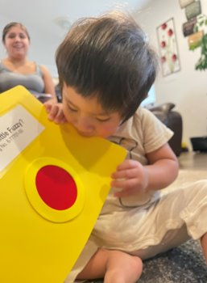
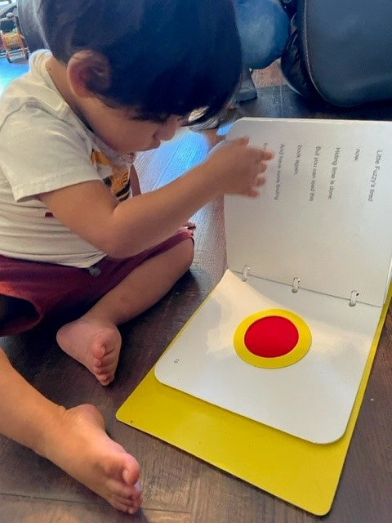
Investigate Books
Books for babies
Books for toddlers
Sensory considerations
Book adaptations
Homemade books
Book handling experiences
Notes:
JESSICA
Investigate Books is the next booklet in the kit!
Description of 2 Images shown above:
One: A toddler turns a page of "Where's Little Fuzzy?"
Two: A slightly younger toddler chews on the cover of "Where's Little Fuzzy?"
“For infants, books—like other toys—are things to touch, turn, shake, and put in your mouth. Well-chosen books can also provide valuable experiences with pictures, textures, sounds, and words.” (Bardige & Segal, 2005)
Learning about books and what they are important prerequisites for reading and writing! Encouraging active participation during literacy activities is key- especially for a baby without vision! Books and book experiences will vary with the age or developmental level of the child.
Books for babies might be one that a baby can look at, feel and taste will be most appealing to young infants. Plastic “bath” books, board books, fold out books and cloth books are examples of fun, interactive, multi-sensory books for the youngest “reader”.
As your baby grows, new book experiences should follow. A toddler might like Board picture books, Pop em books and books with moveable pictures and tabs that lift or slide. These are just a short list of great examples of books to read together with your toddler.
Sensory considerations should be part of the selection of materials for a reading experience!
Babies with vision are able to get a good look at pictures as you read the words…so how do we give babies who are blind or low vision a good touch, smell, listen or move?
Stores carry books that might incorporate smell or tactile books with interesting textures! Board books with sound are also popular and can be found almost anywhere books are sold. APH offers braille books with interesting texture components for exploration. There might come a time when you want to make a child's favorite title accessible. When considering adapting a store bought book, APH has a product that can add sound to a page of any book to meet the child’s unique interest! They also offer clear, sticky pages for braille that can be added to a print book. Items that connect to the story can accompany it in a bag or box for a child to hold and manipulate. Adaptations can even be made so that book handling is addressed with your young child- just add soft back Velcro to the bottom outside corner of the page to allow easier grasping and manipulating!
Speaking of customizing books, while there are many ways to put a spin on store bought books, you can try your hand at a homemade book. Using sewing skills, or tapping into someone else’s, cloth books can be sewn and child-safe items added. Talking photo albums are a fun way to personalize a story and connect to photographs. Wouldn’t it be cool to record Grandma and Grandpa’s voices on a page with their photo?!?! Personal experience books are another homemade book idea! A homemade "A Day at the Park" experience book following a trip to the park with items from the trip placed in a bag or in a box are a great way to document a fun event. The event can then be revisited- imagine what items might be collected, like sticks and grass...maybe a leaf...all saved for later exploration and a conversation.
READ IMAGE DESCRIPTION Book concepts and skills will evolve as your baby grows! How your baby interacts with a book and understanding of what a book is and how to handle it will look different early on with babies chewing on books, shaking them and crumpling the pages leading to the careful handling of books later on!
What does book handling or book skills mean to you? CHAT (15 sec)
That’s right- grasping and holding a book, opening and closing books, orienting them upright, point to pictures in books, exploring all parts of a book, noticing symbols on the page and following along while being read to.
The Investigate Books Parent booklet can really get families thinking “outside the book” and initiate fun, meaningful literacy experiences tailored to the needs of their baby! And of course, puts the parent in the "drivers seat" for careful selection of books and their unique components!
Now, Kay is going to get us moving toward writing!

Slide 35
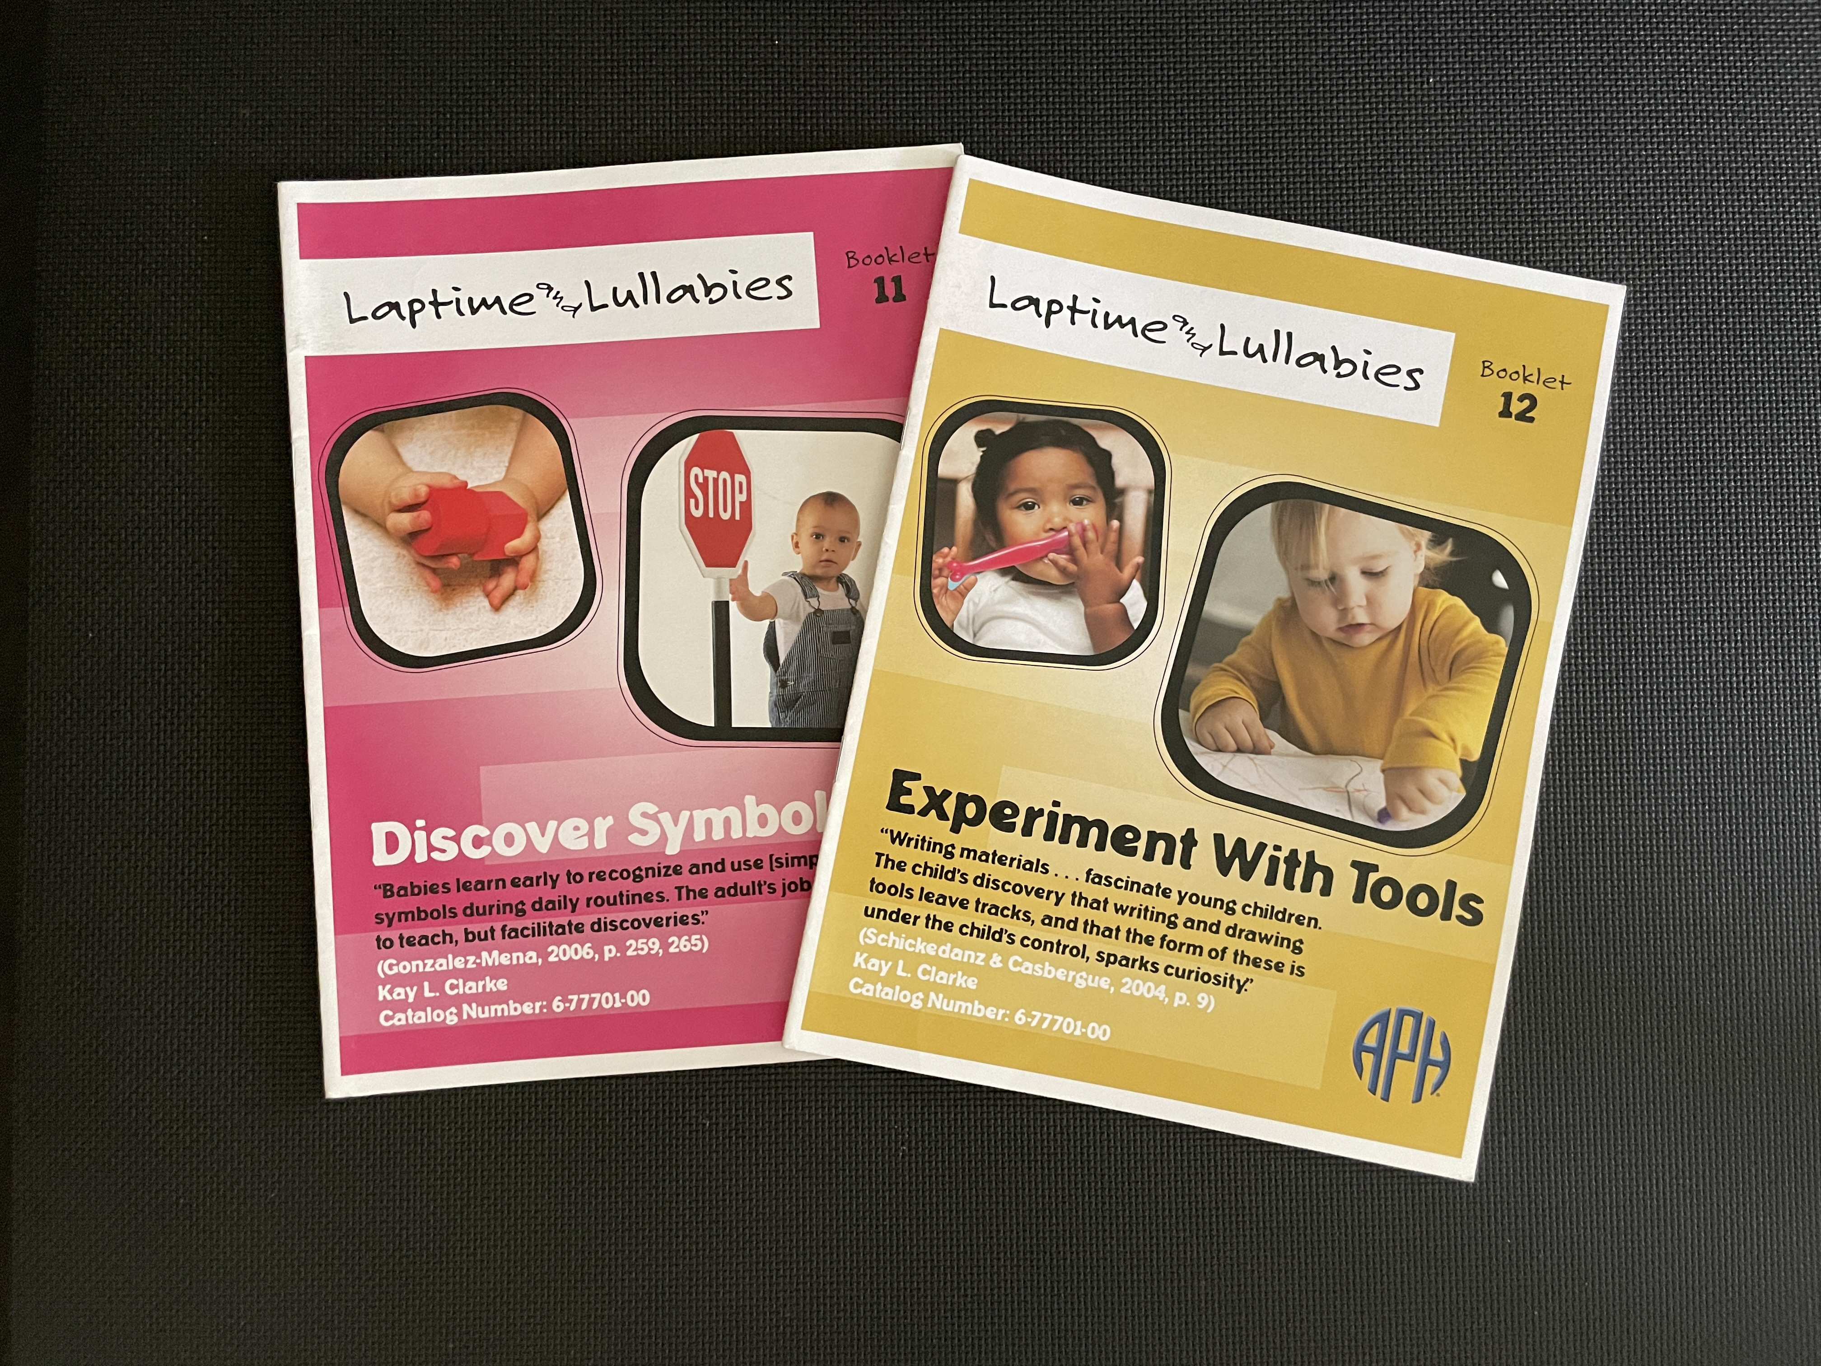
Moving Toward Writing
Notes:
KAY
HERE IS AN Image of Discover Symbols and Experiment with Tools Booklets
SYMBOLS are cross-over between reading and writing
Tool USE prepares children for writing

Slide 36
Discover Symbols
“Babies learn early to recognize and use [simple] symbols during daily routines. The adult’s job is not to teach, but to facilitate discoveries.” (Gonzalez-Mena, 2006)
Notes:
Read Quote: “Babies learn early to recognize and use [simple] symbols during daily routines. The adult’s job is not to teach, but facilitate discoveries.”(Gonzalez-Mena, 2006)
Very young children are born as concrete thinkers. Over time, thinking gradually becomes more abstract.
Early symbolic experiences do not include teaching letters or numbers What examples of early symbolic experiences can you think of that do not involve letters or numbers? EXAMPLES: MIRRORS; PICTURES; ATTACHMENT OBJECTS; ACTION SYMBOLS (arms outstretched; squeak as door opens)
Pretend activities kick in in toddlerhood, and can be observed when a child, for example, holds a block as if it is a telephone.
Sequence of symbolic learning:
3-D Objects – Child's Own Spoon that represents "Lunchtime"
3-D Shapes – Sphere (ball); Cube-shaped block
2-D Shapes - Flat shaped puzzle pieces; square cracker
Pictures (simple to more complex; realistic to more abstract line drawings)
Textures – Piece of a washcloth material hung beside door = This is the bathroom; Car seat material = Time to go bye-bye
Spoken Words – attaching meaning to people, things, places, etc.
Letters – print and/or braille; exposure to understanding; letter sounds; familiar letters (name); symbolic understanding
Numbers – print and/or braille; Rote counting to one-to-one correspondence to symbolic understanding Environmental symbols: such as stop sign pictured here, Braille symbols in an elevator; and daily mail that is delivered
Provide opportunities and draw child’s attention (SHIMMY UP THE POLE during walk; look; touch)
Print or Braille? Often difficult or impossible to tell in the first few years. For many children, exposure to BOTH (and perhaps HEARING for more involved children)

Slide 37

Discover Symbols (cont.)
Symbolic thinking: concrete to abstract
*Early symbolic experiences: not letters or numbers
Pretend activities in toddlerhood
Familiar 3-D Objects / 3-D & 2-D shapes/ pictures /
textures / spoken words / letters / numbers
Environmental symbols: stop sign; braille symbols in elevator; mail
Print or Braille? Listening and/or Speaking?
Notes:
Read Quote: “Babies learn early to recognize and use [simple] symbols during daily routines. The adult’s job is not to teach, but facilitate discoveries.”(Gonzalez-Mena, 2006)
Very young children are born as concrete thinkers. Over time, thinking gradually becomes more abstract.
Early symbolic experiences do not include teaching letters or numbers What examples of early symbolic experiences can you think of that do not involve letters or numbers? EXAMPLES: MIRRORS; PICTURES; ATTACHMENT OBJECTS; ACTION SYMBOLS (arms outstretched; squeak as door opens)
Pretend activities kick in in toddlerhood, and can be observed when a child, for example, holds a block as if it is a telephone.
Sequence of symbolic learning:
3-D Objects – Child's Own Spoon that represents "Lunchtime"
3-D Shapes – Sphere (ball); Cube-shaped block
2-D Shapes - Flat shaped puzzle pieces; square cracker
Pictures (simple to more complex; realistic to more abstract line drawings)
Textures – Piece of a washcloth material hung beside door = This is the bathroom; Car seat material = Time to go bye-bye
Spoken Words – attaching meaning to people, things, places, etc.
Letters – print and/or braille; exposure to understanding; letter sounds; familiar letters (name); symbolic understanding
Numbers – print and/or braille; Rote counting to one-to-one correspondence to symbolic understanding Environmental symbols: such as stop sign pictured here, Braille symbols in an elevator; and daily mail that is delivered
Provide opportunities and draw child’s attention (SHIMMY UP THE POLE during walk; look; touch)
Print or Braille? Often difficult or impossible to tell in the first few years. For many children, exposure to BOTH (and perhaps HEARING for more involved children)

Slide 38
Experiment With Tools
“Writing materials…fascinate young children. The child’s discovery that writing and drawing tools leave tracks, and that the form of these is under the child’s control, sparks curiosity.” (Schickendanz & Casbergue, 2004)

Slide 39
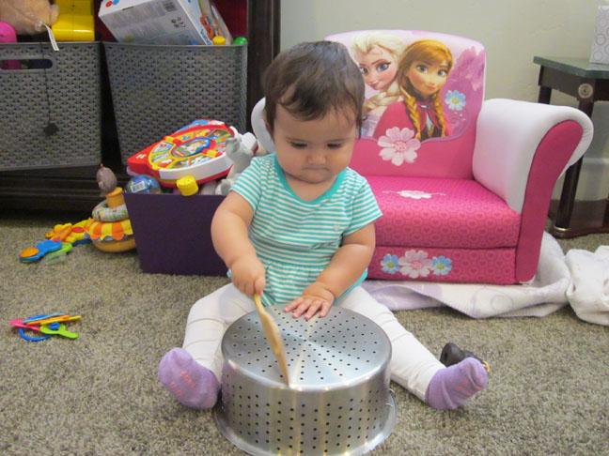
Experiment With Tools (cont.)
Prepare hands: strength; dexterity; hold
Early tool use: short/light to long/heavy
*All kinds of everyday tools
Mobility tools / vision tools: device & glasses
Tactile literacy tools: crayons and window screen; braille writer; scented markers
Print literacy tools: dome magnifier; pillow 'stand'; child safe lamp
***
Notes:
KAY
Read Quote: “Writing materials…fascinate young children. The child’s discovery that writing and drawing tools leave tracks, and that the form of these is under the child’s control, sparks curiosity.” (Schickendanz & Casbergue, 2004)
First order of business is to prepare hands – types of things Jenni mentioned in the Enhance Touch section—strength, dexterity, hold & release
Research has shown us that there is a progression from short, light tools (such as a rattle) to longer, heavier tools (such as pushing a toy mop around the floor or using a mobility device).
There are tons of opportunities for children to experience and experiment with tools throughout the day.
Name a few! CHAT BOX [spoon for eating; drumstick for beating on a toy drum in play; a hairbrush or toothbrush for self care; using a stepstool to reach the sink in the bathroom to wash hands]
There are also many special tools that are important in the lives of our children who are blind or have low vision: Cane or alternative mobility device for travel; and vision tools, such as eye glasses.
Specific to tactile literacy, can be items such as scented markers; a window screen under drawing paper; a braille writer; and paint with sand or other texture that can be painted onto paper with a brush or sponge and create a tactile image.
AH-HA MOMENT STORY OF SUSIE – I'm making my own Braille!"
Print literacy tools, among others, can include a dome magnifier; crayons; a reading/writing stand OR PILLOW; and a child-safe added light source/desk lamp.
All of these tools may be gradually introduced within the early years so children understand what they are and increasingly learn to use them in more sophisticated ways.
In order to accomplish all of the learning and skills we have outlined so far, building a team is critical.
Jenni will next offer some ideas for PUTTING TOGETHER a literacy team.

Slide 40
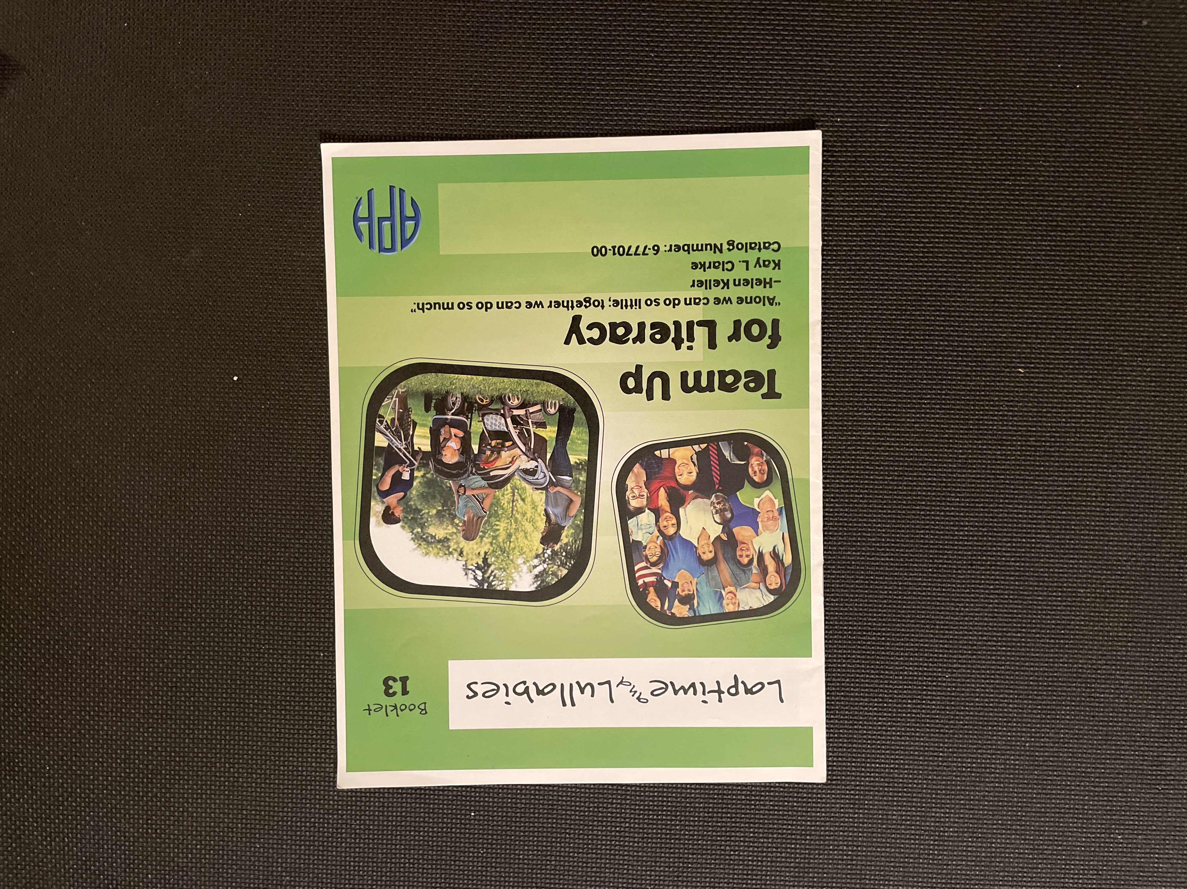
Building a Literacy Team It Takes a Village!
Notes:
Image Description: Cover of Team up for Literacy Booklet

Slide 41
Team Up for Literacy
“Alone we can do so little; together we can do so much.” -Helen Keller

Slide 42

Team-Up for Literacy
Parents/families
Early Intervention staff
Occupational Therapist/ Physical Therapist
Speech-Language Pathologist
TVI/COMS
Medical Personnel: vision & hearing
Notes:
JENNI
Read Quote .. Together is the operative word in this quote by Helen Keller. In reviewing these 12 major components of early literacy, there is no doubt that you were able to see yourself as an integral member of this team! The phrase "It takes a village" couldn't be more true.
Image Description: 3 women sit at a table together in a coffee shop, two of them smile as they give each other a high five.
Parents or primary caregivers drive the literacy bus! They know their child best, hold the key to what motivates them, and along with other family and friends, their input is most valuable to the success of their child.
Although early intervention systems of practice may differ from one state to another, family access to a core team of providers is something they all share in common.
Among many other things, Occupational Therapists and Physical Therapists are key members to provide input on engaging the sensory systems and positioning. When children are able to explore, their access to environmental concepts increases.
Speech-Language pathologists can help strengthen your child's early communication skills, as a critical foundation for listening, speaking, reading and writing.
Vision professionals, including teachers for children with visual impairments and orientation and mobility specialists, are critical team members who help to provide access. From support with daily living and play skills, providing exposure to enhanced picture books and pre-braille, and providing direct interaction with the environment, these professionals help fill the gap that can occur from lack of incidental learning opportunities.
Frequent Communication with Medical personnel, such as ophthalmologists, audiologists, help to lay the groundwork so we are able to recognize and optimize children's primary learning modes.
can you think of additional members that can contribute?

Slide 43
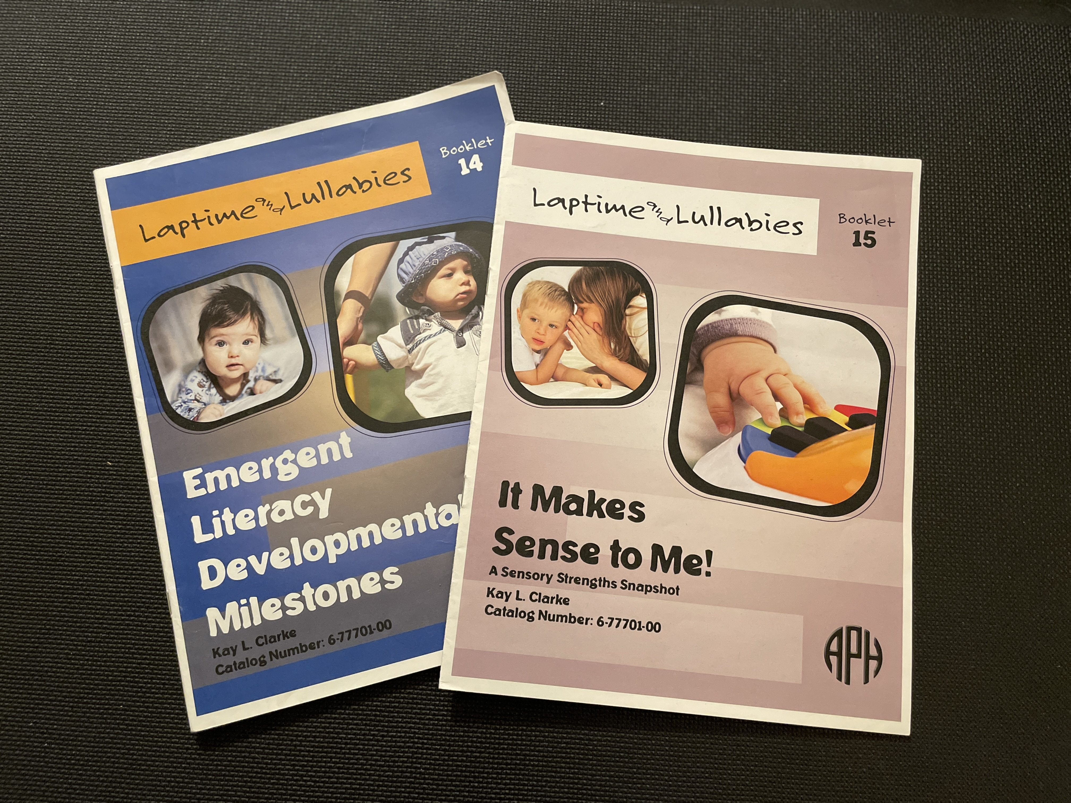
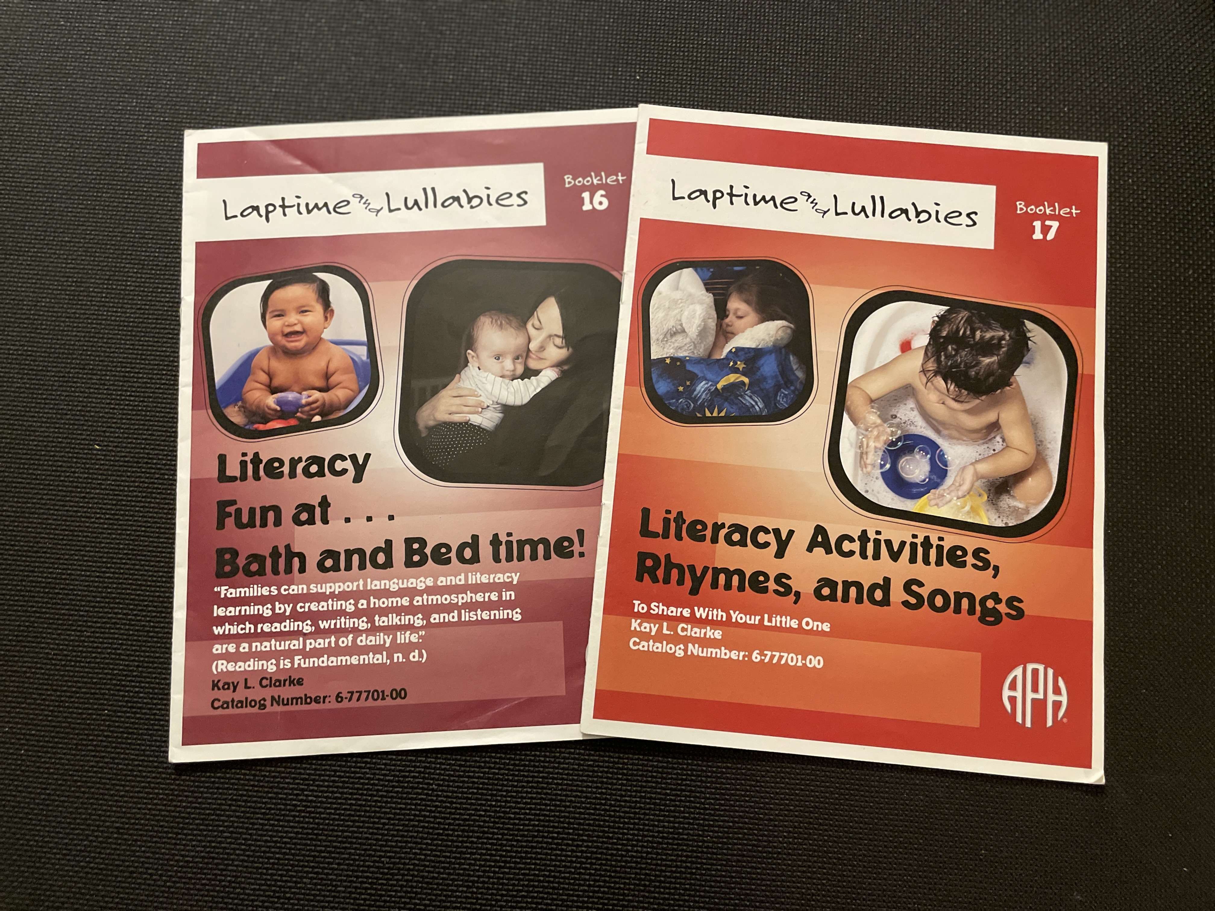
Laptime and Lullabies Additional Pieces - Handbook
Developmental Milestones/Ranges (#14)
Sensory Strengths Snapshot (#15)
Routines: Bath Time and Bedtime (#16)
Activities, Rhymes, Songs (#17)
Notes:
JENNI
In addition to the 12 booklets highlighting components of early literacy development, there are additional pieces to this kit that you will certainly have you thinking "how have I made it this far without them!"
The developmental Milestones/Ranges provides a list of developmental milestones from 0-36months for each of the 12 highlighted areas. This is a great tool that not only helps families and providers meet children where they are, but it can also be used to guide in the development of purposeful outcomes for your child's IFSP.
The sensory strengths snapshot booklet is an amazing tool that can be used as babies first learning media assessment. It includes a checklist of sensory skills for vision, touch, hearing, movement and smell and helps to identify where a child’s strengths are and it is important to recognize that this may be different from one setting to another.
Routines: bath time and bedtime, includes a variety of activities, books, and products that will help you to imbed literacy within these natural daily routines.
And last, but not least, an amazing collection of activities, rhymes and songs for bath and bedtime developed by the amazing Kay Clarke! I have laminated these for families and separated them on separate o-rings that can hang from a command hook near the tub and in baby’s room. This makes them easy to grab and use on the spot!
If you join us for the second piece of this presentation, we will be diving deeper into these tools.

Slide 44
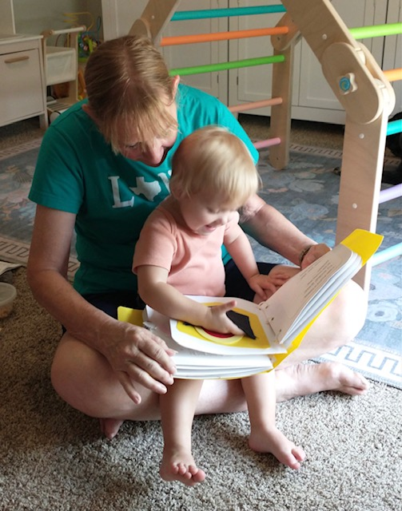
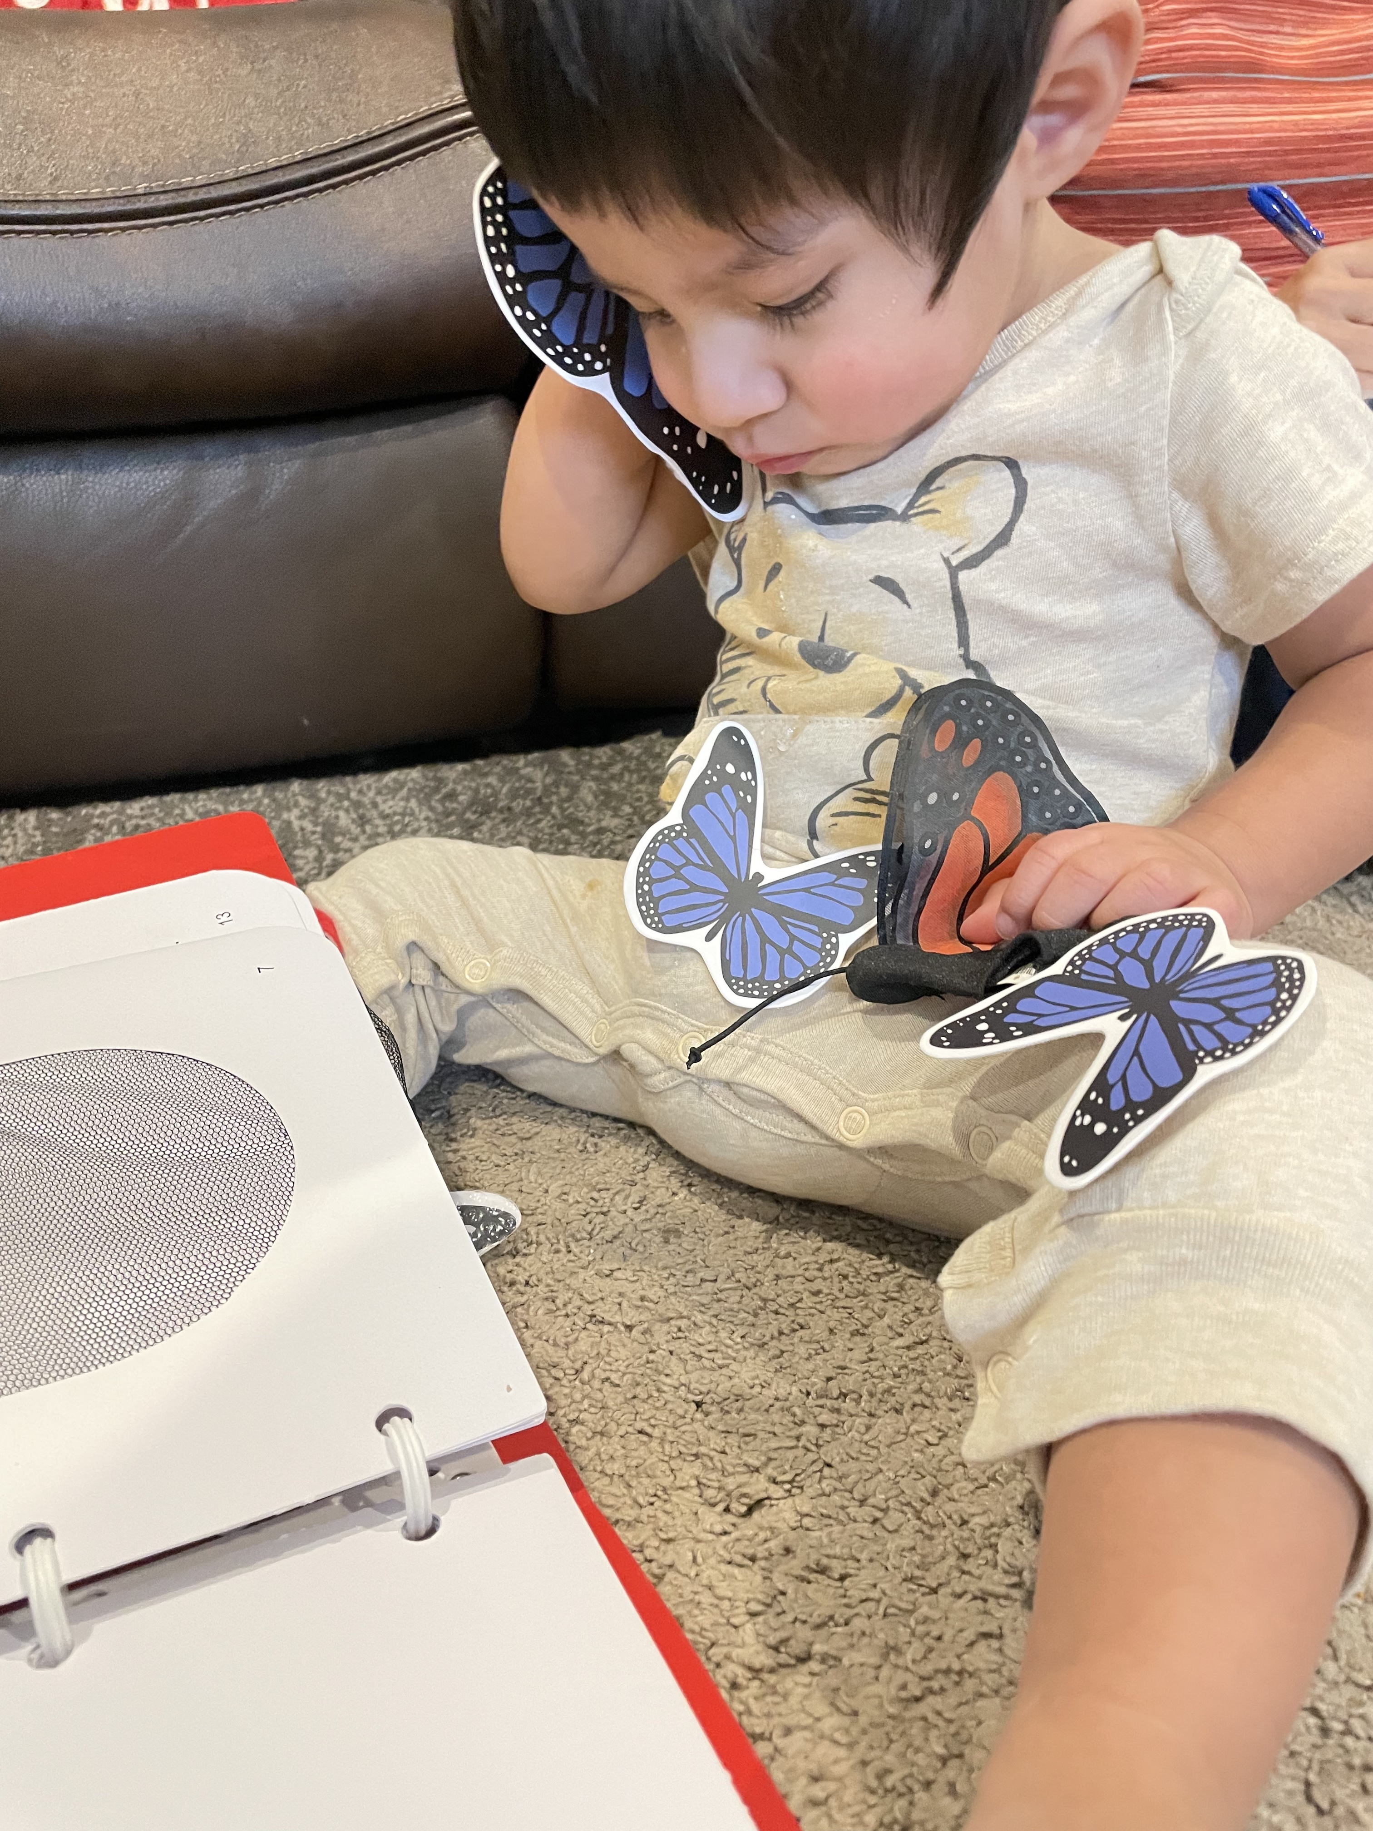
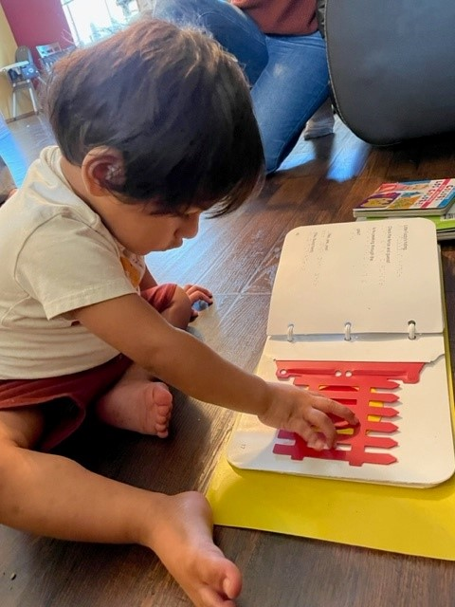
Additional Pieces - Storybooks
Two interactive books: braille, print, rhymes, manipulative pieces. 1-3 years
Where’s Little Fuzzy?
Butterflies!
Make-It-Fun Tip Sheets
Handbook/booklets and storybooks together is best! ****
Notes:
KAY
Last two pieces of L&L are the little storybooks, Where’s Little Fuzzy? and Butterflies, written for children approximately 1-3 years.
Both storybooks include braille, print and manipulative pieces, that accompany their simple rhyming text.
Make-It-Fun Tip Sheets, with ideas for using the books with little ones , are also included.
Pictured here are three children at different developmental stages using the books.
Toddler on the left is exploring a moveable red gate on the page of the Where's Little Fuzzy? book with his hand.
The younger middle toddler is holding a butterfly piece to his ear and cheek with one hand and clutching the butterfly finger puppet (that comes with the book) with the other. Several of the butterfly pieces are velcroed onto his pantlegs.
Older toddler on the right is participating in an interactive reading of the Little Fuzzy book on an adult's lap. She smiles as she slides her hand into the pocket on the page and finds the Little Fuzzy character.
Although the Storybooks may be ordered separately from the Parent Handbook, the pieces compliment each other and are intended to be used together.
WE SINCERELY HOPE YOU WILL FIND THE L&L KIT TO BE A VALUABLE RESOURCE TO ADD TO YOUR COLLECTION OF LITERACY TOOLS FOR YOUR VERY YOUNG CHILDREN AND FAMILIES.
JESSICA WILL NOW WIND US DOWN FOR TODAY—AND ENTICE YOU TO JOIN JESSICA AND JENNI FOR THE L&L WEBINAR PART 2!

Slide 45
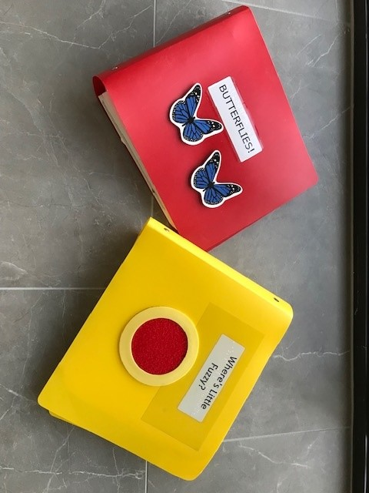
READY FOR SOME MORE “THINKING OUTSIDE THE BOOK”?
American Printing House for the Blind
Laptime and Lullabies
Storybooks:
https://www.aph.org/product/laptime-and-lullabies-storybooks/
Parent Handbook (Booklets):
https://www.aph.org/product/laptime-and-lullabies/
Notes:
JESSICA:
Laptime and Lullabies Storybooks are displayed in a photo on this slide:
Butterflies on the left and Where's Little Fuzzy on the right
The Laptime and Lullabies Parent Handbook and story book companions are available through American Printing House for the Blind.
Both can be purchased with federal quota funds, made possible through the annual census that appropriates and shares funds “proportionally among all public institutions for students who are blind or visually impaired in the United States”- even our B-3 population.
(Mouse Click) Is your brain spinning? Are you thinking of an “outside of the book” activity that will be perfect for a little one? Or are you thinking of a little one and how you might try to adapt or make a homemade book for them? Maybe a family is on your mind and you can’t wait to share these ideas with them but need a little more help to get started.

Slide 46

Join us for Laptime and Lullabies: Part II June 6, 2023
Increase your ability to incorporate developmentally appropriate literacy activities into routines for infants, toddlers and very young children who are blind or have low vision.
Link to Registration is in the Chat
Share your ideas and early literacy creations:
Jessica Chandler Jessica.Chandler@wssb.wa.gov
Jenni Remeis jremeis@ossb.oh.gov
Notes:
Jessica:
Image Description: A drawing of Three girls holding books dive into a pool
Please join Jenni and I for Part II of Laptime and Lullabies on June 6 as we take a deeper dive and explore more possibilities for fun and meaningful literacy experiences using the ideas we introduced you today!
The registration link is in the CHAT and we encourage you to take some of the concepts and ideas you heard about today and if you have a child or family you are thinking of, come prepared to participate on June 6 with that child in mind. You can also email descriptions and/ or photos of your early literacy projects to Jenni or I. Our email addresses are also in the CHAT.
We are so excited to celebrate Kay’s work in this area and share to it with each of you!
Thank you so much for coming today. We can take questions now.

Slide 47
Thank you for joining us today!
Notes:
JENNI
Read Quote .. Together is the operative word in this quote by Helen Keller. In reviewing these 12 major components of early literacy, there is no doubt that you were able to see yourself as an integral member of this team! The phrase "It takes a village" couldn't be more true.
Image Description: 3 women sit at a table together in a coffee shop, two of them smile as they give each other a high five.
Parents or primary caregivers drive the literacy bus! They know their child best, hold the key to what motivates them, and along with other family and friends, their input is most valuable to the success of their child.
Although early intervention systems of practice may differ from one state to another, family access to a core team of providers is something they all share in common.
Among many other things, Occupational Therapists and Physical Therapists are key members to provide input on engaging the sensory systems and positioning. When children are able to explore, their access to environmental concepts increases.
Speech-Language pathologists can help strengthen your child's early communication skills, as a critical foundation for listening, speaking, reading and writing.
Vision professionals, including teachers for children with visual impairments and orientation and mobility specialists, are critical team members who help to provide access. From support with daily living and play skills, providing exposure to enhanced picture books and pre-braille, and providing direct interaction with the environment, these professionals help fill the gap that can occur from lack of incidental learning opportunities.
Frequent Communication with Medical personnel, such as ophthalmologists, audiologists, help to lay the groundwork so we are able to recognize and optimize children's primary learning modes.
can you think of additional members that can contribute?

