Slide 1
Perspectives on Math Braille Codes: Let’s Get Excited about UEB Math/Science and Nemeth Code within UEB Contexts!
Alexis Redford, M.Ed., TSVI
University of Utah
Tina Herzberg, Ph.D., TSVI, COMS
University of South Carolina Upstate
Chris Clark-Bischke, Ph.D., TSVI, DT/V
University of Utah

Slide 2
Objectives
Participants will be able to:
Describe the results of the survey completed by 176 TSVIs.
Identify three strategies and resources that can be used to teach Nemeth Code within UEB Contexts to students who read braille.
Identify three strategies and resources that can be used to teach UEB Math/Science to students who read braille.

Slide 3
Summary of Survey Data

Slide 4
Survey Participants
176 TSVIs from 36 geographically diverse states
States with the most responses included California (n=14), Georgia (n=13), Florida (n=12), and Indiana (n=11).
Participants learned math braille codes in a variety of ways.
107 participants indicated that their state has a default code.
  Nemeth Code (n=86)
  UEB Math/Science (n=27)

Slide 5
UEB Math/Science Competency Level
Advanced, 13
Intermediate, 37
Beginner, 67
I do not know UEB Math/Science, 32
Did not respond, 27

Slide 6
Nemeth Code Competency Level
Advanced, 32
Intermediate, 63
Beginner, 43
I do not know UEB Math/Science, 11
Did not respond, 27

Slide 7
Factors That Influence Math Braille Code Taught
Curriculum (n=36)
Textbooks and/or test availability (n=36)
State default braille code (n=35)
Age of student (n=32)
Individualized Education Plan (IEP) team decision (n=31)
Teacher knowledge and experience (n=30)
Students’ personal preference (n=30)
Teachers’ personal preference (n=11)
Parent’s personal preference (n=10)
Outside influence (n=10)
Other (n=10)

Slide 8
Barriers to Teaching UEB Math/Science
TSVI doesn't teach/know UEB Math/Science (n=37)
Tests, textbooks, and materials not being embossed/available in UEB Math/Science (n=34)
TSVIs’ personal preference for Nemeth Code (n=12)
Need additional training for TSVIs (n=11)
The fact that we have two math braille codes in the US (n=8)
Incorrect rumors and biases against UEB Math/Science amongst professionals (n=7)
No barriers perceived (n=7)
Students’ preference for which math code they use (n=6)
Issues with UEB Math/Science (BrailleSense, etc.) (n=6)

Slide 9
Barriers to Teaching UEB Math/Science (continued)
UEB Math/Science is difficult for TSVIs and students to learn (n=6)
The time it takes to teach UEB Math/Science (n=5)
TSVIs’ confidence in ability to teach UEB Math/Science (n=3)
Students who have to transition from Nemeth Code to UEB Math/Science (n=3)
Lack of UEB Math/Science materials and resources (n=3)
Students transitioning from one TSVI to another TSVI and the varied knowledge of TSVIs in UEB Math/Science may impact student performance (n=2)
Parent preference for which math code is taught (n=1)
TSVI only teaches UEB Math/Science through elementary, then switches to Nemeth Code (n=1)

Slide 10
Barriers to Teaching to Nemeth Code
TSVI does not know/teach Nemeth Code (n=45)
Code switching (n=31)
Tests, textbooks, and materials not being embossed/available in Nemeth Code (n=18)
Need more training and resources for TSVIs (n=9)
Issues with refreshable braille displays accurately displaying Nemeth (n=3)
Time (for TSVIs to teach Nemeth Code, acquire materials, etc.) (n=3)
TSVI doesn’t have a math background, making it difficult to support students (n=2)

Slide 11
Barriers to Teaching to Nemeth Code (continued)
Many students come in knowing UEB Math/Science and I (TSVI) have to transition them to Nemeth (for advanced mathematics) (n=2)
Student preference on which math code to learn (n=2)
Support from other professionals (n=2)
TSVI’s preferences (n=1)
Misinformation about the two math codes and which is better (n=1)
Expense of textbooks (n=1)

Slide 12
Resources and Strategies for Teaching UEB Math/Science

Slide 13
UEB Math/Science
Codebooks and Guidelines
The Rules of Unified English Braille, 3rd Edition, 2024 (print & braille editions)
Provisional Guidance on Transcribing Mathematics in UEB, 2019
Graphing Calculator Guidelines Guidance for Transcription Using UEB, 2024

Slide 14
UEB Math/Science
Codebooks and Guidelines (continued)
Unified English Braille Guidelines for Technical Material 2014 (print & braille editions)
  (International Council on English Braille) ICEB is working on a 2nd edition.
  Section 3: Signs of Operation and Comparison was updated in 2018.

Slide 15
UEB Math/Science Resource
The Hitchhiker’s Guide to UEB

Slide 16
UEB Math/Science Online Resources
APH UEB Math Reference Booklet (print and braille)
APH UEB Math Tutorial
UEB Online
Canadian National Institute for the Blind (CNIB) UEB Technical Course

Slide 17
UEB Math/Science Resources from the National Braille Association
UEB Math/Science Reference Sheets (print and braille versions)
Using UEB in Technical Materials (digital print, hardcopy print, and braille versions)
Grade 1 and Capital Indicators (digital print, hardcopy print, and braille versions)
UEB Technical: Algebra and Geometry – Basic (print)

Slide 18
UEB Math/Science Resources from APH
Math Drill Cards in Braille and Large Print: Addition Facts in UEB
Math Drill Cards in Braille and Large Print: Subtraction Facts in UEB

Slide 19
UEB Math/Science Resources from APH (continued)
Feel ‘n Peel Stickers UEB Print/Braille Numbers
Flip Over Concept Books – Telling Time
Flip Over Concept Books - Fractions

Slide 20
Resources and Strategies for Teaching the Nemeth Code within UEB Contexts

Slide 21
  Nemeth Code within UEB Contexts
  Codebooks and Guidelines from BANA
The Nemeth Braille Code for Mathematics and Science Notation, 2022 (print and braille)
Graphing Calculator Guidelines, April 2018
Chemical Notation Using the Nemeth Braille Code, 2023

Slide 22
Nemeth Code within UEB Contexts
Resources
Learning and Teaching the Nemeth Code within UEB Contexts: A Step-by-Step Guide
  Designed to support you as you learn the Nemeth Code.
  Throughout the book, you will also view real life examples of STEM materials transcribed into braille.
  Teaching strategies have been embedded.
  All materials in both print and braille.

Slide 23
Nemeth Code within UEB Contexts
Online Resources
APH Nemeth Tutorial
APH Math Symbols Reference Booklet (print and braille)

Slide 24
Nemeth Code within UEB Contexts
Other Resources
Nemeth at a Glance: A Math Resource, Grade Level Chart, and Evaluation Tool, February 2017, TSBVI
Nemeth Reference Sheets from the National Braille Press (print and braille versions)

Slide 25
Paths to Literacy Resource
Nemeth Braille Code Curriculum

Slide 26
Nemeth Braille Code Curriculum
(Pre-K through 2nd Grade)
Teaches students to read and write Nemeth Code within UEB Contexts
Pre-K, kindergarten, first grade, and second grade materials
Aligned with the Common Core State Standards (CCSS Initiative, 2010)
Hands-on games and activities
Includes teacher scripts, braille ready files for student worksheets, answer keys, data recording sheets, review activities, and assessments

Slide 27
Focused Nemeth Lessons
Students of any age may enjoy and learn from the lessons, especially if they need additional practice.
  Five-Step Rule and Exceptions
  Fractions and Mixed Numbers
  Multiplication and Division
  Number Lines
  Radical Expressions

Slide 28
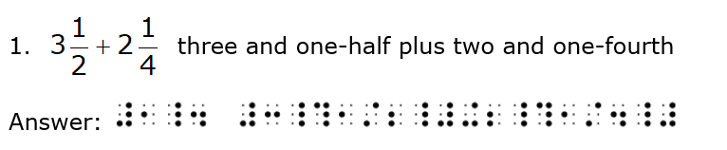
Fractions and Mixed Numbers

Slide 29
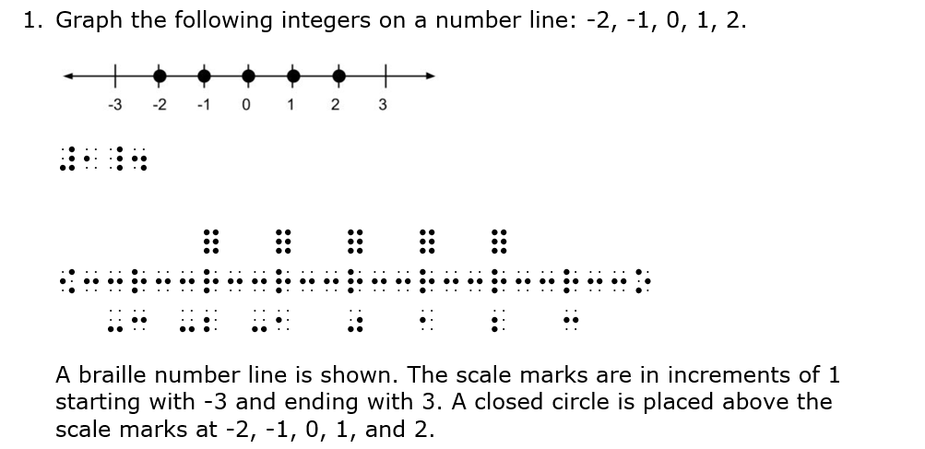
Graphing Points on a Number Line

Slide 30
Paths to Literacy Resource
Nemeth Symbol Library Page

Slide 31
Nemeth Symbol Library
Began with higher grade levels
Has extended down through all grade levels
Incorporates over 600 examples at different grade levels
Includes tutorial and list of commands used to access library
Contains 240 terms, 136 definitions

Slide 32
Nemeth Code within UEB Contexts
Resources from APH
Math Drill Cards in Braille and Large Print: Addition Cards
Math Drill Cards in Braille and Large Print: Subtraction Cards
Quick Pick Math: Addition
Quick Pick Math: Subtraction
Addition and Subtraction Table

Slide 33
Other Resources for Use within UEB Math/Science and
Nemeth Code within UEB Contexts

Slide 34
Pre-Kindergarten – Building a Train
Materials
  Foam stickers
  Craft sticks
  Flash cards labeled 1- 7
Steps
  Student shuffles flash cards
  Student draws a card and reads the numeral on the card
  Student uses stickers to “build” the train

Slide 35
Kindergarten - Rebuild a Hundreds Chart

Slide 36
More Curriculum Materials
  Templates for BINGO cards
  Connect Four Game Cards and Problem Sets
  Place Value Chart
  Roll and Race Game Cards
  Shapes Activity
  Counting to 120 Chart
While many of these are available only in Nemeth Code, they can be easily modified or created using UEB Math/Science.

Slide 37
Nemeth in a Box (Mathlete Competition Coming Spring 2025!)
Teaches Nemeth Code symbols in math context through puzzles and games that challenge students and build their reasoning skills.
Materials available online in print and braille from Project INSPIRE 2.

Slide 38
Hands-on Materials and Manipulatives from APH
DRAFTSMAN: Tactile Drawing Board
TactileDoodle
Tactile Five and Ten Frames

Slide 39
More Hands-on Materials and Manipulatives
Geometry Tactile Graphics Kit (APH)
  Has both early and more advanced concepts
  Includes common graphics used in geometry class
Math Window – magnetic tiles
  Available in UEB Math/Science and Nemeth Code within UEB Contexts

Slide 40
Rounding Decimals
Fifth grade skill
The APH Number Line Device works well for teaching students to round decimals.
Wikki Stix can be used to mark on the APH Number Line Device.

Slide 41
Graphing
Graphing is a huge part of algebra at the high school level.
Students begin graphing by hand and then later move to electronic tools once basic skills are mastered.
Tactile dots
  APH Graph Benders
  Craft stores
    Sticky foam sheets
    Push pins on a corkboard

Slide 42
Braille Brain
Braille materials that support braille literacy and mathematics instruction with a current focus on UEB literary braille, some UEB Math/Science and Nemeth Code
  UEB Advanced (UEB Math/Science) coming soon!
Braille reading and writing assessment
Contains instructional materials and evidence-based practices that support braille literacy and STEM instruction.

Slide 43
Project INSPIRE 2 (Access and Equity in STEM Education for Individuals Who Read Braille)
Builds on the work of Project INSPIRE. Materials available at no cost include:
  Seven courses for professionals focused on math braille codes, methods, and teaching materials
  Four programs for students to build their STEM knowledge while having fun!
The team will revise courses and add new courses, offer a student program each year, and more!
Sign up for the mailing list to get updates on course offerings, webinars, student programs, and more!

Slide 44
Mathlete Competition
In spring 2025 the competition will be held! Register for a webinar on March 25 from 4-5 Eastern to learn more!
Mathletes compete in four competition rounds.
  Sprint Round (multiple choice, find the correct way of writing the problem in braille)
  You Solve It Round!
  You Write It Round!
  Relay Round (Use last answer to get the next answer!)

Slide 45
Seven Professional Development Courses
Self-paced online, free courses
Nemeth Code or UEB Math/Science lessons
Lessons focused on methods and materials used in STEM instruction with braille learners.

Slide 46
The United States and Two Math Braille Codes
“UEB [Math/Science] and Nemeth [Coded within UEB Contexts] are different codes, but they are simply different ways of representing the same things. Children will learn to read, write and do math and science no matter which code is chosen …”
UEB Math/Science and UEB with Nemeth: A Guidance Document for IEP Teams from the Pennsylvania Training and Technical Assistance Network, 2023

Slide 47
Closing Thoughts
Consistency is key!
Every student should have access to high-quality, timely instruction in the code that has been selected for them.
Every student should have access to high-quality, timely instructional materials in the code that has been selected for them.

Slide 48
Closing Thoughts (continued)
If the United States is to be successful supporting student instruction given the choice of two math braille codes, relevant entities (BANA, APH, TSBVI, Perkins, university faculty, etc.) must work together to create high-quality materials for students, resources for TSVIs and other professionals, textbooks, and student assessments in both codes.

Slide 49
Where to Find Us
Alexis Redford
  alexis.redford@utah.edu
Tina Herzberg
  herzberg@uscupstate.edu
Chris Bischke
  chris.bischke@utah.edu

