Slide 1

Dots to Devices
Supporting the Braille Journey with APH Tools

Slide 2
Presenters

Slide 3

Rachel Bishop
She is an NLS certified braille transcriber and the APH Braille Product Manager. Her Products include, Building On Patterns, LDQR, LEGO Braille Bricks, and On the Way to Literacy, among others.

Slide 4

Bobby Fulwiler
He is an NLS-certified braille transcriber, and along with Karen Poppe, they make up the Braille Literacy Team (BLT) at APH. His products include multiple LDQR releases, Braille Buzz-Spanish App, Five Little Speckled Frogs, The Memory Puzzles Line, Monarch Masking Frame, and coming soon, Astro Adventure Balls and the Alphabet Number line.

Slide 5

Sarah Welch
Product Manager on the Braille Technology Team at American Printing House for the Blind.

Slide 6

Melisa Matthews
Product Manager on the Braille Technology Team at American Printing House for the Blind

Slide 7
Braille Progression from Dots to Devices

Slide 8
Early Tactile Readiness
Explore textures, shapes and real objects
Develop finger sensitivity tactile discrimination
Learn special awareness (left/right, top/bottom)
Early concept development: same/different, big/small

Slide 9
Emergent Braille Skills
Tracking lines and patterns
Recognize and differentiate braille dot configurations
Match braille symbols and meanings
Hand and finger positioning to track across and down pages

Slide 10
Beginning Reading and Writing
Master braille alphabet and numbers
Use phonics and inventive spelling knowledge
Learning to read
Writing braille using a traditional braille writer
Read simple sentence and stories fluently

Slide 11
Developing Fluency, Comprehension and Writing to Communicate
Expanding on knowledge of contractions
Reading for meaning and learning
Write multi-sentences to convey ideas, need and learning
Developing endurance for extended reading/writing tasks

Slide 12
Developing Digital Skills
Using refreshable braille devices
Navigating digital media
Collaborating with peers through shared digital platforms
Refreshable braille devices for research, note-taking and other tasks

Slide 13
Advanced Braille Literacy Skills
Fluent braille reading/writing both literacy and technical materials
Use braille with mainstream applications
Collaborate in real time with peers, teachers and colleagues in shared documents

Slide 14
Building on Patterns

Slide 15
Overview
Building On Patterns is a systematic, comprehensive, and balanced literacy program designed to teach young children with visual impairments to read and write using braille.
Notes:
Building on Patterns is our braille reading and writing curriculum for students in grades pre-k through 2nd grade. It is a comprehensive literacy program, meaning it covers everything the student will need to know to achieve grade level standards in literacy, reading, writing, speaking, listening, braille contractions, etc.

Slide 16
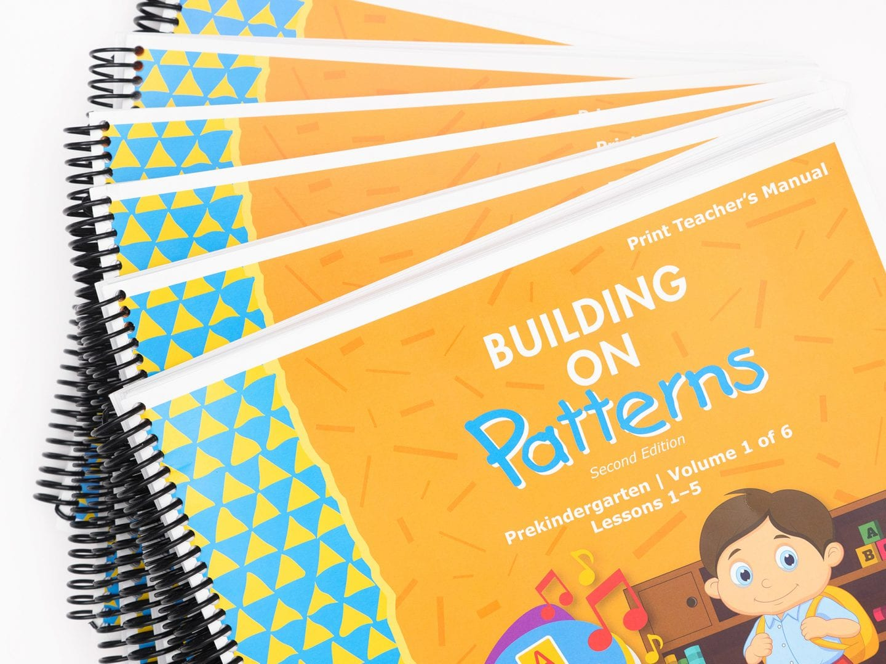
Prekindergarten
This is the first level of the Building On Patterns curriculum, designed to teach braille literacy skills to beginning learners and prepare them for kindergarten.
Notes:
The Building on Patterns curriculum begins with pre-kindergarten, which is designed to prepare your students for kindergarten.

Slide 17
What’s included?
BOP Pre-k includes three separate catalog items:
Student kit
Print teacher kit
Braille teacher kit
Notes:
Building on Patterns pre-kindergarten includes three catalog items, including the student kit, print teacher kit, and braille teacher kit. The student kit includes 28 instructional lessons each paired with a children’s book or tactile storybook that supports lesson concepts. We include commercial books like “Maya was Grumpy” or “The Gruffalo” as well as braille storybooks with original text, and tactile graphics. The print teacher kit includes a quick start guide, TVI booklet, Teacher’s manual in 6 volumes, Reading roundup booklet, and a reference volume. The braille teacher kit includes the same items as the print, but in print.

Slide 18
Skills developed
Tracking skills
Letter and number recognition
Phonics
Independent reading of simple tactile storybooks
Practice writing exercises
Enrichment, including poetry, arts and crafts, music, and movement
Notes:
Throughout the curriculum students will learn concepts, such as tracking, letter and number recognition, phonics, reading simple tactile storybooks, writing, and enrichment, including poetry, arts and crafts, music, and movement. Each lesson starts with an objective, followed by sections, including Speaking and Listening, Knowledge and concept development, phonological/phonemic awareness, reading, and writing.

Slide 19
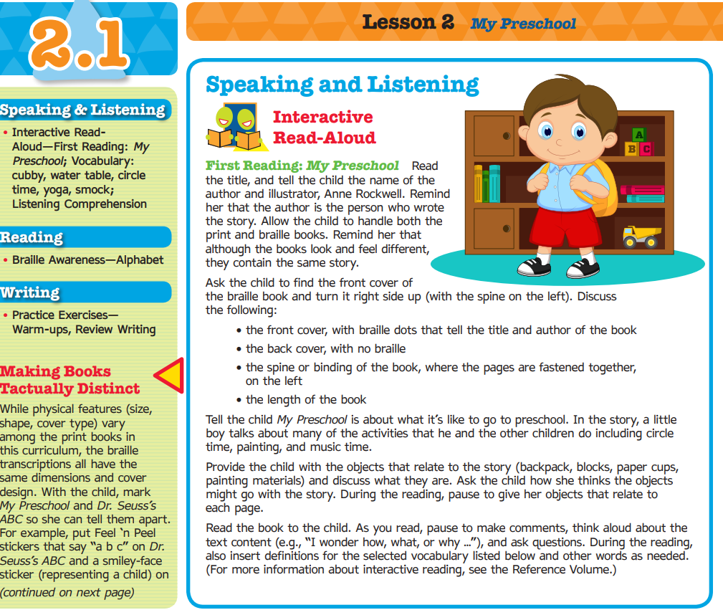
Sample lesson
Notes:
This is a sample lesson from Lesson 2 of prekindergarten called My Preschool. It includes a sidebar with the topics to be covered in the lesson. And then the heading for the beginning of the lesson, Speaking and Listening, which begins with an interactive read-aloud.

Slide 20
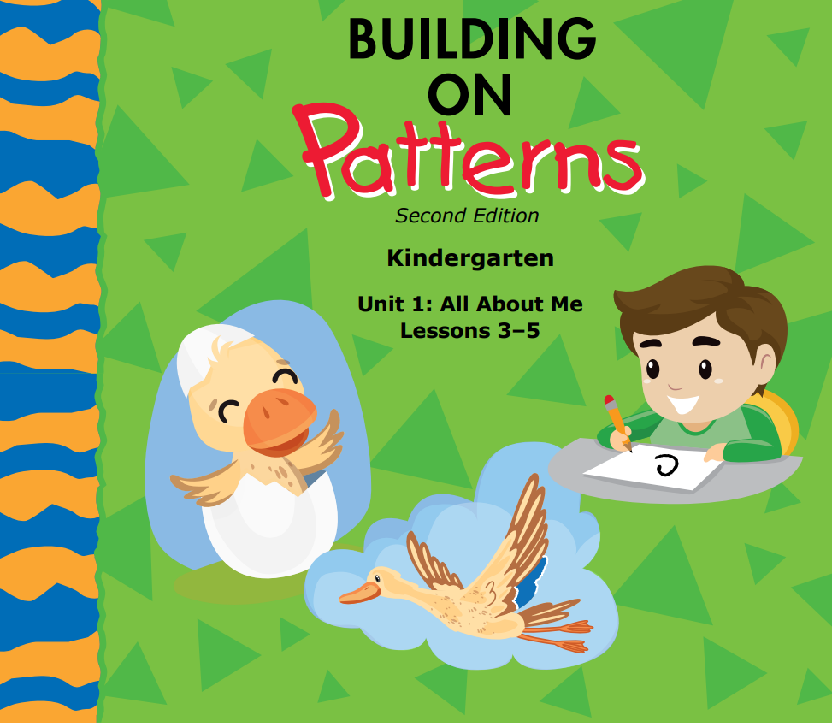
Kindergarten, 2nd Edition
This is the most updated version of BOP Kindergarten and is coming soon!
The program includes more extensive phonics activities, reading and writing of numbers, an introduction to punctuation, and a focus on meaningful student writing using invented spelling.
Notes:
This is the latest version of Building On Patterns Kindergarten, which we expect to arrive in the next few months. The program relies on the latest literacy research and includes more extensive phonics activities, number recognition, introduction to punctuation.

Slide 21
Kindergarten, 2nd Edition: What’s included?
Student kit
Print teacher kit
Braille teacher kit
Notes:
Like prekindergarten, the product includes a student kit, print teacher kit, and a braille teacher kit. The student kit includes set of braille children’s books, workbooks, student storybooks, worksheets, colortime coloring book, assessment binder, My Reader Binder, and a Manipulatives Pack, print children’s books commercial books, some original. The teacher kit includes a Teacher’s Manual, Quick Start Guide, Assessment booklets, and a list of training videos. The training videos will be available on the website.

Slide 22
Kindergarten, 2nd Edition: Skills developed
Listening comprehension
Vocabulary
Letter and number recognition
Segmenting and blending sounds
Phonics
Tactile graphics
Modeled and independent writing
Notes:
The skills developed include, listening comprehension, vocabulary, letter and number recognition, segmenting and blending sounds, phonics, tactile graphics, modeled and independent writing.

Slide 23
Kindergarten, 2nd Edition: Sample lesson
Notes:
This is a sample lesson from Lesson 1. Like prekindergarten, each lesson begins with an objective and is organized by section: Speaking and Listening, Reading, Writing, Reading and Writing, and Specialized Skills. [Read some of the sample lesson as an example.]

Slide 24

1st Grade
This is a continuation of the skills developed in kindergarten. Students are expected to read the lessons themselves to build fluency.
Notes:
BOP continues on into 1st Grade, where students are expected to read many of the lessons themselves as we continue to build on the skills developed in Kindergarten.

Slide 25
1st Grade: What’s included?
Student kits (7 units)
Teacher’s edition of each unit in braille and print
Ideas for incorporating technology
Tactile graphics for teachers to explore with students
Concept development ideas for parents
Notes:
The student kit includes lesson monitoring sheets, assessment checkup forms, student textbook, and a worksheets pack.

Slide 26
1st Grade: Skills developed
Decoding
Comprehension
Fluency
Independent reading
Creative writing
Spelling

Slide 27
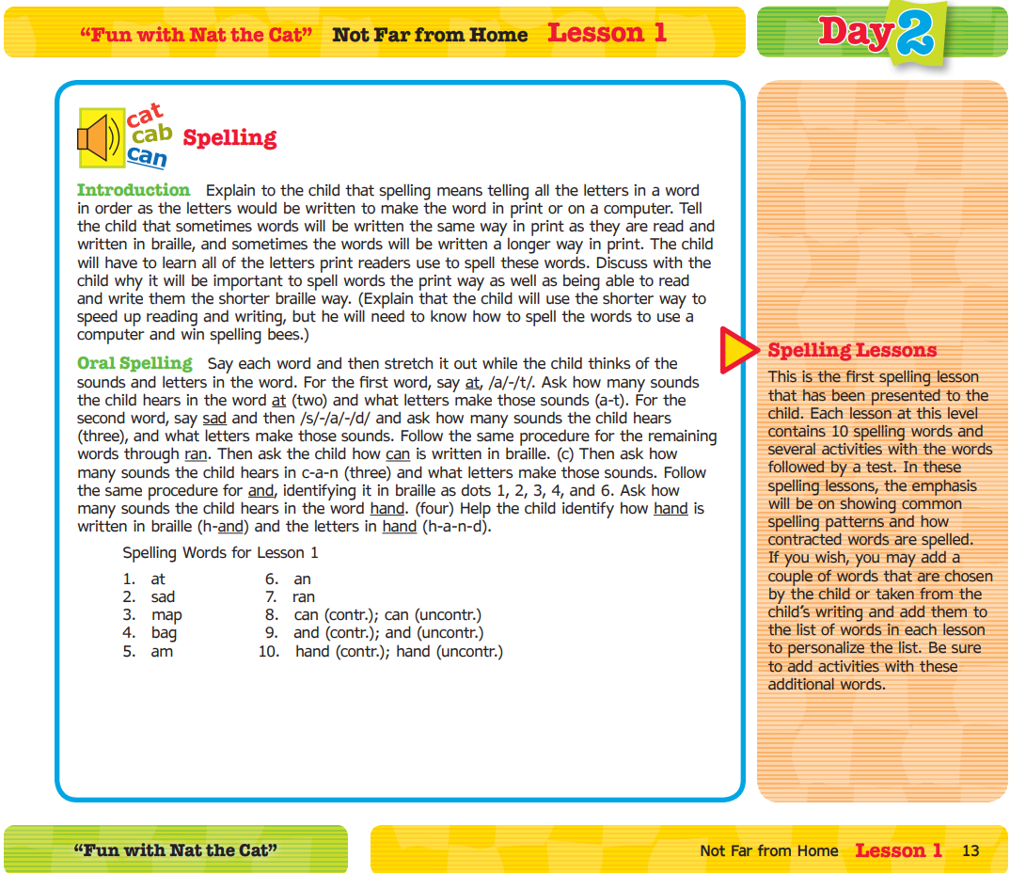
1st Grade: Sample lesson
Notes:
This is an example of a sample lesson on Spelling. There is an introduction and a section on oral spelling and a sidebar explaining what will be covered in the lesson.

Slide 28
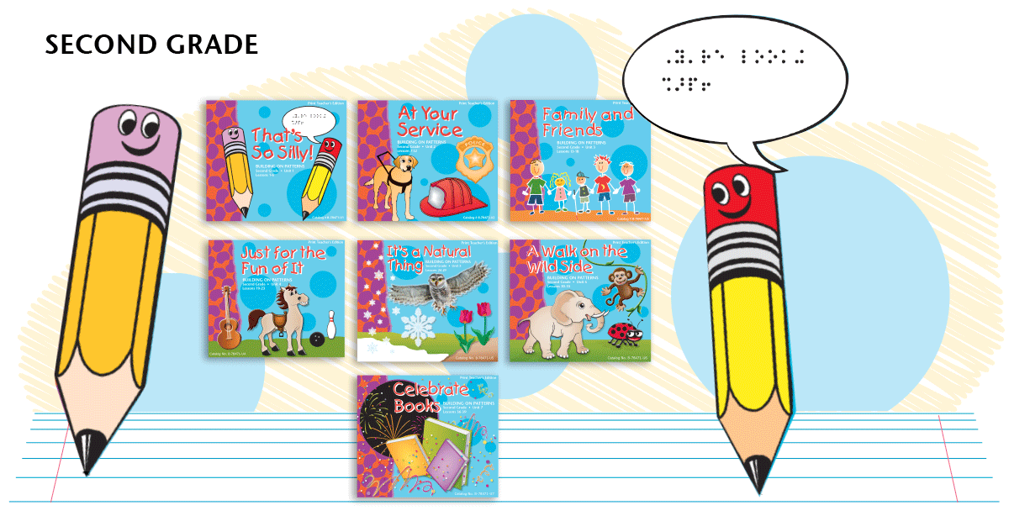
2nd Grade
This is the final part of the Building On Patterns curriculum and a continuation from the skills built in 1st Grade.

Slide 29
2nd Grade: What’s included?
Student kits (7 units)
Teacher’s edition of each unit in braille and print
Independent reading
Timed and silent reading practice

Slide 30
2nd Grade: Skills developed
Part-word contractions
Remaining literary contractions
Syllable and multi-syllabic words
Effects of certain letter combinations on vowel sounds
Independent reading
Phonemic awareness
Dolch word recognition
Grammar and usage

Slide 31
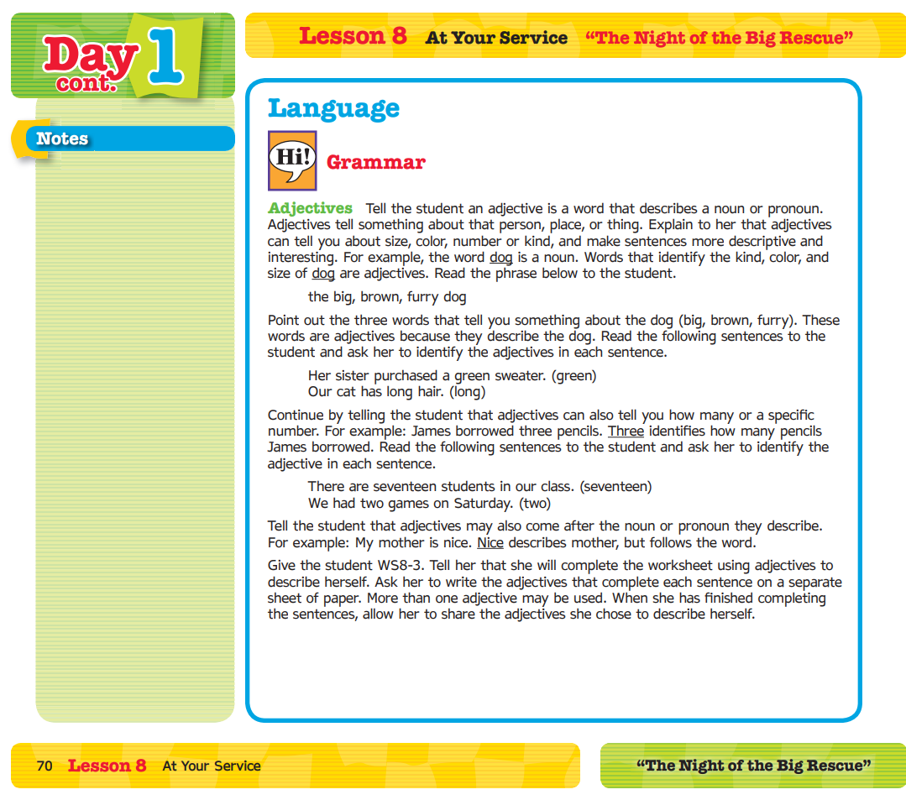
2nd Grade: Sample lesson

Slide 32
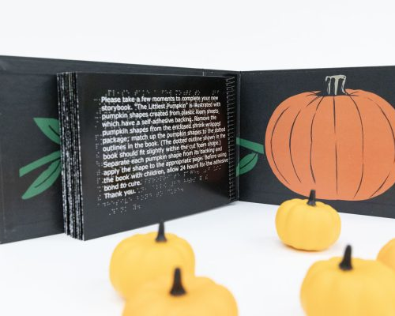
Related storybooks for Pre-k-Kindergarten
On the Way to Literacy (Littlest Pumpkin, Caterpillar, Jellybean Jungle)
LDQR (Tales for Baby Lizard, My Nose, Six Little Dots)
Alphabet Scramble
Notes:
I have made a list of APH books that support literacy at the preschool level, including On the Way to Literacy Littlest Pumpkin, the Caterpillar, Jellybean Jungle, and Geraldine’s Blanket. Also from our LDQR series, we have Tales for Baby Lizard, My Nose, Six Little Dots, and coming soon… Where’s Spot?), and Alphabet Scramble, which provides great opportunities for letter recognition and tracking.

Slide 33
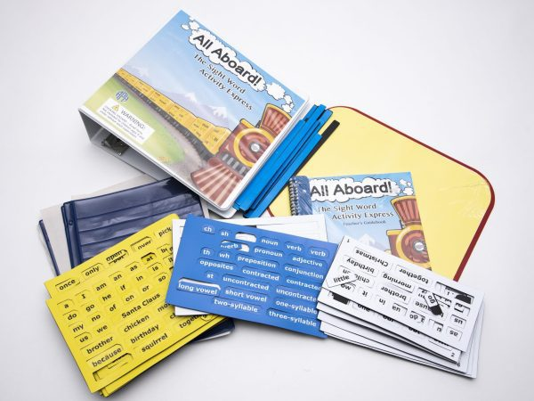
For braille and sight words practice
All Aboard the Sight Word Activity Express
Word Playhouse
Expanded Dolch Word Cards
Notes:
Products that are helpful for this grade level are All Aboard! Word Playhouse, and Expanded Dolch Word Cards.

Slide 34
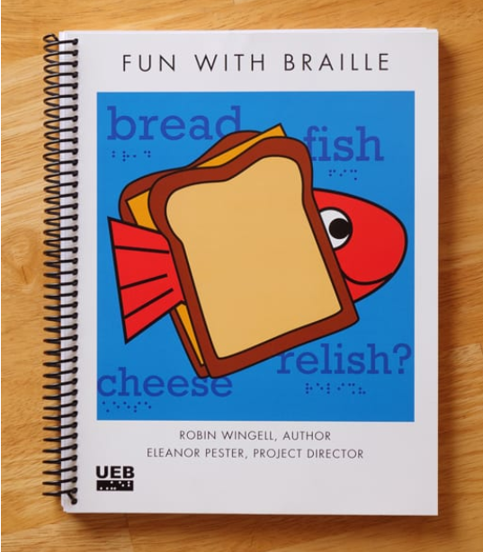
Contractions practice
Fun With Braille
Braille Contraction Cards
Quick Pick: Braille Contractions

Slide 35
Memory Puzzles and More

Slide 36
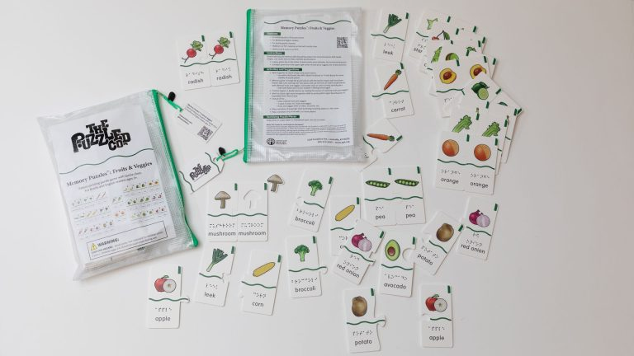
Memory Puzzles: Fruit & Veggies
Overview:
Memory Puzzles: Fruits and Veggies is a tactile braille matching game for learners ages 3 and up. The contents include 60 colorful pieces forming 20 matching shape sets. Each piece has braille labels. This gamified braille tool enhances problem-solving, memory, spatial awareness, and directionality. Added is a third and removable piece, adding complexity to the original puzzle line.

Slide 37
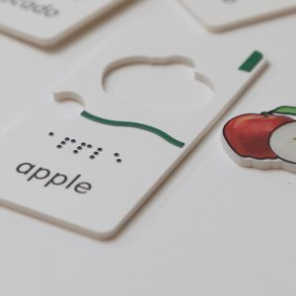
Fruit and Veggies
Next level of puzzle in the Memory Puzzle Line
Designed to support braille readers and low vision learners
Great for engaging with sighted peers
Promotes motor skills and offers an engaging way to explore shapes and healthy food themes.

Slide 38
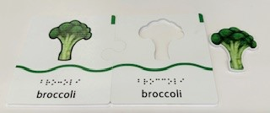
Fruit and Veggies: What’s Included?
60-piece tactile puzzle features three-part matching sets
Third removable piece
Made from durable, easy-to-clean PVC foam
The puzzle is housed in a sturdy pouch for convenient storage

Slide 39
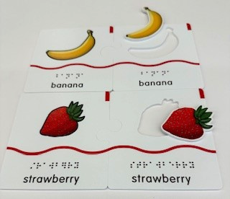
Fruit and Veggies: Skills Developed
A fun, accessible way for blind and sighted individuals to learn and play together
Help users build:
Memory
Matching
Spatial reasoning skills
Enhanced gross-motor and fine-motor skills

Slide 40
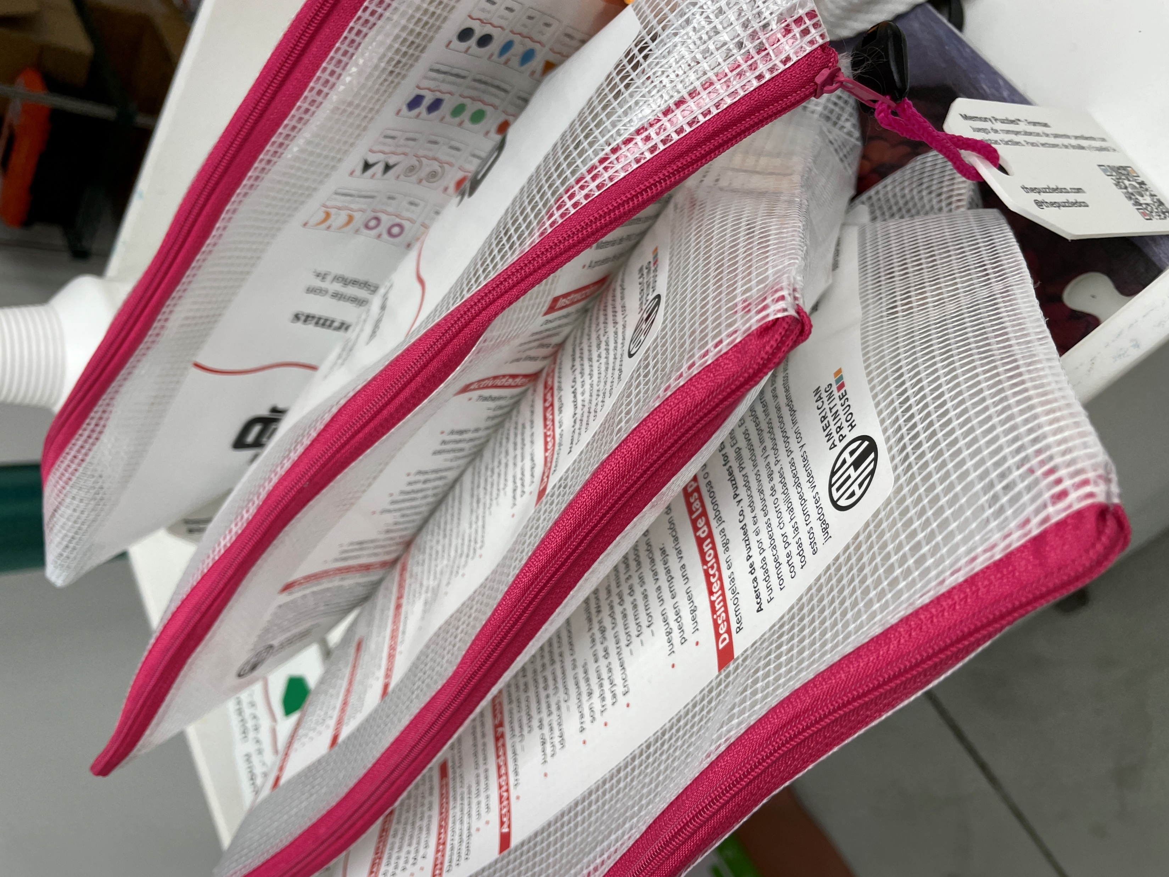
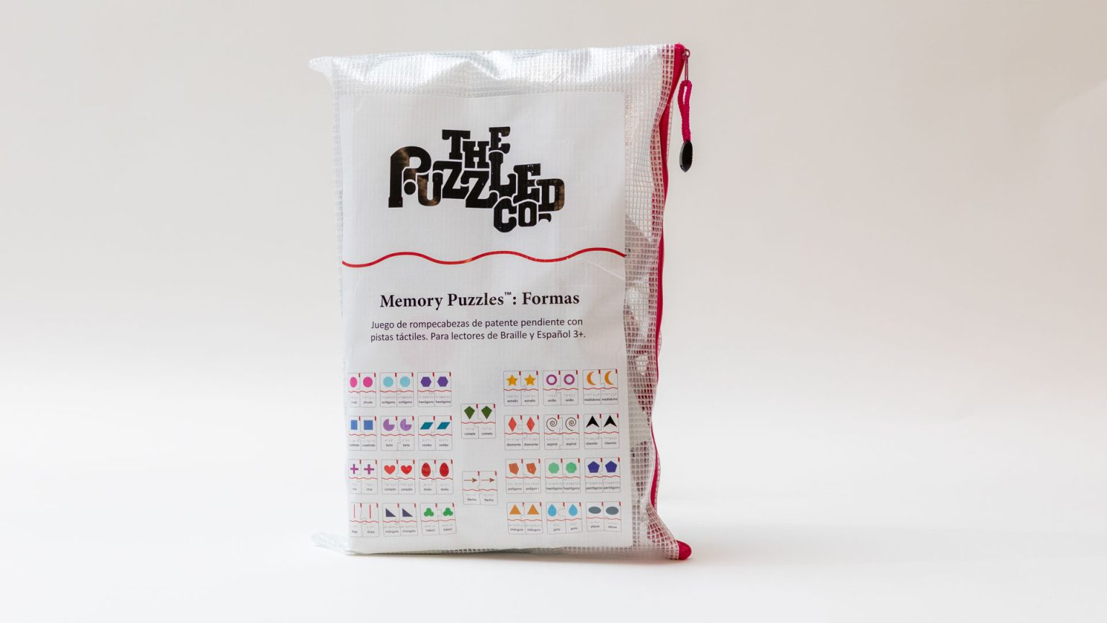
Memory Puzzles: Shapes, Spanish
Overview:
Memory Puzzles: Shapes, Spanish Edition is an engaging tactile braille matching game designed for learners ages 3 and up. This set features 52 vibrant puzzle pieces that form 26 matching shape pairs, each clearly labeled in braille. Inspired by the original Memory Puzzles: Shapes, this Spanish edition mirrors its structure and design so that pieces from both sets fit together perfectly.

Slide 41
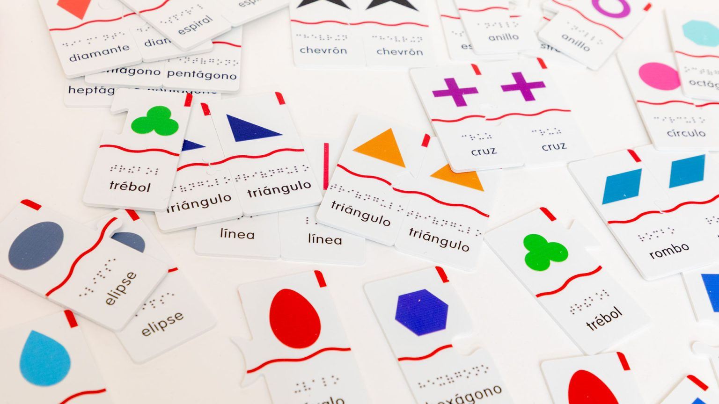
Memory Puzzles: Shapes, Spanish
Modeled after the original Memory Puzzles: Shapes
Maintains the same structure and design
Pieces from both versions interlock seamlessly. When combined, the two sets create a unified puzzle experience, with English on one side and Spanish on the other
Supports bilingual learning through play.

Slide 42
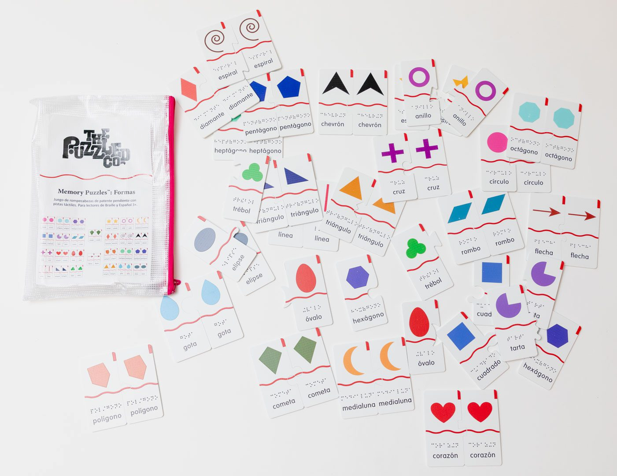
Shapes, Spanish: Skills Developed
Bilingual learning through playful engagement
A fun, accessible way for blind and sighted individuals to learn and play together
Inclusive and encompassing
Help users build:
Memory
Matching
Spatial reasoning skills
Enhanced gross-motor and fine-motor skills

Slide 43
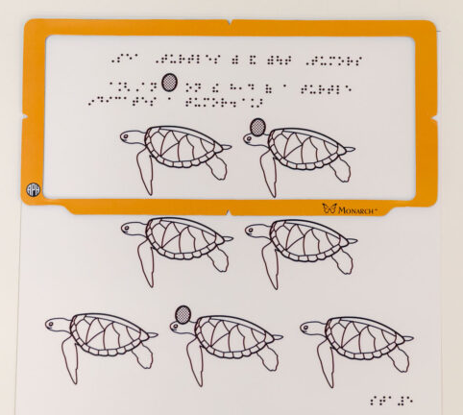
Monarch Masking Frame
A frame cut out to the perimeter size of the Monarch's tactile display
Used to represent masking for students who will be transitioning to using the Monarch for tactile graphics
Goal: to demonstrate what the experience will be like when viewing a larger tactile graphic on a smaller tactile surface
Moving the frame around on an embossed tactile graphic will demonstrate the process of panning around a graphic using the Monarch

Slide 44
Digitizing Braille Devices

Slide 45
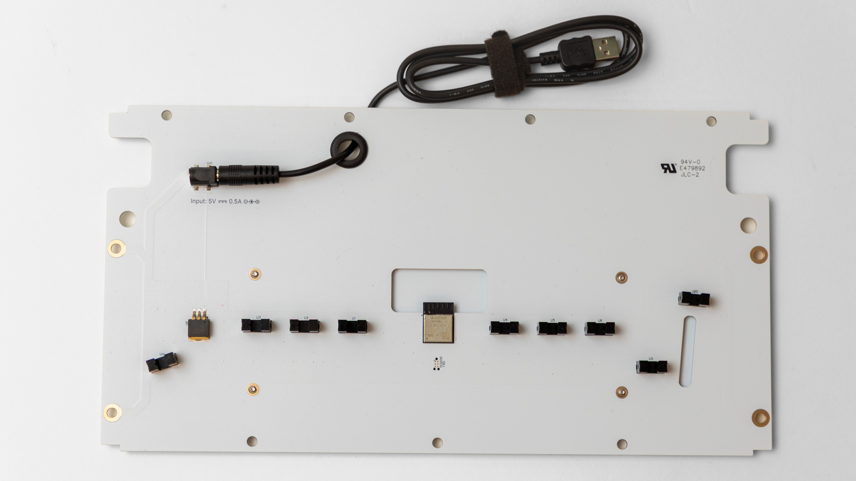
Paige Connect
Targeted Skills:
Hand positioning
Finger isolation and strength building
Light touch for tracking and reading
Audio feedback

Slide 46
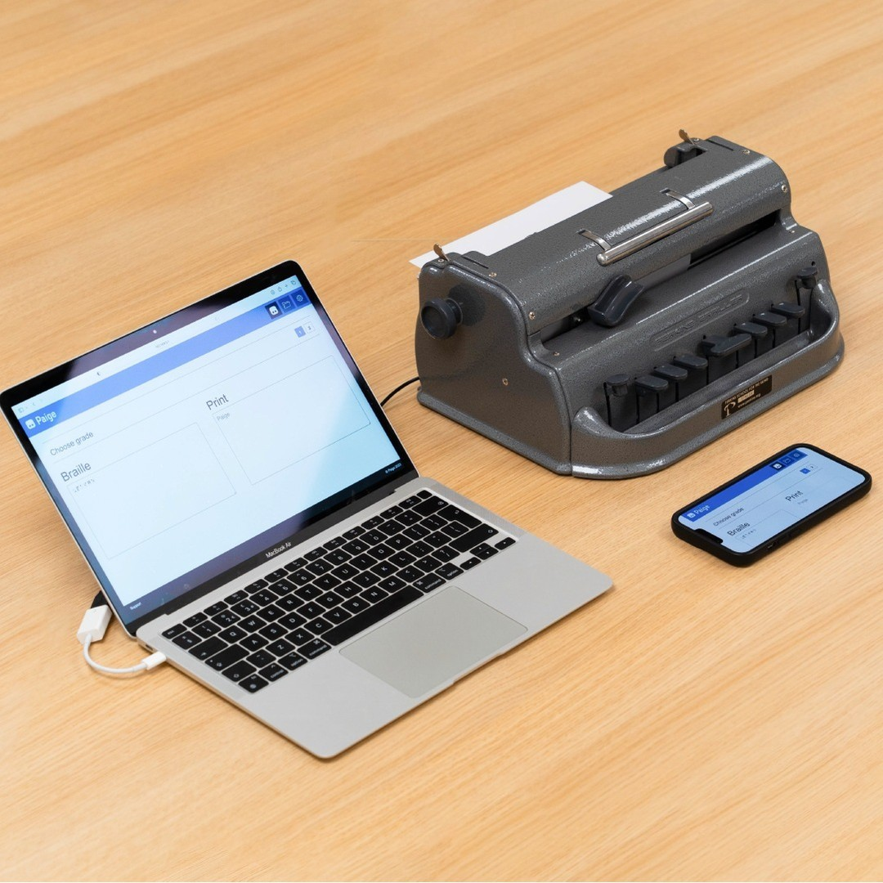
Paige Braille Website
Targeted Skills:
Integrated with technology
Collaboration with other
Ownership and Independence
Learn
Translate
Homework

Slide 47

Braille Brain
Targeted Skills:
Decoding to fluency
Self-paced and individual needs
Advanced and technical braille lessons

Slide 48
Braille Brain, Continued
Designed to support braille literacy
UEB Foundation
UEB Foundation Assessments
UEB Advanced
Nemeth
Let’s explore!

Slide 49

Nemeth Tutorial
Supporting Nemeth
Specific skill lessons
Specific skill exercises
Beginning Nemeth to Advanced Nemeth concepts

Slide 50
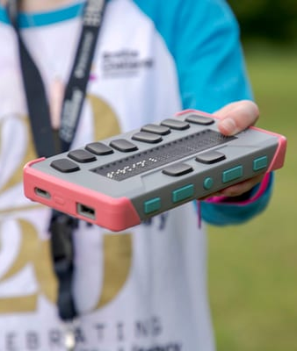
Chameleon 20
Targeted Skills:
Accessing digital media
Collaborating with peers through shared digital platforms
Refreshable braille with braille keyboard
Reading fluency and comprehension

Slide 51
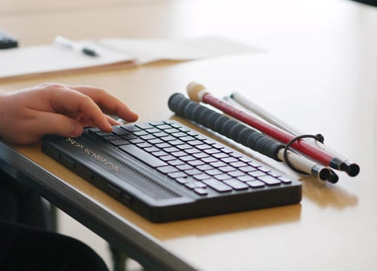
Mantis Q40
Targeted Skills:
File manager
Download books
Refreshable braille with QWERTY keyboard
Tasks such as research, note-taking, creating and editing BRF files.

Slide 52
Apply Your Learning Activity
Table activity with individual learner scenario
Product to consider supporting your learning
Discuss with your table skills and products that would support the individuals' current skills and plan for their next steps in their braille literacy journey, from dots to devices.

Slide 53
Resources
APH Website, www.aph.org
BOP Website
Memory Puzzles: F+V Product Page
Memory Puzzles: Shapes, Spanish Product Page
Monarch Masking Frame Product Page
Paige Connect
Paige Braille
Braille Brain

Slide 54
Resources Continued
Nemeth Tutorial
Chameleon 20
Mantis Q40
Customer Service: 1-800-223-1839
Email: support@aph.org

Slide 55
Contact Information
Rachel Bishop, rbishop@aph.org
Bobby Fulwiler, bfulwiler@aph.org
Sara Welch, swelch@aph.org
Melisa Matthews, mmatthews@aph.org

Slide 56

ACVREP Submission www.aphhive.org
Enter Hive with QR code
Select sign-in
Click “Event Certificate Request”
Enter opening and closing codes
Click “Validate Codes”
Notes:
Review slide

