Slide 1

Welcome APH annual meeting
2025

Slide 2
President’s address
Craig Meador

Slide 3
APH scholars
Leanne Grillot

Slide 4
APH Awards
Craig Meador

Slide 5
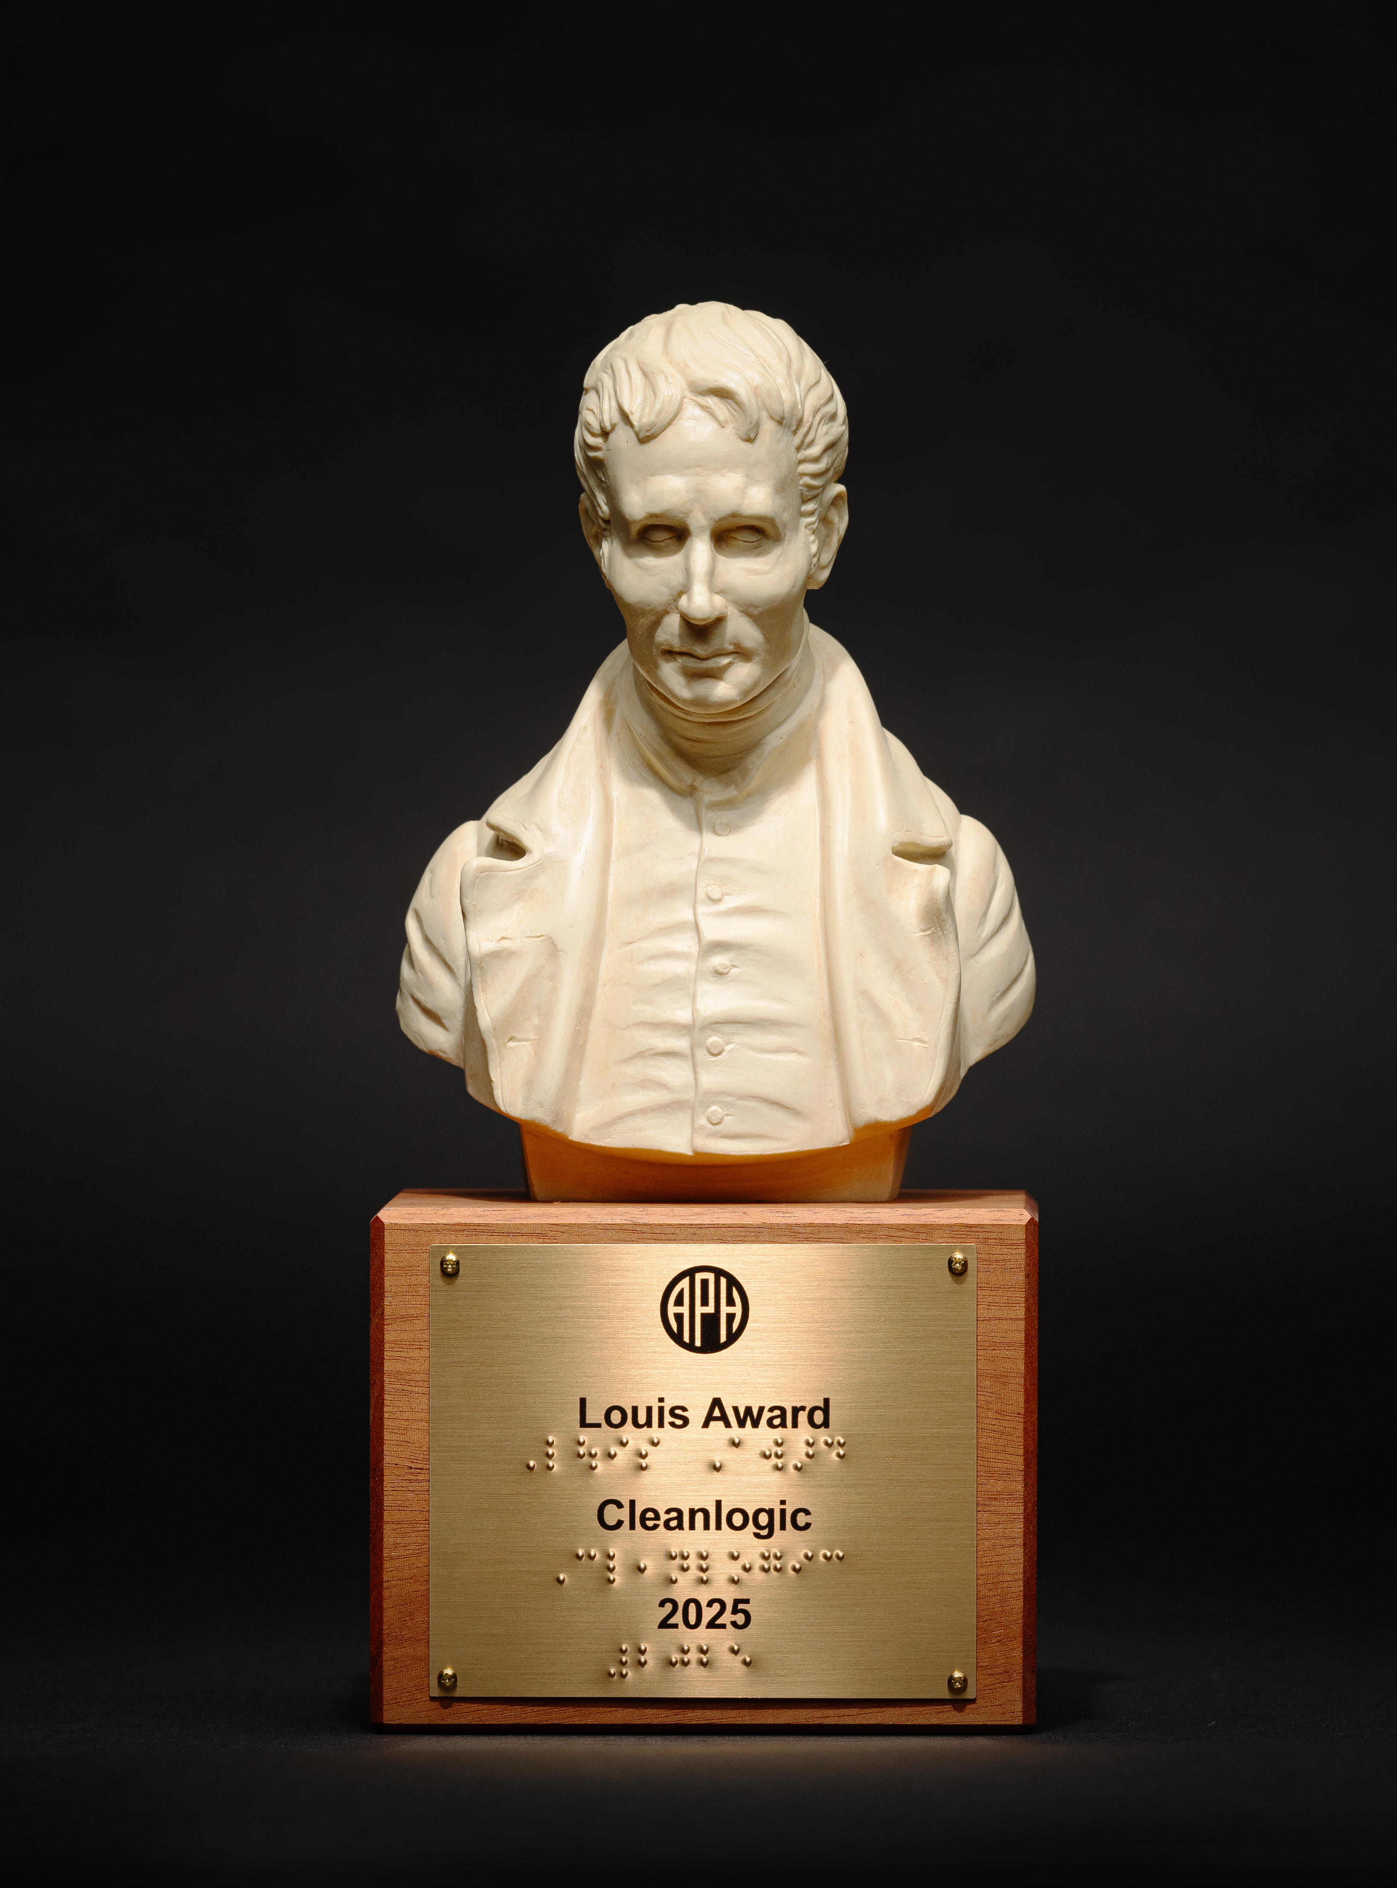
2025 Louis Award Cleanlogic Accepted by Isaac Shapiro

Slide 6

2025 Horizon Award Ray Kurzweil Accepted by Mark Riccobono, NFB

Slide 7

2025 Navigator Award VisionServe Alliance Accepted by Lee Nasehi

Slide 8

2025 Wings of Freedom Dr. William Wiener

Slide 9
Thank you
Please join us for plentiful appetizers and cocktails immediately following in the Foyer and Salon VI.

