Slide 1

Quick Draw: Tactile Graphics for Monarch, Embossers, and Beyond!
Nicole Gaines
Stacy Fontenot
Abigail Webster-Blair
Caroline Merk
Jason Martin

Slide 2
The Tactile Graphic Image Library:
Helping Students Thrive – through Access to Free Graphics!

Slide 3

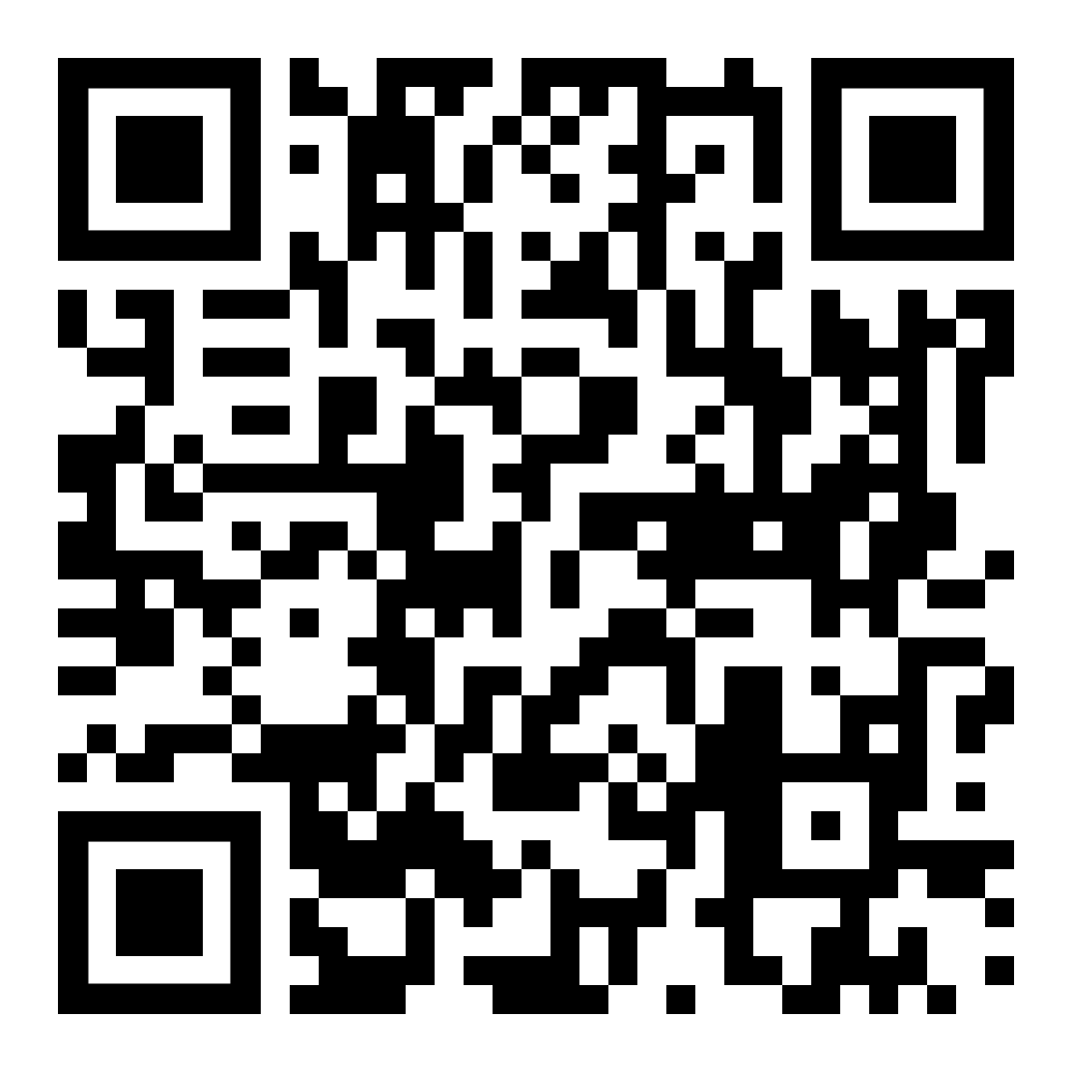
Tactile Graphic Image Library
What is the TGIL?
The TGIL is a free online library of downloadable tactile graphics files.
Accounts are free – and anyone is welcome to register!
https://imagelibrary.aph.org/

Slide 4
Supporting Transcribers – and Students
APH launched the TGIL over fifteen years ago to support transcribers with free, customizable tactile graphics templates.
A key goal of TGIL is to help expedite K-12 braille textbook production by giving transcribers a starting point for creating tactile graphics that are commonly found in educational materials.
Since 2024, TGIL has expanded to offer student-ready graphics to serve Monarch users.

Slide 5
The TGIL Today: Content
The TGIL currently has over 2,600 graphics available to download.
Most files are graphics templates – intended to be customized by the transcriber – but we are now adding new "finished" graphics that are ready-to-use by the student.
The majority of TGIL files are PDFs, but we have a small number of other file types, such as PRNs, fonts, and 3-D graphics (primarily replacement parts for APH products).

Slide 6
The TGIL Today: Users & Downloads
TGIL has an international base of users – with over 9,000 users from about 70 countries.
TGIL is also a hugely popular resource, with tens of thousands of downloads each year!
Just so far in 2025, we have had over 36,000 file downloads!
Even more exciting, more than 40% of these downloads have been by Monarch users!

Slide 7
The TGIL: Website and Monarch App
TGIL can be accessed via the website or by Monarch users directly through an app on the device.
Monarch users do not need to create an account or log in when using the device to access TGIL.
The Monarch app search results only includes materials that are in PDF format.
APH continues to work with Humanware to build out the app so that it provides additional metadata and functionality.

Slide 8
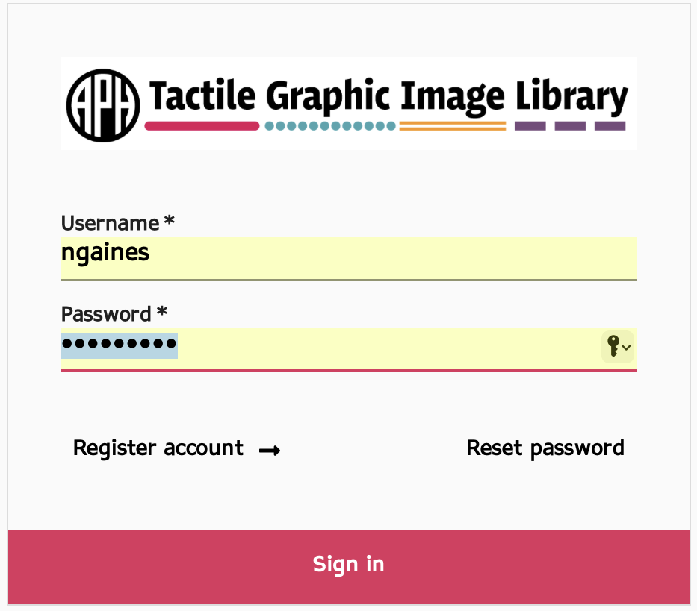
The TGIL Website

Slide 9
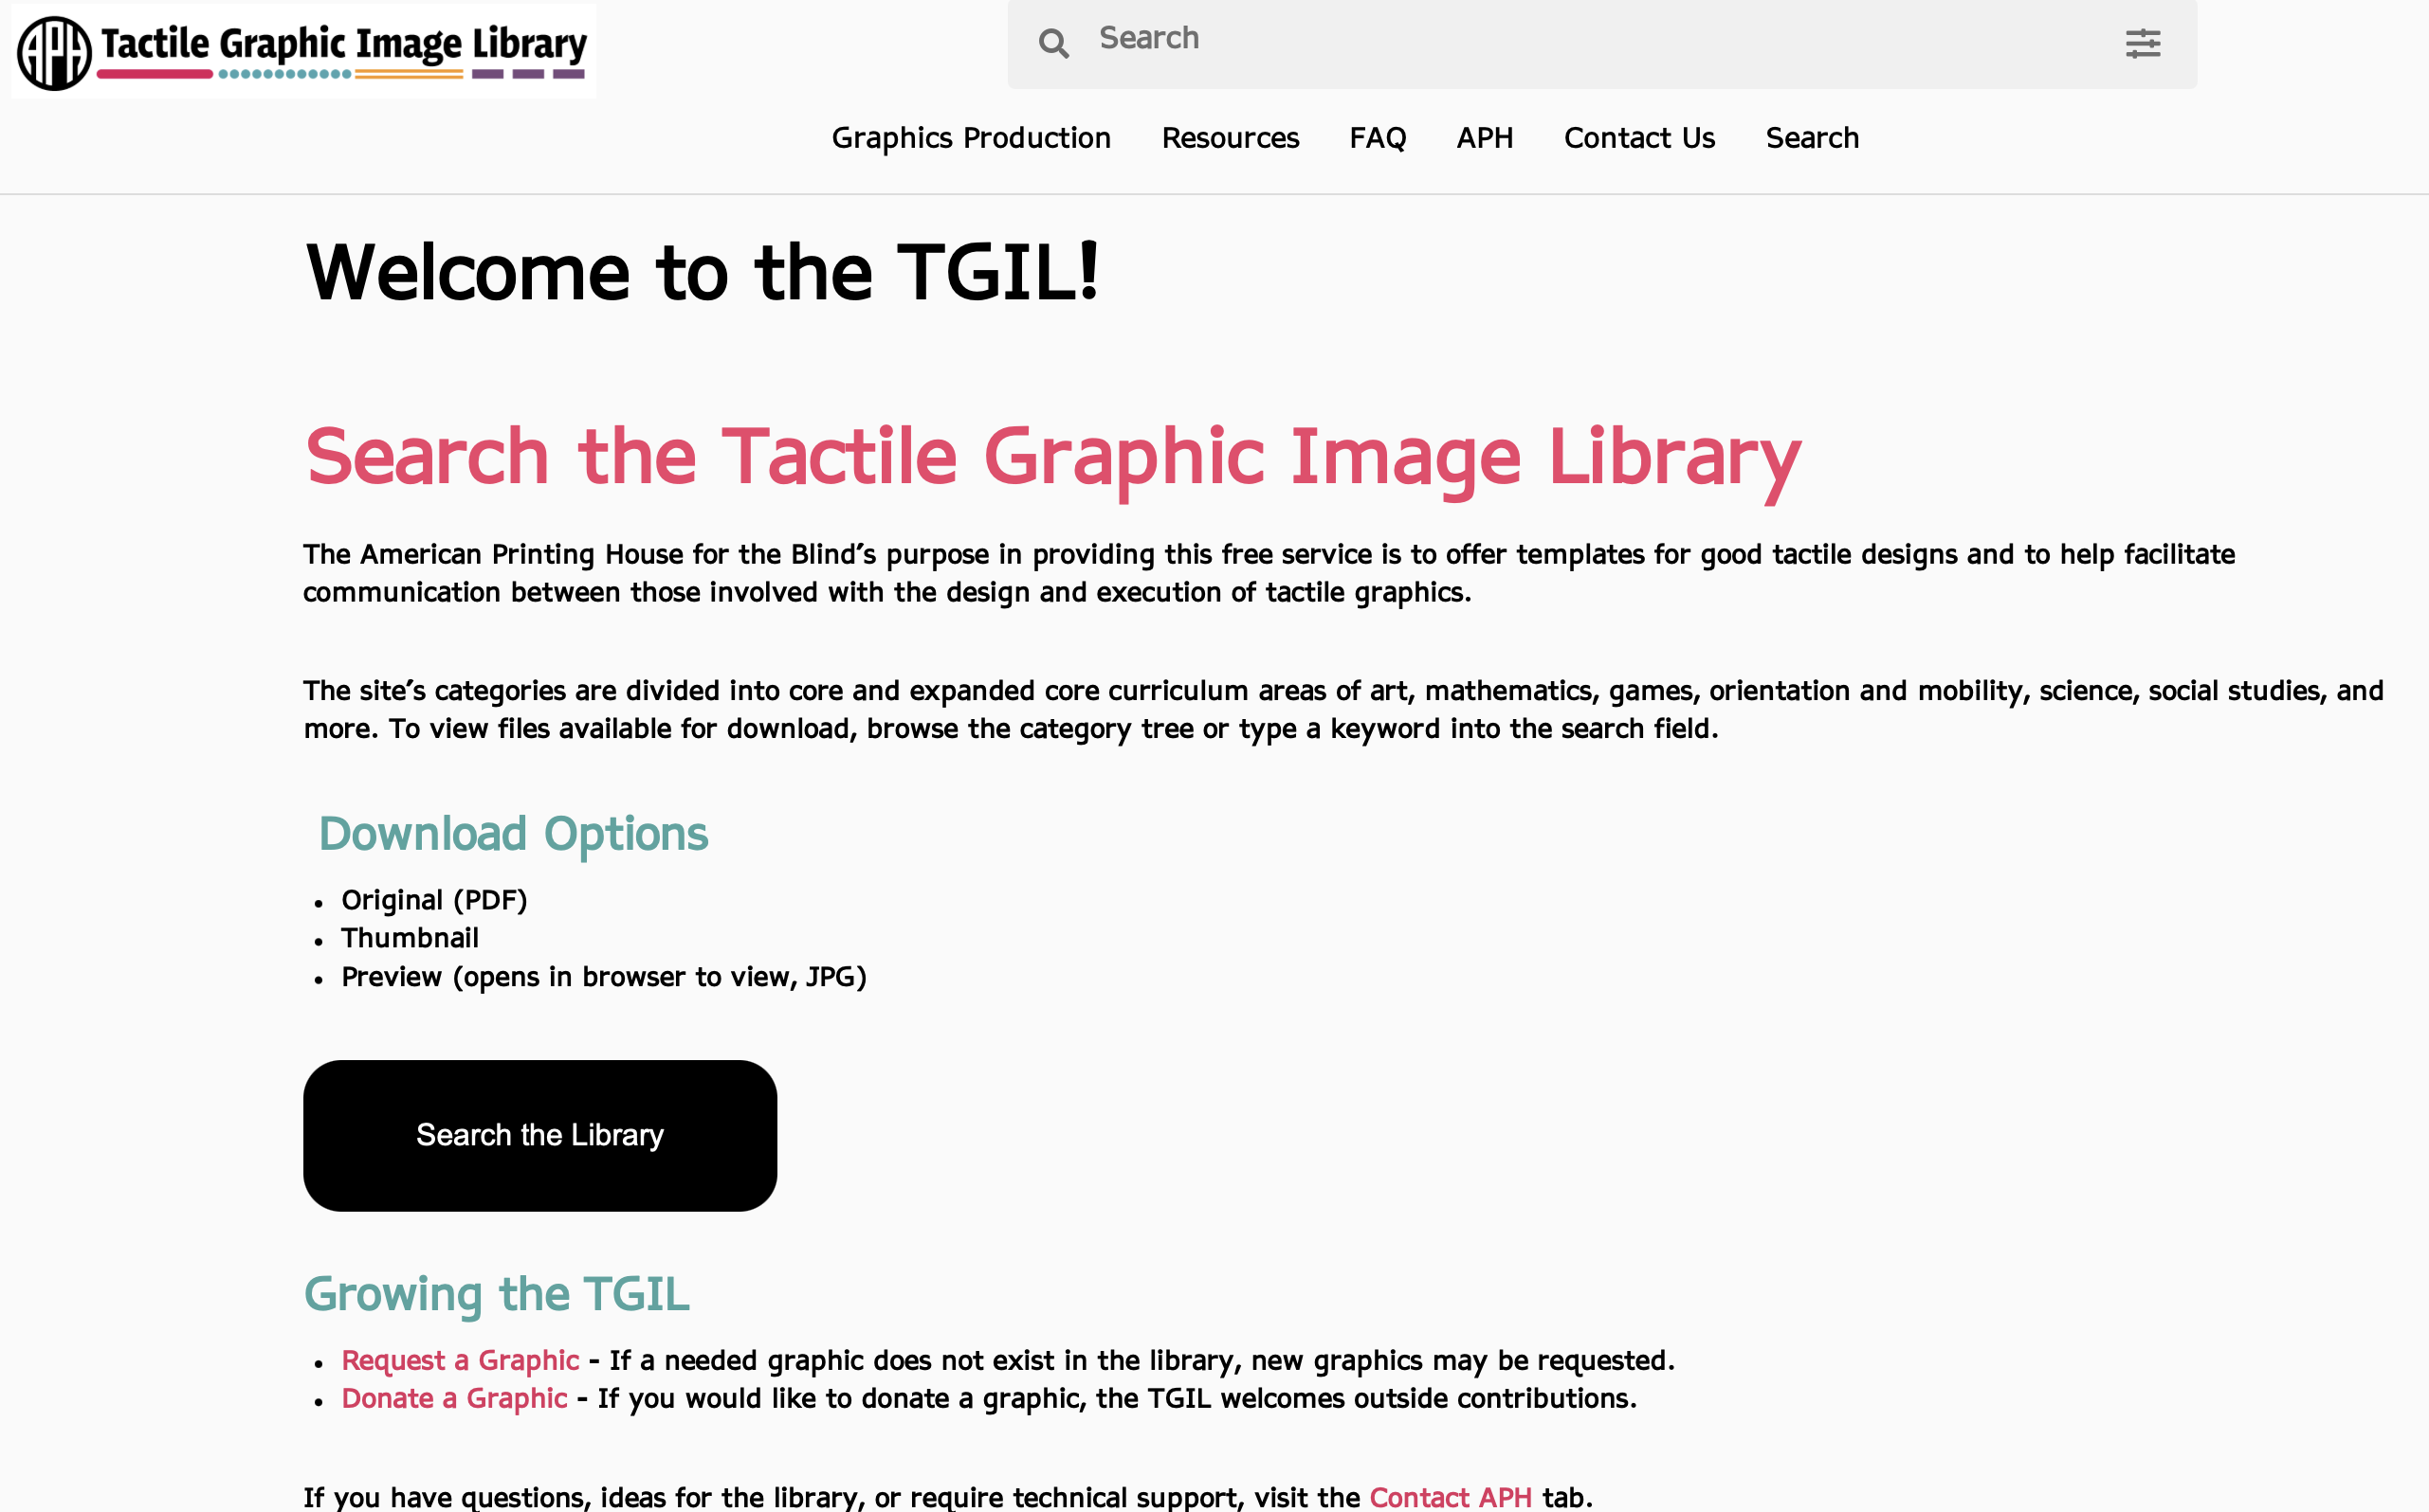
TGIL Home Page

Slide 10
Searching the TGIL Website
Categories
Search Terms
Filters

Slide 11
TGIL Website: Categories & Search Terms
When you enter the library, you will see tiles for all the categories.
You can either browse graphics by clicking a Category, or you can enter search terms in the box at the upper right.
When you enter search terms, you can use quotation marks around your search term or terms to retrieve exact matches.

Slide 12
TGIL Website: Search Filters
There are a limited number of search filters available.
One that can be very handy is "Optimized for Monarch."
Filters are applied by clicking the box at the upper right and choosing from the available options.

Slide 13
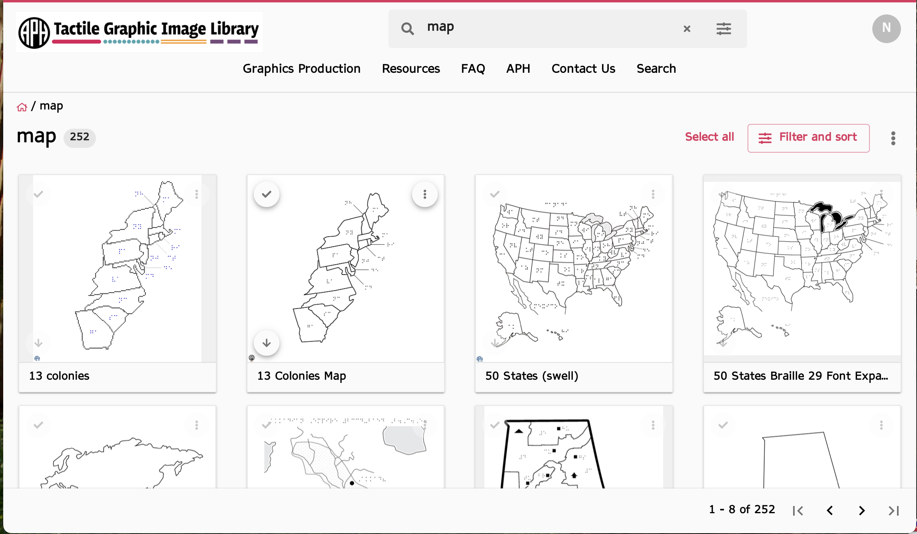
Tactile Graphic Image Library

Slide 14
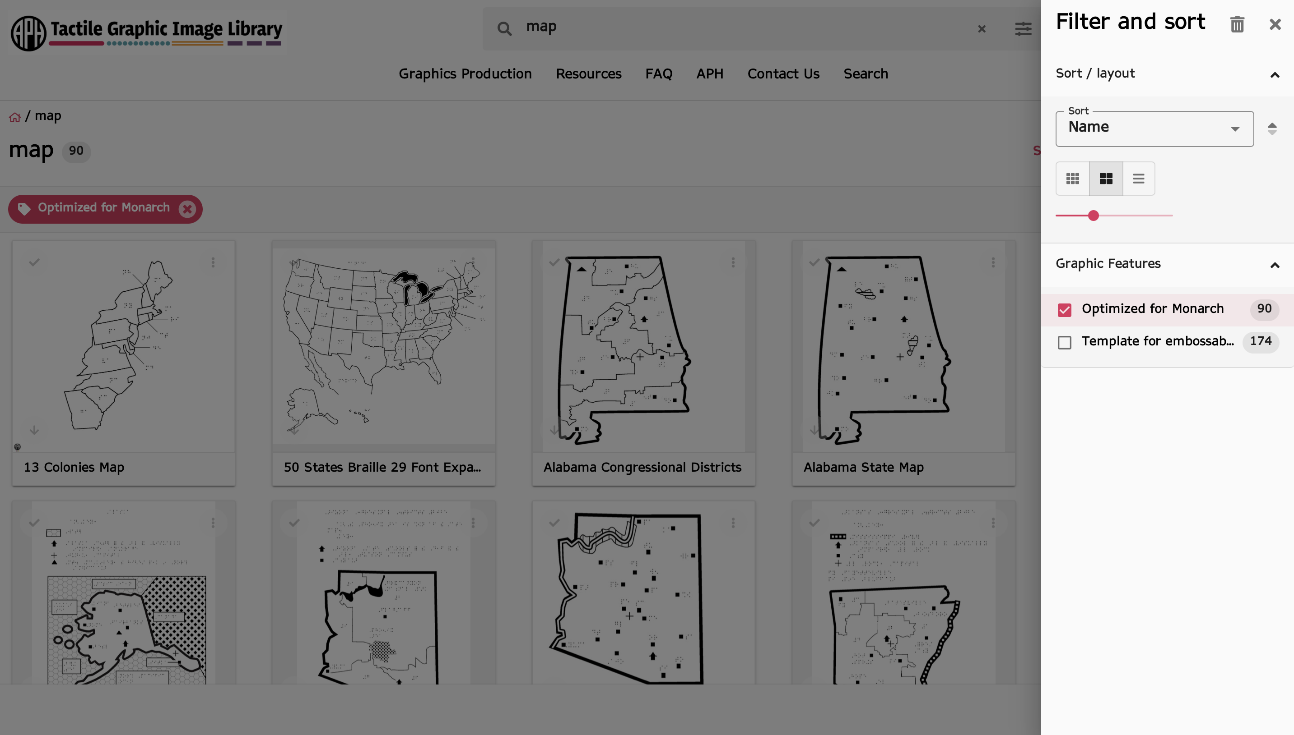
Tactile Graphic Image library

Slide 15
Quick Hint on Downloading:
TGIL has a range of download options.
If you are downloading a PDF from the TGIL, all you need to do is select "Download Original" from the list of download options.
If the file is already a PDF, do not choose "Create PDF" as your download option.

Slide 16
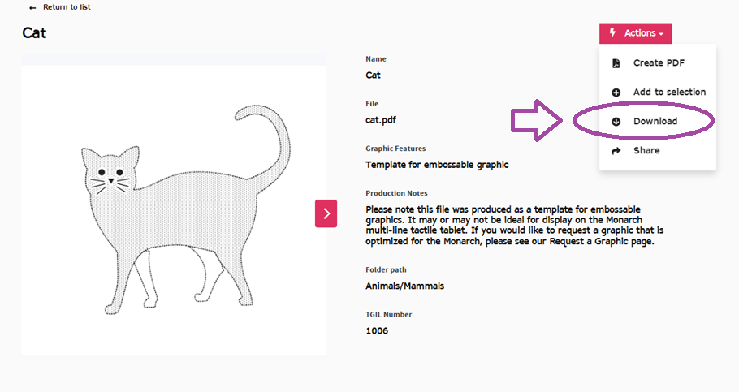
From Actions menu, select Download

Slide 17
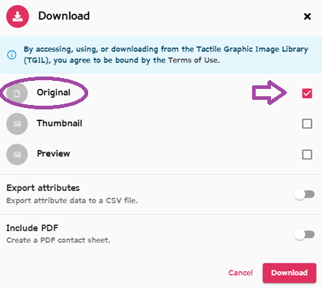
From Downloads options, select Original

Slide 18
The Monarch TGIL App
Monarch users can directly access the TGIL without logging in.
The Monarch TGIL app has more limited functionality and metadata than the website.
Monarch users can add the term "monarch" to other search terms to limit results to graphics that have been vetted to work well on the device.
Graphics with this designation will also show "monarch-approved" at the end of the file name.

Slide 19
Improving TGIL: Metadata Projects
READS is working to improve TGIL by updating and adding new metadata. Efforts include:
Reviewing and updating TGIL categories.
Adding new metadata to indicate whether graphics were created for Monarch or created for embossing – and to indicate if the graphic is optimized for use on Monarch.
Working on short descriptions for all graphics.

Slide 20
Improving TGIL
READS is actively engaged in several efforts to further improve the TGIL website, the Monarch app, and content:
Working with Humanware to make additional metadata available for graphics.
Remediating the most popular graphics so they will display well on Monarch.
Reviewing and revising the categories to make them more intuitive and easier to use.

Slide 21
Growing the Monarch: Donations & Requests
TGIL welcomes your requests and your donations!
For information on the guidelines for submitting a request or donating graphics, please see the "Growing the TGIL" section of our TGIL Frequently Asked Questions.

Slide 22
For more information & support
Check out these additional TGIL resources:
Graphics Production
Resources
Donations & Requests
Request form

Slide 23
Contact Us
We want to hear your feedback and ideas!
tgfeedback@aph.org

Slide 24
Designing graphics

Slide 25
Best Practices and Standards for Creating Monarch Tactile Graphics
A handbook for educators and transcribers on creating optimal tactile graphics for the Monarch.
Accessible via the APH Hive and Louis.
Best Practices and Standards for Creating Monarch Tactile Graphics

Slide 26
Basic Considerations
Identify Key Components
What is needed to convey meaning?
Eliminate Unnecessary Parts
Irrelevant details like backgrounds and decorative elements.
Simplify
Limit the amount of line and fill textures.
When possible, render 3D images as 2D.
Do not include more detail than you would on a pumpkin carving.

Slide 27
Lines
Use a variety of line weights and textures to separate components of a tactile graphic.
Example: On a graph, the grid lines should be the lightest, while the plotted lines should be the thickest.

Slide 28
Textures
A pattern of pixels used to fill an outline to distinguish an area or shape within a tactile graphic.
The Best Practices document features a selection of Monarch-approved textures.
Limit the amount of fill textures to maintain clarity.

Slide 29
Spacing
Avoid Clutter
Keep delineations between elements as clear as possible.
Separate elements should be at least one braille cell apart.
Braille labels should be placed at least ¼” away from a tactile element.
Retain a margin of at least ½” around a graphic.

Slide 30
Image size
11.5″ × 11″
Standard braille paper
8″ × 4″
Minimum size for Monarch
Monarch allows for larger images

Slide 31
Braille fonts
Braille29
Size: 29 pt.
Recommended for Monarch graphics
Braille36
Swell Braille
Size: 24 pt.

Slide 32
File types
PDF
Text elements are retained
Single zoom level on Monarch
Recommended for graphics with braille
Image file
JPG, PNG, BMP, etc.
Text is converted to pixels
Multiple zoom levels on Monarch

Slide 33
Conclusion
It is important to continually check and update graphics as the Monarch continues to evolve and improve!
Questions? E-mail us at outreach@aph.org.

Slide 34
Computer Software

Slide 35
CorelDRAW
Widely used in the field
Good for complex graphics
Lots of control over image
Somewhat complicated
Price: $269 per year, or $549 outright
$65 per year for teachers

Slide 36
Adobe Illustrator
Comparable to CorelDRAW
Widely used in general
Lots of support and resources
Slightly different tools and textures
More features = more complicated
$35 per month, or $264 per year

Slide 37
Microsoft Word
Widely available
Features a variety of drawing tools
Good for simple, quick graphics
Lacking many design tools that are in other programs
Not ideal for large, complex graphics

Slide 38
TactileView
Developed specifically for tactile graphics
Similar features to other design programs like CorelDraw
Monarch Mode and Dot View allows for dot-perfect editing
Missing some of the key design tools in CorelDraw and Illustrator
Price: $595 outright in the US

Slide 39
Wing It

Slide 40

Wing It
Enables TVI's, classroom teachers, family or peers to draw on an iPhone or iPad app
A paired Monarch instantly displays drawings in a tactile form
iOS user can add labels to the tactile graphic with the iOS keyboard and the print instantly translates to braille
Monarch users can add their own labels on the Monarch and save or load tactile drawings
Drawings can also be shared via email to the student directly from the app when not nearby
6. Wing It is iOS VoiceOver Accessible
7. Download Wing It from iOS.

Slide 41
Stations

Slide 42

ACVREP Submission www.aphhive.org
Enter Hive with QR code
Select sign-in
Click “Event Certificate Request”
Enter opening and closing codes
Click “Validate Codes”
Notes:
Review slide

Slide 43
THANK YOU!

