Slide 1

A Deep Dive into User Stories and Consumer Perspectives

Slide 2
Your Presenters
Daniel Loy, Project Manager, Product Operations
Heather Kennedy-MacKenzie, Director, Global Technology Innovations
Matthew Bowdy, Head of Technology Solutions for Unified Growth Partners

Slide 3
What on tap today?
Learn about Personas, Customer-Centric User Stories, and Scope
Find out how these are used in Agile Software Development
Get some perspective on how they’re used in other industries
Get hands on with an Activity!

Slide 4
What’s a persona?
According to Google, it’s “the aspect of someone's character that is presented to or perceived by others”
Defining a Persona is identifying the perspective of your user.
As a Product Manager…
As a Blind 1st Grade Student…
As a Digital Strategy Manager…
As a Senior Adult with a Degenerative Eye Condition…

Slide 5
What’s a user story?
According to Google, it’s “a concise, informal description of a product feature or functionality from the perspective of an end-user, outlining their goal and the benefit they receive”
Who, What, Why
As a [Persona]…
I want [an Action]…
So that [a Benefit]
As an Annual Meeting presenter, I want to build an engaging presentation, so that my audience doesn’t fall asleep.

Slide 6
Let’s get specific
Persona
User-centric
Clearly defined subset of your user or customer base
Action
Specific
Measurable
Benefit
Clear
Attainable by the action

Slide 7
Bonus POints
Some User Stories have Acceptance Criteria (more on this later)
This is how you know when the benefit has been derived, or the need is met.
Think of it as a I’m done with this user story when…
As an Annual Meeting presenter, I want to build an engaging presentation, so that my audience doesn’t fall asleep.
Done when the Annual Meeting presenter looks at the audience at a random time interval and finds them still awake.

Slide 8
Scope (not the mouthwash)
According to Google, the Scope of a project is defined as, “defining the boundaries, goals, tasks, and deliverables of a project, including what is and is not included, to ensure a common understanding among stakeholders and prevent ‘scope creep’” [things getting out of hand]
In other words,
The Scope of this slide is only Scope because that’s all we’re talking about
The Scope of this presentation is a bit wider than that
The Scope of Annual Meeting is a bit wider even than that
If I talk about Annual Meeting on this slide, that’s Scope Creep

Slide 9
Some examples
As a homeowner, I want to control all of my smart devices from a single app, so I can easily manage my home's technology.
As a restaurant owner, I want to update my menu items in real-time on my website, so that my customers have accurate information.
These stories get at a basic need for a specific user that is met by a specific action.

Slide 10
Lets drill down and refine
As a member of Dot 6, I want to create beautiful communications so that my target audience can enjoy them.
How can we refine this story?
As a member of EPI, I want to create amazing products, so that my consumers can use them.
How can we refine this story?

Slide 11
Break time!

Slide 12
Now let’s hear how user stories are used in software development

Slide 13
What We will cover
What is Agile?
What is the Software Development Life Cycle?
Why Agile & Software Development Life Cycle Matter
Project Scope
Why Project Scopes & User Stories Matter
Key Takeaways

Slide 14
What is Agile?
Agile is a way of working that focuses on:
• Flexibility & collaboration
• Working in small steps (iterations)
• Delivering usable pieces quickly
• Improving with feedback
• Clear communication across teams

Slide 15
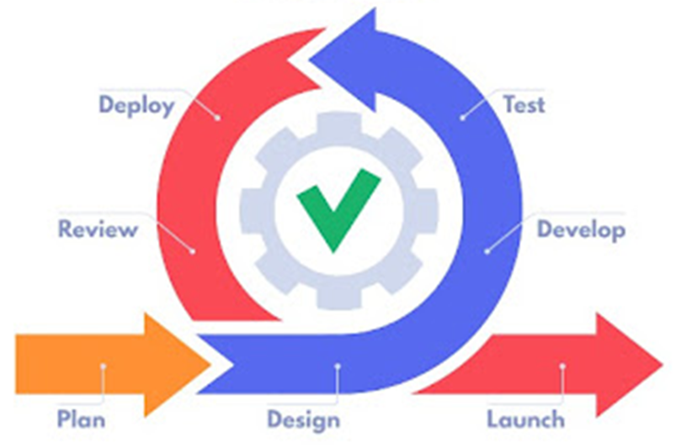
Agile Lifecycle

Slide 16
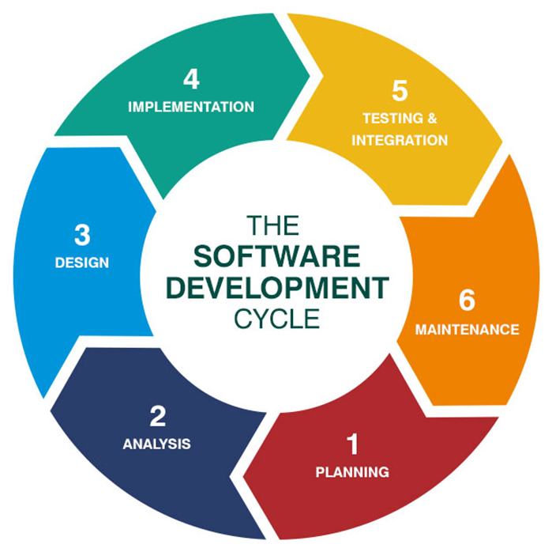
What is the Software Development Life Cycle (SDLC)?
SDLC is a step-by-step process for building software.
Helps teams stay organized and structured.
Common stages:
Plan – Understand the problem and goals.
Design – Create solutions and prototypes.
Build – Write and test the code.
Test – Check if it works correctly.
Deploy – Release to users.
Maintain – Fix issues and improve.

Slide 17
Why Agile & SDLC Matter
Software Development Life Cycle (SDLC) provides structure for software projects.
Agile makes these steps shorter and repeatable, so teams can adapt quickly.
Aligns Product, Marketing, and Engineering.
Enables faster delivery and responsiveness.

Slide 18
Project Scope
Defines what the team will and won’t build.
Scope evolves as user needs are clarified.
Minimum Viable Product (MVP) first: deliver core value quickly.
Prevents scope creep and misaligned expectations.

Slide 19
Example – Embossable Word Search
Project Scope Statement: Develop a free, accessible application that allows educators to generate custom and pre-made braille word search puzzles that can be easily embossed using tools such as the PixBlaster and Monarch. The app will focus on supporting braille literacy, spelling, and vocabulary development in K–12 classrooms and will be accessible to both Teachers of the Visually Impaired (TVIs) and sighted educators.

Slide 20
Example (Assumptions)
Project Assumptions and Constraints Assumptions
Most users are working on Windows machines, based on survey data and past field experience.
Assumption: The majority of TVIs and educators will use Windows systems to generate and transfer embossable files.
TVIs or support staff (paras/sighted teachers) are trained or can be trained quickly in basic file transfer and embosser operations.
Schools will allow the use of email or USB drives to transfer files from a computer or laptop to the embosser.
Basic familiarity with embosser technology exists among the target audience.

Slide 21
Example (Constraints)
Constraints
Very few embossers support AirPrint or direct mobile-to-embosser workflows. PixBlaster does, PageBlaster does not.
Primary technology for interfacing with embossers will be desktop-based, particularly Windows. Monarch is self-presenting
Some school IT policies restrict the use of thumb drives, which may limit file transfer options. Very little concern.
The Monarch device, while central to the project, is expensive and may limit access to certain schools or regions.
The app cannot (initially) support direct embossing from iPhone/iPad – development will prioritize Windows compatibility.

Slide 22
Example (Out of Scope)
Items Not in Scope
Direct embossing from iOS mobile devices (e.g. iPhone) – High out of scope
Bluetooth or wireless embosser connection – We are not concerned about how they emboss
Full mobile-native app experience on Android or iOS in early phases
Custom embosser hardware development
Advanced puzzle types (e.g. crossword, memory matching) – may be added in future phases

Slide 23
Why Scopes & User Stories Matter
For Software Engineers
Clear stories = less ambiguity and confusion.
Well-defined scope = focused work, fewer distractions.
Helps engineers prioritize critical features.
Reduces wasted effort and costly rework.
For Project Momentum
Keeps everyone aligned on what matters most.
Prevents scope creep and shifting priorities.
Allows for steady, incremental progress.
Builds trust across teams with visible wins.

Slide 24
Impact of Project Scopes & User Stories
Without Clear Scope & Stories
With Clear Scope & Stories
Ambiguity
Confusion
Rework
Delays
Clarity
Focus
Momentum
Progress

Slide 25
Remember…
Checklist for a Good User Story (INVEST)
I - Independent Story can stand alone.
N - Negotiable Details can be discussed/adjusted.
V - Valuable Delivers clear value to the user.
E - Estimable Small enough to estimate effort.
S - Small Can be completed within one iteration.
T - Testable Has clear acceptance criteria.
Acceptance Criteria
Acceptance criteria define when a story is complete. They provide measurable conditions for success.
Example:
• Filter option appears on product page.
• User can select multiple filters.
• Product list updates instantly based on selected filters.

Slide 26
Breakdown
User Story | Requirements | Acceptance Criteria
As a learner, I want to move the turtle and feel its position/orientation on the braille display so that I can understand how commands affect graphics. | Step execution of commands Display turtle orientation & location Represent turtle as Braille T with directional line | User can press a key to step through one command at a time. The turtle’s location updates on the braille display after each command. The turtle’s orientation is tactilely distinct using Braille T with directional line.
As a user, I want to issue turtle graphics commands so that I can draw, reposition, and reset the display. | FORWARD, BACKWARD RIGHT, LEFT PENUP, PENDOWN HOME, CLEAR | When entering a movement command (e.g., FORWARD 5), the turtle moves correctly and leaves a line if the pen is down. RIGHT/LEFT rotate the turtle correctly. PENUP prevents lines from being drawn, PENDOWN resumes drawing. HOME resets the turtle to (0,0) facing up. CLEAR wipes the braille display and resets turtle position/orientation.

Slide 27
Key Takeaways
Agile = flexibility, teamwork, and delivering value in small steps.
SDLC = structure and organization for building software.
Project scope defines boundaries → prevents scope creep and misalignment.
User stories keep the focus on customer value and clear communication.
Clear stories + scope = less confusion for engineers, more momentum for the project.
Strong alignment across Product, Marketing, and Engineering drives faster, more impactful results.
👉 Good user stories and clear scope keep engineers productive, projects on track, and teams moving forward together.

Slide 28
Break time?

Slide 29
Now let’s hear how customer needs are identified and addressed in other industries

Slide 30
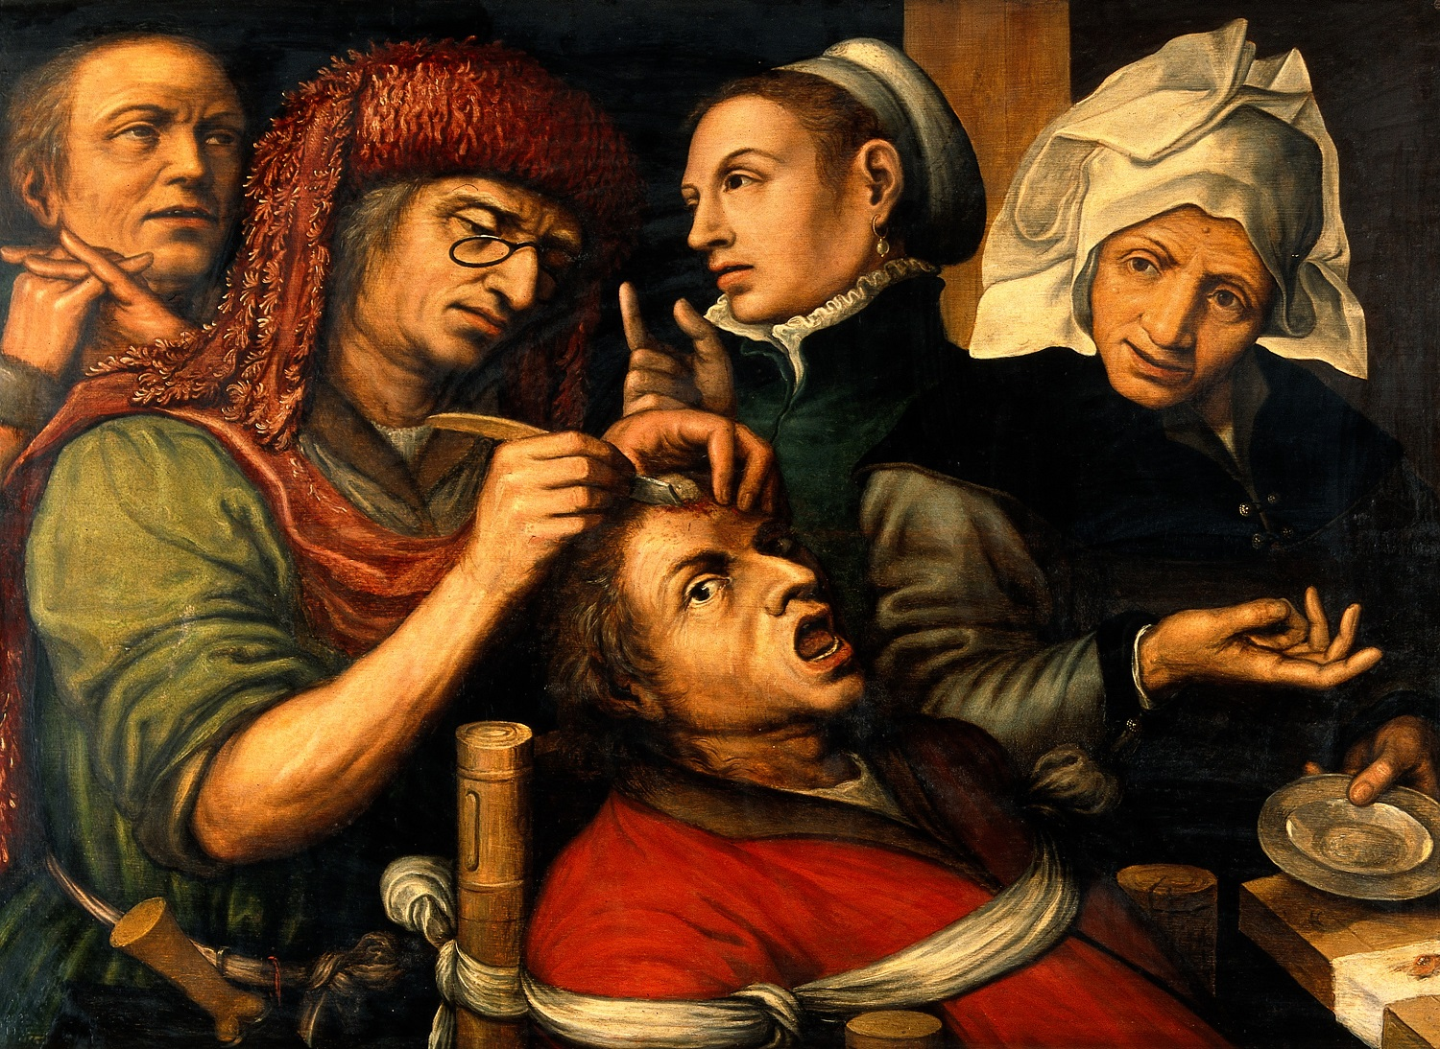
Get Inside Your Customer’s Head!

Slide 31
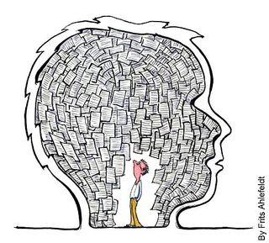
You’re Inside…Now What?

Slide 32
Historical Perspective
History & Adoption Timeline
Personas
Introduced in the 1990s by Alan Cooper in his book The Inmates Are Running the Asylum (1998).
Gained traction in UX and design practices in the early 2000s.
Now a standard tool in human-centered design and product development.
User Stories
Emerged in the late 1990s with the rise of Agile and Extreme Programming (XP).
First widely described by Kent Beck (1999, Extreme Programming Explained).
Became mainstream in the 2000s, with Scrum and Agile adoption in software development.

Slide 33
Value of Personas in Product Development
Humanize the user: Create empathy and a shared understanding of user needs.
Align teams: Provide a clear, relatable picture of who the product is for.
Prioritize features: Focus on solving real user problems instead of building “nice-to-have” features.
Guide design decisions: Personas act as a compass for UX, design, and communication strategies.

Slide 34
Value of User Stories in Product Development
Keep the focus on the user: Frame requirements in terms of user goals, not technical tasks.
Enable collaboration: Help designers, developers, and business stakeholders speak a common language.
Promote iterative development: Break work into small, testable units tied to user value.
Measure success: Acceptance criteria make “done” explicit and testable.

Slide 35
Personas + User Stories Together
Stronger together: Personas provide context (“who and why”), user stories provide detail (“what and how”).
Reduce risk: Prevents building products that no one wants.
Drive innovation: Reveal unmet needs that can inspire new features or products.
Boost adoption: Products resonate more when they reflect real user motivations.

Slide 36

FAILURES!

Slide 37
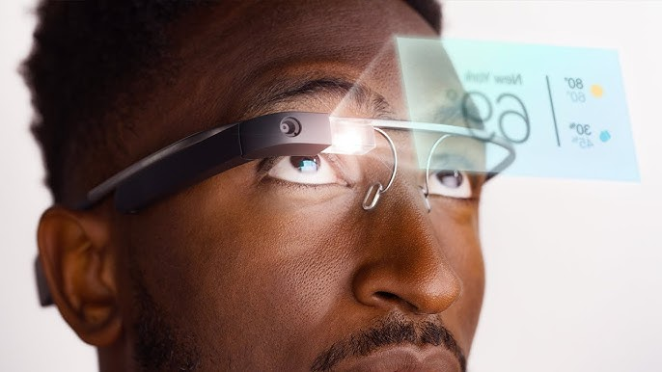
Google Glass

Slide 38
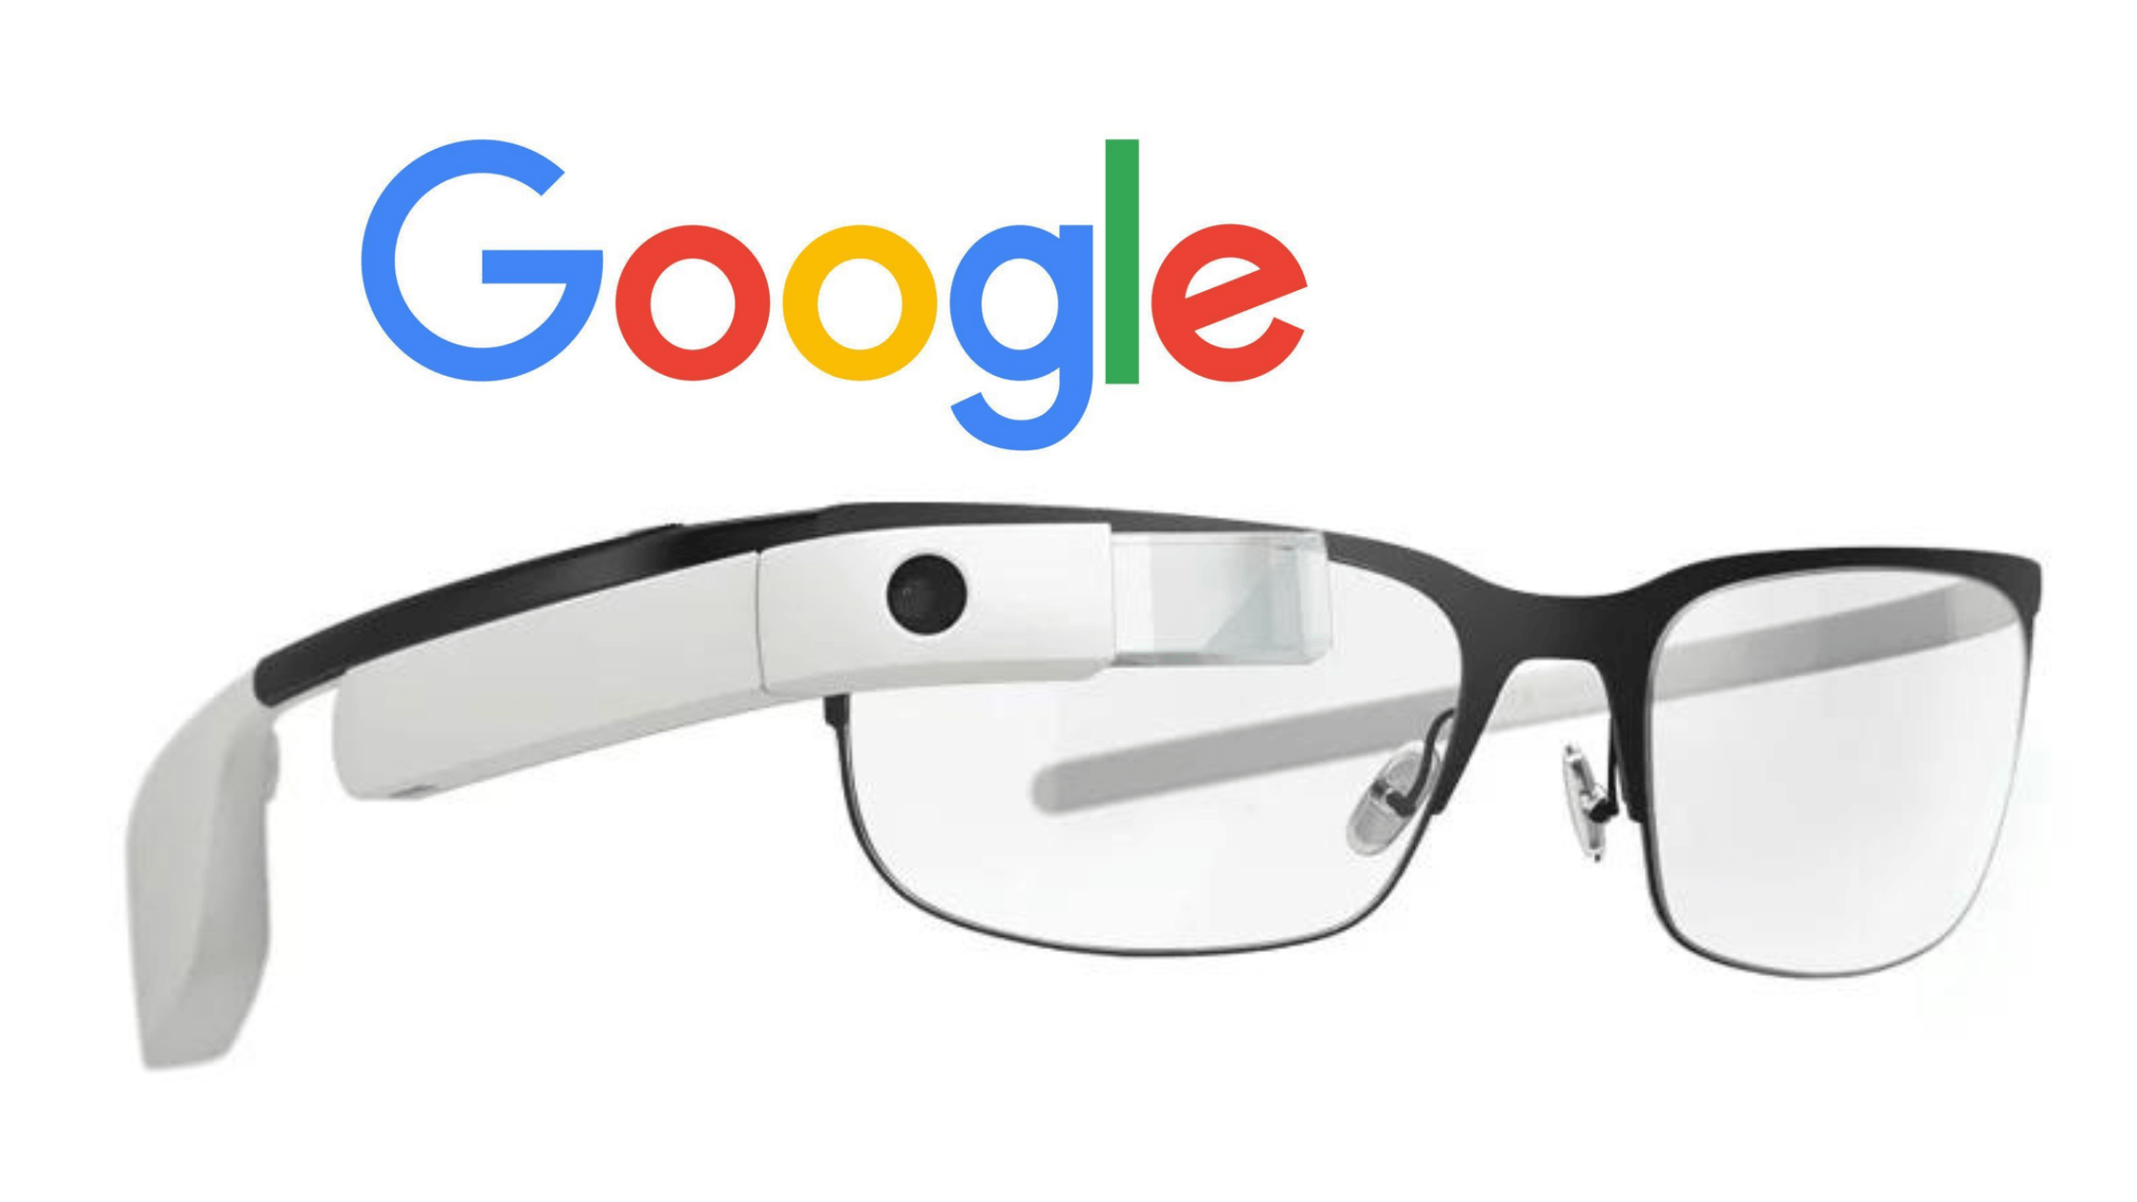
Google Glass(es)

Slide 39
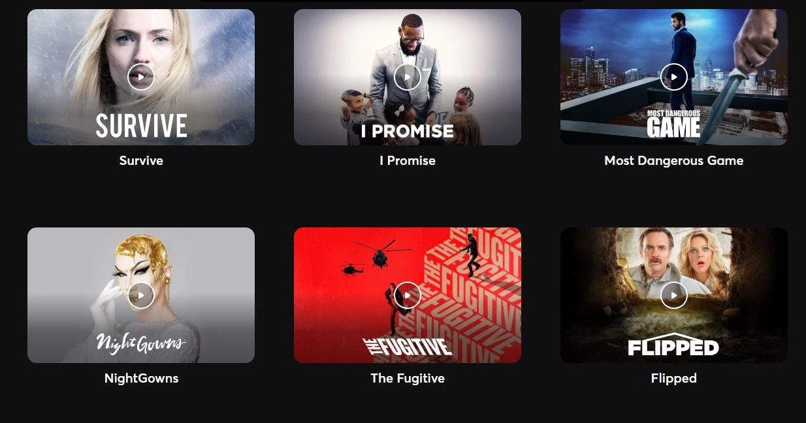
Quibi

Slide 40

Quibi No More

Slide 41
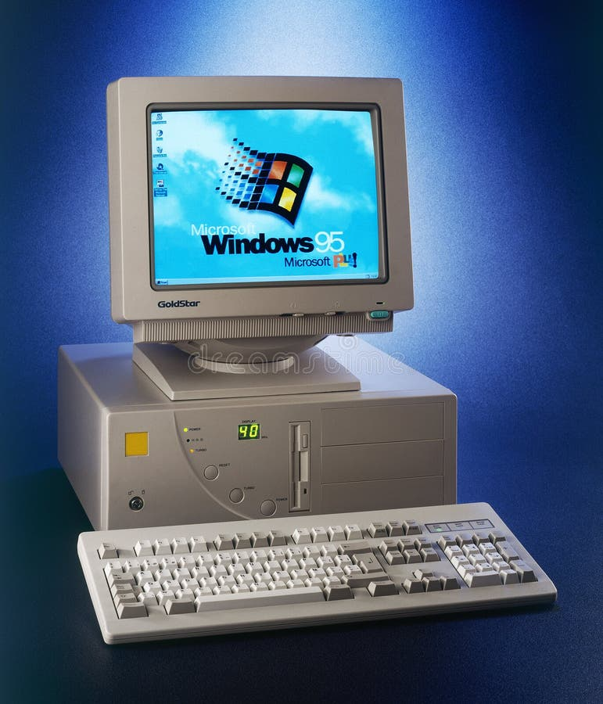
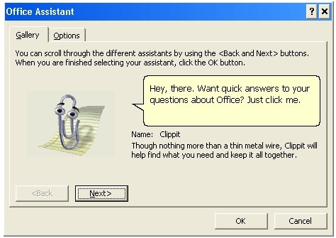
Clippy!

Slide 42

Clippy Tried So Hard

Slide 43
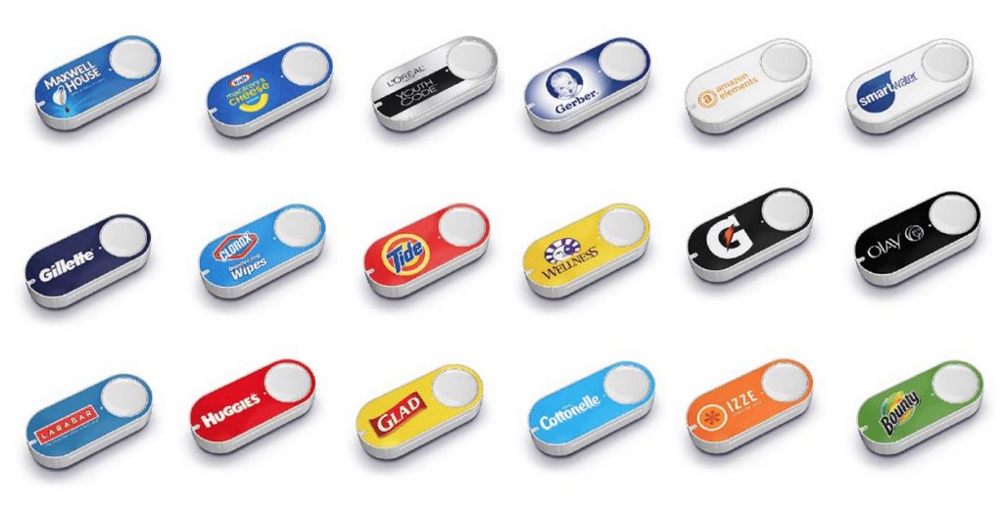
Amazon Dash

Slide 44

Amazon Dash and Too Many Deliveries

Slide 45
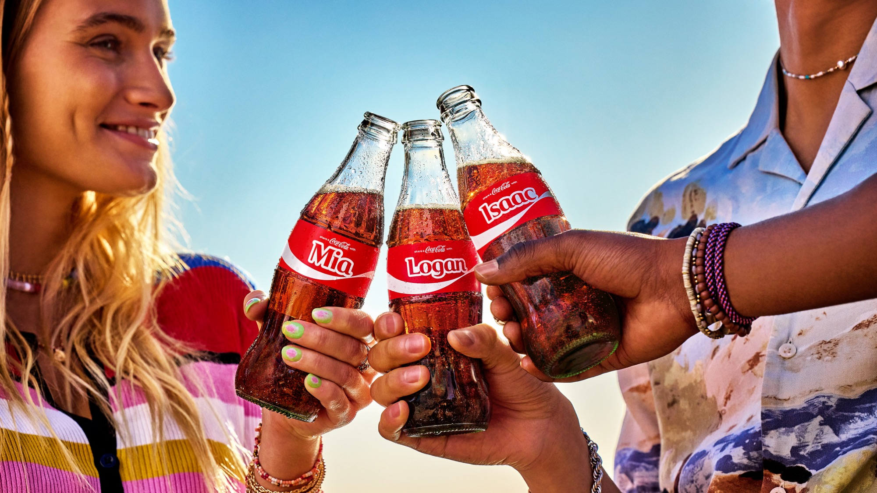
Have a Coke and a Smile

Slide 46

New Coke (Bring Back Old Coke Pls)

Slide 47

SUCCESES!

Slide 48
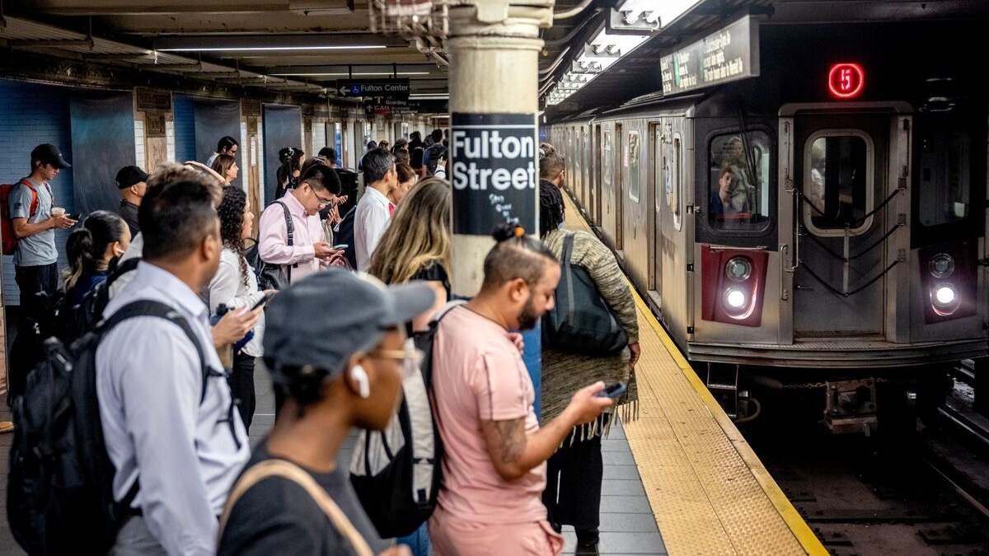
What are You Listening To?

Slide 49
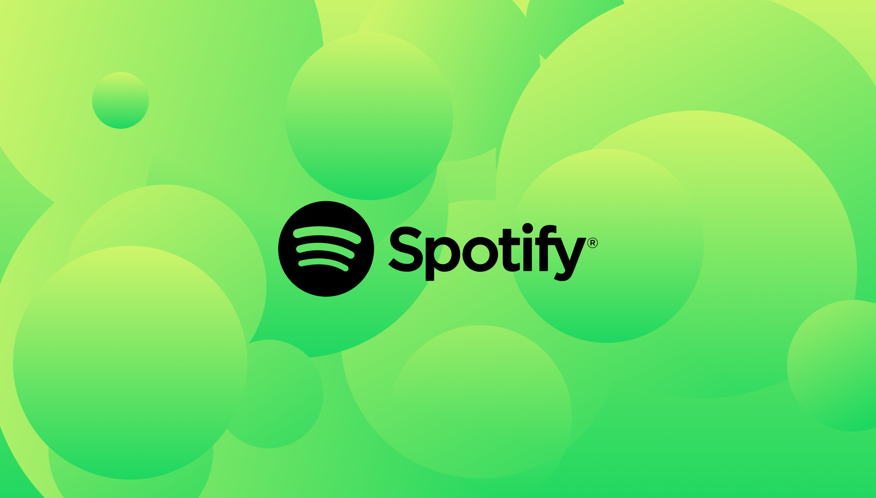
Spotify!

Slide 50
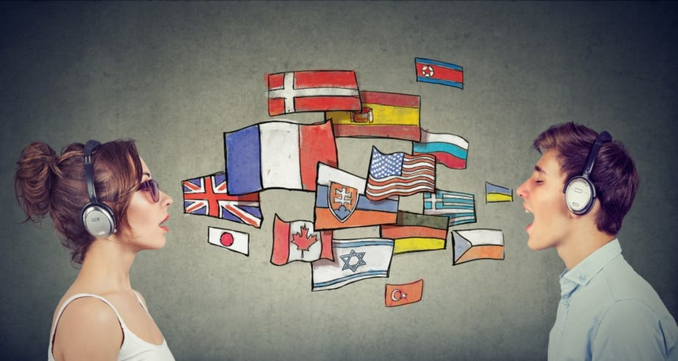
Let’s Talk!

Slide 51

Let’s Keep Talking!

Slide 52
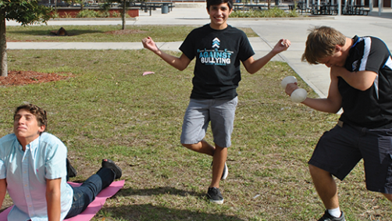
Get Active!

Slide 53
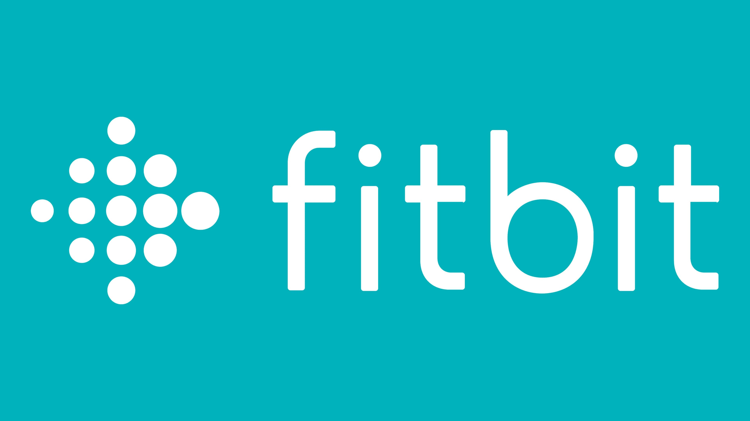
Stay Active!

Slide 54

Taking a Ride…

Slide 55

With Uber!

Slide 56
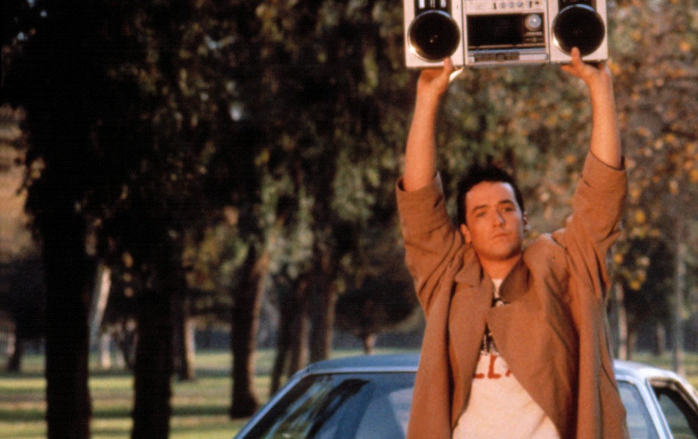
Say Anything!

Slide 57
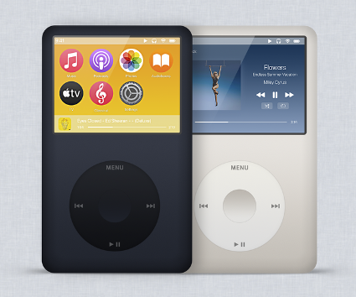
I’m Listening…

Slide 58
Break time??

Slide 59
Now it’s activity time! Hooray!

Slide 60
Set up
Split up into groups of 3 to 5
As a group, pick a number between 1 and 50
Based on your number, I will give you a household item with adjectives and its accessibility feature

Slide 61
How it works
Your team needs to come up with the following:
3 Personas of the End Consumer for this product
5 User Stories that identify a Persona, an Action, and a Benefit
As a…I want…so that.
Heather, Matt, and a special guest will be the judges
They are looking for Personas and Stories that identify and address the core need
Don’t forget the adjectives!
Don’t forget to drill down and refine or they’ll send you back to work!

Slide 62
Wrap up
Open Discussion…
In your role at APH or in the outside world, how will you use this new skillset you’ve learned today?
How might this help in your personal life?
Anything else?

Slide 63
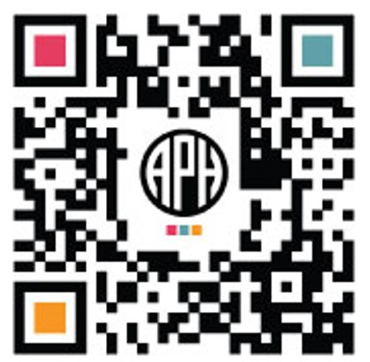
ACVREP Submission www.aphhive.org
Enter Hive with QR code
Select sign-in
Click “Event Certificate Request”
Enter opening and closing codes
Click “Validate Codes”
Notes:
Review slide

Slide 64
THANK YOU!

