Slide 1

APH Jeopardy!
Your Mission to Learn, laugh, and level up!

Slide 2
Learning Objectives
Identify key literacy and technology products offered by APH and describe their relevance in supporting students with visual impairments.
Analyze common scenarios encountered by Ex Officio Trustees and propose appropriate solutions using available APH resources and services.
Evaluate the roles and responsibilities of Outreach Team members and explain how to leverage their support in your region.

Slide 3
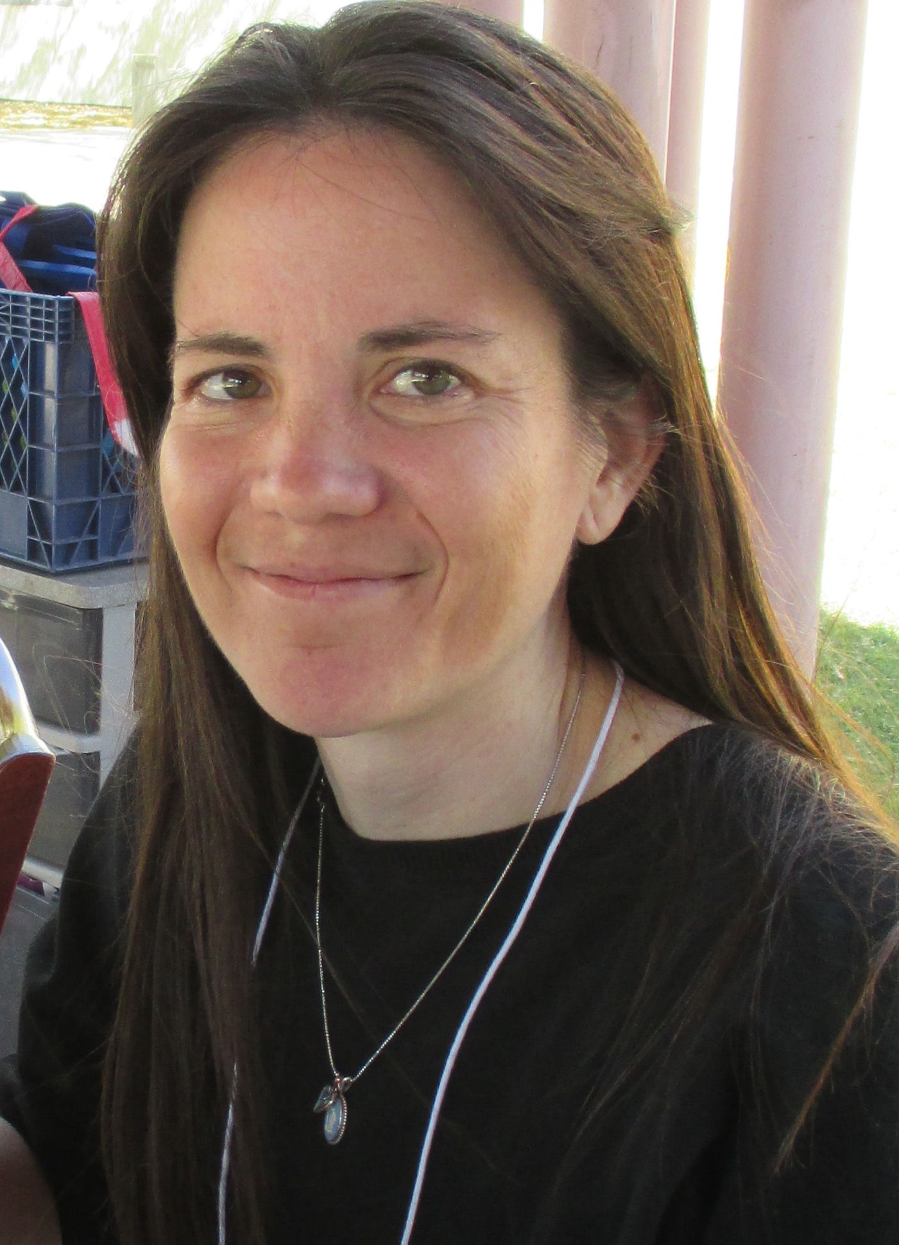
Host: Jenny Wheeler
APH Outreach Specialist; Southwest Region
15 years, Teacher of Students with Visual Impairments & COMS
20 years, certified Braille Transcriber
jwheeler@aph.org

Slide 4

Host: Alicia Wolfe
APH Outreach Specialist; Southeast Region
Master of Science Visual Disabilities
27 Years, Teacher of Students with Visual Impairments
awolfe@aph.org

Slide 5

Your Mission to Learn, Laugh, and Level Up!
October 17, 2025
APH 157th Annual Meeting
Notes:
Choose a score keeper from audience.
Get chocolate or treats for the crowd.
What is our budget for give aways?
Alicia sound effects.

Slide 6
APH JEOPARDY!
Literacy | Technology | What would you do? | Outreach | APH or Regional Trivia
$100 | $100 | $100 | $100 | $100
$200 | $200 | $200 | $200 | $200
$300 | $300 | $300 | $300 | $300
$400 | $400 | $400 | $400 | $400
$500 | $500 | $500 | $500 | $500
Notes:
Regional Trivia
Double Jeopardy – double amount
Lit – Alicia
Tech – Jenny
WWYDo? Alicia
Outreach Jenny
Regional Shared 1-3 (all other regions) Alicia, 4-5 JW (NW & SW)
Alicia SE, NC, SC

Slide 7

ACVREP Submission www.aphhive.org
Enter Hive with QR code
Select sign-in
Click “Event Certificate Request”
Enter opening and closing codes
Click “Validate Codes”
Notes:
Review slide

Slide 8
THANK YOU!

