Slide 1

Breaking barriers in digital learning
Challenges & Opportunities

Slide 2
Materials in K-12
Today’s classrooms rely on both print and digital resources.
Teachers pull from a range of digital and print materials in their teaching.
Multiple strategies are needed to ensure student access.

Slide 3
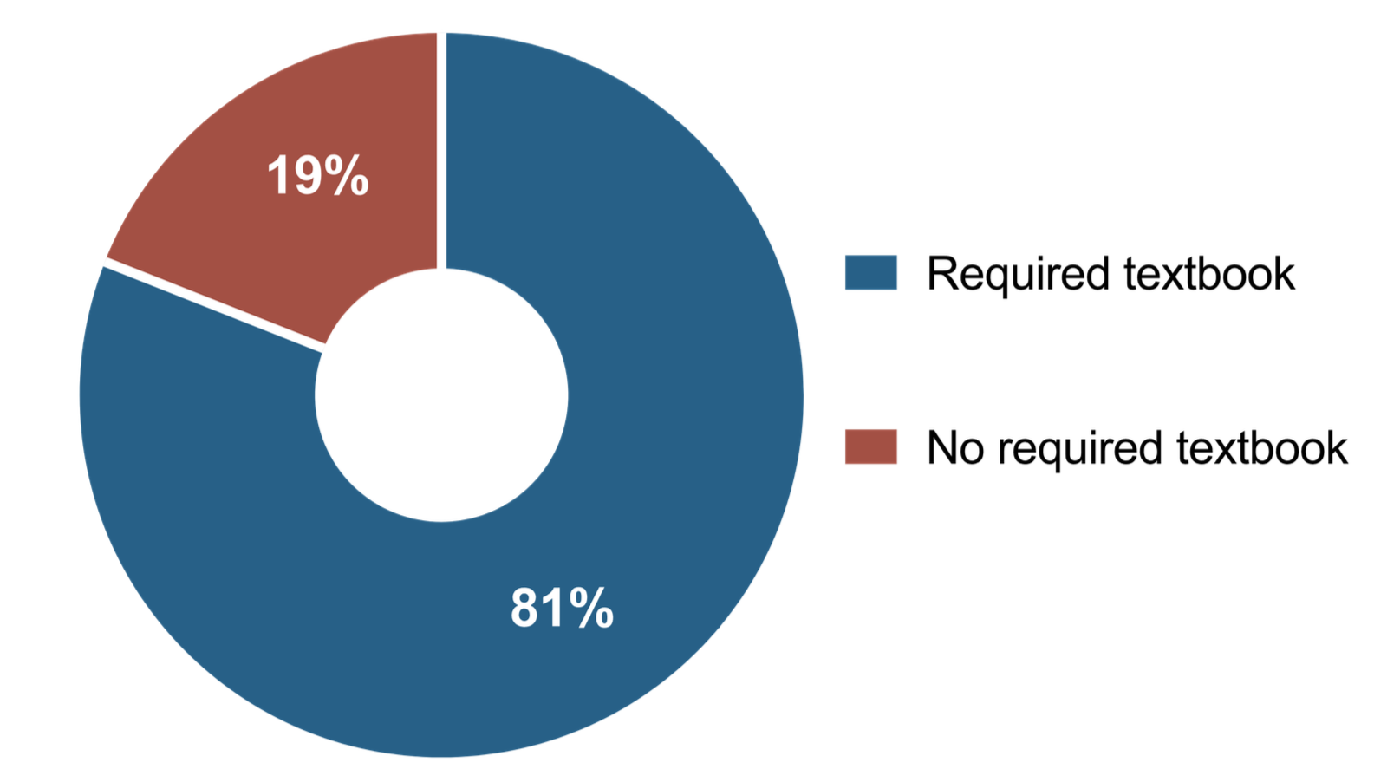
Use of a core textbook
81% of teachers surveyed in 2025 required a textbook.

Slide 4
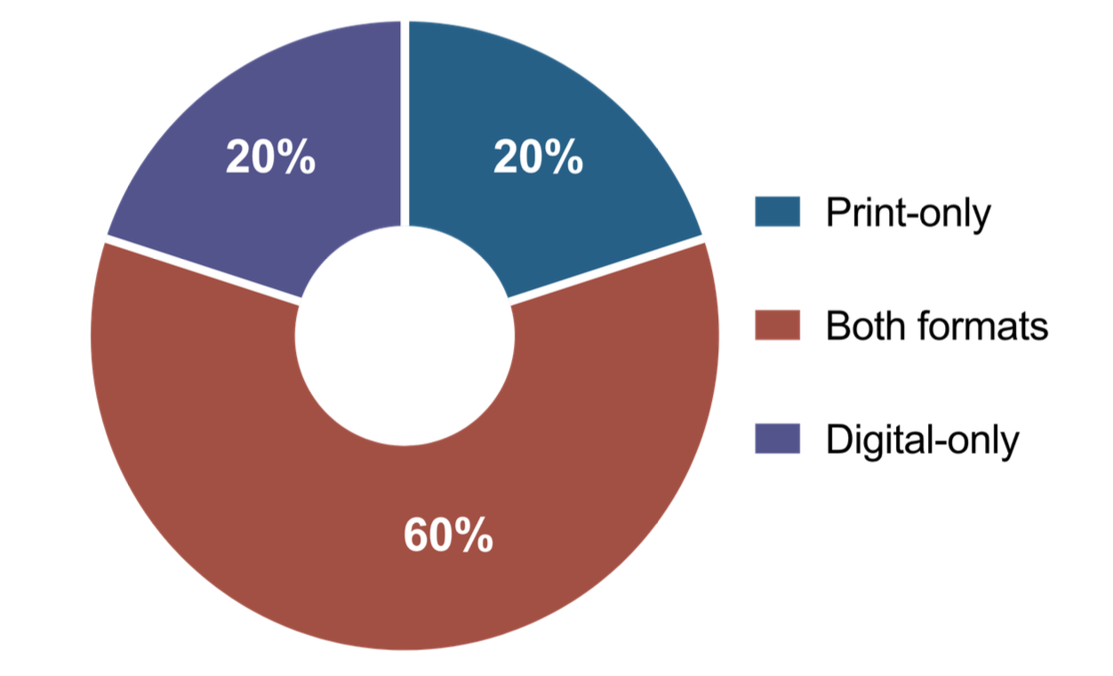
Textbook format
60% of teachers used both digital and print for the core textbook in the classroom.

Slide 5
Today’s teachers are “cobblers”
Most teachers mix and match materials to teach their classes.
Nearly one-half of teachers reported using curriculum material that they created themselves.

Slide 6
No such thing as a “typical classroom”
“There is no typical classroom when it comes to material formats and the adoption of digital tools, even if the content may be similar.”
Digital materials used by teachers include a range of materials that may or may not be obtained through a procurement process.

Slide 7
Digital materials and the NIMAC
NIMAC was given the green light by the Department to accept NIMAS for some digital materials in May of 2020.
Digital materials meeting WCAG 2.0 AA are exempt.

Slide 8
Digital materials in the NIMAC
File submissions for digital materials have been light. (Currently, 253 out of 84,759 files.)
Total file submissions to the NIMAC – and downloads – are increasing.

Slide 9
NIMAC Inventory and Downloads
Inventory is up 67% this year relative to 2020, while last year was over double 2020 submissions.
Downloads in the past 5 years also continue upward, with downloads this year being 41% higher than in 2020.

Slide 10
Overarching accessibility strategies: instructional materials procurement
Print materials → NIMAS → Accessible Formats
Digital materials → WCAG 2.1 AA → “Born Accessible”

Slide 11
Where are we today with accessibility of digital instructional materials?

Slide 12
Digital Materials Accessibility Challenges: Key Themes
Inaccessibility of platforms and content (especially images and math)
On-going lack of understanding in Gen Ed that digital does not equal accessible
Inadequate lead time for vetting instructional materials or remediating digital content
Difficulty obtaining a source file when braille or LP is required
Inaccessibility of teacher-created materials including “real-time” content creation (e.g., Smart Board)

Slide 13
A recent TVI quote
“I think the biggest challenge I have is getting the student's teachers to understand that even though it is digital it isn't accessible. [….] Most of the time when the material is inaccessible it takes a million more steps for my student to make it usable compared to their peers. Also, the younger the student, the more difficult the task becomes trying to use it. Which ultimately leads to the student not participating.”

Slide 14
Digital Accessibility: Solutions
ADA Title II (and other policy solutions?)
Technical Assistance/Training
New Technology and Formats
Creative Strategies for Serving Students . . .

Slide 15
Ice breaker
What curriculum trends are you seeing in 2025?
Are you seeing an improvement in accessibility in digital materials?

Slide 16
Accessibility and ADA Title II
ADA Title II is a key policy change that will move accessibility of digital materials forward by requiring that apps, websites, online curriculum and platforms be WCAG 2.1 AA-compliant.
What TA and resources are available to support SEAs and LEAs in implementing the new requirements?
How is your company, organization, or state gearing up ADA Title II?

Slide 17
Inaccessibility of freely available digital materials
Are there additional policy-based strategies for ensuring the accessibility of Open Educational Resources (OER), teacher-created materials, and other freely available digital resources a teacher might use in the classroom?

Slide 18
Accessibility vs. usability
Learning and using multiple digital platforms can be challenging for students, especially for younger learners.
How can we ensure platforms are usable as well as accessible?
What specific strategies can support younger learners?

Slide 19
New tech and formats
What role will new and emerging tech play in supporting access to digital instructional materials?
Using APH as an example, what are some new products and apps that will move access forward for BLV students?

Slide 20
Lead time for remediating digital content
Are there practices that can be incorporated into procurement to ensure adequate lead time to review/remediate digital materials?
How are SEAs, LEAs, and publishers vetting to ensure that platforms and content meet accessibility requirements?

Slide 21
Obtaining a digital file when braille or LP is required by a student
What procurement-related strategies can help ensure a file will be available if braille or LP is required by a student, even if the digital content meets WCAG criteria?
How are publishers and agencies currently meeting this need?

Slide 22
Teacher-created content
How can we promote production of accessible teacher-created material?
What strategies are successful in providing accessibility in “real-time” instruction when inaccessible tech is used in daily instruction?

Slide 23
Supporting students
What recourse exists if materials are not accessible, and students are left to figure it out for themselves?
How can general education teachers and support staff most effectively support students when districts or schools adopt platforms that are not fully accessible?

Slide 24
Closing thoughts?
How can those of us here today help move things forward when it comes to the accessibility of digital materials?

Slide 25
Sources
Mixed Marks for Classroom Resources: Educational Resources in U.S. K-12 Education, 2025
Teachers’ Use of Instructional Materials from 2019–2024: Trends from the American Instructional Resources Survey

Slide 26
THANK YOU!

