Slide 1

Building a Foundation for THE Tactile Journey

Slide 2

Erin Weaver
Outreach Specialist Northeast Region
American Printing House for the Blind
Notes:
Erin’s experience working in the field of visual impairments extends over 30 years.
She has served as a TVI, and Orientation and Mobility Specialist in western New York and as the Coordinator of Statewide Education Services for the Blind and Visually Impaired for the Delaware Division for the Visually Impaired.
Erin has been involved in Camp Abilities, a sports camp for students with BVI for 15 years.

Slide 3
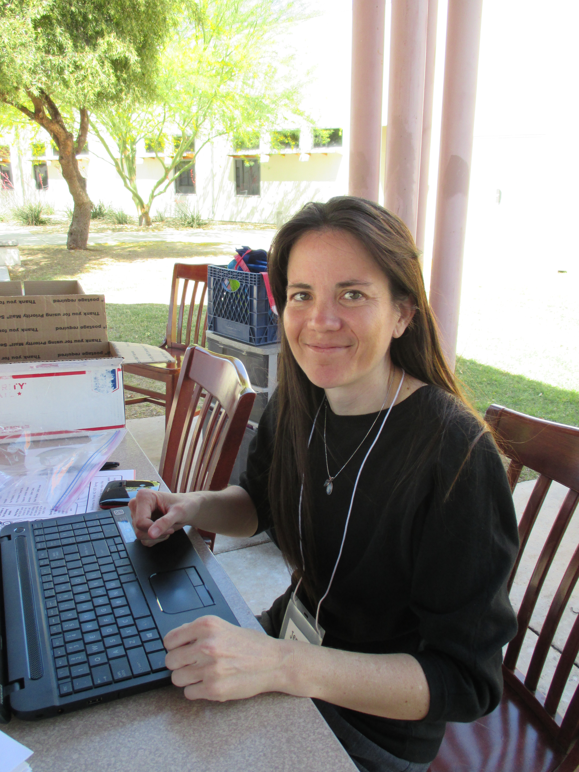
Jenny Wheeler
Outreach Specialist Southwest Region
American Printing House for the Blind
Notes:
JW

Slide 4
Objectives
Discuss the connections between braille literacy, tactile literacy, and tactile graphicacy for students with visual impairments
Use tactile learning principles and concepts to teach effective graphics reading and perceptual skills
Given an overview of available resources and tools for tactile graphics learning, consider how to evaluate students' tactile perceptual capability and identify new areas for development and progression

Slide 5
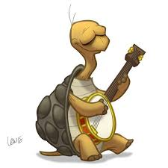


Your Icon Guide to the PowerPoint
Activity
Discussion
Championship Round

Slide 6
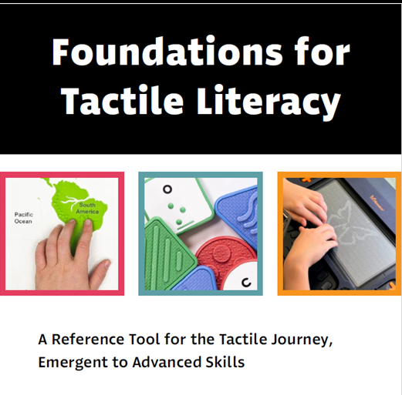
The Tactile Journey
Notes:
Living in a visually rich environment where written communication has become increasingly image-dependent over the past 5-10 years and students are constantly entertained with graphics brings the importance of Tactile Literacy to the forefront.
The ability to decode information presented as a graphic is an essential component of literacy. This document defines the skills and concepts of tactile learning, provides examples, and links products to skills and concepts.
The Foundations for Tactile Literacy: A Reference Tool for the Tactile Journey, Early to Advanced Skills can be used in a variety of ways to enhance your instructional practice. It can be used as a checklist, an informal assessment tool, or a source of data when conducting a Learning Media Assessment. This tool can also be used to assist in formulating Present Levels of Performance for an Individualized Education Plan (IEP), writing IEP goals, and progress monitoring. A final suggestion is to use the tool as a means of identifying and ordering ideal products to develop concrete educational strategies and activities for teaching tactile learning.
Advancements in technology have brought refreshable braille displays into reality, the introduction of multi-lined braille displays and other means of producing tactile graphics. It is imperative that students with visual impairments are afforded intentional opportunities to develop the skills and concepts necessary to gather information tactually and become efficient tactile learners.
RESOURCE:
Tactile Literacy Matrix https://www.aph.org/resources/tactile-skills-matrix/
Thank you to Karen Poppe, who began work in this area many years ago. Karen’s work, the Tactile Literacy Matrix, was the foundation that allowed us to springboard into planning for and developing The Foundations for Tactile Literacy: A Reference Tool for the Tactile Journey, Early to Advanced Skills

Slide 7
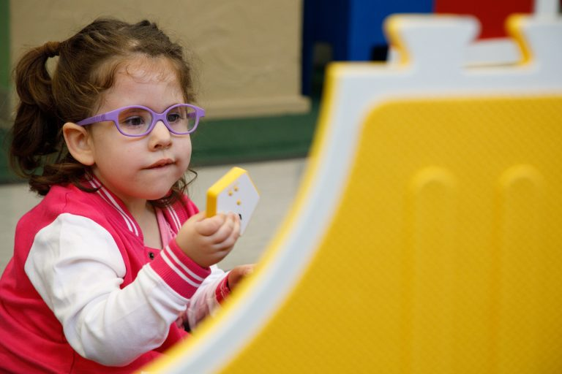
Overview – What & Why
The ability to decode information presented as a graphic is an essential component of literacy!
Skills and concepts of tactile learning
Many hands-on, practical examples
Links products, resources, and tools to skills and concepts
Teachers are encouraged to use this tool in a variety of creative ways to enhance their instructional practice
Notes:
Preface
Living in a visually rich environment where written communication has become increasingly image-dependent over the past 5-10 years and students are constantly entertained with graphics brings the importance of Tactile Literacy to the forefront.
The ability to decode information presented as a graphic is an essential component of literacy. This document defines the skills and concepts of tactile learning, provides examples, and links products to skills and concepts.
The Foundations for Tactile Literacy: A Reference Tool for the Tactile Journey, Early to Advanced Skills can be used in a variety of ways to enhance your instructional practice. It can be used as a checklist, an informal assessment tool, or a source of data when conducting a Learning Media Assessment. This tool can also be used to assist in formulating Present Levels of Performance for an Individualized Education Plan (IEP), writing IEP goals, and progress monitoring. A final suggestion is to use the tool as a means of identifying and ordering ideal products to develop concrete educational strategies and activities for teaching tactile learning.
Advancements in technology have brought refreshable braille displays into reality, the introduction of multi-lined braille displays and other means of producing tactile graphics. It is imperative that students with visual impairments are afforded intentional opportunities to develop the skills and concepts necessary to gather information tactually and become efficient tactile learners.
RESOURCE:
Tactile Literacy Matrix https://www.aph.org/resources/tactile-skills-matrix/
Thank you to Karen Poppe, who began work in this area many years ago. Karen’s work, the Tactile Literacy Matrix, was the foundation that allowed us to springboard into planning for and developing The Foundations for Tactile Literacy: A Reference Tool for the Tactile Journey, Early to Advanced Skills

Slide 8

Overview (2 of 3)
Foundations for Tactile Foundations works nicely as:
  a checklist
  an informal assessment tool
  a source of data for a Learning Media Assessment
  inspiration for teaching ideas, strategies, and materials to use in presenting skills and concepts
Notes:
The Foundations for Tactile Literacy: A Reference Tool for the Tactile Journey, Early to Advanced Skills can be used in a variety of ways to enhance your instructional practice.
It can be used as a checklist,
an informal assessment tool,
or a source of data when conducting a Learning Media Assessment.
RESOURCE:
Tactile Literacy Matrix https://www.aph.org/resources/tactile-skills-matrix/
Thank you to Karen Poppe, who began work in this area many years ago. Karen’s work, the Tactile Literacy Matrix, was the foundation that allowed us to springboard into planning for and developing The Foundations for Tactile Literacy: A Reference Tool for the Tactile Journey, Early to Advanced Skills

Slide 9
Overview (3 of 3)
Assists in formulating Present Levels of Performance for an Individualized Education Plan (IEP)
Guides creation of IEP goals and informs progress monitoring
Develops concrete strategies and activities for teaching tactile learning
Helps teachers identify and obtain ideal, complementary devices, tools, and activity materials
Now that multi-line braille displays and other means of producing electronic tactile graphics are a reality, students with visual impairments must have intentional opportunities to learn to gather information tactually and become efficient tactile learners!
Notes:
This tool can also be used to assist in formulating Present Levels of Performance for an Individualized Education Plan (IEP),
writing IEP goals,
and progress monitoring.
A final suggestion is to use the tool as a means of identifying and ordering ideal products to develop concrete educational strategies and activities for teaching tactile learning.
Advancements in technology have brought refreshable braille displays into reality, the introduction of multi-lined braille displays and other means of producing tactile graphics. It is imperative that students with visual impairments are afforded intentional opportunities to develop the skills and concepts necessary to gather information tactually and become efficient tactile learners.
RESOURCE:
Tactile Literacy Matrix https://www.aph.org/resources/tactile-skills-matrix/

Slide 10
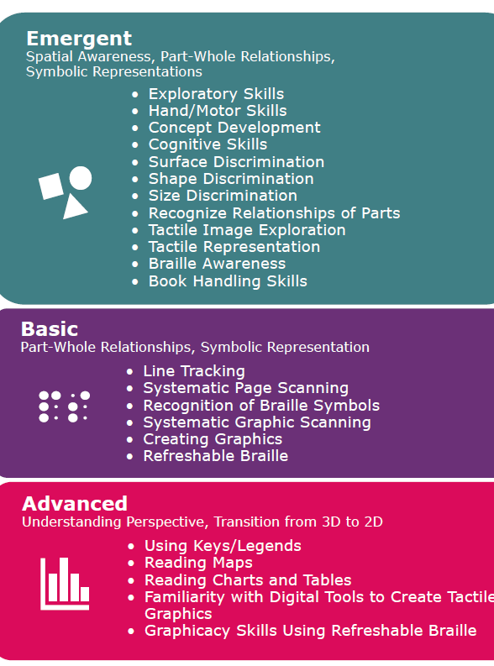
Tactile Skills
Emergent
Spatial Awareness
Part-Whole Relationships
Symbolic Representations
Basic
Part-Whole Relationships
Symbolic Representation
Advanced
Understanding Perspective
Transitioning from 3D to 2D
Notes:
NOT LINEAR
https://www.aph.org/resources/tactile-skills-matrix/
chrome-extension://efaidnbmnnnibpcajpcglclefindmkaj/https://media.aph.org/app/uploads/2025/04/Foundations-for-Tactile-Literacy.pdf
The Foundations for Tactile Literacy: A Reference Tool for the Tactile Journey, Early to Advanced Skills can be used in a variety of ways
enhance your instructional practice.
checklist
informal assessment tool
source of data when conducting a Learning Media Assessment
assist in formulating Present Levels of Performance for an Individualized Education Plan (IEP)
writing IEP goals
progress monitoring
a means of identifying and ordering ideal products to develop concrete educational strategies and activities for teaching tactile learning

Slide 11
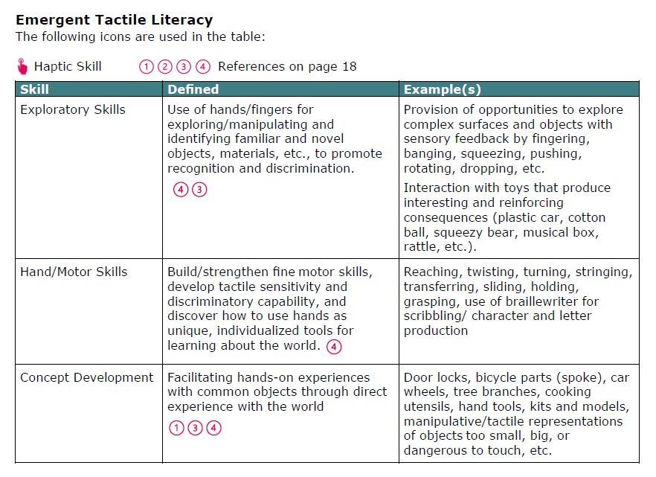
Emergent Tactile Literacy
Notes:
NOT LINEAR
https://www.aph.org/resources/tactile-skills-matrix/
chrome-extension://efaidnbmnnnibpcajpcglclefindmkaj/https://media.aph.org/app/uploads/2025/04/Foundations-for-Tactile-Literacy.pdf
The Foundations for Tactile Literacy: A Reference Tool for the Tactile Journey, Early to Advanced Skills can be used in a variety of ways
enhance your instructional practice.
checklist
informal assessment tool
source of data when conducting a Learning Media Assessment
assist in formulating Present Levels of Performance for an Individualized Education Plan (IEP)
writing IEP goals
progress monitoring
a means of identifying and ordering ideal products to develop concrete educational strategies and activities for teaching tactile learning

Slide 12
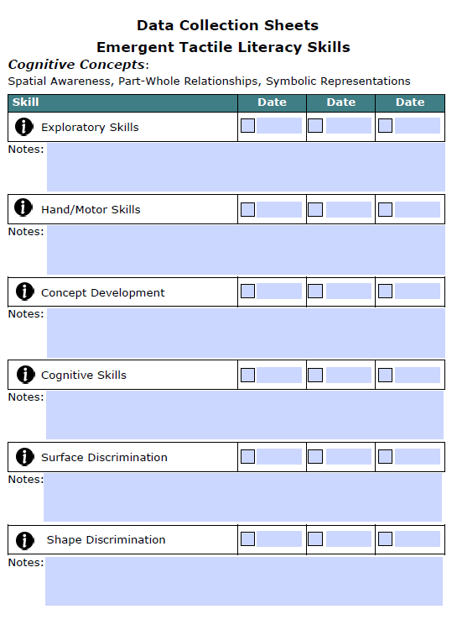
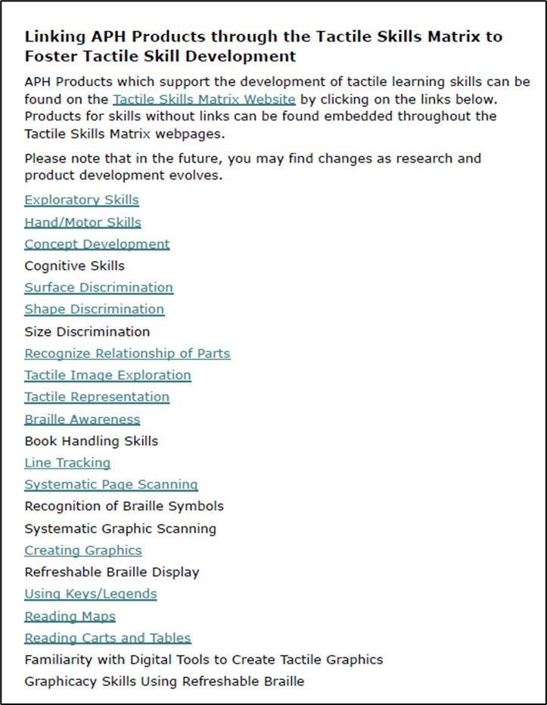
Data Collection Sheets
Emergent Tactile Literacy Skills
Notes:
NOT LINEAR
https://www.aph.org/resources/tactile-skills-matrix/
chrome-extension://efaidnbmnnnibpcajpcglclefindmkaj/https://media.aph.org/app/uploads/2025/04/Foundations-for-Tactile-Literacy.pdf
The Foundations for Tactile Literacy: A Reference Tool for the Tactile Journey, Early to Advanced Skills can be used in a variety of ways
enhance your instructional practice.
checklist
informal assessment tool
source of data when conducting a Learning Media Assessment
assist in formulating Present Levels of Performance for an Individualized Education Plan (IEP)
writing IEP goals
progress monitoring
a means of identifying and ordering ideal products to develop concrete educational strategies and activities for teaching tactile learning

Slide 13
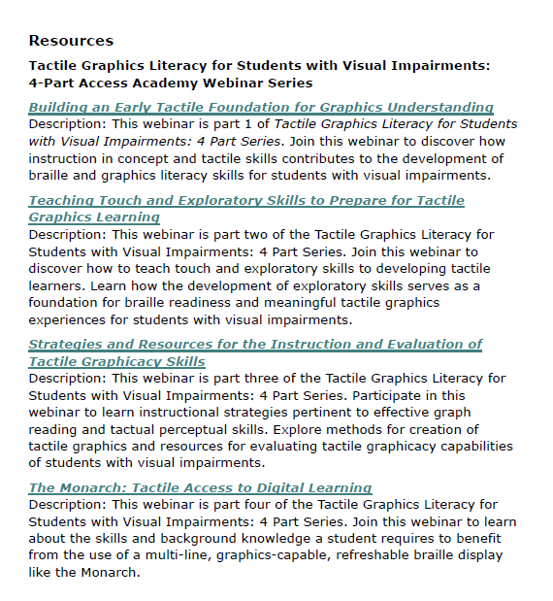
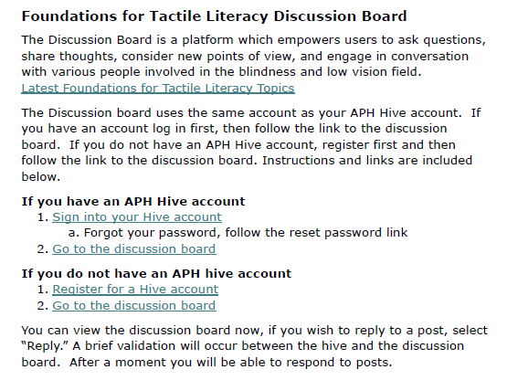
Resources
Notes:
NOT LINEAR
https://www.aph.org/resources/tactile-skills-matrix/
chrome-extension://efaidnbmnnnibpcajpcglclefindmkaj/https://media.aph.org/app/uploads/2025/04/Foundations-for-Tactile-Literacy.pdf
The Foundations for Tactile Literacy: A Reference Tool for the Tactile Journey, Early to Advanced Skills can be used in a variety of ways
enhance your instructional practice.
checklist
informal assessment tool
source of data when conducting a Learning Media Assessment
assist in formulating Present Levels of Performance for an Individualized Education Plan (IEP)
writing IEP goals
progress monitoring
a means of identifying and ordering ideal products to develop concrete educational strategies and activities for teaching tactile learning

Slide 14
Evaluation of Tactile Skills
Assists in determining the need for additional evaluation and instruction of specific tactile skills
Can be used to develop a “Tactile Profile” for students with visual impairments who:
  are chronologically or developmentally functioning between the ages of birth to 5 years old
  have struggled with the acquisition of tactile skills, or have not made expected progress
  may be considered “non-traditional tactile learners” or “non-readers”

Slide 15
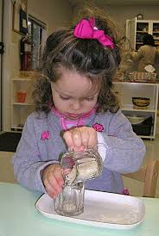
Importance of a Tactile Skills Profile
Effective use of touch to gather information goes beyond matching textures, recognizing shapes, and tracking
Tactile inefficiency is a common difficulty for students with visual impairments
Even accomplished braille readers may have limited knowledge of the tactile features of an object
Need to evaluate at every stage of development:
  Exploratory procedures
  The broad spectrum of functional tactile skills as part of the LMA
  Collaborate with an OT and other members of the educational team

Slide 16
Concept development and early literacy

Slide 17
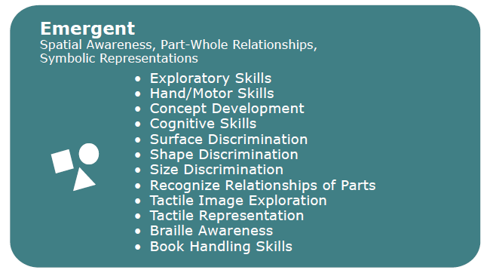
Emergent Tactile Skills

Slide 18

Graphics Learning Begins with Concepts
To understand tactile graphics, students with visual impairments first need firm concepts about the objects or ideas they represent
Pictures reinforce our visual concept of an object – this is not the same for a student with a visual impairment

Slide 19

What is a Concept?
An idea formed about something by mentally combining all of its available characteristics and details
Conceptual understanding requires knowledge of qualities and functions of people, places, and objects
As information is gathered, concepts become clearer
Conceptual structures are formed from social interactions, language development, and experiences

Slide 20
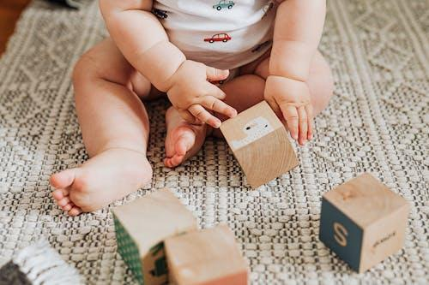
Concept Development
Through concept development, children begin to understand their relationships to each other, to their environments, and to objects in those environments
Concept development is often experienced and achieved through play, pretend, imagination, and natural childlike creativity

Slide 21

The Role of Creative Play
Age 2 or 3: Children use words and images to represent experiences
Then: They begin to reconstruct the past and think about objects that are not present
Next: They use objects to represent other objects and to engage in simple pretend play
Examples: Children pretend to drink milk from an empty cup, or have conversations with their stuffed animals

Slide 22

Developmental Process
The child becomes aware that something (an object) exists
The child has both opportunity and motivation to interact with the object
Someone provides a label that the child associates with the object
The child becomes aware of other similar and different objects
The child is able to classify objects with different shapes, sizes, and materials that fit the concept it represents

Slide 23
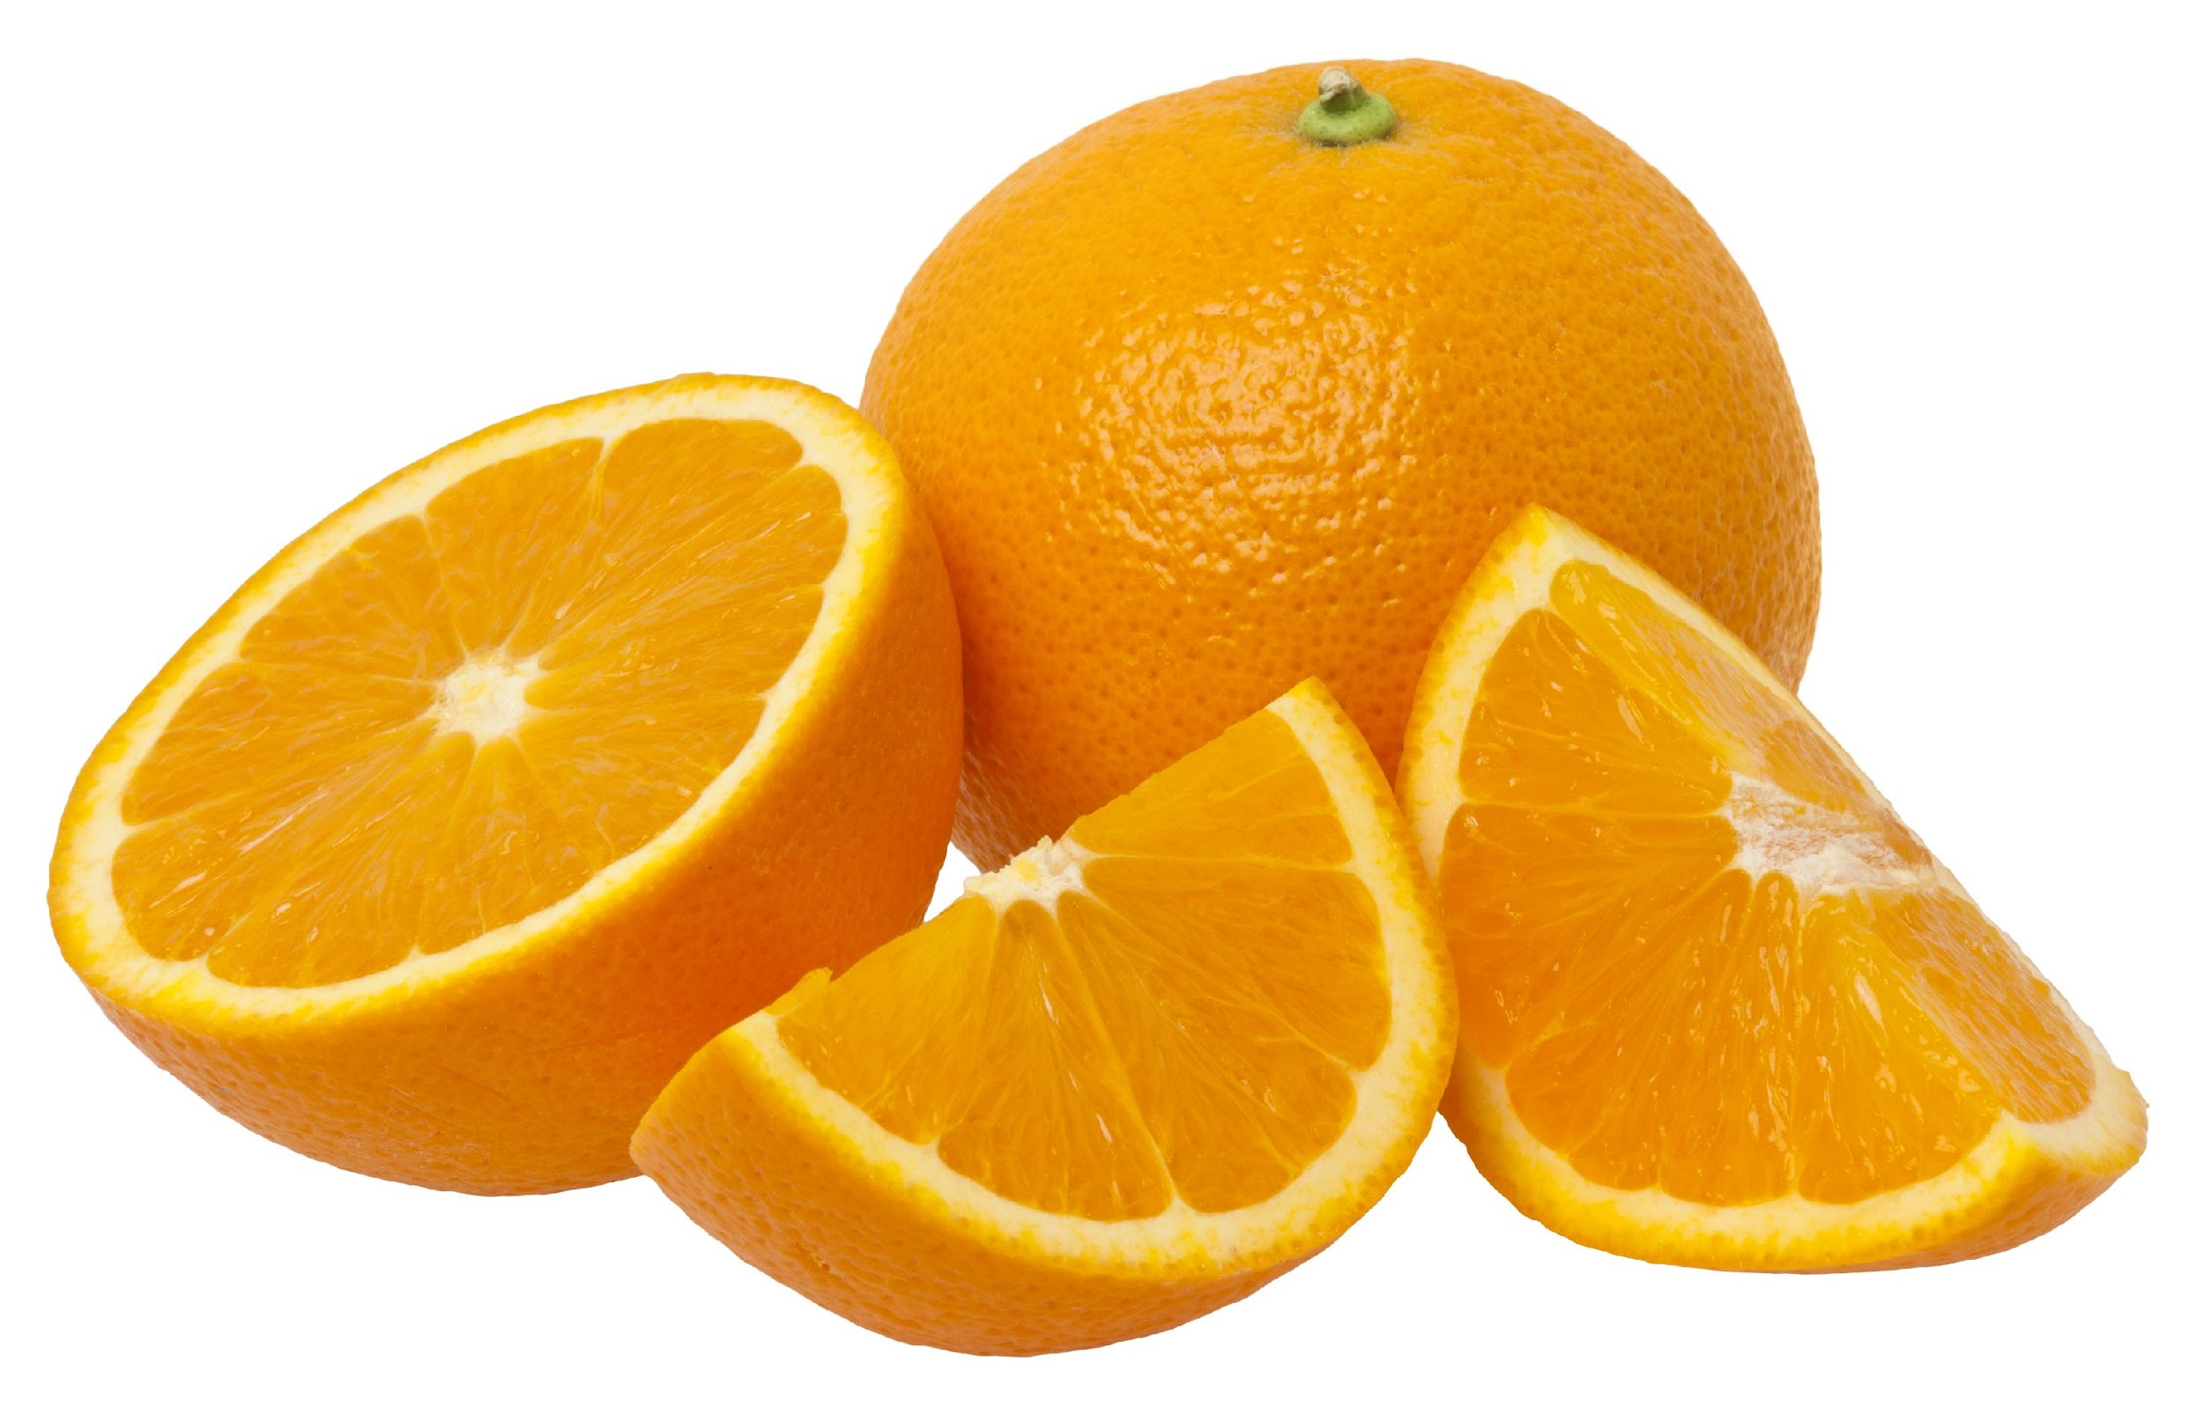
Verbalize the Concrete
For young children, real objects found in their daily environment are key
  Which shoelace is longer?
  What shape is this ball? It's square! (just kidding)
  Why does this orange piece look different from the whole orange?
  Does this blanket feel poky, or is it soft and fuzzy?
  This book is big. This one is little! Which one should we read?

Slide 24
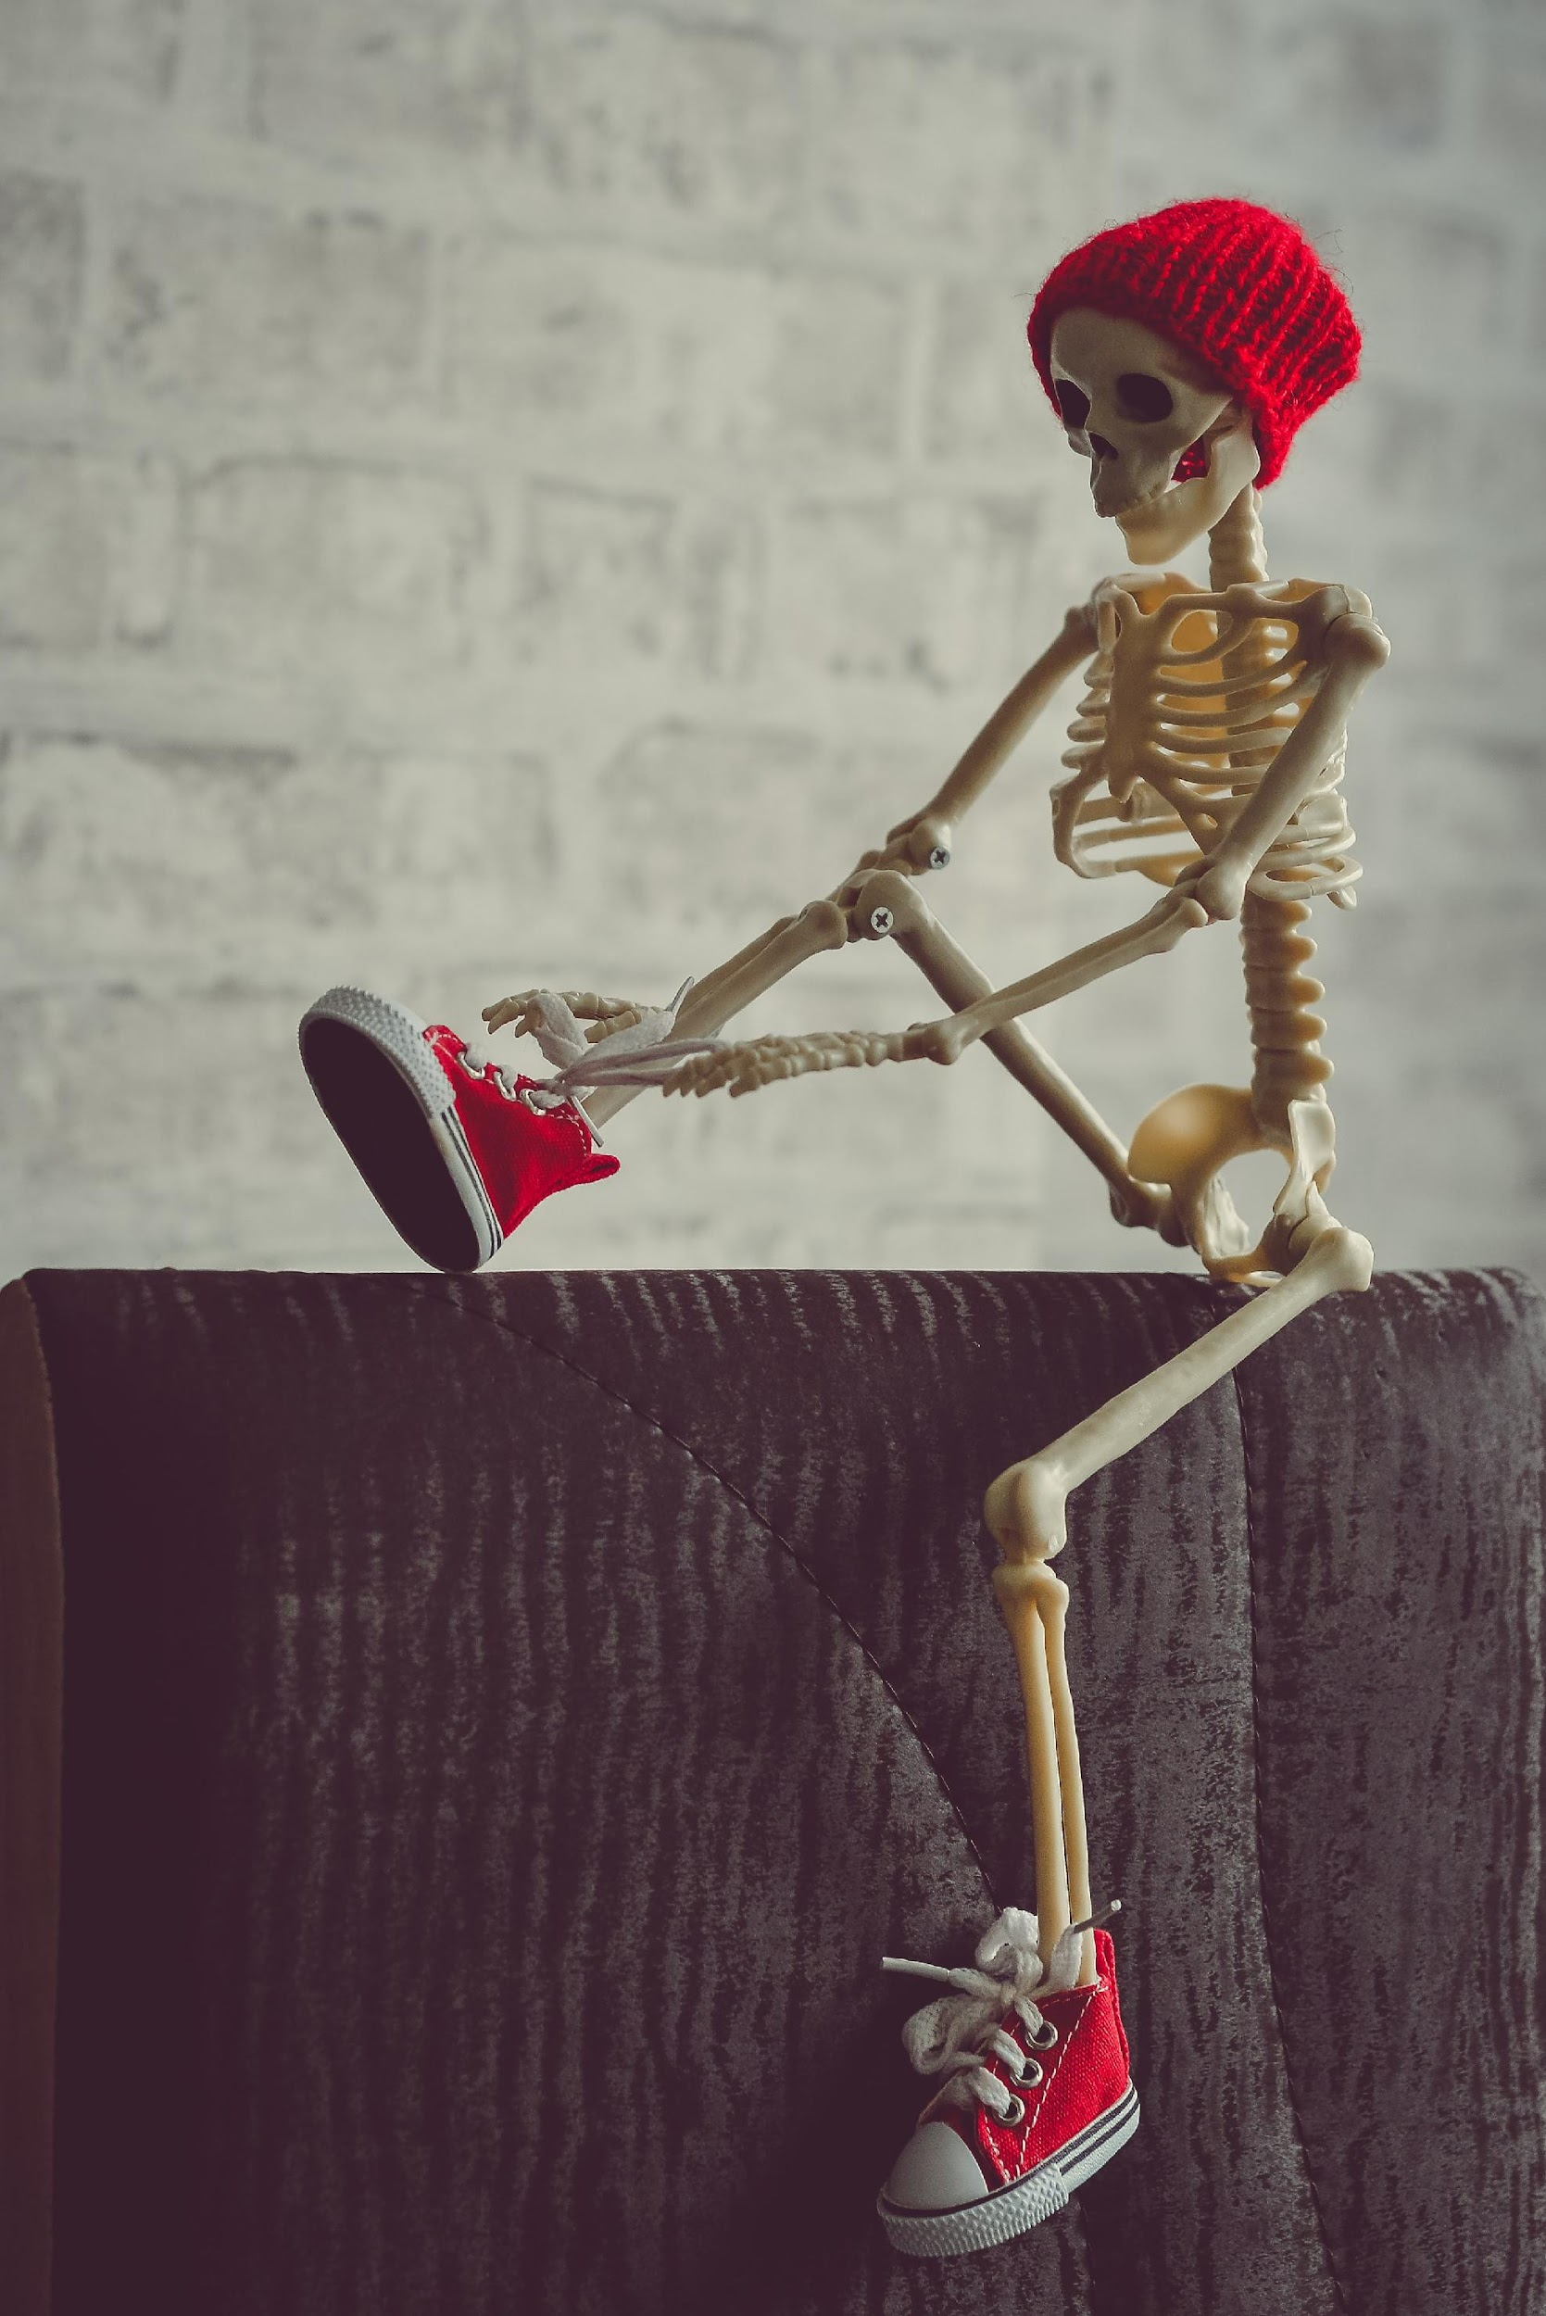
Concept Development Follows Patterns
Simple to complex: Leg – knee
Gross to fine: Toes – toenails
Functional to abstract: My foot – my chair's foot
Egocentric to exocentric: Awareness of body parts – relationships between body parts and self – relationships to others – relationships with objects
Midline to lateral: Toys in front – toys to the side or behind
Proximal to distal: Objects closer to the body – objects farther from the body
Horizontal to vertical to diagonal: Tracking horizontally – tracking vertically

Slide 25
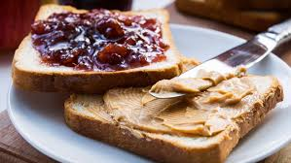
Concepts in Daily Life
"Will you make a peanut butter and jelly sandwich?“
At least 26 basic concepts
We must ensure young learners with visual impairments have a broad concept base!

Slide 26
Let’s Talk …
What is another example of a seemingly simple task that is loaded with complex concepts?

Slide 27
Championship Round

Slide 28

Whole to Part, Part to Whole
The learner with a visual impairment:
  Relies on sequential observations
  Only part of an object can be explored with the hands at a time
  The entire image must be built out of components

Slide 29

Fill in the Gaps
Gaps are more obvious and anticipated with congenitally blind children
Children with low vision often receive incomplete or inaccurate sensory information
Very important to look for/perceive gaps and correct misconceptions

Slide 30

Critical Graphics Concepts
Body awareness
Shapes
Sizes
Relationships
Comparisons
Textures
Positional Concepts
Spatial Concepts
Object Concepts

Slide 31

The Role of the Educational Team
Everyone can be involved in concept development and emergent literacy!
  Family members
  Classroom teachers
  PE teachers
  Therapists and specialists
An approach to teaching and common vocabulary can be developed together
Emphasis should be on meaningful, individualized, experiential learning opportunities

Slide 32
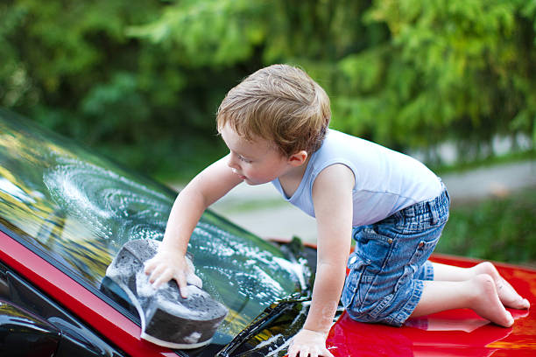
Parents and Caregivers
Parents often benefit from guidance on how to actively involve children and successfully introduce concepts can't be learned casually and incidentally
Opportunities abound everywhere!
  Petals on a flower or branches on a tree
  Parts of a car or bicycle
  Different kinds of rocks in the garden
  Comparisons of chairs and tables

Slide 33

Parents and Caregivers (2 of 3)
Parents can be encouraged to expand conversations by asking questions AND labeling
  Tell me more about elephants. Are they big or small? How do you know?
  Look at this rotten banana. What happened here?
Keep the conversation open
  How can I help my child understand an elephant?

Slide 34
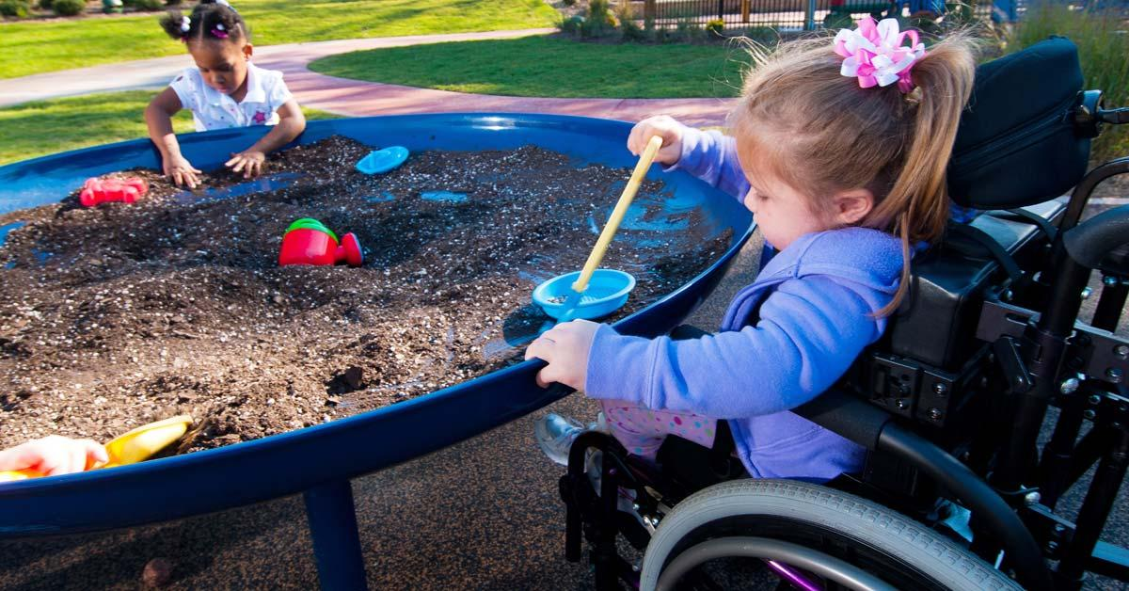
Parents and Caregivers (3 of 3)
Parents and other team members can work together to:
  Design and create fun, accessible, and active play environments
  Describe details, properties, meaning, purposes, and functions
  Use consistent terminology

Slide 35
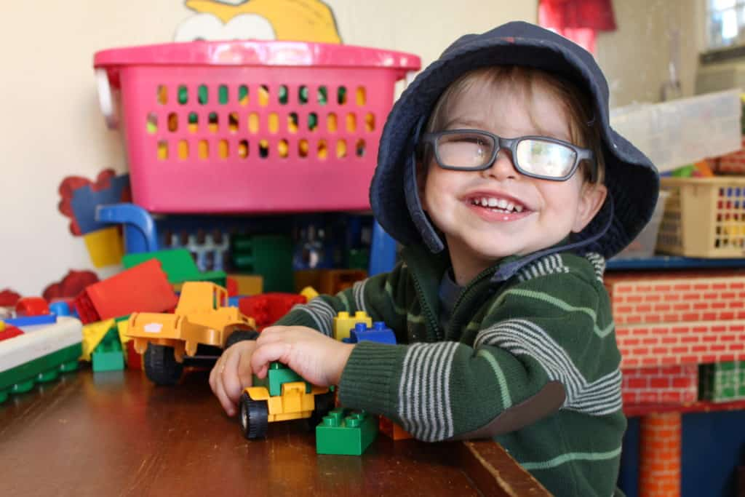
Foster Enthusiasm and Curiosity
Enthusiasm is built through success at finding information independently
Curiosity and willingness increase
A child becomes a "do-er" as opposed to being "done to"
Positive self-concept
Notes:
Think again about making a peanut butter sandwich. A young child watching all of the steps happening to make that sandwich could then pretend to do so for a toy, and then, if given the opportunity, would try with the real materials. How do our children become enthusiastic about learning if we are never giving them the opportunity to learn?

Slide 36
Let’s Talk …cont.
What unique aspect about your role in the field provides opportunities to engage with and encourage parents (directly or indirectly) as they teach early literacy concepts to their children?

Slide 37
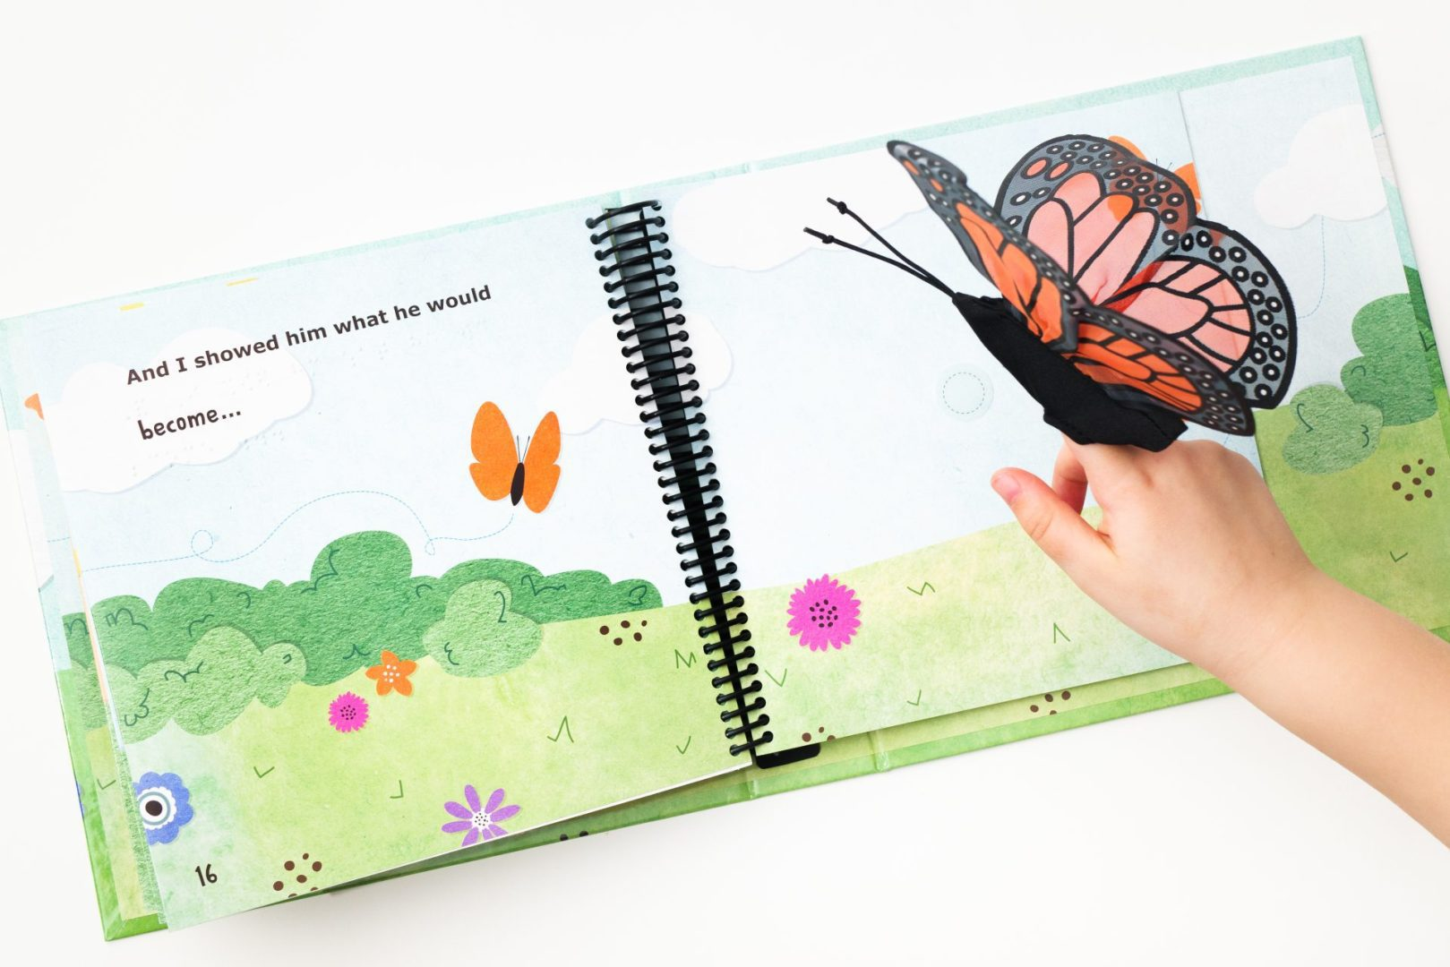

Concepts Activity
Notes:
Let me share an example of understanding & producing grap hics within an O&M context.

Slide 38
Concepts Activity: On the Way to Literacy
Form a group and choose an On the Way to Literacy book!
Examine the text and the pictures together
Identify one person to briefly summarize the story for the group
Choose one picture to explore with more depth
Name at least five concepts the picture conveys and five words that are critical to fully accessing and understanding it
Choose one of these concepts. How would you explain this concept using 1) this picture, 2) some or all of these words, 4) manipulatives, 3) lived experiences, and 5) a game or creative activity?
One takeaway for the whole!

Slide 39
Championship Round, cont.

Slide 40
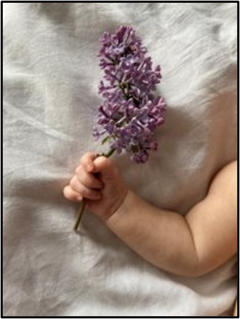
basic Tactile Skills: Exposure, Experience, and Exploration

Slide 41
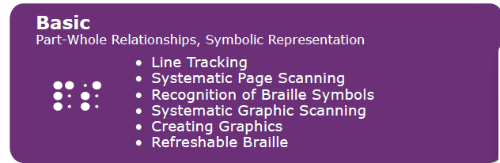
Basic Tactile Skills

Slide 42
Exposure, Experience, and Exploration
Three keys to teaching our students the literate touch skills they will need: Exposure, Experience, and Exploration
These help to build a child's motivation, enthusiasm, and curiosity to further explore the world
Sometimes students may have gaps in their learning and understanding
Bringing our learners back to these early foundational skills is the key to moving them toward independence with more complex skills

Slide 43

Exposure
Notes:
Our little learners need plenty of exposure to various textures and surfaces to help them develop awareness and attention as they grow
Includes being tactually and verbally introduced to real objects, braille, and tactile illustrations
Brings awareness of the existence of things, causes, and effects
Stimulates curiosity and activates the imagination
Feeds the mind with information that can be varied or consistent, random or sequenced, tangible or undefined
Contributes to a foundation for comparing, categorizing, comprehending, and eventually communicating about the world
Textures
Temperature
Vibration
Shapes
Structures
If we can strategically think about the textures in our little learners’ world, we can gently expose them to interesting features at a very young age
Include whole body experiences
If they’re reluctant with their hands, try the feet!
Provide learners with a rich environment of tactile variety
Textures (scratchy, hard, soft, fluffy, rubbery, squishy…)
Temperature (cold, warm)
Vibration patterns and sensations
Shapes (circle, square, triangle)
Structures (big, small, in-between)
This picture shows a child holding a flowering branch
Feel and smell of the flower are unique compared to any of the baby’s typical toys
Feedback from the touch
Weight of the flower and the stem bending as their arm lifts
So much information in such a simple object!
Try blankets with various textures (quilts are great for this): lace, corduroy, leather, and more! ​
Different types of clothing ​
Moveable parts​ and sounds
Games to bring hands to midline​
Games to incorporate hands, feet, fingers, toes, etc

Slide 44

Allow Exposure
Active involvement with others
Experience, play, and engagement, not just vocabulary and language
Developing concepts of "chair-ness", “truck-ness"
Beginning to identify characteristics and features of things encountered
Notes:
Example: A five-year-old student who is blind is asked to get a chair from a nearby room. After some time, she returned without the chair, stating there wasn’t one. The teacher knew that another child had taken a chair into that room earlier. She went back with the student and noted that the chair was in the middle of the room. The student went right to it and said, “this is all I found in the room.” The teacher said, “Yes, that’s the chair. It’s upside down. Let’s turn it over and take it with us.” This is an important reminder that the perspective of our student can be fragmented until a solid foundation is established. Our student in the example did not have experience with chairs in any other position than upright. The one in the room did not match her idea of ‘chair-ness’. The picture on the screen is a line drawing of a chair tipped on its side. Think of how this is different than a tipped classroom chair – the importance of concepts before tactile pictures should come to mind.
Think of a truck. Your student might only have experienced the cab of a pickup truck. What about a mail truck, ice cream truck, semi, or logging truck? In order to compare, categorize, comprehend and communicate about trucks our student needs to exposure to many different types.

Slide 45
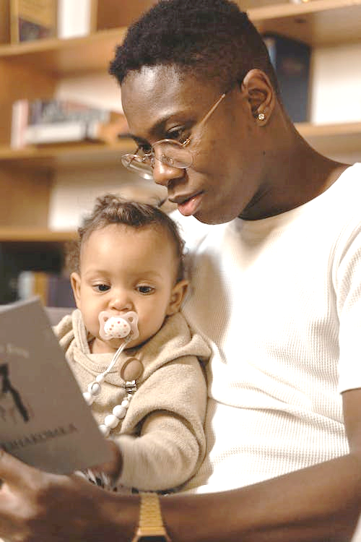
Books
Reach out and touch
Actively explore
Orient to the top left of the page
Use both hands
Isolate fingers
Encounter and recognize symbols
Notes:
Books as a Sensory Experience
When books are incorporated into a routine with trusted and loved adults, reading is a motivating and fun activity for everyone
How do we encourage using hands and fingers to develop effective search patterns?
“Feely” books with many textures, pockets, and interactive features
Story boxes and bags invite active engagement
Pair use of real objects from the natural environment to add excitement and encourage exploring
Skills – turning pages, orienting front/back​
Concepts – page numbering, placement of text smd pictures, beginning – middle – end
Discovery of Lines – curvy, straight, wavy, solid, dashed

Slide 46
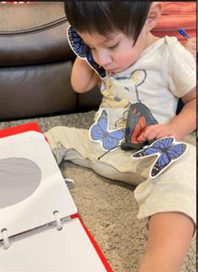
Graphics
“It has been found that tactile graphics assist a child to retain information and the more active the searching of the tactual information, the greater the understanding of the text.” (Curtin, 2019)

Slide 47
Graphics (continued)
When parents, teachers, and others reinforce ideas about the story through the tactile pictures, children:
  Are more attracted to the book
  Remain focused on the storytelling
  Better retain memory of the story or rhyme
Pictures begin to represent parts of the story
This is the beginning of a knowledge of symbolic representation
Children can make choices for their preferred books just by looking at graphics on the cover
This is only possible with repetitive exposure and experience!

Slide 48
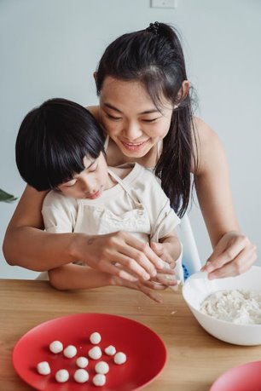
Experience
Notes:
To gain an understanding of the world in ways that give them realistic associations, children need to be able to process and interpret for meaning
Experience provides our learners with the opportunity to tie together features and concepts with understanding
Experience is doing!
More than just words!
Language is abstract and can be meaningless without real associations
It is possible for children to enthusiastically and accurately describe objects and living things without ever actually touching or experiencing them
Daily Life Activities
Real Objects
Everyday Items
Outdoors!
Sensory experiences are embedded into daily life
Mix everyday items into a child’s toy box
Typical cooking utensils
Tools
Self-care objects – hairbrushes, toothpaste
What can you find in the garage? What can you find at the doctor's office?
Use sensory items to mix up some homemade playdough
Outdoors – grass, leaves, sand
So many textures and sensations to experience!

Slide 49
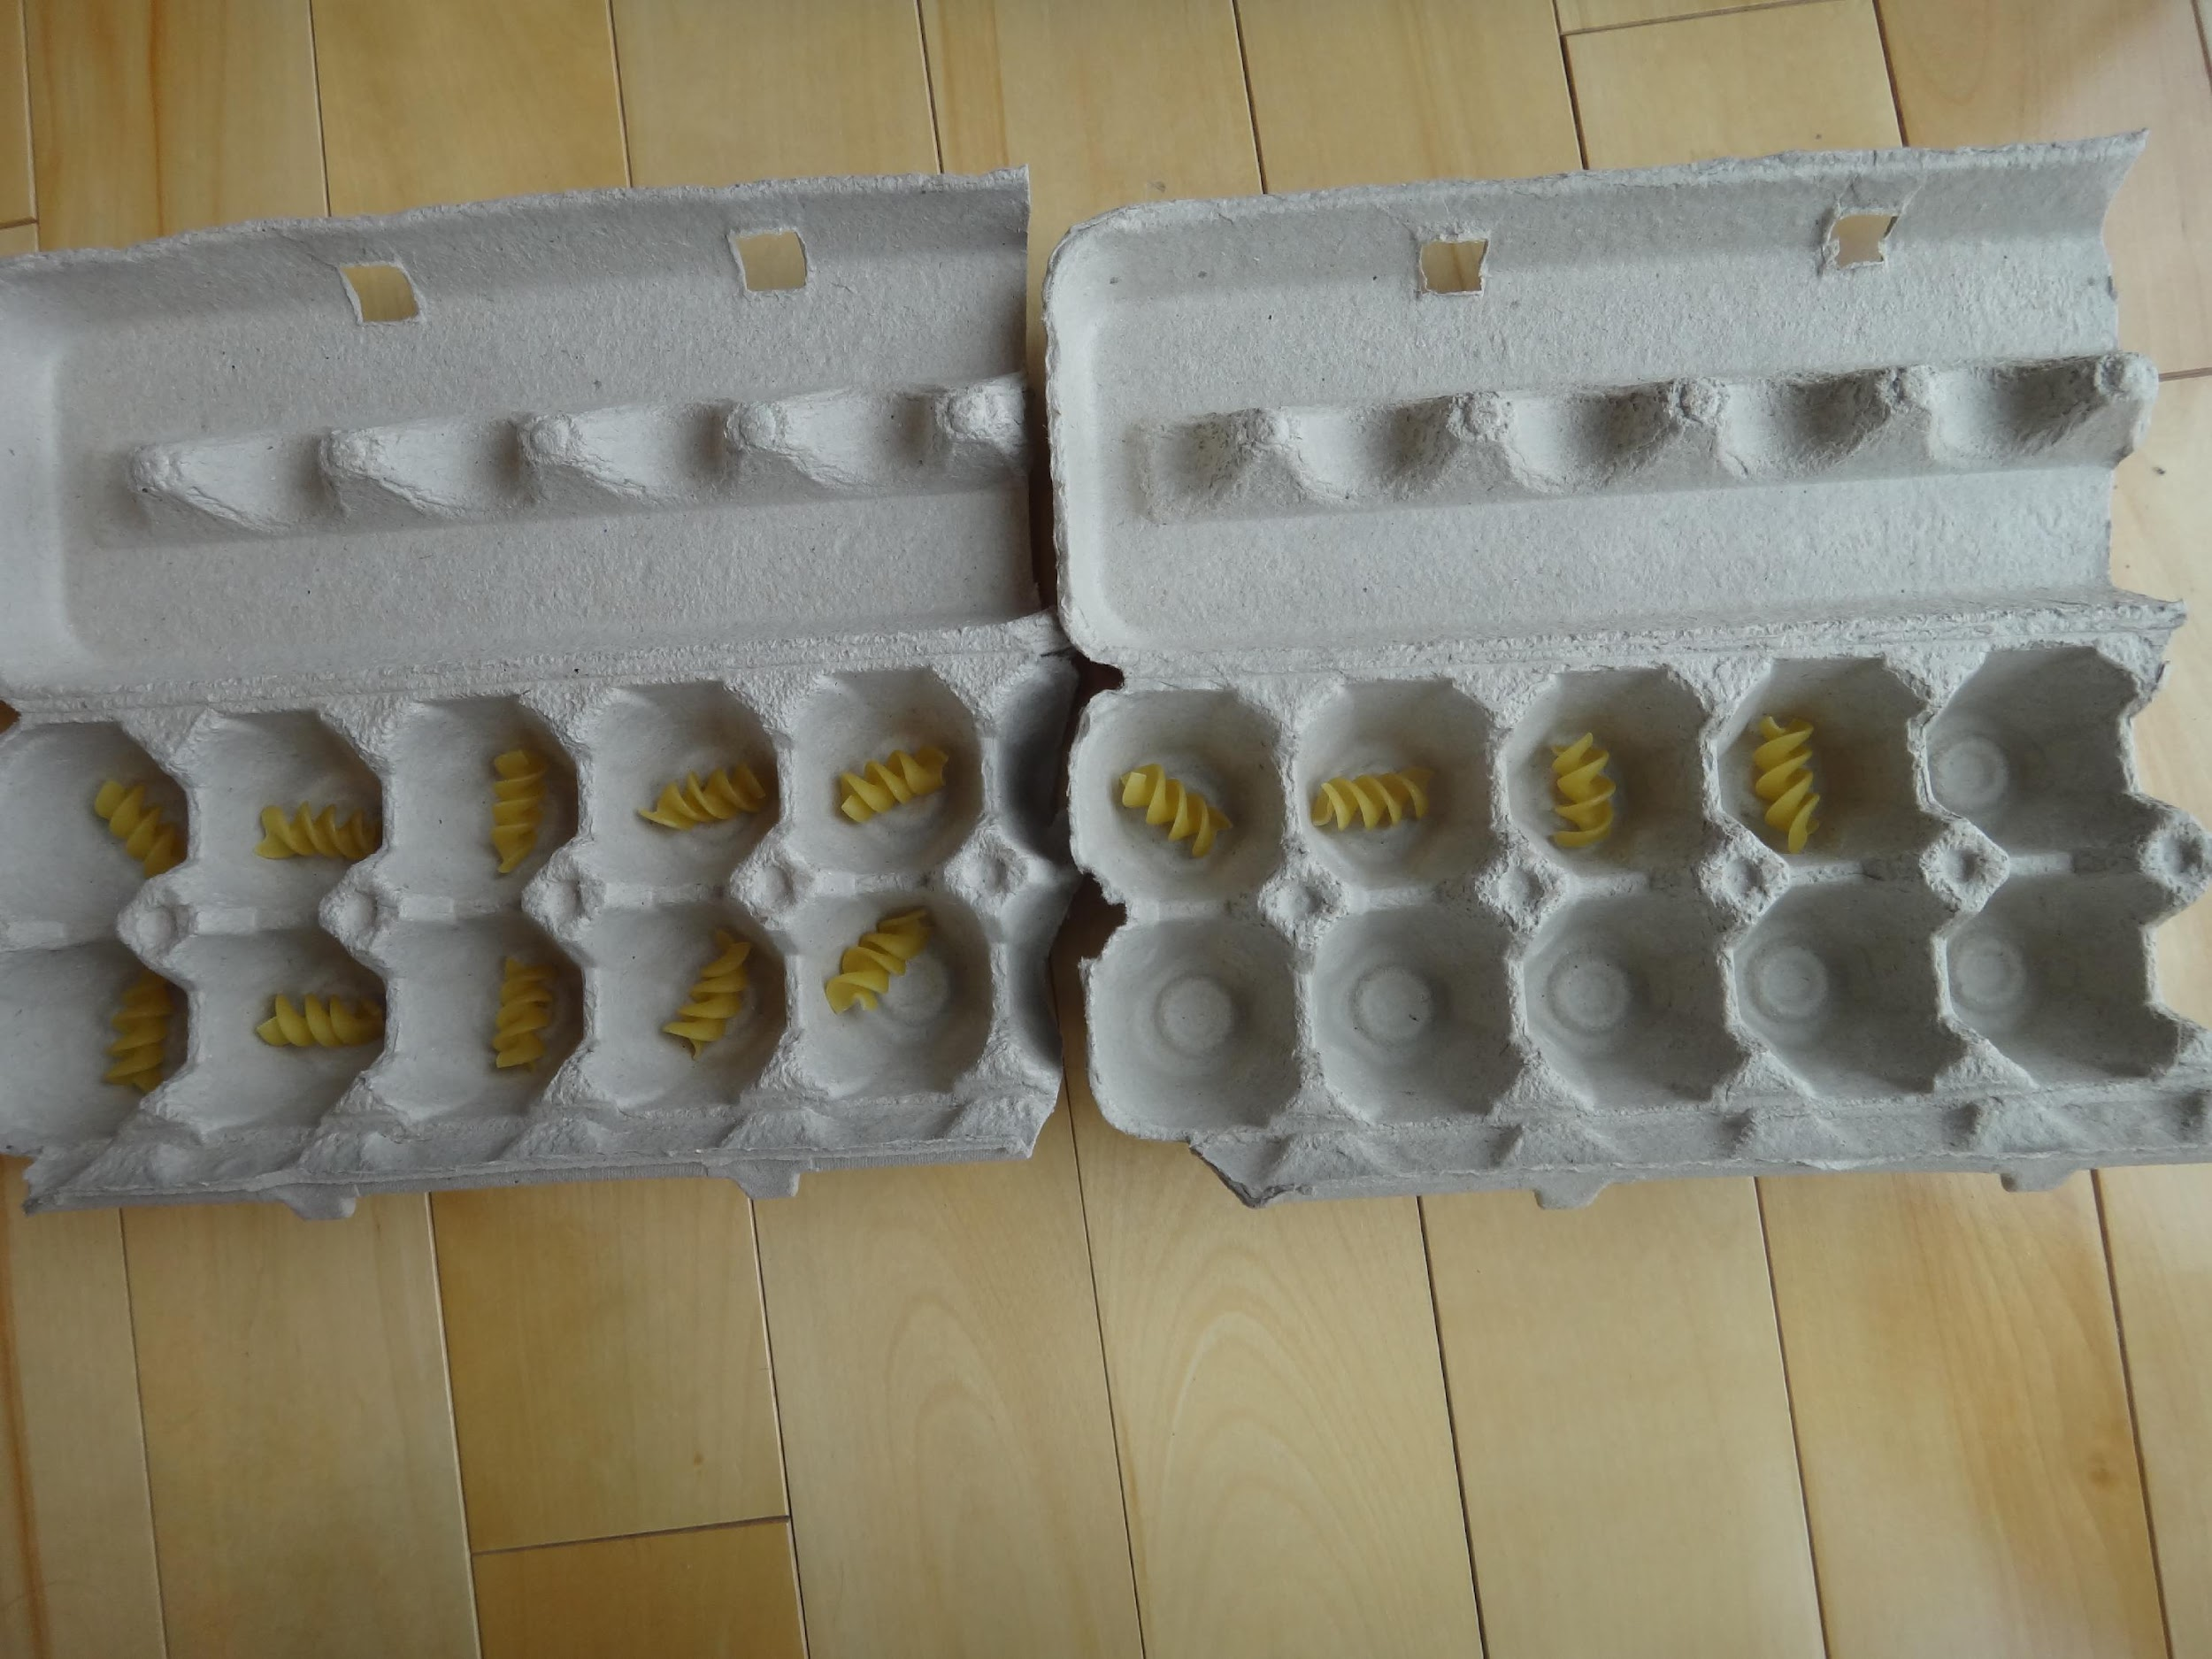
Constantly Provide Experiences
Children need opportunities to:
  Have common experiences that people around them discuss
  Establish how things are related and connected
  Manipulate objects within the environment
  Match language with experience
True fact: It is possible for a child to feed a kitten, eat an egg, or watch television without actually touching, experiencing, or understanding its physical qualities

Slide 50
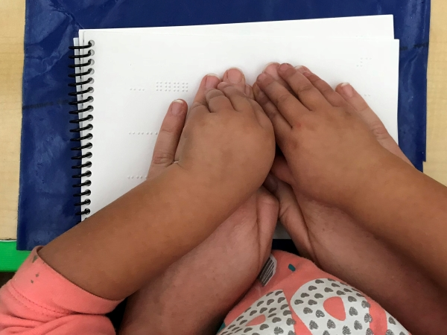
Connect Tactual Skills to Experience
Using both hands
Using individual fingers
With attention to details
Emerging search strategies
https://www.youtube.com/watch?v=eBVqcTEC3zQ

Slide 51

Fingers Now Have Jobs
The index finger is the "leader finger"
The middle and ring fingers of the right hand are the "detective fingers" - identify what is coming
The pinky finger of the right hand detects the end of the line and signals that it is time to look for the next line
The middle and index fingers on the left hand are the "reference fingers“ - if the right hand gets lost or confused, it comes back to the left hand to find its place

Slide 52

Exploration
Notes:
Exploration is the complex process of independently reaching out with the intent of gathering information
Involves:
Spatial awareness
Organized scanning skills
Ability to piece information together
Tactual discrimination
Identifying salient features
Using landmarks or “start/stop” points on the object
Language skills to apply labels
Cognitive skills to think comparatively about the object of focus and its relation to other objects
Random exploration provides information for a child’s mind to sift and sort
Deliberate, intentional attention and instruction helps the child learn to define, map, and organize the immediate world; build efficiency; and reduce frustration
Guide learners through methods of exploration: rubbing a finger across the surface, squeezing, poking, using the entire hand or palm of the hand
Investigating the weight of an object and guiding a child on how to trace the contour or outline to learn about its properties
Motor, cognitive, sensory, and language skills are interconnected
For learners to fully access and explore using these techniques, they need to grasp and release, isolate their fingers, use two hands together and separately, have developed hand and finger strength, use a light touch, and more

Slide 53
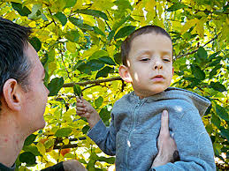
Active Exploration is Vital
Exploration follows experience, given chances to independently gather information
Requires (but also enhances):
  Spatial awareness
  Organized scanning skills
  Part-to-whole assembly
  Tactual discrimination (identifying symbols, selecting landmarks)
  Language skills (labels, etc.)

Slide 54
Let’s Talk …cont. 2
How do exposure, experience, or exploration affect successful early literacy development?

Slide 55
Championship Round, cont. 2

Slide 56
Graphics and Written Language: The Connection

Slide 57
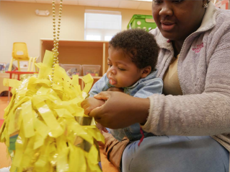
What We Know
Braille reading develops as children learn to explore and discern similarities and differences in objects and materials (Dunst, 2011)
Weak tactile foundations lead to gaps in braille readiness and reading skills
Children need active encouragement to explore with their hands

Slide 58
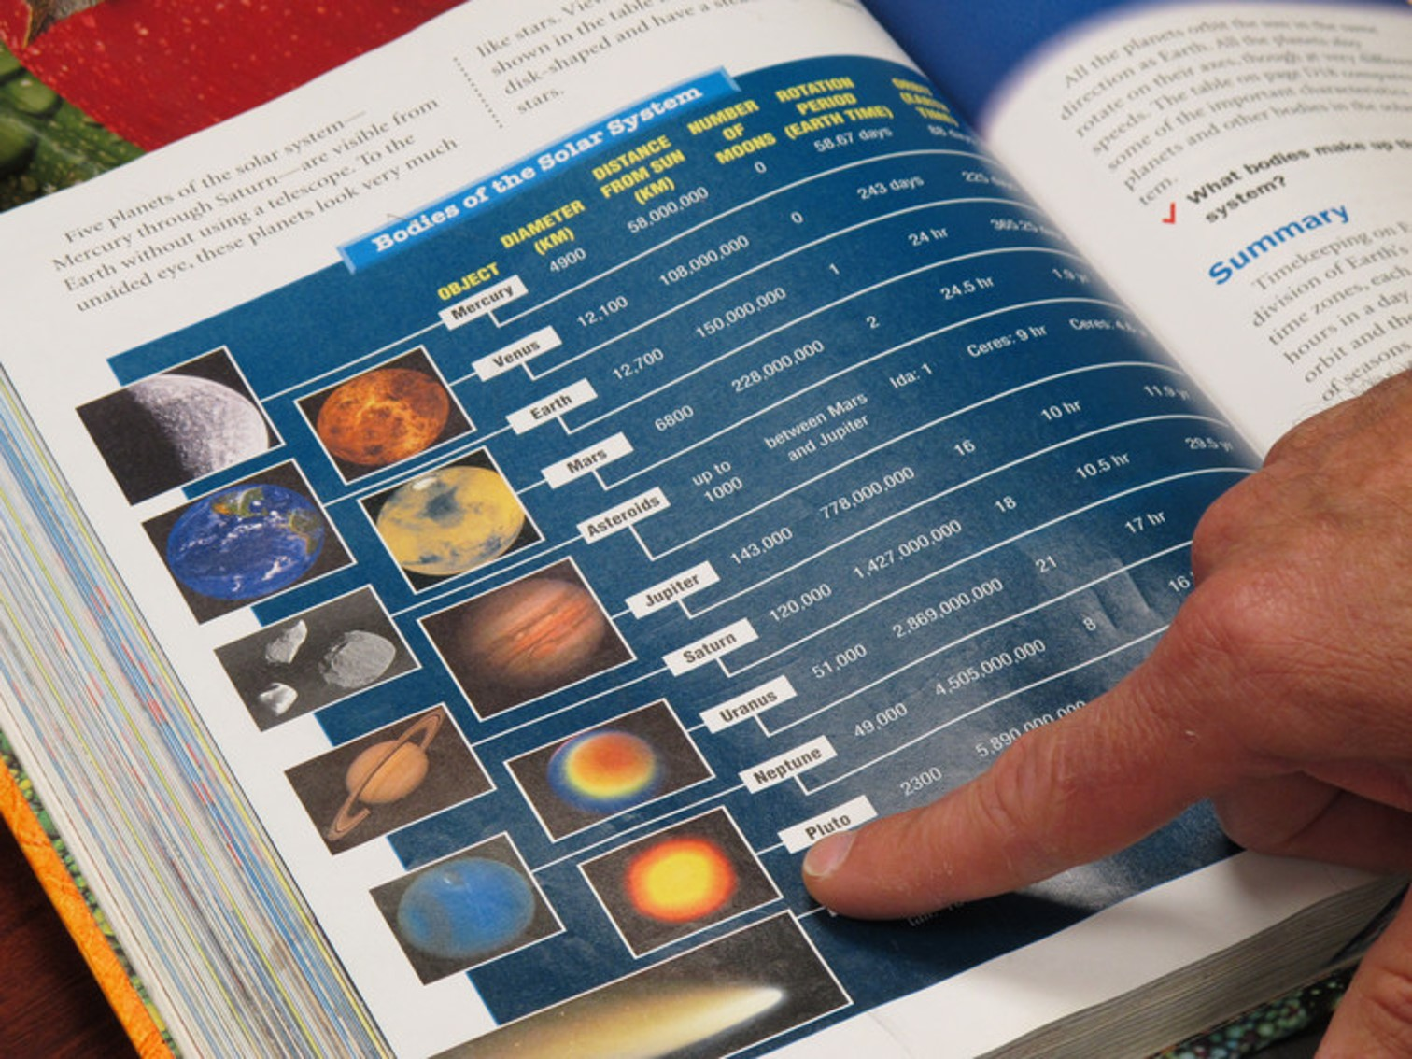
Graphics and Written Language
Graphics are symbols that represent connections to written language
As much as 50% of text content in today's textbooks may be presented in graphic form
If braille readers are to be truly literate, they must be able to apply their tactile literacy skills not only to braille but to symbolic tactile graphics
Notes:
We also know…

Slide 59
Literacy vs. Graphics Literacy
As children reach out to touch and make sense of the world, they can simultaneously discover how it is depicted in books
To be literate, a child must:
  Distinguish features by touch
  Understand conventions (punctuation, spelling, paragraphing, left to right/top to bottom orientation, etc.)
  Recognize its symbols (text and pictorial)
  Decode its meaning

Slide 60
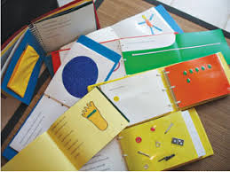
Literacy vs. Graphics Literacy (cont.)
Graphics literacy is an extension and enrichment of tactile literacy skills
Books are an interactively inspiring source of exposure, experience, and exploration
Pictures are an essential part of the literacy journey

Slide 61
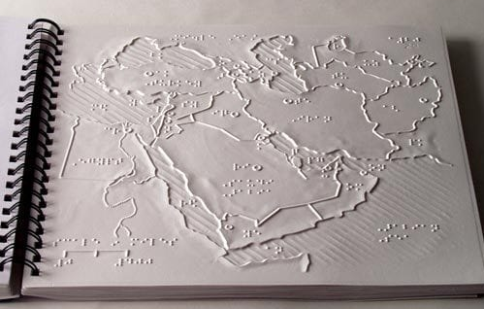
What Does a Tactile Graphic Do?
Conveys graphic (non-textual) print information to people who have visual impairments
Provides unique access that can’t be similarly acquired any other way
Includes tactile representations of pictures, maps, graphs, diagrams, and other images

Slide 62
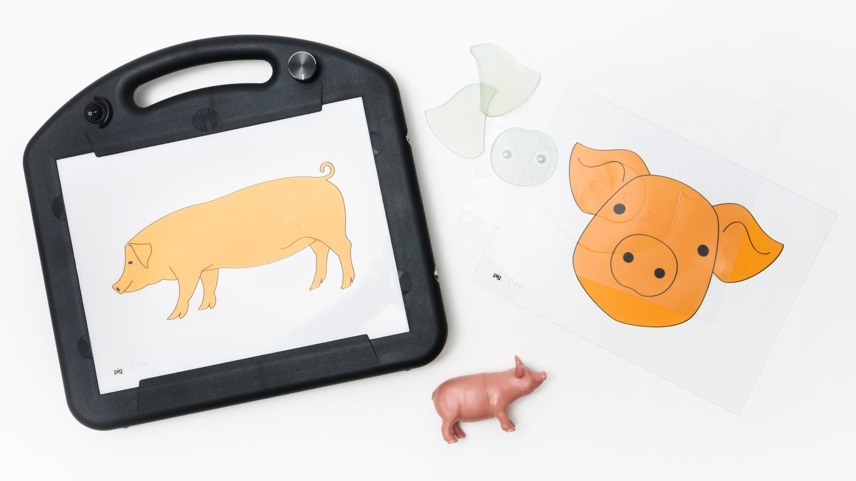
Tactile vs. Tactual
Tactile = word that describes a thing that can be touched
  Tactile graphic – Tactile map – Tactile system
  Static: Tactile objects or surfaces do not engage and must be acted upon
Notes:
JW

Slide 63
Tactile vs. Tactual (continued)
Tactual = word that describes the physical (biological) sensation of touch
  More abstract and conceptual
  Involves all parts of the body, as well as the whole physical framework, that experience touch, perception, and discrimination
  Dynamic: The tactual sense is the acting agent that engages the power of tactile objects
Notes:
JW

Slide 64
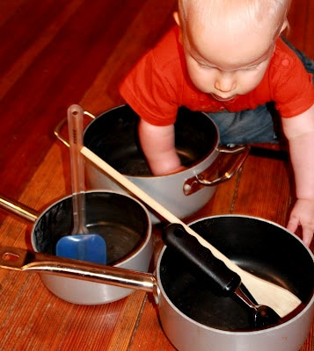
Tactile Literacy
Ability to effectively and efficiently access information, construct meaning, and learn through touch
  Explore and identify real objects
  Understand the meaning and connection of manipulatives to real objects
  Competently and accurately use tactile information to complete tasks
Notes:
Part to Whole (feet, shin, knee, thigh = leg)
Tactile Image Exploration
Tactile Representation
Braille Awareness

Slide 65

Braille Literacy
Successful access and meaningful application of written (text) information
Much more than fluent decoding or mastery of text symbols
  Braille is the “medium”
  Reading, writing, and computing with a purpose within varied contexts
Tool for engagement, interaction, progress, and achievement
Notes:
Ability to access, comprehend, and produce symbolic (written) language through touch
Requires:
Fine motor sensitivity and dexterity
Efficient use of carefully constructed knowledge
Variety of tactile-cognitive strategies

Slide 66
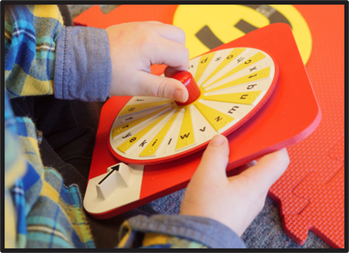
Characteristics of Braille Literacy
Curiosity for exploring and discovering with the hands
Interest in perceiving, decoding, and utilizing tactile information
Capability to track fluently across lines of text
Systematic movements with both hands
Multiple fingers on each hand
Notes:
JW

Slide 67
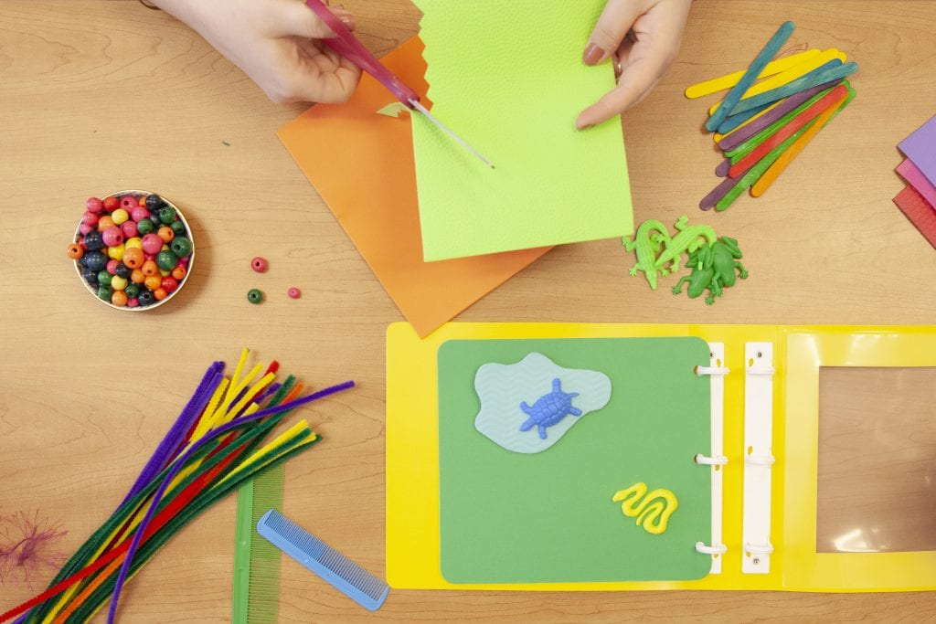
Characteristics of Braille Literacy (cont.)
Understanding how a book works
  Beginning, middle, end
  Titles, headings, and paragraphs
Left-to-right, top-to-bottom progression
Knowing what to look for on a page
Ability to preview/anticipate information
Ability to return to and review information
Notes:
JW

Slide 68
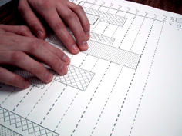
Tactile Graphicacy
Ability to efficiently read, interpret, and produce tactile graphics or raised line drawings through touch (Curtin, 2019)
Requires highly developed tactual skills and tactile-cognitive connections
A lifelong, interactively joyful and challenging process
Notes:
Requires:
Fine motor sensitivity and dexterity
Efficient use of carefully constructed knowledge
Variety of tactile-cognitive strategies

Slide 69
Characteristics of Tactile Graphicacy
Perception that there are different kinds of symbolic information on a page with different kinds of meaning
Ability to discriminate between different tactile surfaces and to draw meaning from them
Advanced form of tactile literacy
Not inherent for tactile readers
Requires explicit attention, education, and careful building up of skills
Notes:
JW

Slide 70
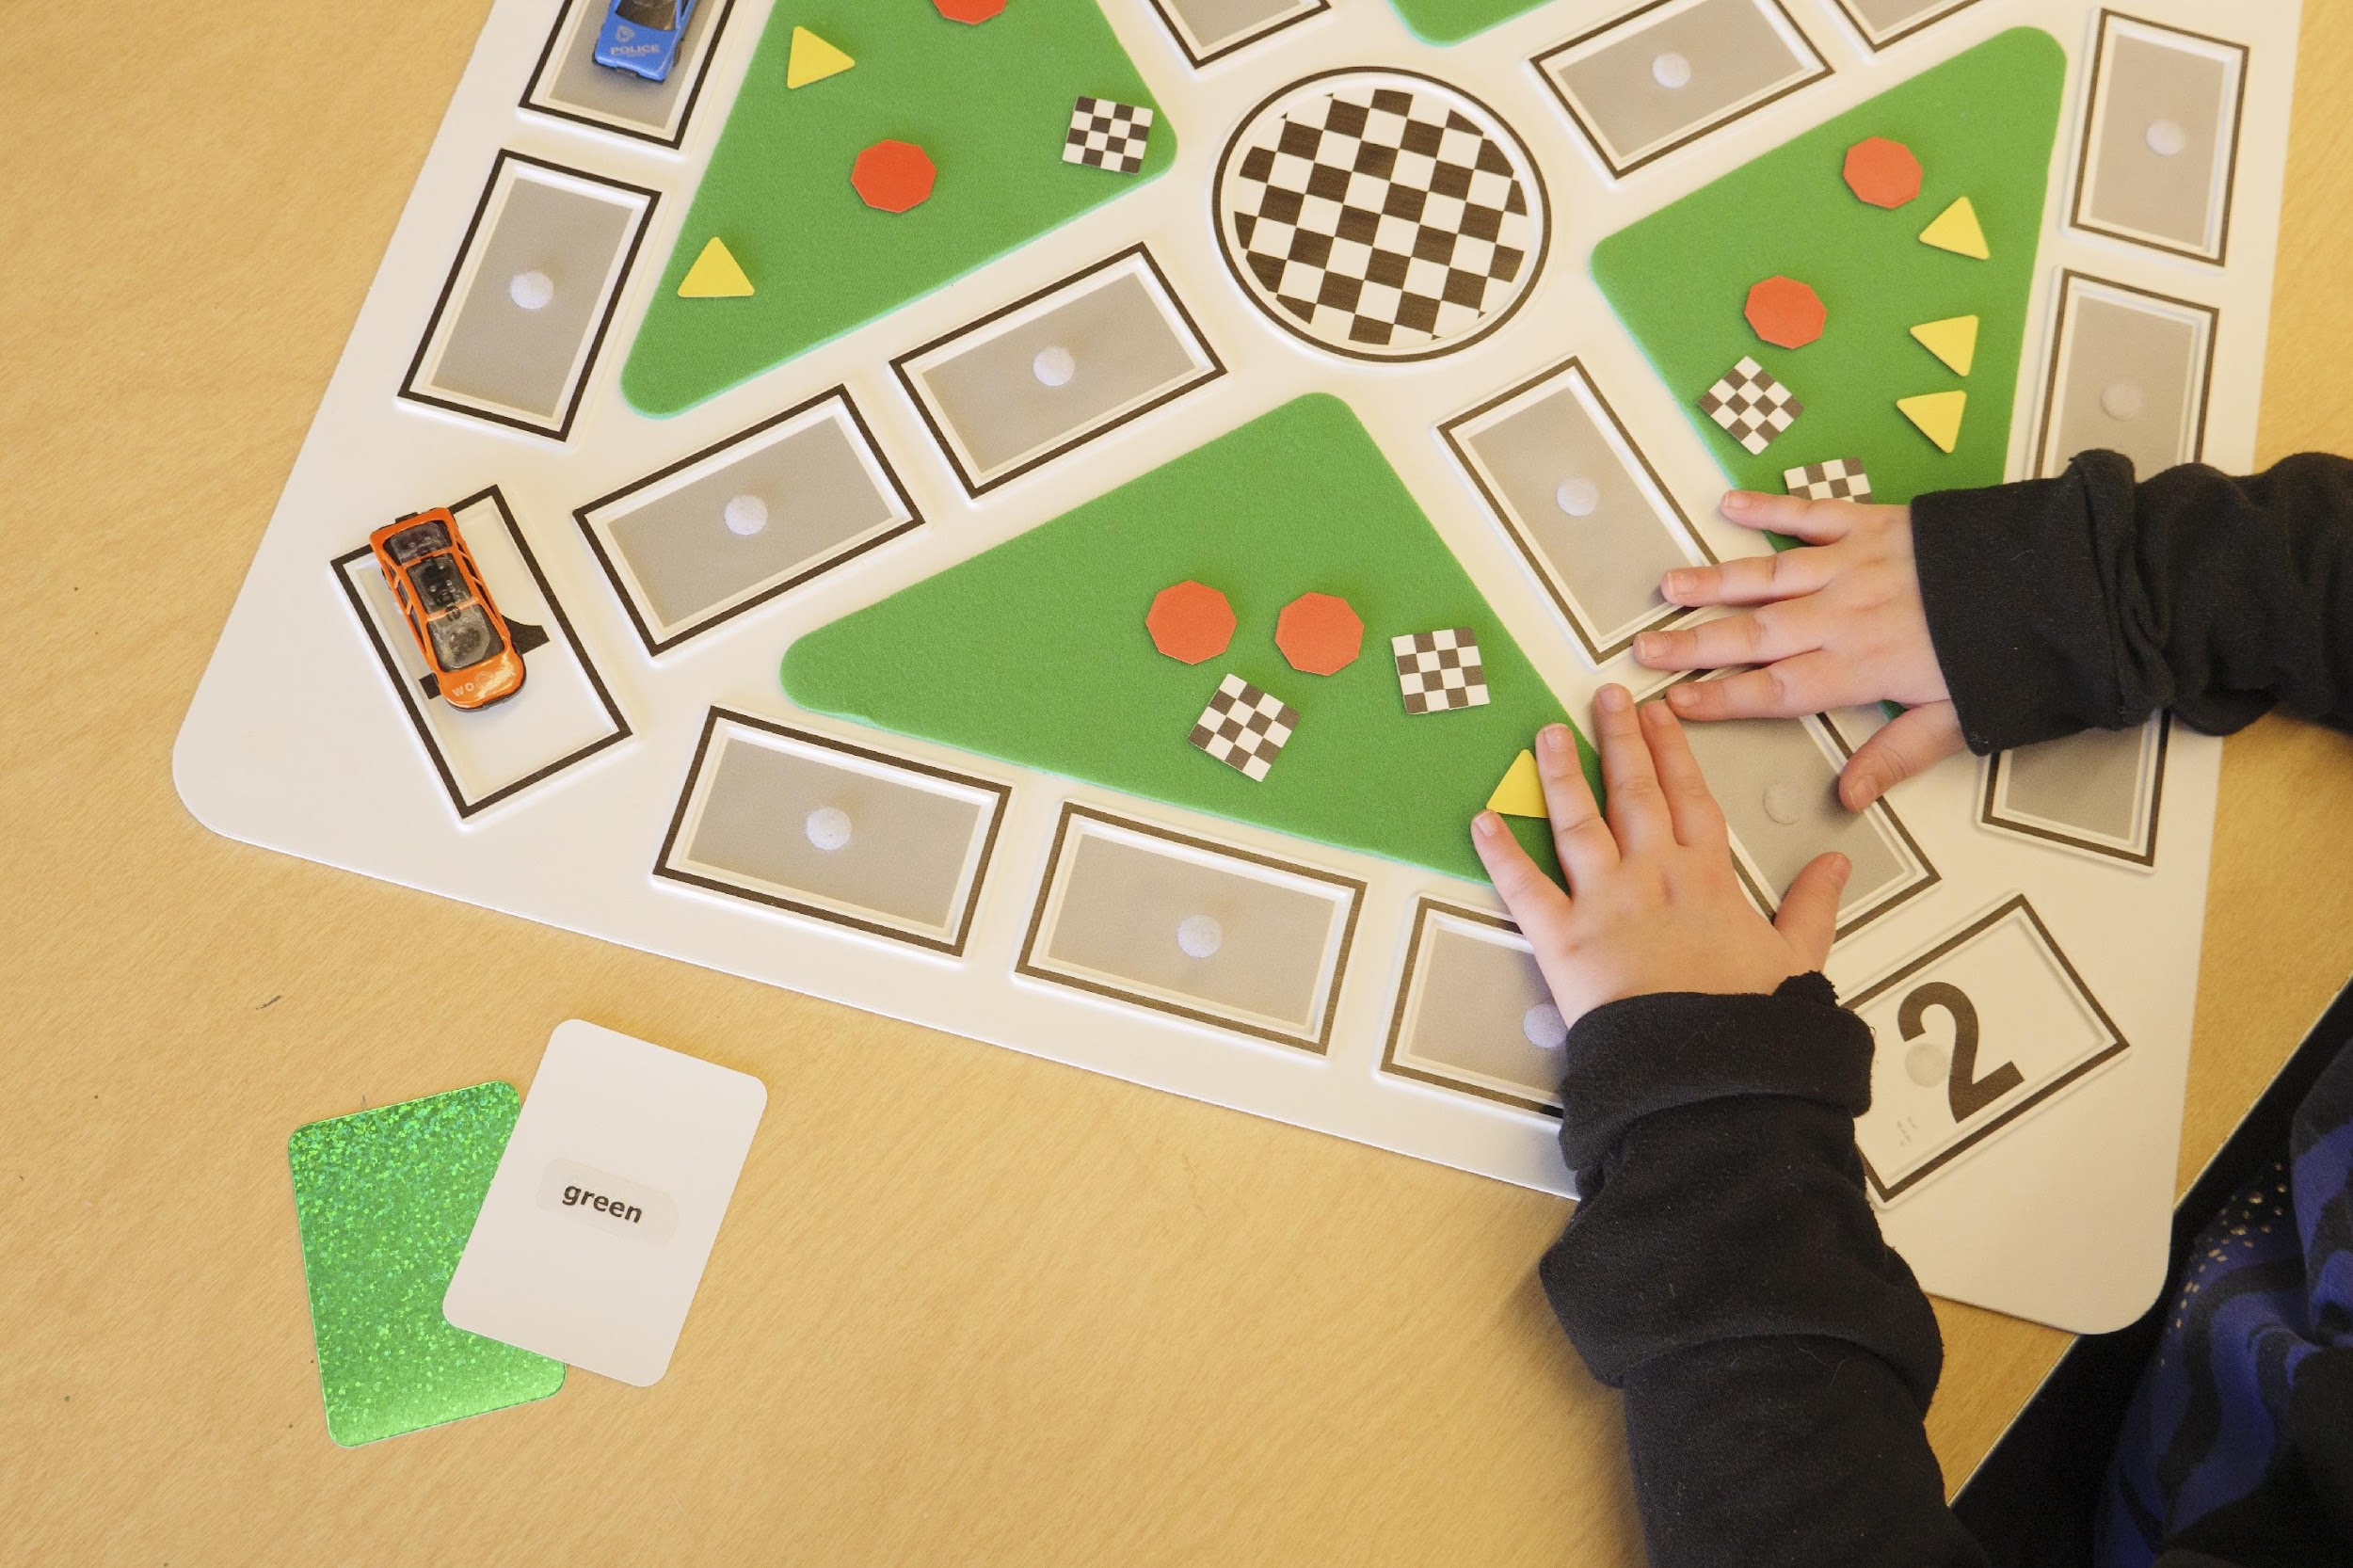
Importance of Tactile Graphics
Children love pictures and symbols
Focus for attention and perception
Natural destination for conversation and social interaction
Place where creativity and imagination are fostered first
Pictures invite and motivate children's curiosity and active engagement
Notes:
JW

Slide 71
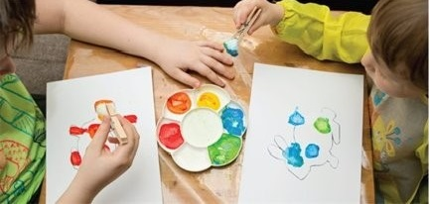
Benefits of Graphicacy Skills
Build confidence
Provide pathways to retain and memorize information
Develop more sensitive
fine motor skills, finger
strength, and exploration
techniques
Notes:
JW

Slide 72
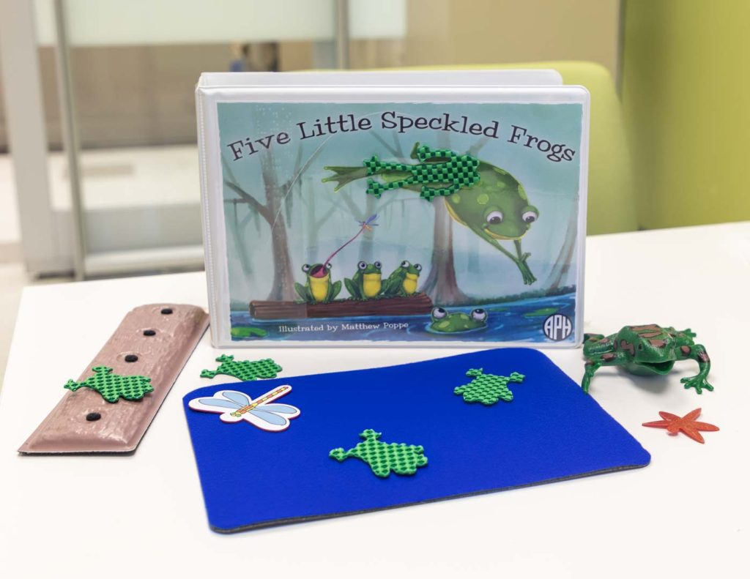
Benefits of Graphicacy Skills (2 of 3)
Pictures clarify and reinforce text content through symbolic
representation
Setting
Characters
Plot
Dialogue
Conflict and resolution
Different viewpoints
Notes:
JW

Slide 73
Benefits of Graphicacy Skills (3 of 3)
Organize verbal information and create mental scaffolds
  Stories are more concentrated, concrete, coherent, and comprehensible
Enhance language, literacy, and social development
Children learn to use symbols to tell their own stories
Wider variety of study and career options available
Notes:
JW

Slide 74
Let’s Talk …cont. 3
What makes pictures such a powerful way to teach concepts, make connections with lived experiences, and foster literacy development?

Slide 75
Championship Round, cont. 3

Slide 76
Importance of Graphics Literacy:
Example
Notes:
Let me share an example of understanding & producing grap hics within an O&M context.

Slide 77
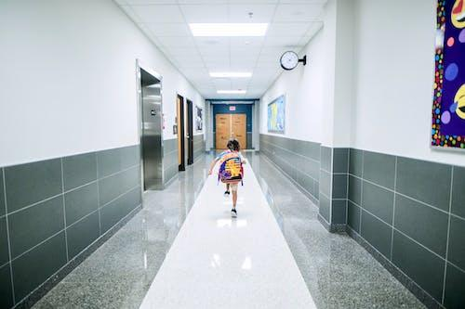


Our Learner
Notes:
Featured learner:
4th grade
Low vision
Provided with O&M instruction in the 3rd grade.
The instructor worked with her on navigating the neighborhood and the walking route from school to her house.
Activity:
Draw the map of her route from school to home with APH Tactile Town Kit
Student could describe the route enthusiastically
Was hesitant about traveling the route

Slide 78

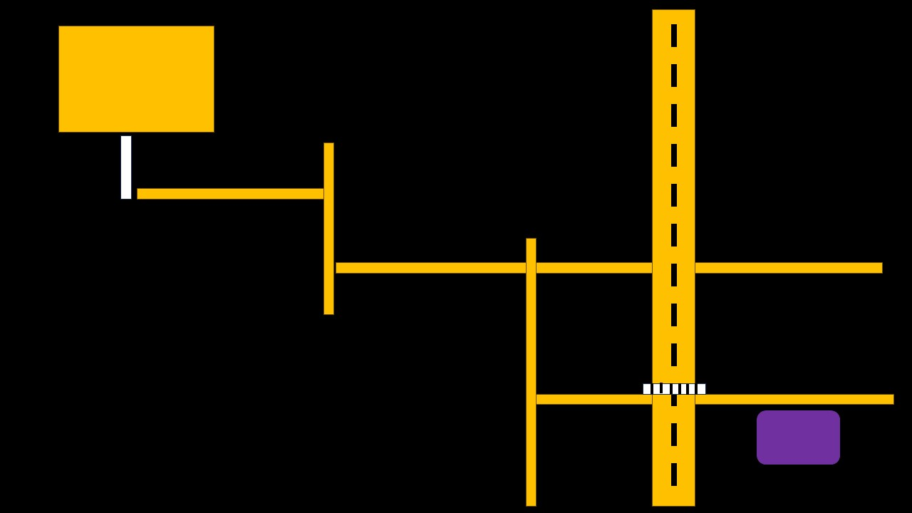
Understanding the Route
Tactile Town Depiction
Actual Map of Route
Notes:
Student picked out her preferred pieces
Set the school on one end of the board and her house on the opposite end of the board
Talked through her route while placing the yellow streets in a row from one to the next
“First we go from the school to this street, then we cross and turn down this other street, and then to the next street and then we’re home!”
However… The map was much more complex than this simple straight line!
Her language reflected knowledge and understanding, but her mental mapping skills and creation of a map did not reflect her comprehension of the route nor the concepts involved

Slide 79
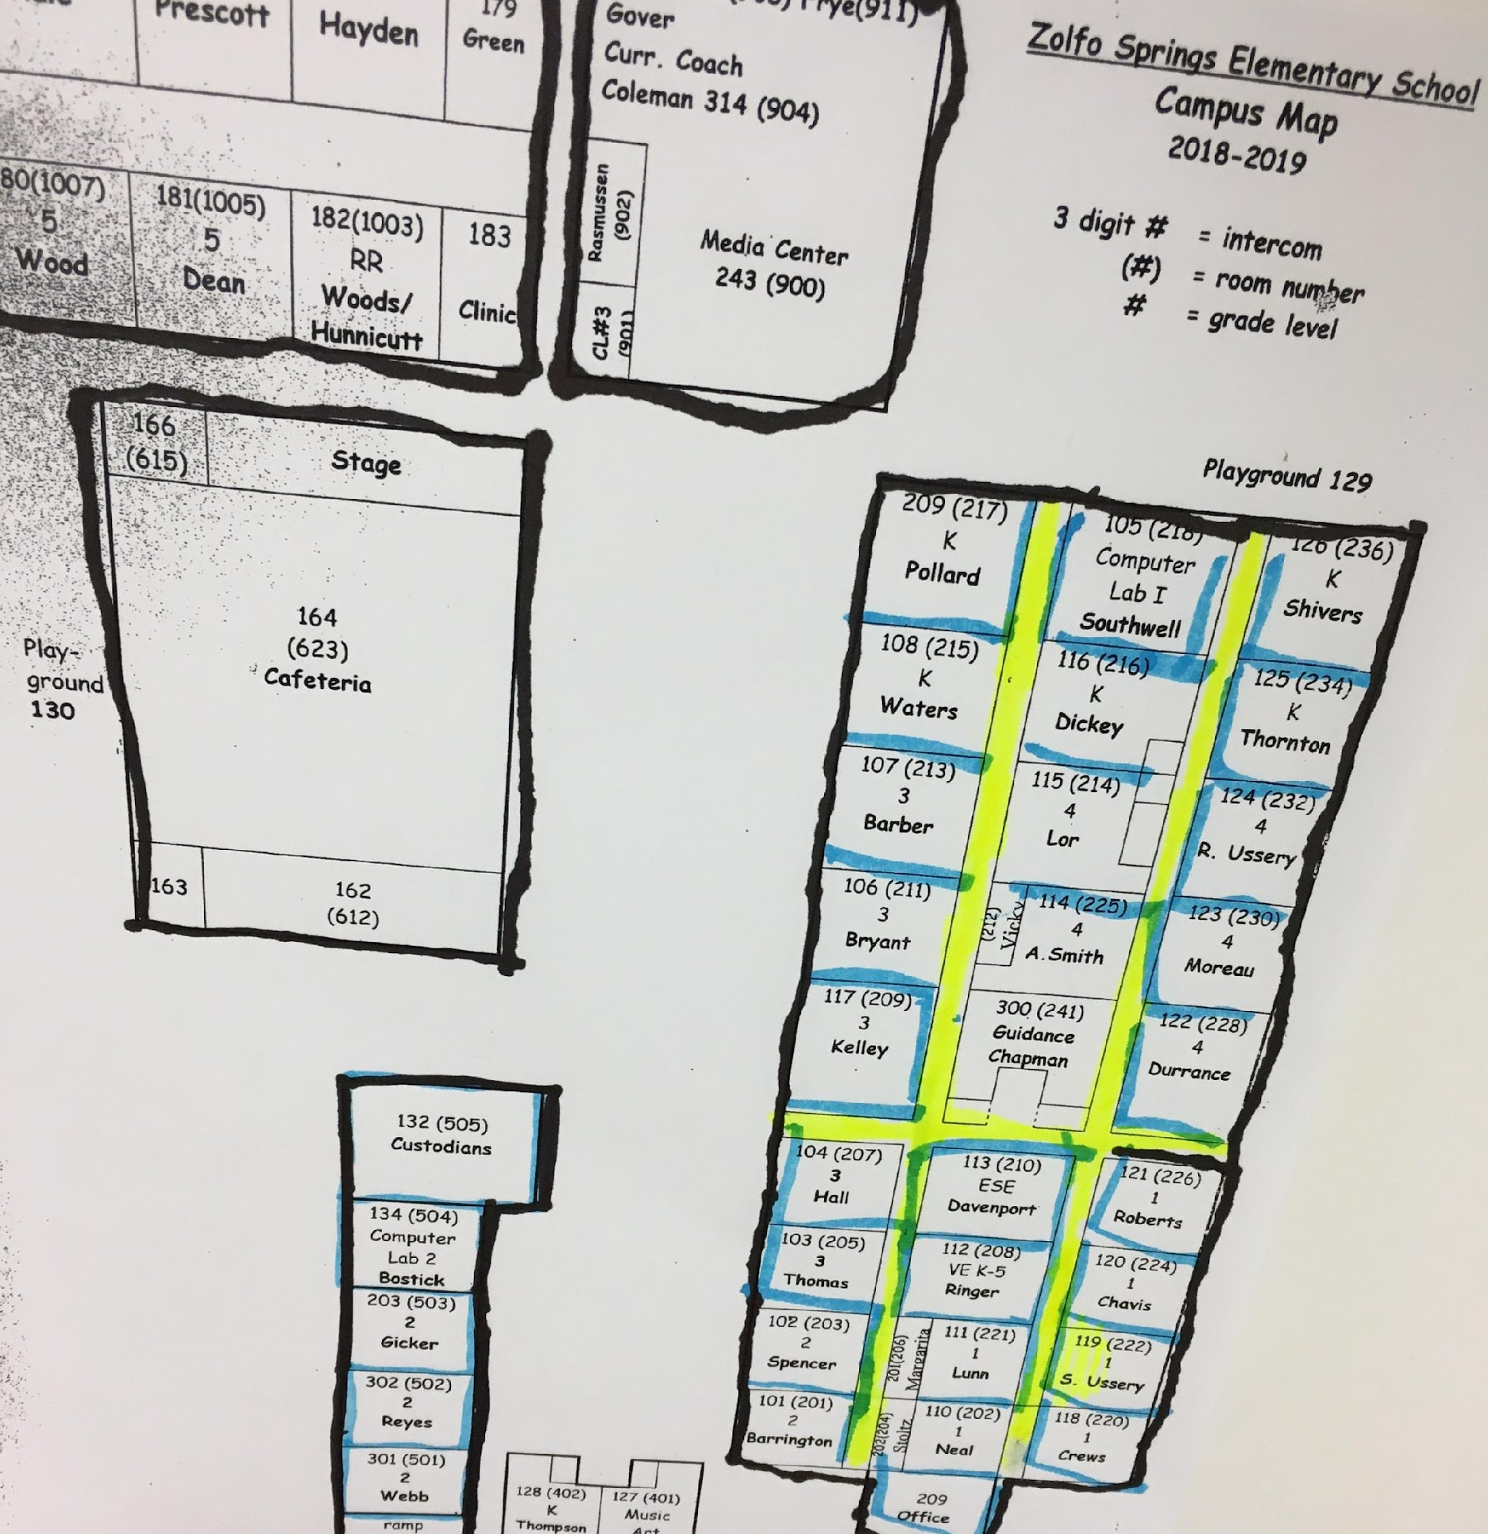
Sample Strategies
Notes:
Work to develop graphic literacy
Start with the simple halls within her school
Provide exposure and experience – repeated lessons of becoming more familiarized with the graphic and the concepts it represents
Simplify (remove words, create a raised line graphic)
Used the map with a CCTV for a student with low vision
Outline the buildings and explore their features inside and out
Outline each classroom and walk the halls to locate each one physically and on the map
Hallways – blank space between two walls.
Can be drawn as two walls or as one object

Slide 80
Let’s Talk …cont. 4
How does exploring print pictures or tactile graphics with children help us to identify gaps in their knowledge, experience, and understanding?

Slide 81
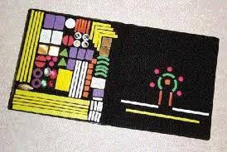
Experience Activity
Notes:
Let me share an example of understanding & producing grap hics within an O&M context.

Slide 82
Experience Activity: Wheatley Picture Maker
Form a group and get a Wheatley Picture Maker!
Choose a concept that you want to convey
What picture will you draw using the pieces of the Picture Maker to convey this concept?
Pass the Picture Maker around the group until your picture is complete
How would you explain your chosen concept using your picture?
Take a photo of your picture and email it to jwheeler@aph.org
If you have time: Draw another picture! (same or different concept)
Designate one person in your group to share your picture with all of us and summarize your experience together

Slide 83
Championship Round, cont. 4

Slide 84
Advanced Tactile Skills

Slide 85
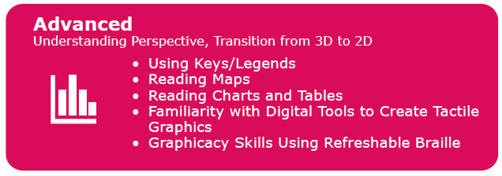
Advanced Tactile Skills, cont.

Slide 86
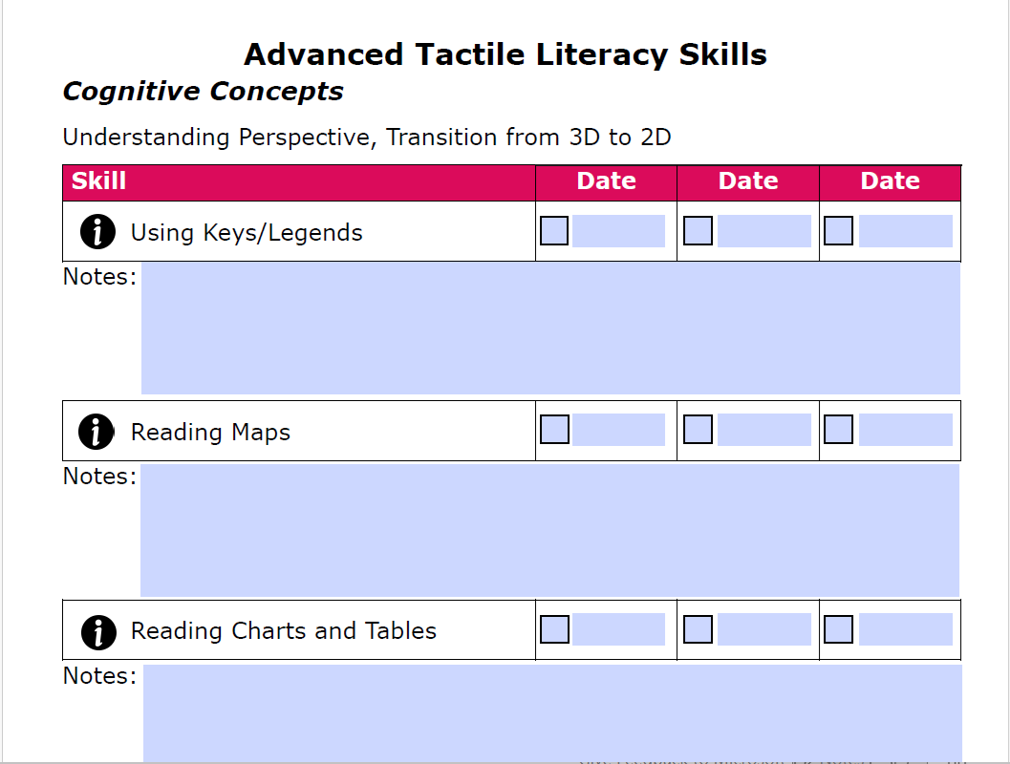
Strategies and Resources for the Instruction and Evaluation of Tactile Graphics

Slide 87
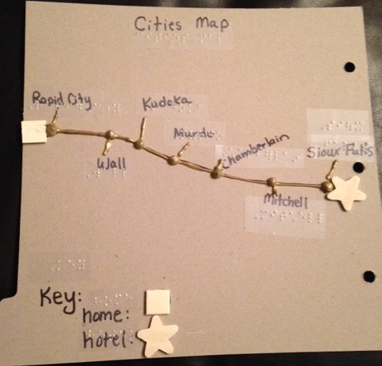
What Is a Tactile Graphic, and What Is It Not?
A tactile graphic is …
An image meant to provide information through touch
A means of giving someone with a visual impairment understanding of the purpose and elements of a print illustration
A representation of visual and conceptual information
A tactile graphic is NOT a photocopy or precise reproduction of a visual image
Notes:
Jenny

Slide 88
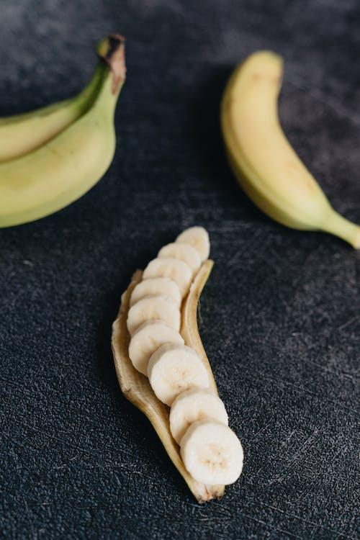
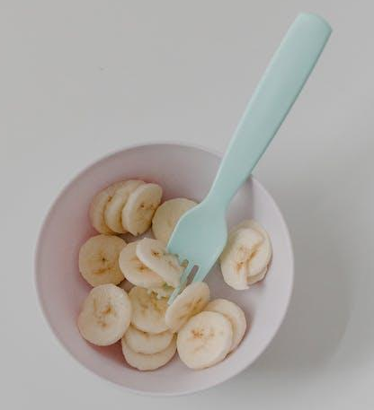
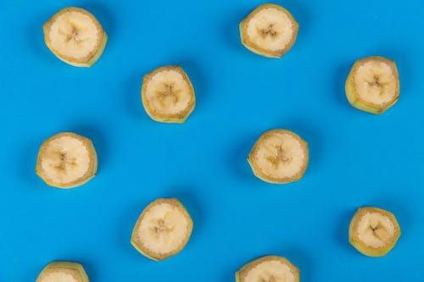
How are Concepts Represented in Real Life?

Slide 89


Graphic Representations
Notes:
Here we have some examples.
Left picture: variety of graphic representations with braille labels (2-D representation)
Right picture: clay modeling of same concepts. This could be for a younger student for learning (3-D) or perhaps it represents a student's work to demonstrate understanding? You decide.

Slide 90


Learner’s Viewpoint
Tactual
Visual

Slide 91
Learner’s Viewpoint (2 of 3)
We need to consider the learner’s viewpoint
  Our pig on the right only has 3 legs!
  Why are the ears different? Why is the tail a circle?
We can’t base our tactile graphics off of the visual viewpoint
What is the experience when you get hands-on and tactual?
What are the salient features of a pig? A curly tail? A big nose?
  Those might be the simple tactile graphic that we use for our student!

Slide 92
Learner’s Viewpoint (3 of 3)
Stay focused on the most important features that represent the subject
  Examples: Highlight just a cat’s whiskers instead of the furry body, or use only a pig’s curly tail to represent the pig
Simplify, especially for early learners – one element per page to start
Be consistent
  Characters and objects in a storybook should be represented in the same way on each page
  Example: A character is always identified by a unique characteristic like a curly tail, or a pom pom nose

Slide 93

Tactual vs. Visual Learning
Visual learning: Simultaneous perception
Eyes give detailed information and overall impression all at once
Tactual learning: Sequential perception
Touch does not give an instant "bigger picture"
Things must be explored a piece at a time and the pieces fit together
Notes:
JW

Slide 94
Tactual vs. Visual Learning (2 of 6)
A tactual learner typically experiences the world in three dimensions, not two
Small objects are explored by enclosing them in the hands, enabling a view of front, back, and all sides or portions
  Complete exploration yields a whole picture
Larger objects must be turned or walked around, and parts examined until a whole picture is obtained
Notes:
JW

Slide 95
Tactual vs. Visual Learning (3 of 6)
When three-dimensional objects are rendered in a two-
dimensional format, they are not the same for a tactual reader
Two-dimensional representations are not automatically or easily recognized
  Each three-dimensional experience must be transferred mentally onto a flat surface
  The meaning of each line, curve, shape, and symbol must be learned
Notes:
JW

Slide 96



Tactual vs. Visual Learning (4 of 6)
Notes:
JW

Slide 97
Tactual vs. Visual Learning (5 of 6)
Touch relies on memory skills and concentration
If concentration fails during exploration or parts are mentally put together in the wrong order, the final picture is distorted
The brain's capacity and tactual library grows with time
At first, the same things may need to be explored many times and in different ways
This is a labor-intensive process, especially in the beginning
Slowing down allows for greater accuracy in tactile impressions
Notes:
JW

Slide 98

Tactual vs. Visual Learning (6 of 6)
Each new type of information requires a similar approach
Greater speed and ability come with mental assembly of many experiences
Notes:
JW

Slide 99

From 3D to 2D

Slide 100
From 3D to 2D (2 of 3)
A child has to learn to recognize a 3D objects and transfer it onto a flat surface
Best to begin practicing this skill at a young age!
  Collect items and make imprints on sand, clay, playdough
  Use objects like a comb, ball, sole of shoe, pine cone, sea shell, fork and spoon
  Explore the 3d object and compare/contrast to the 2D impression
  What features stand out from the 2D imprint?
Compare real items to outlines of items.
  Example: fruit puzzle pieces or 2D shapes with real fruit
  The Lines Song

Slide 101

From 3D to 2D (3 of 3)
Draw the outline around all kinds of shapes – bottle, cutlery, branch with a leaf, apple, pencil, parts of the body (hand/foot)
  Geometric shapes: Check the kitchen!
  Examples: Cup for circle, cereal box for rectangle, banana for banana, etc.
  There's really no limit!
Match the 3d object to the 2d outline or impression

Slide 102
Let’s Talk …cont. 5
How is 2-dimensional learning different from 3-dimensional learning?
Extra credit: What are advantages and disadvantages to both?

Slide 103
Progression of Graphics Production Methods for Student Learning
Lived experiences with real objects
Real objects as symbols
Manipulatives
Collage graphics, without and then with labels
Raised-line drawings created using tools or classroom/household materials, with or without labels
Embossed graphics
Dynamic tactile display graphics (i.e., Monarch)
Notes:
JW

Slide 104

Mechanics
Use both hands and multiple fingers on each hand
One hand can be used temporarily to examine an image while the other hand reads and returns to related text information
Use a variety of exploratory procedures, movements, search techniques, and strategies
Notes:
JW
The use of 2 hands is not just the difference between being able to see more information and less information
It is the difference between potentially passive or partially dependent interaction and full engagement
For more advanced learners, one hand is sometimes very effective as a means of focusing on and deriving meaning from targeted segments of a graphic
As children develop their skills and independence, they should be allowed to experiment with patterns of exploration and make choices about what their hands do
In the beginning, the rule should be use of 2 hands with limited exceptions

Slide 105
Movements and Search Techniques
Contour following: Tracing an edge or outer boundary of a shape
Enclosure of the global shape: Molding the palm and pads of the fingers to the outer boundaries of the whole shape, enclosing it within the hand
Enclosure of local shapes: Molding the tips of the fingers to the boundaries of part of a shape or tactile pattern
Pinch procedure: Holding the edge of a shape or tactile pattern in a pincer grip between the thumb and one or more fingers
Notes:
JW

Slide 106
Movements and Search Techniques (cont.)
Surface sweeping: Movement of the fingers and/or palm over an image's surface
Static contact: Stationary contact with an image's surface (i.e., resting a finger, group of fingers, palm, or the whole hand on a shape or tactile pattern without movement)
Symmetrical movements: Symmetrical finger displacements (movements) around a tactile pattern or shape using both hands
Notes:
JW

Slide 107

Exploration Strategies
Grid
Systematic horizontal and vertical movements to locate all elements in the graphic
Top-to-bottom, left-to-right in a grid-like pattern
Notes:
JW

Slide 108

Exploration Strategies (2 of 4)
Perimeter
Follow the outer boundaries or outline(s) of the graphic
Identify main elements based on their shapes or other tactile characteristics
Organize a mental concept according to the whole before examining the parts
Notes:
JW

Slide 109

Exploration Strategies (3 of 4)
Cyclic
Identify a starting position inside or on the outer boundary of the graphic
Use cyclic patterns to move outward
Browse a series of elements, then return to the starting position
Memorize the relative location of different elements
Notes:
JW

Slide 110

Exploration Strategies (4 of 4)
Reference point
Identify an easy-to-locate reference point based on an outstanding graphic characteristic or position
Examine different elements of the graphic located around the reference point
Understand the relationship between graphical elements using the reference point
Build a full mental image of the graphic
Notes:
JW

Slide 111

Let's Talk …
What exploration strategy would you use first with this tactile graphic?
Grid
Perimeter
Cyclic
Reference Point

Slide 112
Championship Round, cont. 5

Slide 113
essential materials for graphics creation and learning

Slide 114

Importance of Student Creation
Students must create their own pictures!
Graphics creation helps students to:​
    Be active participants
    Build creative thinking/decision-making skills
    Develop spatial orientation and understanding of spatial concepts​
    Reinforce concrete and symbolic understanding​: Concepts, Language, Mental maps
Essential aspect of literacy
Notes:
We teach reading and WRITING, therefore we must teach graphics reading and graphics CREATION
You cannot fully understand one until you also practice the other.
“Creating your own marks is an essential aspect of literacy as it enables two-way communication, and reinforces understanding of language conventions.” Quote from: Documenting Tactile Graphicacy; Louise Curtin, Debra Lewis, Leona Holloway
Remember- Language is abstract. (Graphics reading and graphics creation can help make abstract language tangible – reinforces concepts and the learner’s understanding of these).
Creating their own graphics reinforces our learner’s understanding of Concepts, Language, and it assists their development of Mental Mapping.

Slide 115

Creating and Drawing
Enables two-way communication
Students demonstrate their understanding of a concept or idea
Teachers are able to confirm that the student has truly integrated the concept of the tactile representation
Essential aspect of assessment and checking for understanding!

Slide 116

Quick-Draw Paper
Special technology allows drawings created using water-based tools (including markers) to swell and become tactile
Immediate visual and tactile results
Experiment with dotted, dashed, thick, thin lines and variety of textures (bumpy, striped, sprinkled)
Braille dots and lettering can be created using fine-tipped markers

Slide 117


Tactile Doodle and Draftsman
Use tactile drawing film and a stylus or ballpoint pen to create raised-line drawings, shapes, and letters

Slide 118



Picture Maker Wheatley Tactile Diagramming Kit
FQ Picture Maker Wheatley Board
FQ Picture Maker Geometric Textured Shapes
FQ Picture Maker Textured Strips

Slide 119


Color-by-Texture Marking Mats
Vinyl mats include many fun shapes and textured areas
  Rough and coarse
  Wavy, bumpy, bold
  Diagonal and stripes
  Zigzag and cross-hatch
Place a mat under a coloring page and rub the page with a waxed crayon (crayons come with the kit)
Notes:
$167.68

Slide 120

Symbols
Point symbols like circles, dots, squares, and triangles for graphs, games, microwave buttons, etc.
Reward statements (GOOD, GREAT, SUPER, COOL, WOW, etc.)
Faces (smile, frown, etc.)
Letters and numbers

Slide 121

Letters and Numbers
Feel 'n Peel Stickers: Braille-Print Capital Letters A-Z
Feel 'n Peel Stickers: Braille-Print Alphabet Letters (lowercase)
Feel 'n Peel Stickers: UEB Braille/Print Numbers 0-100
Feel 'n Peel Stickers: Numbers (0-9)

Slide 122

Math Labeling
Feel 'n Peel Stickers: UEB Basic Math Symbols
Feel 'n Peel Stickers: Nemeth Basic Math Symbols
Feel 'n Peel Stickers: Nemeth Braille/Print Numbers 0-100
Feel 'n Peel Stickers: UEB Braille/Print Numbers 0-100

Slide 123

Braillables
Adhesive labeling sheets can be used with a brailler, slate and stylus, or embosser
  Small labels (3.87 x 0.95")
  Large labels (3.87 x 1.7")
  Full-size labels (8-1/2 x 11" sheets)
  Pin-fed with full continuous sheets
  Pin-fed with 7 x 2.4" labels

Slide 124

Texture Labeling
Feel 'n Peel Sheets, Carousel of Textures
Feel 'n Peel Sheets, Carousel of Textures II
Textured Paper Collection
Great for children with less fine motor and finger dexterity/sensitivity, and memory or other cognitive challenges
Some of the sheets or items have adhesive backing
Double-backed adhesive sheets are included for items that are not self-adhesive
  Sticky dots also come with Carousels of Textures

Slide 125
Let’s Talk
What is one tool that you can use for labeling that might work especially well for children who have not yet developed braille awareness or have limited fine motor skills?

Slide 126

Tactile Graphics Kit (TGK)
7 pairs of tongs for point symbols
Hammer for point symbols and areal patterns
Roller tool for areal patterns
3 line tools create at least 7 distinct lines
Line sharpening tool
Vent tool (for thermoforming)
4 areal pattern plates
Slate and stylus, wooden eraser, ruler, rubber pad, aluminum foil squares
Other items you might like to have: Tool Holder, Carbon Paper, and Extra Aluminum Sheets

Slide 127

SENSEable Strips
2200 adhesive tactile strips with 17 line and path types
Brightly colored and distinctively tactile
Shape strips with tactile circles, squares, stars, and triangles

Slide 128


Graph Benders
Flexible strips and point symbols – triangles, circles, squares
Self-adhesive
Both visual and tactual
Create and plot graphs and tactile diagrams/charts
Work well with Feel 'n Peel Stickers, Tactile Compass for Math and Art, Graphic Aid for Mathematics, tactile/bold print graph sheets, and many other tools

Slide 129

Graphic Art Tape
  Colored Graphic Art Tape from Amazon
  Colored Whiteboard Tape from Walmart
  Easy-to-Make Tactile Tracking Paths article by Karen Poppe

Slide 130

Book Builder Kits
Tactile Book Builder Kit
CVI Book Builder Kit
Create experience and concept books
  Counting books
  Number books
  Pattern books
  Shape books
  Sorting books
  Measurement books
  … and so much more!

Slide 131

Tactile Theme Pack: In My Yard
Textured mats and other themed materials to get teachers started with creating tactile graphics
Notes:
$179

Slide 132

Laptime and Lullabies
Large print and tactile books
Early literacy tool that incorporates many basic math concepts, including comparisons of size and texture
Beautiful removable illustrations that can be used for developing spatial awareness and conceptual connections

Slide 133



On the Way to Literacy Series

Slide 134

Tactile Treasures
Thermoformed sheets with pictures of pretzels, buttons, rings, zippers, scissors, shells, and other items
Help children learn to recognize and understand tactile images

Slide 135

Hundreds Boards
Includes Number Board and Grid Board
Numbers 1-100 appear in print and braille on high-contrast Velcro squares
Shapes for graphs and other activities include red circles, blue squares, green triangles, and yellow stars

Slide 136



Reach & Match Kit
Reach & Match Light
Reach & Match Number Tiles
Reach & Match Letter Tiles
Reach & Match is a giant tactile graphic!
The kit comes with letter tiles but extra or replacement sets are available

Slide 137

Symbols and Meaning Kit
Games and guidebook that help to provide a strong sensory foundation in symbolic representation for children with multiple disabilities
Teaches children concepts about people, objects, actions, and places
  What is it?
  What does it do?
  How does it relate to other things?

Slide 138

STACS
Tactile symbols system that helps children to have conversations about people, places, events, and ideas, and to learn vocabulary through the use of picture and object symbols
Starts with 25 symbols that are either miniatures or parts of real objects or have direct correspondence to their associated activities
Add individualized symbols
Notes:
$734.81

Slide 139

Monarch
Multi-line braille display
10 lines of 32 cells each, 320 total braille characters
Tactile graphics viewing window with link to APH Tactile Graphics Image Library (TGIL) Graphing calculator with link to DESMOS online
Scientific calculator
Word Processor with Math Editor
Braille Editor for multi-line problem-solving
Terminal Mode

Slide 140

Tactile Graphics Image Library
Create a free account
Download hundreds of graphics for embossing and teaching tactile skills
  Art and Music
  Education
  Health
  Independent Living
  Mathematics
  Orientation and Mobility
  Science … and much more!

Slide 141

Tactile Skills Matrix
Wonderful article that includes many resources for:
  Exploring real objects
  Part-whole relationships
  Shape recognition
  Spatial and symbolic understanding
  Texture discrimination
  2-D and 3-D representations
  Understanding perspective
  So much more!
Notes:
$209.00

Slide 142
Let’s Talk, cont.
What could go into a classroom teacher's kit for creating tactile graphics for students?
Draftsman
Point Symbol stickers
Picture Maker
Carousel of Textures

Slide 143
Advanced Activity
Notes:
Let me share an example of understanding & producing grap hics within an O&M context.

Slide 144
Advanced Activity: Graphics Potpourri
Form a group and get a little of everything!
  SENSEable Strips
  Carousel of Textures
  Graph Benders
  Feel 'n Peel Stickers
  Point Symbols
We will identify something (i.e., an object, a person, a place, an idea, a food or drink, etc.) to draw
In your group, create a tactile graphic that illustrates the chosen item
Nominate one person to show and describe your graphic

Slide 145

Questions?
Comments?
Suggestions?

Slide 146
Championship Round, cont. 6

Slide 147

ACVREP Submission www.aphhive.org
Enter Hive with QR code
Select sign-in
Click “Event Certificate Request”
Enter opening and closing codes
Click “Validate Codes”
Notes:
Review slide

Slide 148
Thank You!
Erin Weaver
Outreach Specialist – NE
eweaver@aph.org
Jenny Wheeler
Outreach Specialist - SW
jwheeler@aph.org

