Slide 1

Cultivating Strategies for Time Management
Notes:
Have everyone jot down what they hope the outcome of this session will be and the benefit they think it will have.

Slide 2
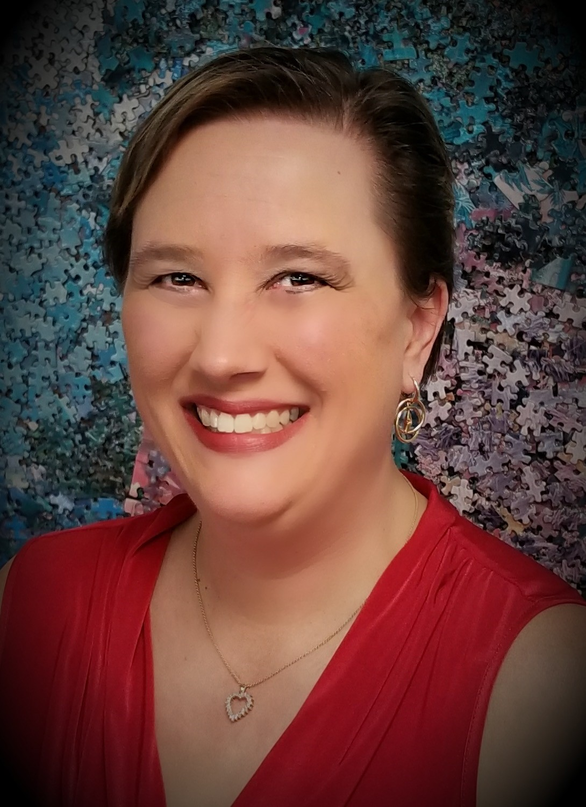
Leanne Grillot
Senior Director of Outreach Services

Slide 3
Learning Objectives
Develop strategies to prioritize effectively and work efficiently.
Consolidate multiple calendars into one comprehensive calendar.
Design personalized weekly worksheets to make use of limited free time.
Establish routines to process emails efficiently.

Slide 4
Assessing Your Strengths and Gaps

Slide 5
Get Yourself Together
My calendar reflects my goals and priorities. There is time blocked for proactive work.
I have everything in one place. For example, all deadlines are in one calendar.
I have a place to note immediate To-Dos that pop up during the day.
I have a place to record longer-term items, and I regularly refer to them.
I can easily select the most important thing to do at any given moment.

Slide 6
Get Yourself Together, part 2
I have a method for tracking delegated work, data, and other needed tools with little wasted time.
I reliably follow up from meetings.
I can easily access reference information, data, and other needed tools with little wasted time.
I am able to focus for a sustained period of time during work blocks.
I can complete tasks efficiently with little procrastination.

Slide 7
Get Yourself Together, part 3
I can accurately predict how long my To-Dos will take to complete.
It is always appropriate to use my system. For example, if I am digital, I can always access my tools.
My system is highly portable; it is easy for me to carry it everywhere all the time.
My system is synchronized across all devices and gadgets.
If applicable, I use administrative supports to their fullest.

Slide 8
Routines Rule
I pause and reprioritize each day when needed.
I pause and plan ahead on a weekly basis.
I pause and plan ahead each month and quarter.
I have checklists or templates for regularly occurring events.
I plan my workload with my energy levels in mind.
I have methods for batch processing similar types of work.
When an emergency arises, I have a method for analyzing and deciding on its importance.

Slide 9
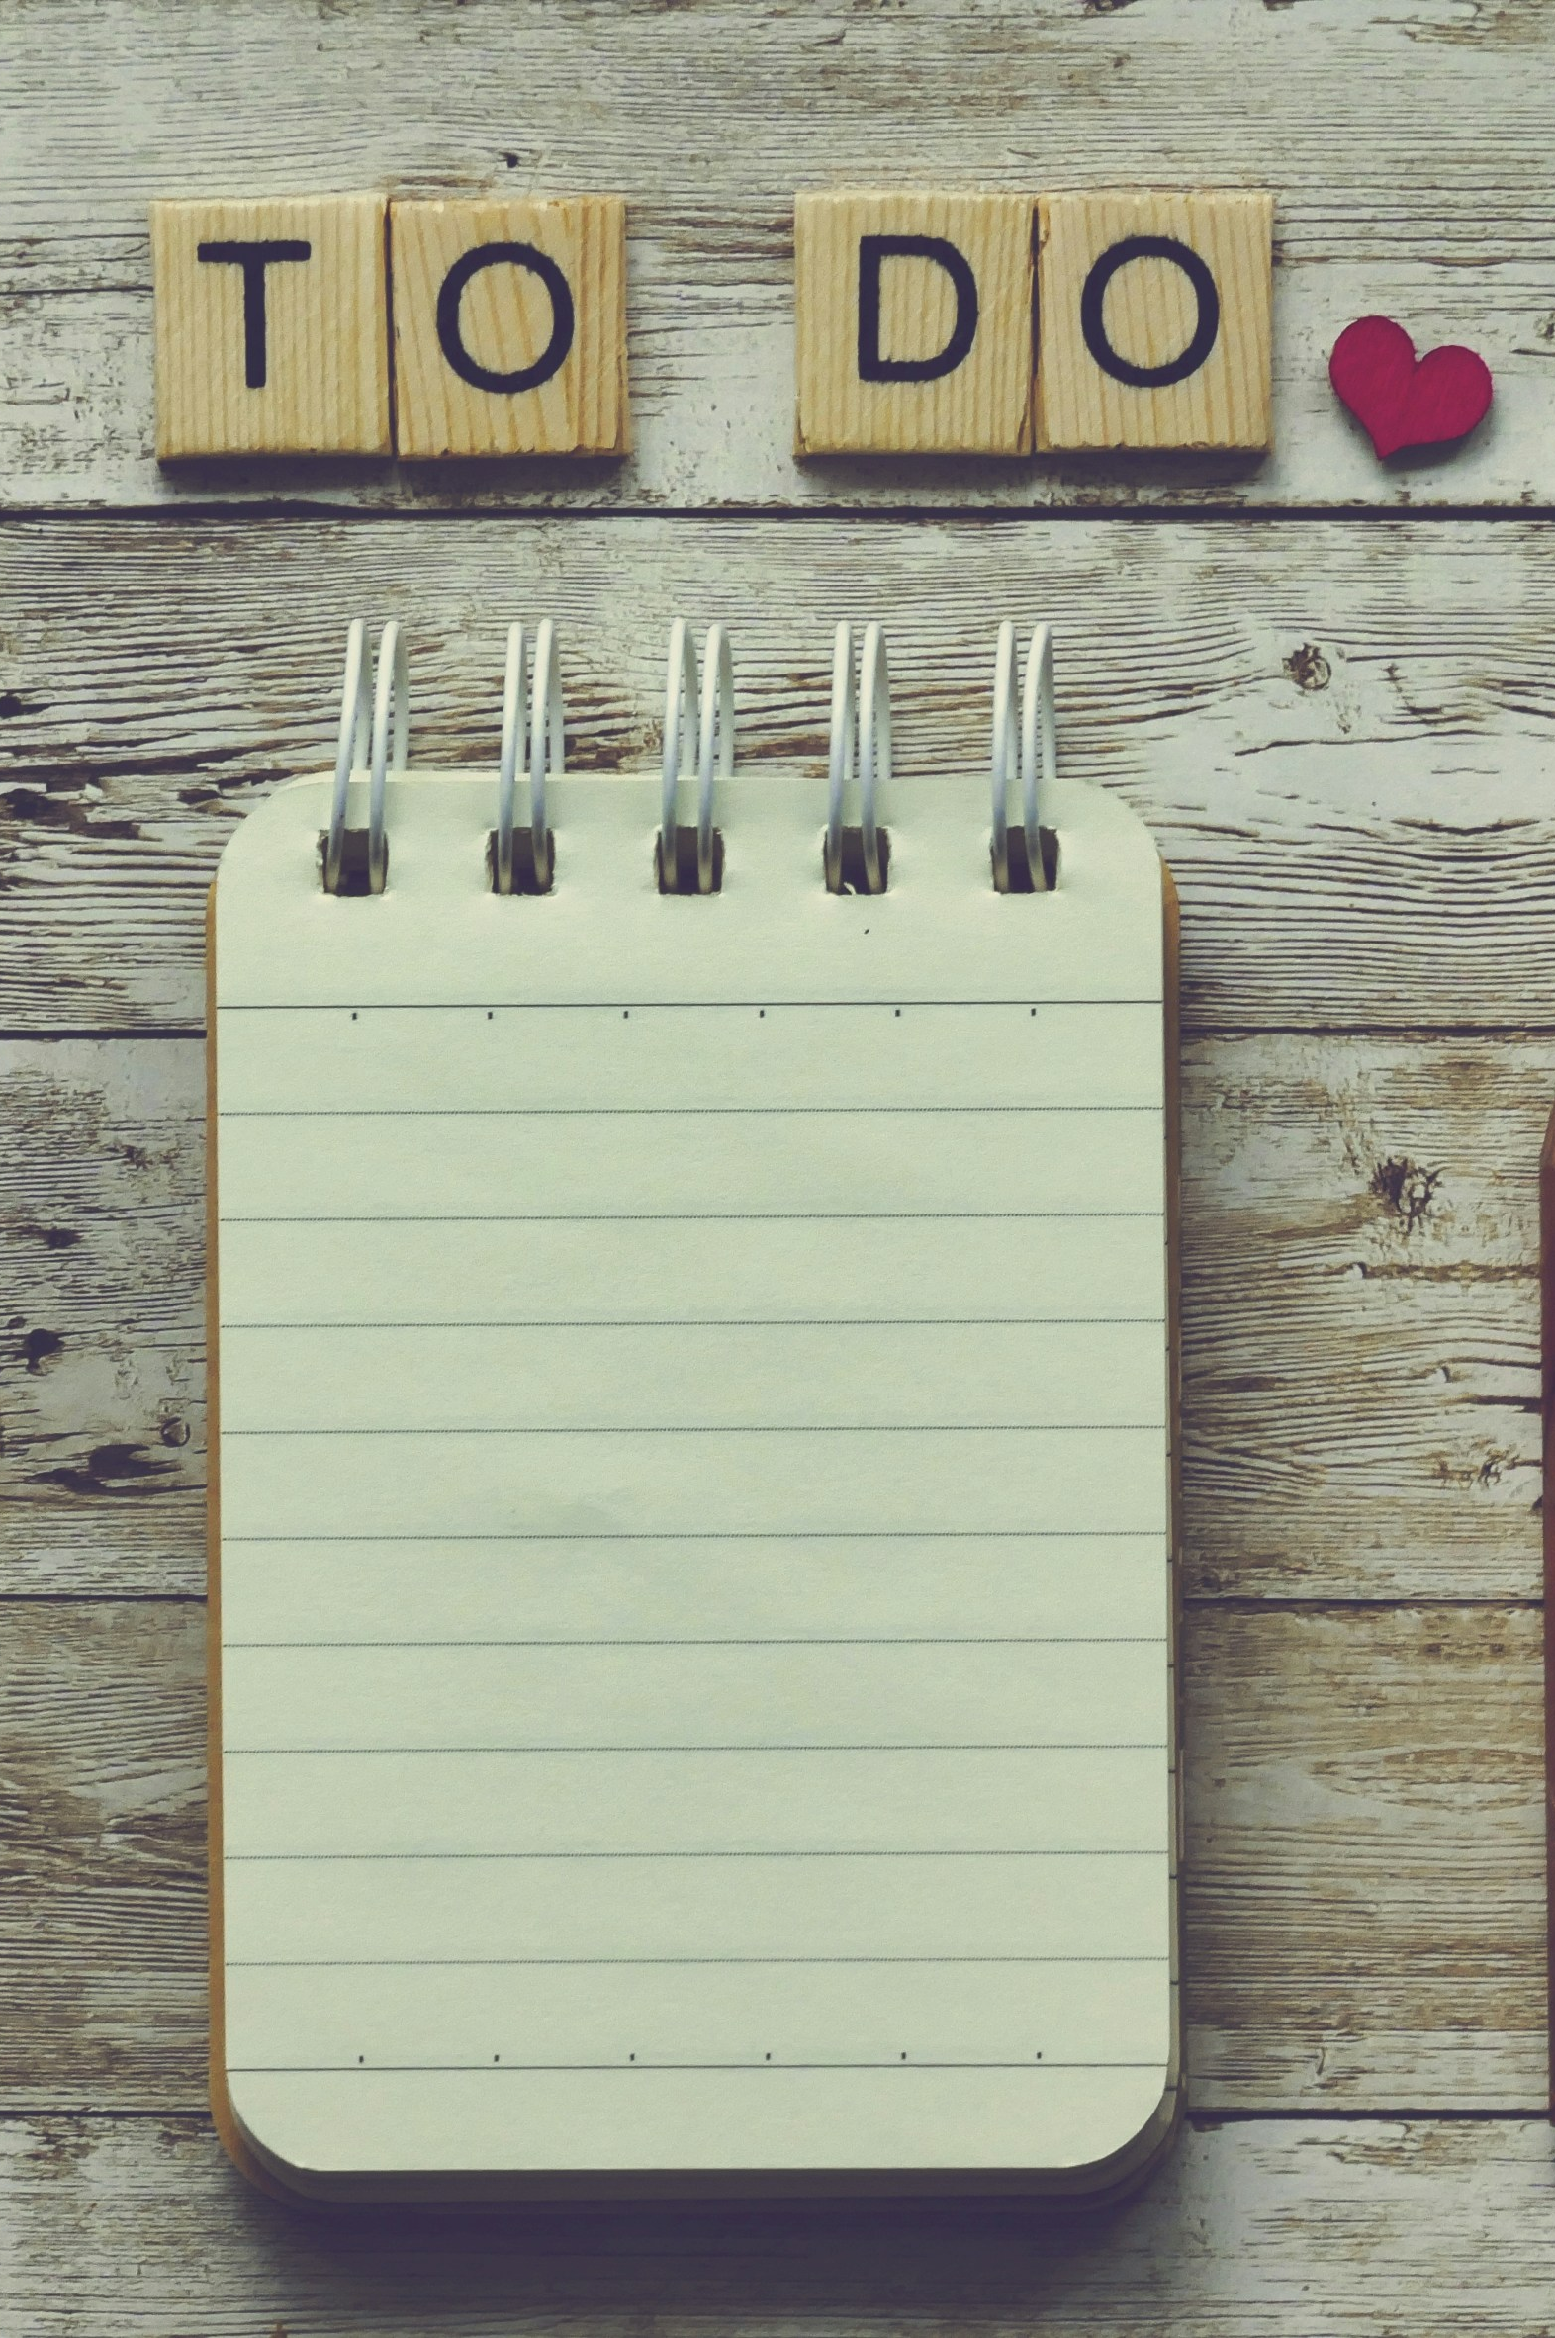
Mindsets Matter!
The more planned you are, the more flexible you can be.
Whether we like it or not, our credibility is on the line.
If you base your success on completing a daily To-Do List, you will never feel successful.
Predictable routines and systems enable us to focus on bigger, bolder, and more creative work!
There are no perfect tools, only consistent routines.

Slide 10

Mindsets Matter! (cont’d)
Clear and up-front expectations are way better than back-end cleanup.
As we go, so go our teams.
We have greater agency over our time than we believe we do.
Just because you set boundaries doesn’t mean you don’t care about the mission.
There is no magical priority fairy.

Slide 11
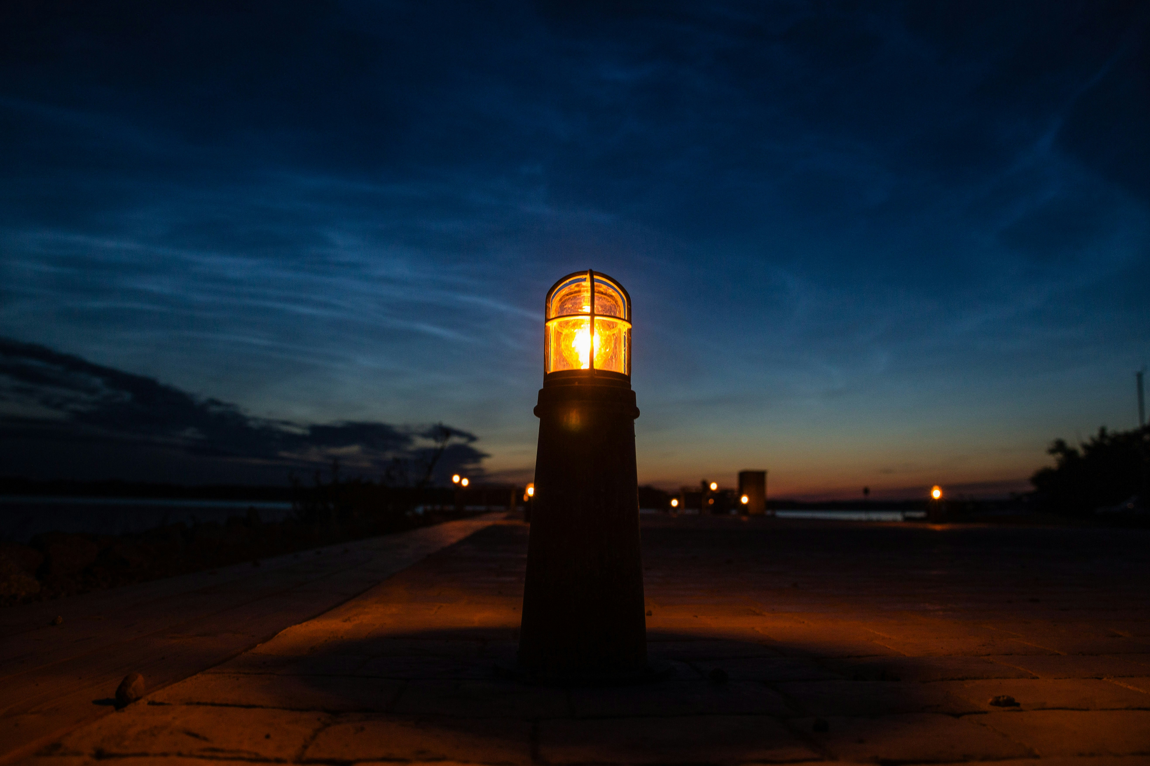
Build the Habit
Remember your guiding light.
Make it easy on yourself.
Enlist others.
Don’t go on an organizational binge.

Slide 12
Design a Comprehensive Calendar

Slide 13
Seen and Heard
“I take on more work than I can complete, and I don’t have a system for holding time to react to things that pop up during the day or week.”
“I don’t keep track of deadlines well. I’m not always sure where to put them, or also deciding where I put the prework on my To-Do List.”
“I spend so much time on getting little tasks done that aren’t necessarily connected to my priorities but are necessary to the team.”

Slide 14
What It Includes
Identify and protect time blocks necessary for planned priorities.
Allocate time to accomplish standard stuff.
Thoughtfully schedule major meetings.
Consolidate all calendars into one master calendar.
Look ahead at the entire year for long-term calendar planning.

Slide 15
Priority Plan
Bold and clear statements of priorities for the next three months
Key actions needed to accomplish the priorities
Includes personal priorities
Outlines priorities for team members

Slide 16
Major Meetings and Standard Stuff
Your supervisor meeting
1-to-1 meetings
Team meetings
Interagency meetings
Meeting with yourself
Checking email
Returning phone calls
Lunch
Completing expense reimbursements
End of day tasks

Slide 17

Sketch an Ideal Week
Macro time blocks
Major meetings
Standard stuff

Slide 18
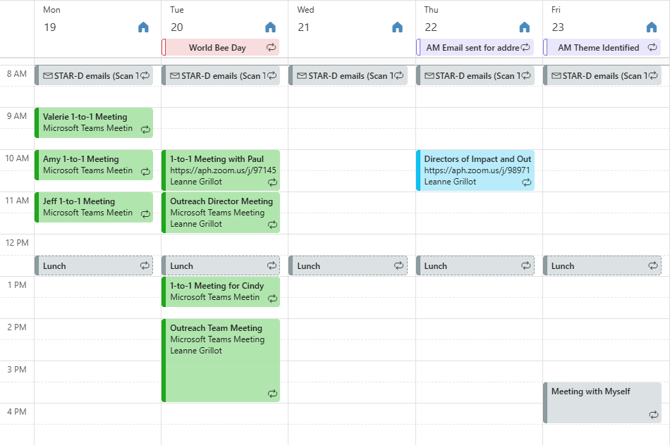
Impose the Ideal Week onto Your Digital Calendar
Remove calendar strays
Make deadlines centrally located
FYIs are clearly noted
Get personal!

Slide 19

Zoom Out to View a Year
Identify crunch times
Block vacation
Block off time
Block recovery time

Slide 20
Design a Later LIst

Slide 21
Seen and Heard (1)
“I don’t have a consistent format for keeping track of my To-Dos. Right now I toggle between a To-Do List on my phone, a To-Do List on my Google docs, and a to-do list on my online calendar.”
“I don’t track my To Dos. I just do!
“I record my most immediate To Dos on sticky notes that I stick to the screen of my laptop. For To Dos that are further into the future, I write them on my desk calendar, but sometimes I end up forgetting about them until the week of.”

Slide 22
The Later List
Your to-do list fully reflects your entire workload.
Items on your to-do list require strategic procrastination.
Separate your short-term from your long-term to-dos.
Separate items between your Comprehensive Calendar and your Later List.
Use deadlines of larger projects to work backward and make progress.

Slide 23
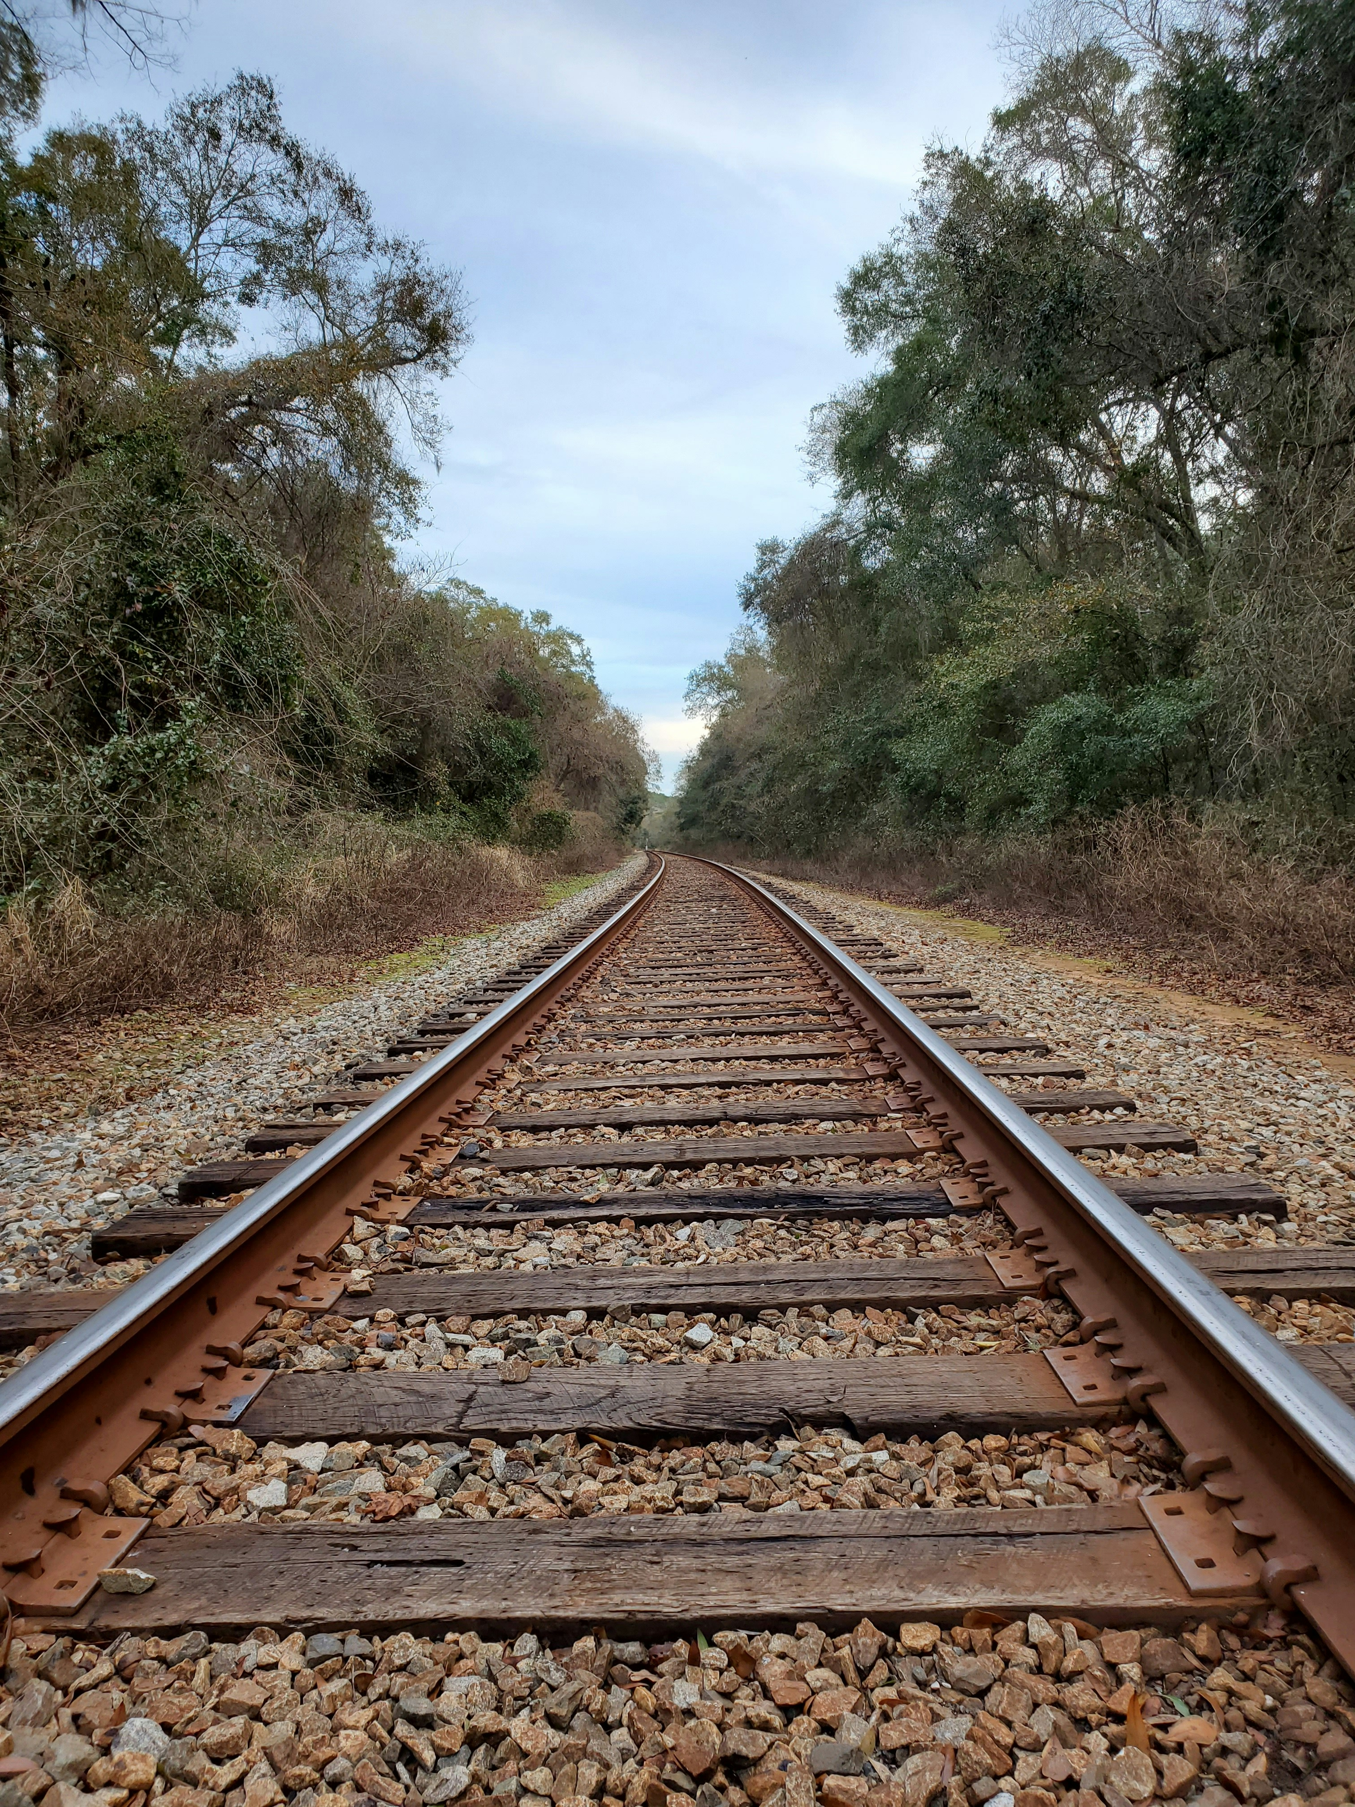
Short-Term and Long-Term
Is this idea for this week or is this idea for the beyond?
If for the beyond, “What month does it make sense for me to even begin thinking about this?”
Open your Later List and dump the thought in the right section.

Slide 24
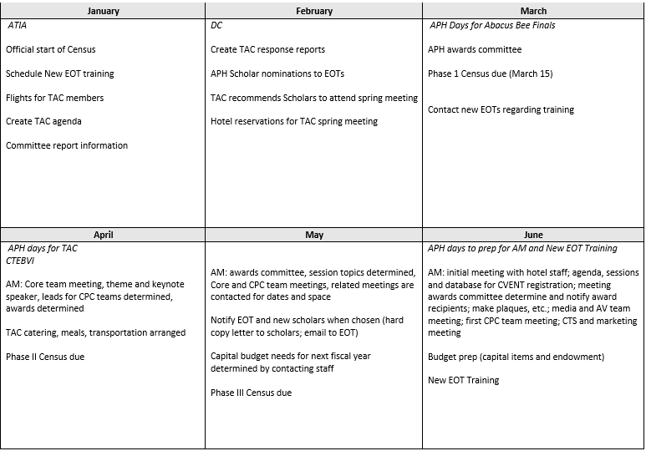
My Later List

Slide 25
Create Your weekly Plan

Slide 26
Seen and Heard (2)
“I schedule long chunks of time to do work both on the weekends and evenings but am not always working efficiently the entire time.”
“I know WHAT I have to do, but I’m not strategic (or disciplined) about WHEN I’m going to do it.”
“The thirty-minute chunks in-between meetings or observations always feel like the biggest wastes of time because I don’t know how to productively use them and never get anything real or meaningful accomplished.”

Slide 27
A Weekly or Daily Worksheet
Master how and why of getting micro for the week.
Develop ways to get more time back in your day.
Determine how to put it all together when you are on the move.

Slide 28
A Good Weekly Worksheet
Schedule time for YOUR activities
Add priorities for the week
Use categories to reflect priorities or type of work
Consider combining professional and personal calendars
Enough flexibility to handle the ever-changing environment

Slide 29
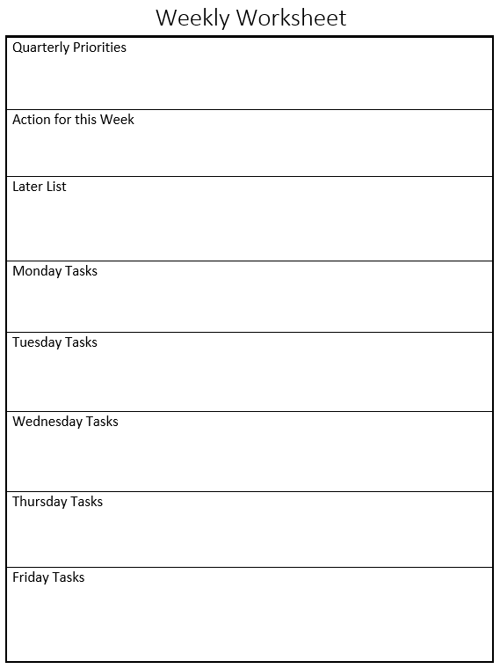
Worksheet Options
Homemade list for the week
Template with digital calendar inserted
Five daily pages with note section

Slide 30
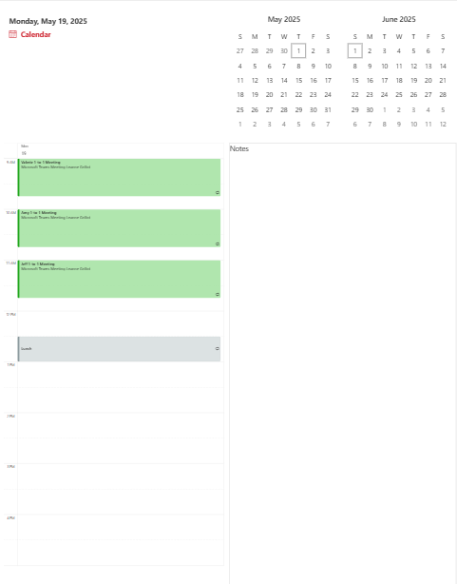
Building Your Own
Priorities
Meetings
To-Dos
Ready for Change
Personal

Slide 31

Little Things Make a Difference
Time to eat
Time to move
Time to travel

Slide 32
Routines and checklists

Slide 33
Seen and Heard (3)
“On the rare weeks when I actually sit down and prepare my calendar, schedule, etc., I am superwoman. But that doesn’t always happen.”
“At the end of the day all I want to do is collapse on the couch and watch TV. But then my mornings are always frantic because I don’t know what’s coming up.”
“There are so many weekends when I can’t relax because I just feel so anxious about the crazy week I have coming up.”

Slide 34
Meeting with Myself
Clean Up
Any papers accumulated?
Emails need addressing next week?
Review residual meeting notes.
Empty brain.
Look Ahead
Priorities reflected?
Review upcoming meetings.
Review Later List, Thought Catchers, and Calendar.

Slide 35

Block Out Time
Opening and closing routines
Monthly or quarterly reviews
Batch processing

Slide 36
Save It for Later!

Slide 37
Seen and Heard (4)
“My email is clogged with so many one-off FYIs from people – wading through them is exhausting.”
“Often times I’ll walk into a meeting and remember five minutes later things that I wanted to be sure to tell a person but forgot.”
“Every week, I spend thirty minutes staring at the computer screen trying to remember everything I want to put in my weekly update to my supervisor.”

Slide 38

Benefits of Thought Catchers
Maintain focus
Filter your thoughts
Reduce email
Save time
Decrease ambushes
Capture feedback

Slide 39
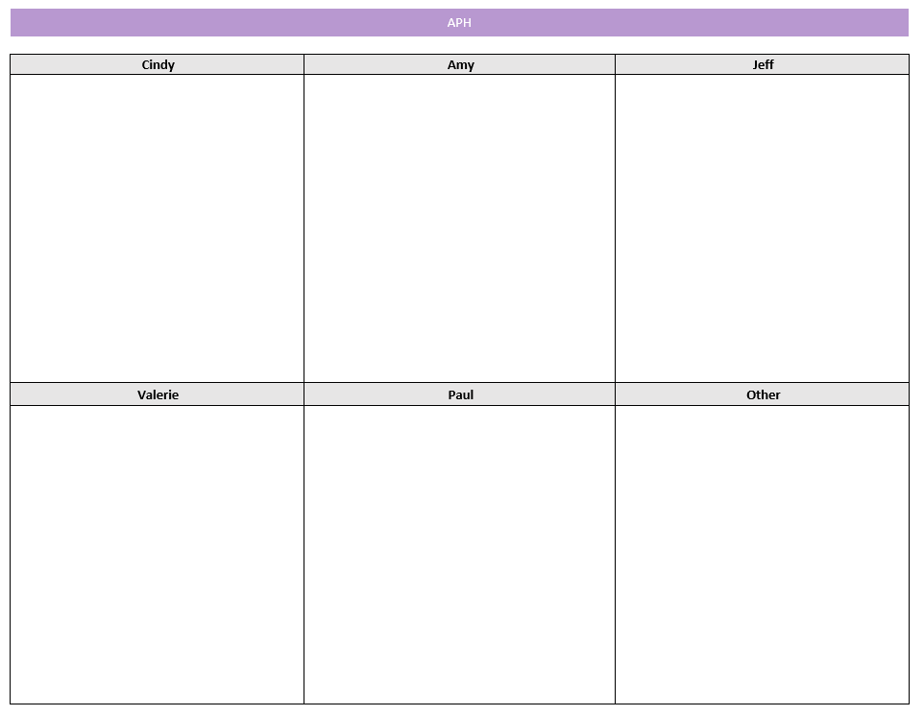
Collected by People

Slide 40
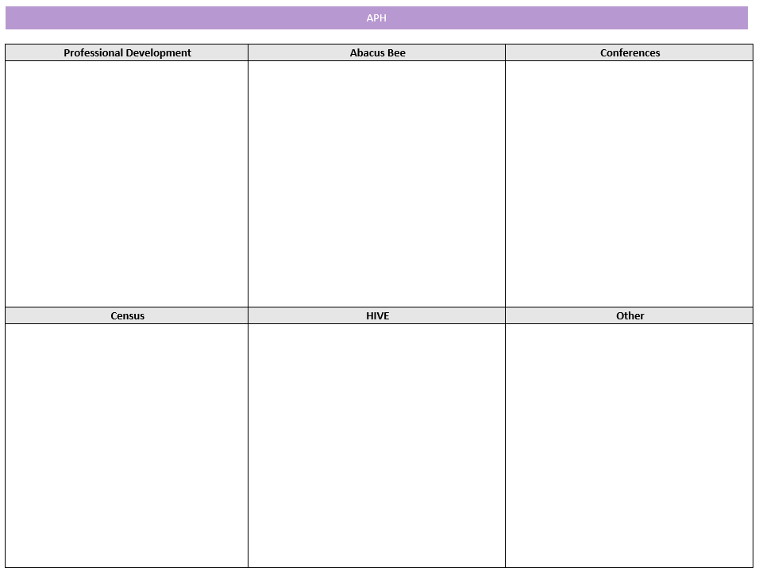
Collected by Topic

Slide 41
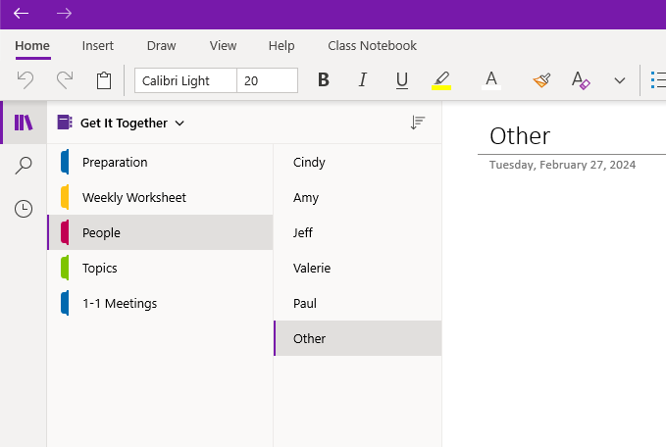
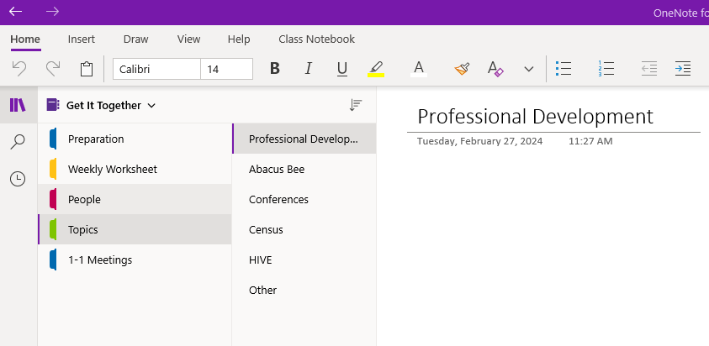
Use OneNote

Slide 42
Keep Email in its Place

Slide 43
Seen and Heard (5)
I feel email shame! Like, a good emailer has everything in folders or deletes and I don’t!
I wish I could just talk out issues and not send out long elaborate emails that take forever to close out.
Logging into email seems to suck my time dry. I think I am only going to spend a few minutes, and hours later, I’m in deep.

Slide 44
Email Intentions
Identify the root cause of your email challenge.
Clear clutter to set up your in-box for success.
Efficiently process incoming email using STAR-D.
Set up routines and rituals for when and how you check your email.

Slide 45
Get Your In-Box Set Up for Success
Declare bankruptcy
Don’t double process emails
Disable pop-ups, beeps, and buzzers
Schedule times to check (reliable not immediate)
Jail the junk
Unsubscribe
Auto respond wisely

Slide 46
Auto Respond
Time frame you will be out
How to reach in an emergency
Whom to contact in your absence

Slide 47
Daily Habits
Scan
Trash
Archive
Respond (from the oldest up)
Defer (until later in that day or place on calendar/later list)

Slide 48
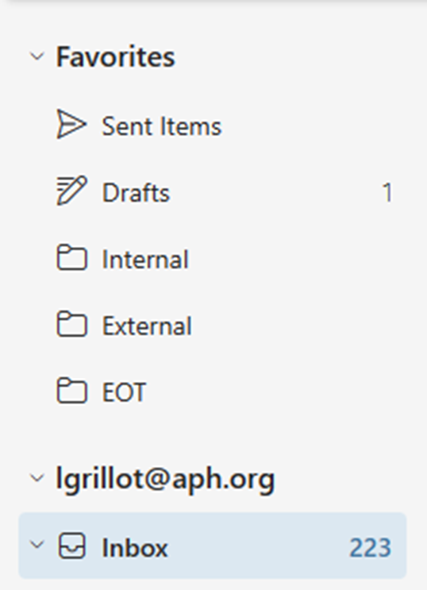
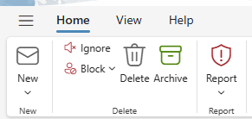
Archive versus Folders

Slide 49
Email Efficiency
Be considered reliably responsive
Create focused work times which are not interrupted by emails
Clear clutter to set up your in-box for success
Straightforward email writing
Process email efficiently
Set routines for when and how you check email

Slide 50
References
Heyck-Merlin, M. (2016). The Together Leader. Jossey-Bass.

Slide 51

ACVREP Submission www.aphhive.org
Enter Hive with QR code
Select sign-in
Click “Event Certificate Request”
Enter opening and closing codes
Click “Validate Codes”
Notes:
Review slide

