Slide 1
APH Customer Experience

Slide 2
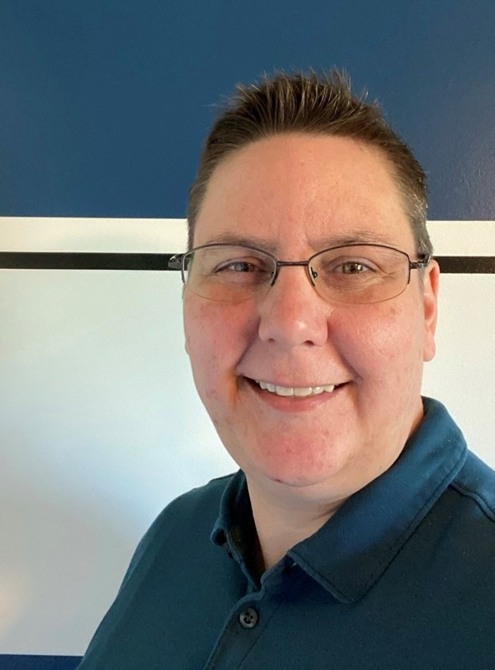
Presenter
Erin Fulkerson
Director, Customer Experience

Slide 3
Who is Customer Experience (CX)?
Order Entry & Repairs
BJ Reece
Dimetre Jackson Grainger
Customer Experience
Amy Corn, Supervisor
Alex Huguenin
Courtney Gilbert
Ernie Segura
Montana McInnis
Technical Support
Amber Messmer, Supervisor
Matt Bittinger, Monarch Support
Alyssa Erven
Amy Harris
Carrie Schaffer
Total of 12 FTE; Team is mostly remote, with staff in nine states; 67% of team is BVI.

Slide 4
Customer Experience Statistics
2025 Year to date
CX calls & cases handled: 14,189
Average customer service & repairs call handle time: 10 minutes
Average customer service & repairs caller time in queue: 1.5 minutes
Average tech support call handle time: 17 minutes
Average tech support caller time in queue: 0.5 minute
Average case handle time: 1.9 days

Slide 5
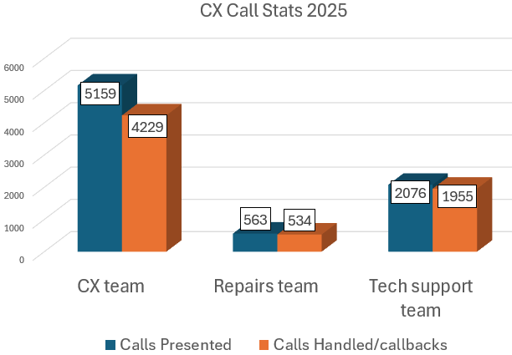
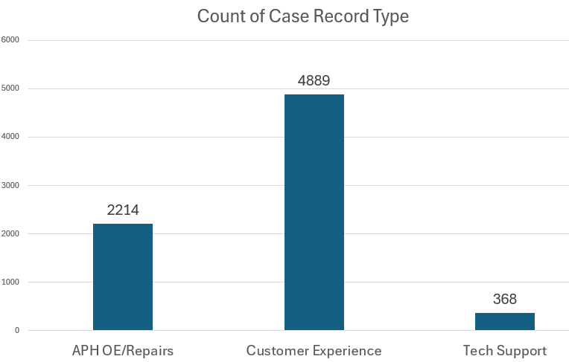
Customer Experience Interactions

Slide 6
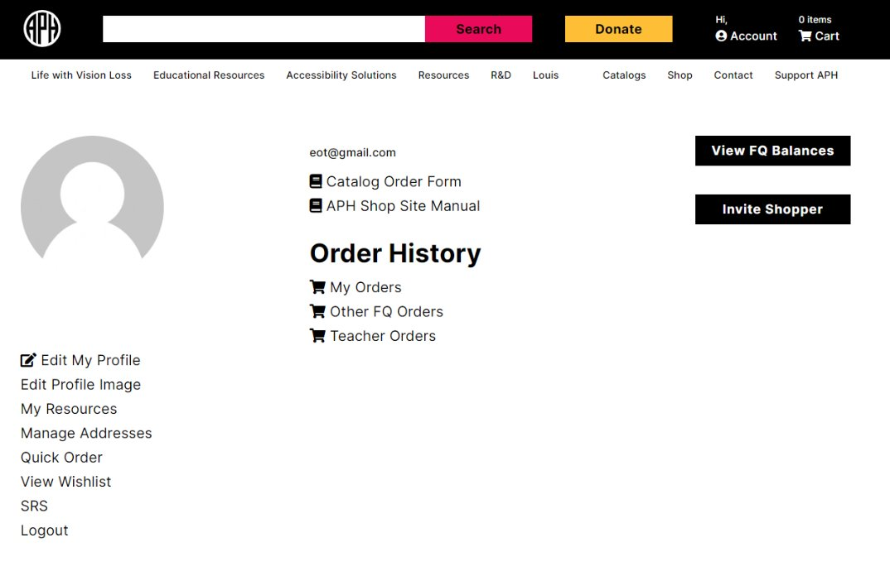
APH.ORG Refresh
Account Dashboard
Use the account page to see your current FQ balances, find catalog quick link, outstanding orders, invite shoppers, and access additional resources.
Order History is available by user​.
Teacher Orders lists invited shopper orders for review and approval/denial.
My Resources: find helpful links to web site user guides, discontinued list, Braille Bricks manual FQ order form, and an APH email directory
Address Book to store recurring addresses ​
Quick Order form​ to order by catalog number and build your cart quickly
SRS site link
Quota pricing for available products can be viewed once you are logged into your account.

Slide 7
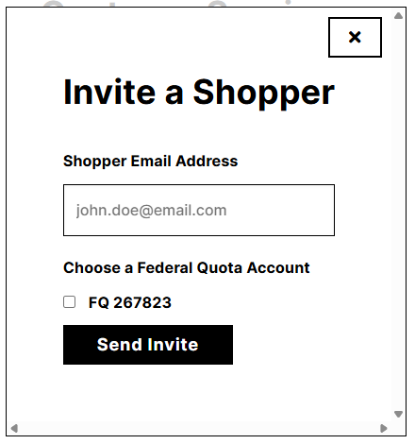
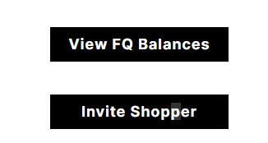
APH.ORG Refresh, cont.
Invited Shopper
The invited shopper feature allows you to invite teachers or others to browse and shop on APH.org using Federal Quota funds. ​
All orders are held for review. EOTs and OOAs may edit, reject, or approve teacher orders.​
For specific training on this tool, check out the Federal Quota EOT Document under My Resources or reach out to APH Customer Experience at support@aph.org

Slide 8
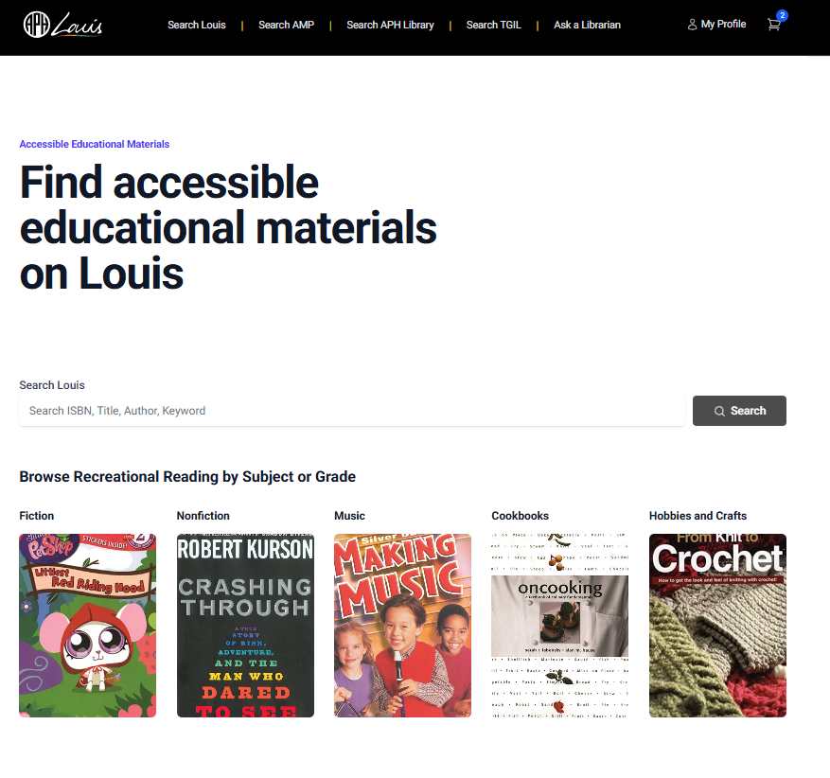
APH.ORG Refresh, cont. 2
Louis – louis.aph.org
Use Louis to find accessible textbooks and other materials from APH and other accessible media producers.​
Search by ISBN number or use search filters​
APH-produced materials can be added directly to your cart for checkout.​

Slide 9
Returns & Replacements
Contact Customer Experience by phone or email at support@aph.org to request a return or notify of incorrect or missing orders/parts for replacement.
Return & replacement requests should be requested within 60 days of shipment.
Return Authorization (RMA) # is required prior to return and must be noted on outside of package.
Suggested carrier return methods are USPS or UPS for tracking purposes.

Slide 10
How to contact Customer Experience
CX Customer service & technical support email: support@aph.org
CX order placement/repairs: po@aph.org
Monarch support email: monarchsupport@aph.org
Phone: 800-223-1839 8am-8pm est Monday-Friday
Aph.org: Contact Us, Product Support form, Repair form
Fax or mail

Slide 11
How to contact Customer Experience, cont.
Links for aph.org contact formats:
Contact us link: https://www.aph.org/contact-us/
Product support link: https://www.aph.org/customer-service/
Repair link: https://www.aph.org/customer-service/repair/

Slide 12
Questions?

Slide 13
THANK You!

