Slide 1
Louis and NIMAC
Updates

Slide 2
READS/NIMAC Department
READS (Louis Database, APH Library, TGIL, Evaluation Services)
NIMAC
Nicole Gaines, National Director of Digital Access Initiatives

Slide 3
NIMAC

Slide 4

The NIMAC Project
Created by IDEA 2004, the NIMAC is the national source file repository for K-12 textbooks and instructional materials.
We make NIMAS files available for use in producing accessible formats for K-12 instructional materials.
We have received over 84,000 file sets from over 200 publishers.
All 50 states plus the 6 eligible outlying areas and the DoDEA work with the NIMAC.
NIMAC users have downloaded over 54,000 files from the repository.

Slide 5
The NIMAC and States
IDEA 2004 does not require that states work with the NIMAC, but all states have chosen to do so.
States that coordinate agree to:
Require NIMAS from publishers in their textbook procurement contracts
Abide by the eligibility requirements of IDEA and copyright law in the use of NIMAS and distribution of materials produced from the files
Each state has a State Coordinator who designates the Authorized Users of the NIMAC for the state.

Slide 6
EOTs and the NIMAC
As an EOT, you may or may not have a direct relationship with the NIMAC.
If your state has not designated APH as an Authorized User, when you place a custom textbook order with APH, an Authorized User for your state will need to assign APH the NIMAS file so APH can download the file.
If you are not sure who the AUs are in your state, please reach out and we will be happy to help.

Slide 7
Braille Transcriber Groups
The NIMAC offers quarterly professional support for textbook transcribers.
There is a group for Duxbury users and another group for Braille 2000 users.
For more information or to get on the email list for meetings, just contact us at nimac@aph.org

Slide 8
READS

Slide 9
Louis Database
Louis is a free service of the American Printing House for the Blind that brings together information about accessible formats from over 50 organizations in one searchable online database.
Louis contains information on over 1.1 million books in accessible formats, with a focus on K-12 instructional materials, including textbooks and recreational reading.
Formats listed in Louis include braille, large print, audio, and a range of digital text formats.
Louis also includes information about materials available from Bookshare, Learning Ally, and NIMAC.

Slide 10
How to Order from Louis
Louis is the best place for teachers or administrators to locate accessible formats that are already available – or in the case of braille, are in the transcription pipeline – from over 50 organizations.
Louis provides contact information for each organization so that your customer can reach out directly to the provider for more information on how to acquire the needed format.
Louis is also the platform for purchasing and downloading APH textbooks!

Slide 11
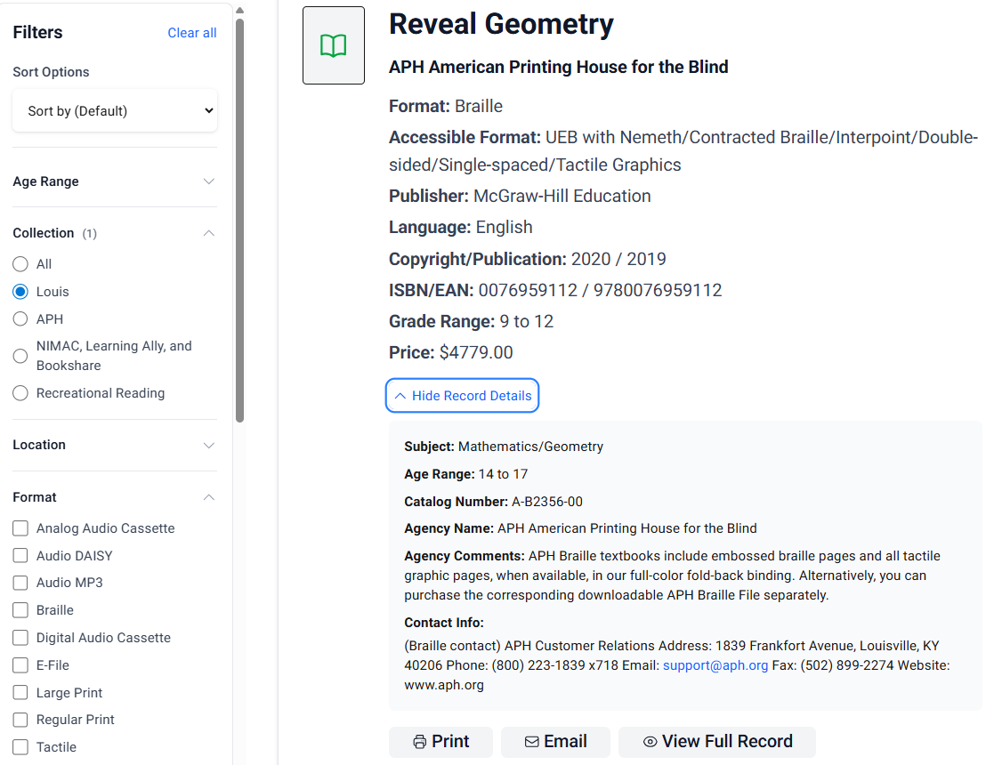
Louis Search
ISBN searching is recommended for K-12 instructional materials.
However, the basic search function is a keyword search that includes the entire record (e.g., subject, title, series, author).

Slide 12
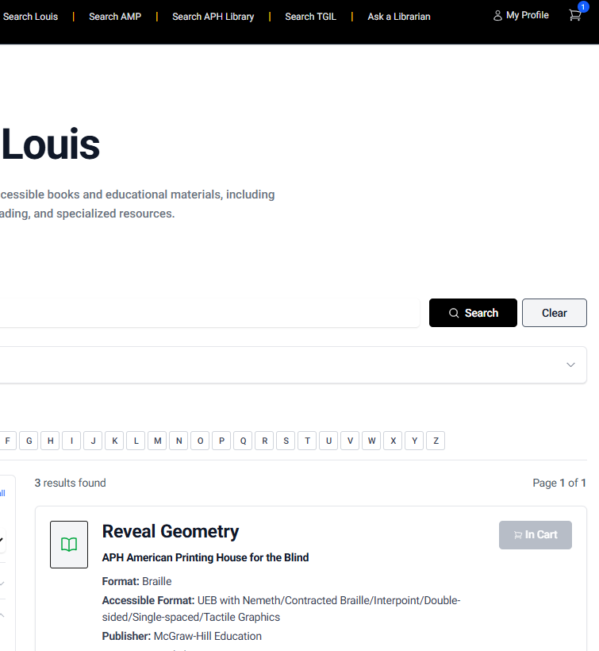
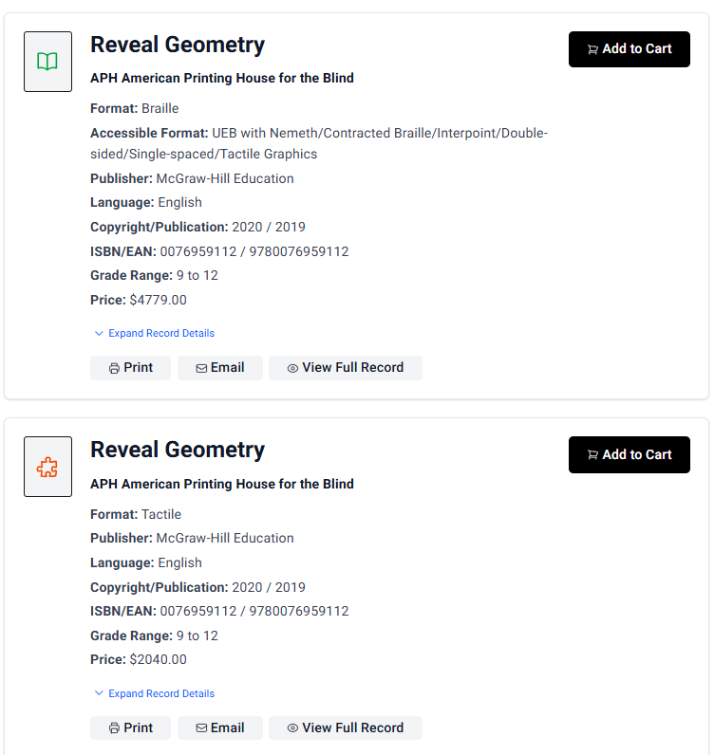
Louis Shopping Cart

Slide 13
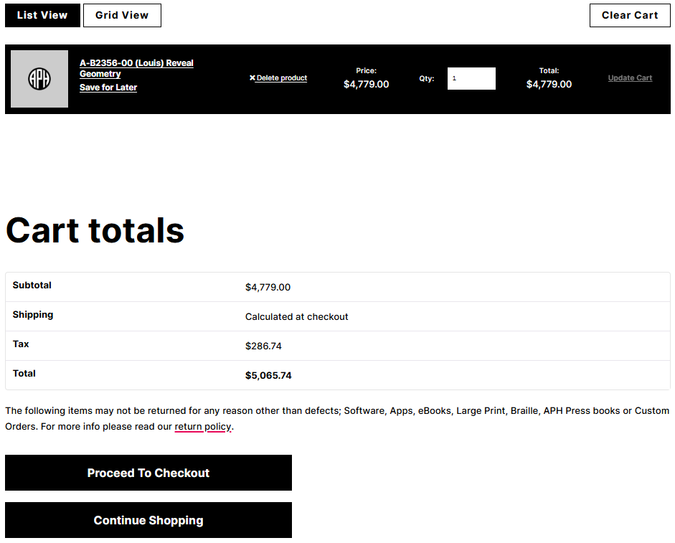
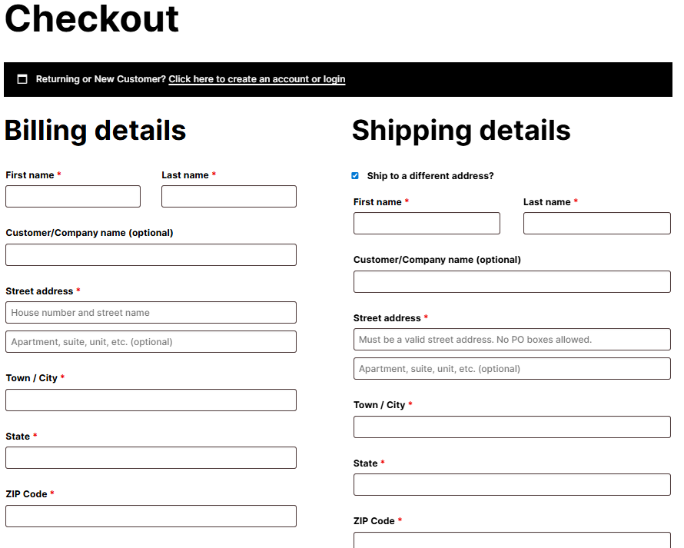
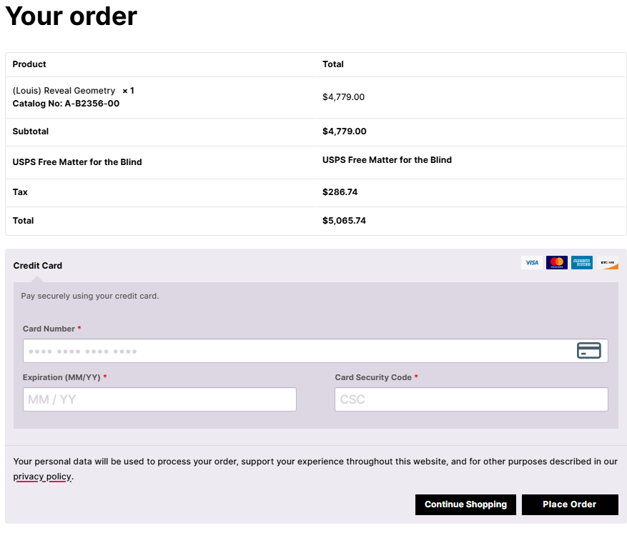
Shopping Cart Checkout

Slide 14
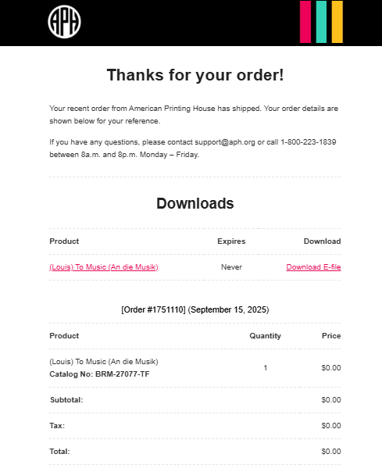
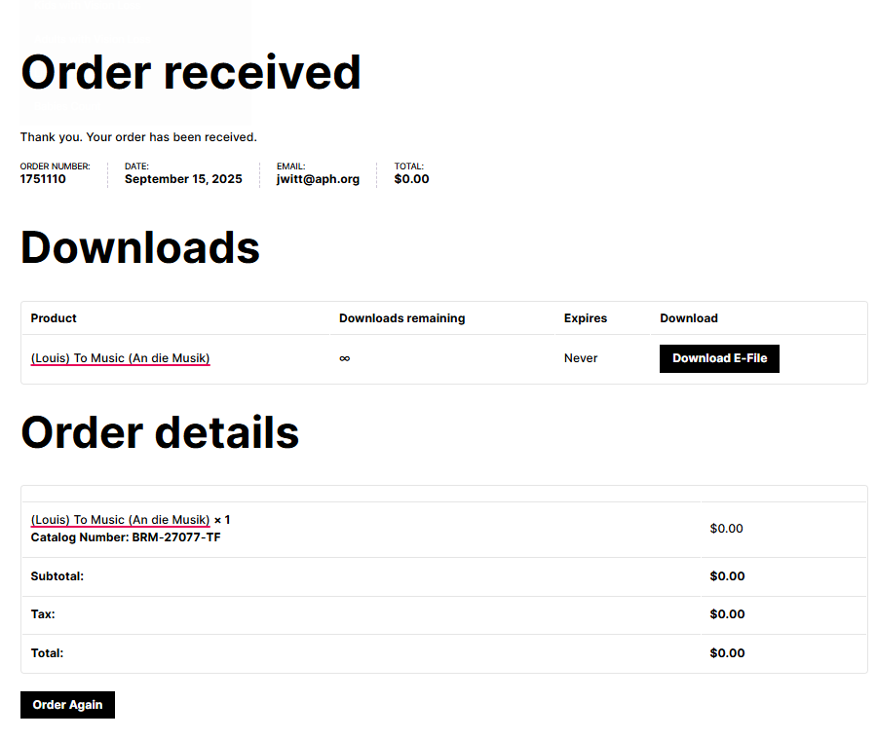
Electronic File Checkout
Electronic files are available upon transaction completion.
Downloadable link following the checkout
Email link

Slide 15
THANK You!

