Slide 1

Accessible Textbooks
Braille, LP, and Digital: Media for Growth

Slide 2
Introduction
Michael Haynes, Manager, Accessible Textbooks and Tests Dept. (“ATT Dept.”), mhaynes@aph.org
Our department (formerly known as ATIC) was founded in 2000 to improve textbook quality and delivery
APH used to deliver about 4 braille textbooks/year. Our dept. averages 200 new braille and LP titles annually
After 26 years, ATT has produced more than 5,000 new titles requests in braille and large print!

Slide 3
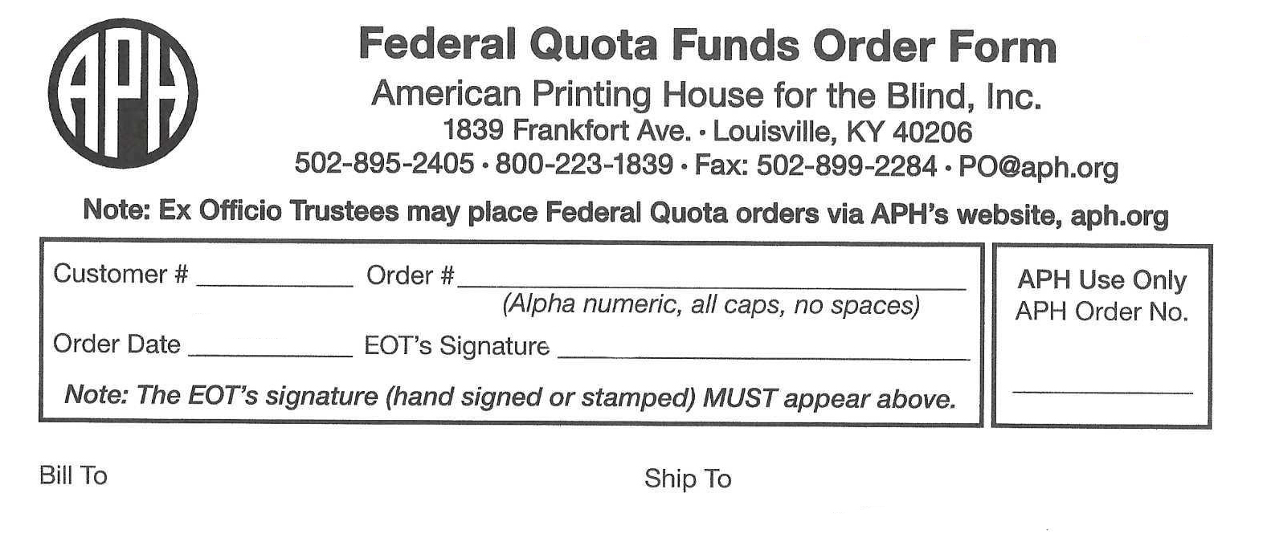
Which materials are available?
Hardcopy braille and large print textbooks
Braille graphics-only package (made by APH)
Large print digital files (PDF download)
Braille files (.BRF), and soon eBraille!
ALL items are available using Federal Quota funds!

Slide 4
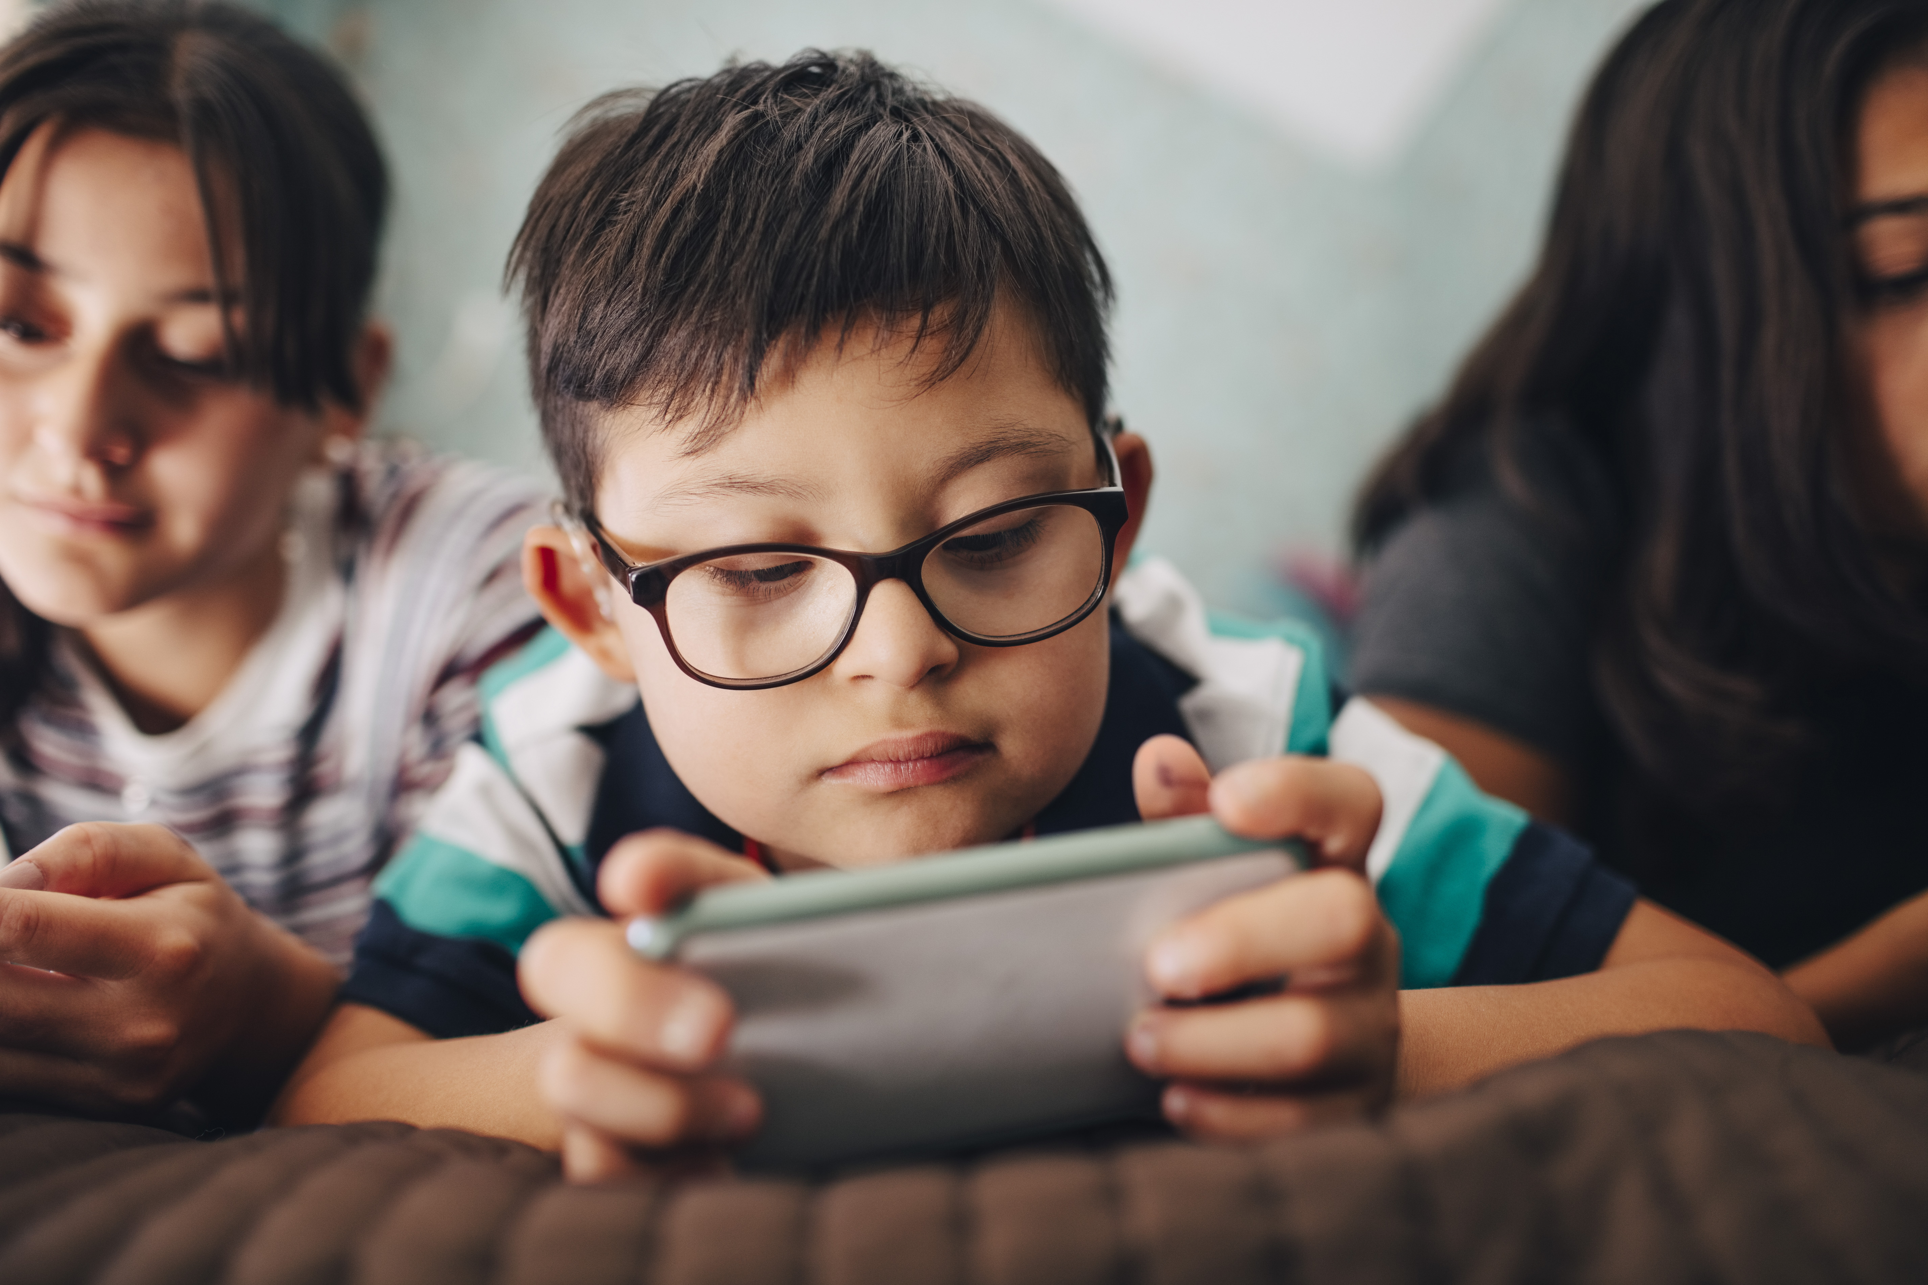
About those digital files…
Instant delivery: no wait for final production!
New titles still require transcription and QC.
LP PDF’s usable on most e-devices; BRF’s for most braille-ready devices and embossers.

Slide 5
How to obtain APH accessible textbooks
Search Louis: https://louis.aph.org. Always use ISBN.
If you find the LP or braille version of your title available from APH, including digital files, order instantly and directly from Louis.
APH can accept most LP requests for titles currently available from other sources. We cannot accept new requests for braille titles available through other producers, unless you need a different braille code from what is currently offered.
If your title (hardcopy braille, LP, or digital file) is not located, proceed to order your new textbook at our website…

Slide 6
How to obtain textbooks (continued)…
2. Order new textbooks at: https://www.aph.org/educational-resources/accessible-textbooks, selecting the relevant form.
Complete all book and contact information, attaching your purchase/FQ documentation before submission.
Some restrictions: K-12 classroom textbooks/trade books only; 5-year-old copyright or less; national editions only (no state eds.); cancellations not possible after transcription begins.
You will receive a customer memo/confirmation with estimated cost and delivery date, with shipping details and options.

Slide 7
How to obtain textbooks (final)
3. After placing your order, go to the NIMAC website: https://nimac.us to search for your book title using ISBN.
If available, you can assign the NIMAS file to APH as your AMP (Accessible Media Producer). Many states have already authorized APH to download files on their behalf.
If not available, you can add the file to the NIMAC ‘wishlist.’
NOTE: NIMAS files are not end-user ready; they are tools to help us create your book.

Slide 8
After ordering… until shipment!
APH LP books are 8.5” by 11” in 18-point font, full color. Base cost is 60 cents per LP page; delivery can range from 6-12 weeks, depending on season.
APH braille textbooks are transcribed in UEB (for relevant titles, select UEB w/Nemeth or UEB Math/Science on your order form). Timeline for the first set (3 to 5 volumes) is 90 days from order date. After that, one additional set each month. Cost estimates vary widely; your funds pay only for embossing and binding, and, if applicable…
Shipping! Free Matter is default method for all books, but not always great for speed. You have the option to upgrade shipping speed with your funds.

Slide 9
Accessible Textbooks Wrap-up!
This was a quick “tour” of all accessible textbook media we offer.
To get the “full” experience of the entire textbook process, come to our 2-hour Friday afternoon session “I’m Just a Book (An Accessible Book!),” a multi-dept. collaboration!
Questions? Contact:
Braille: Dawn Rightenour (brailletextbooks@aph.org)
Large Print: Rhonda Kieffer (largeprint@aph.org)

Slide 10
THANK YOU!

