Slide 1

Monarch Pilot, Project, and Progress
Expanding Access Through Innovation

Slide 2
The Growth Of The Monarch

Slide 3

Greg Stilson
VP – Digital Transformation

Slide 4

Jason Martin
Technical Innovations Product Manager

Slide 5
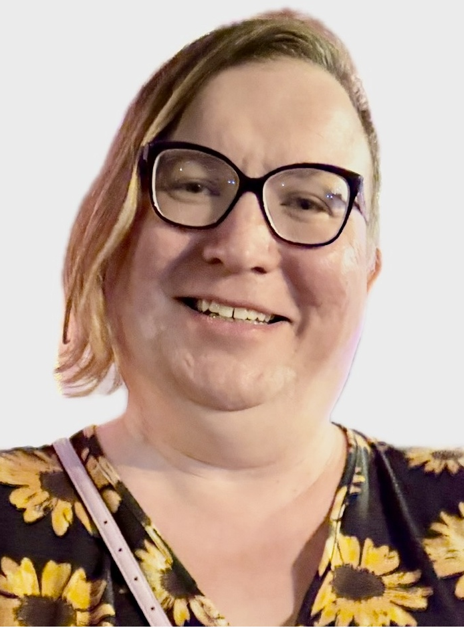
Willow Free
Technical Innovations Product Manager

Slide 6
Monarch Version 1.4 Coming Soon!
Will be available shortly
Office 365 integration
Google Drive integration
Bluetooth braille terminal connectivity
iOS multiline braille coming
Full eBraille support in the book reader

Slide 7
Monarch In The Cloud
Google Drive and 365 integrated via KeyDrive
File manager app now shows KeyDrive. After authenticating 365 and Google both appear as separate drives
Simple copy and paste
Students can work with Google docs in the cloud and do not have to bring them to their local device
If cloud docs contain math objects, they will be translated into the student’s preferred math code

Slide 8
Ready for eBraille
Started in 2022
Worldwide effort with over 40 orgs
Revolutionary dynamic, interactive, and navigable new braille file type (Braille ePUB)
Combines both braille and tactile graphics in one file
Enables digital delivery
Will benefit all electronic braille tools and embossers
APH developing a Converter to batch convert BRF to eBraille in seconds

Slide 9
eBraille On The Monarch
Victor Reader book reading app will now support eBraille files
Students will see spatial formatting as if they were reading a physical book
Tactile graphics will be included
Student points and clicks on the graphic indicator and it opens in Tactile Viewer
Double press the apps square button to flip back to the contents of the book

Slide 10
Apps, Apps, And More Apps

Slide 11
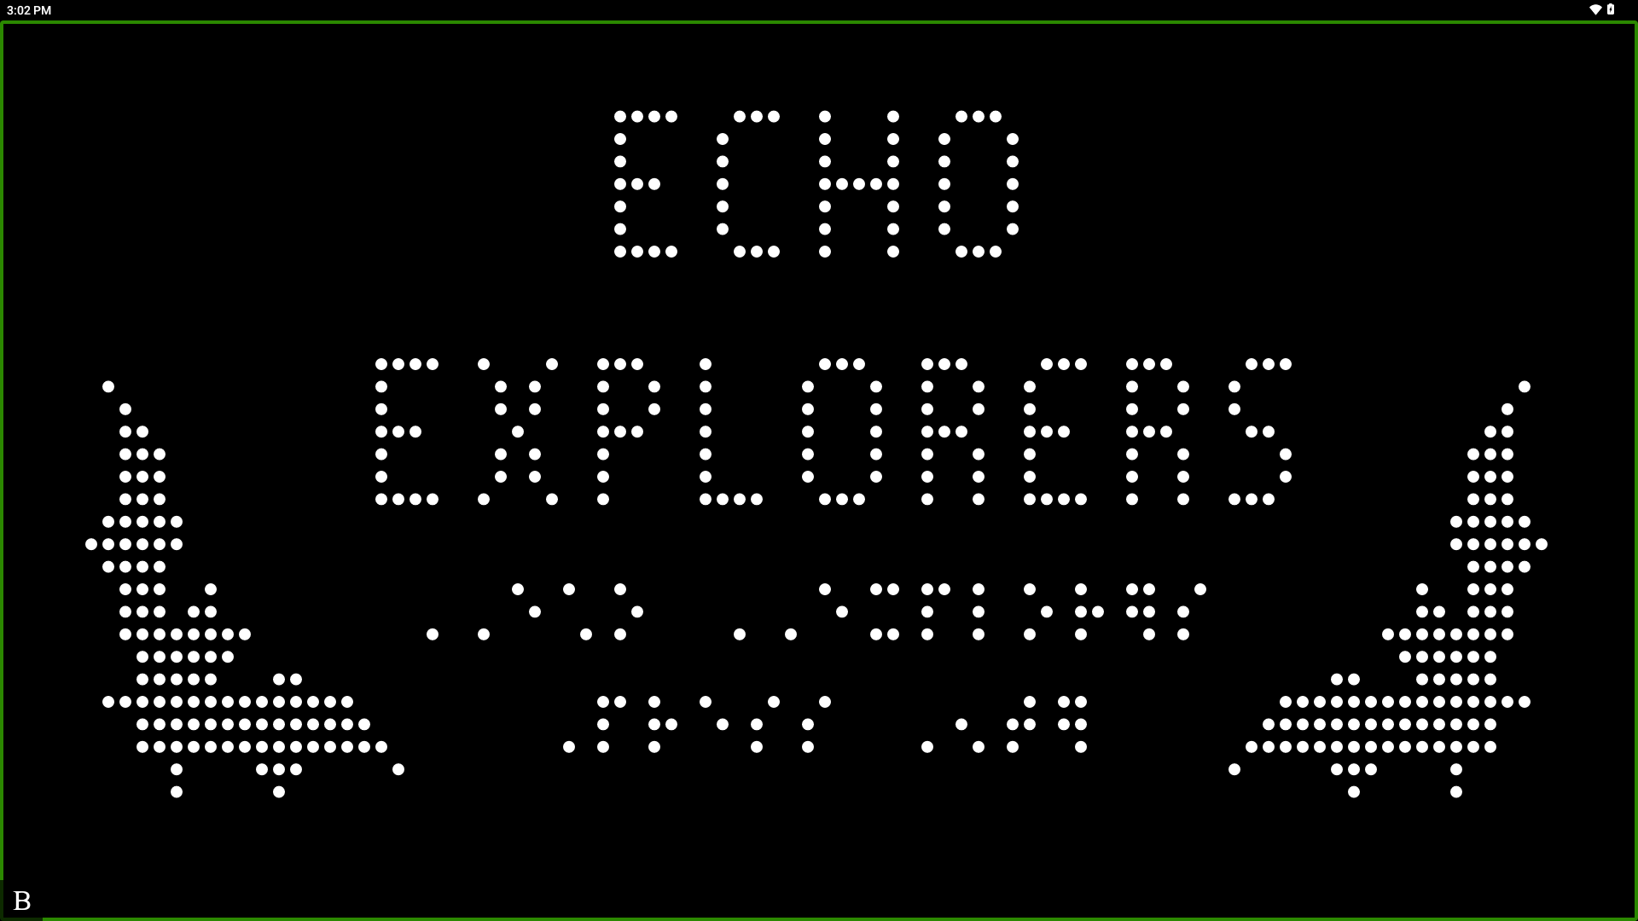
Cyber Chase Echo Explorer
Partnership with PBS Kids
Fully immersive tactile game ported to the Monarch
Blind students play the exact same game as their sighted peers
Story contains tactile graphics with optional descriptions when needed
Teaches valuable gaming skills along with tactile discrimination, spatial and many more
Gives our students the opportunity to learn through play

Slide 12

Periodic Table
Interactive periodic table of elements designed for tactile exploration and braille reading.
Optimized for Monarch’s multi-line braille display and tactile graphics.
Grid-based table layout that matches the standard periodic table structure (groups and periods).
Quick jump to element by atomic number, symbol, or name search.

Slide 13
Periodic Table, cont.
Offline access to periodic data.
On selecting an element, display key data in braille:
Atomic number
Symbol
Name
Atomic mass
Electron configuration (formatted for braille clarity)

Slide 14

Wing It
Enables TVI's, classroom teachers, family or peers to draw on an iPhone or iPad app
A paired Monarch instantly displays drawings in a tactile form
iOS user can add labels to the tactile graphic with the iOS keyboard and the print instantly translates to braille

Slide 15
Wing It, cont.
Monarch users can add their own labels on the Monarch and save or load tactile drawings
Drawings can also be shared via email to the student directly from the app when not nearby
Wing It is iOS VoiceOver Accessible
Download Wing It from iOS.

Slide 16

Monarch Chess Goes Online
Created to serve as a method to teach Point-to-Click
Fully playable on one screen
Full feature tutorial including the basics of chess and how to play our version.
Single and local multiplayer
iOS application in current development
Online play with Lichess

Slide 17

Monarch 45w
Created for Monarch to encourage literacy.
Completely original and tactile reimagining of a popular word game.
The ability to guess 4 and 5 letter puzzles, adding to the approachability for student access.

Slide 18
Monarch 45w, cont.
Access to past challenges through an expansive list of archived words.
Infinite replay-ability.

Slide 19
Student Pilot Project

Slide 20
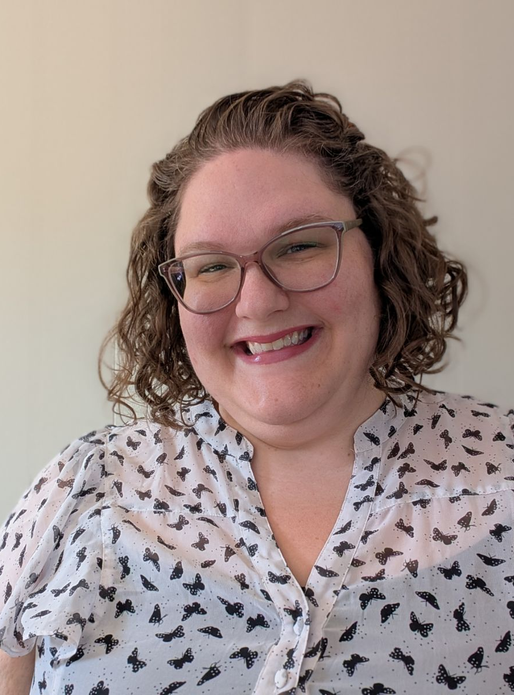
Sarah Gauer
Project Manager – Monarch Student Program

Slide 21

Project Goals
Give students year-round access to powerful new braille technology
Learn from real-world experiences with Monarch
Discover what tools, training, and support help users thrive with Monarch

Slide 22

Key Project Details
Monarchs provided on long-term loan to the family
Participation continues until high school graduation
Monthly questionnaires for students and educators

Slide 23
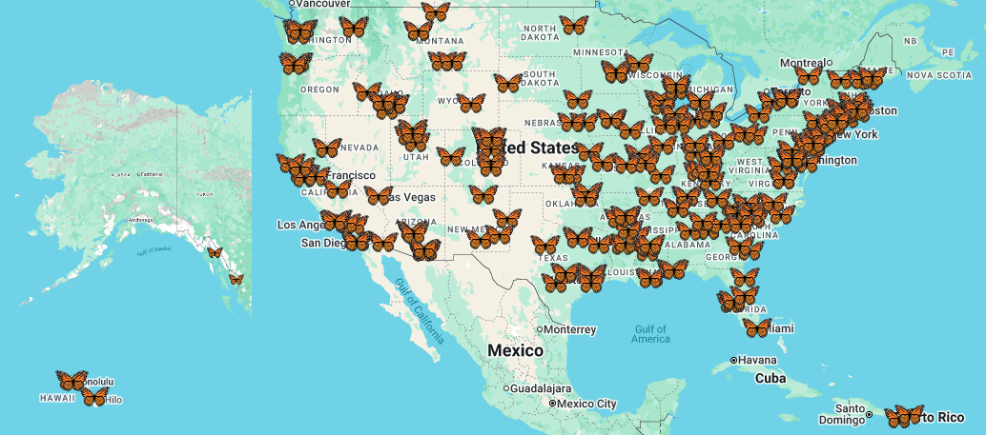
More Than 225 Strong!

Slide 24
What We've Learned So Far
Students are accessing more tactile graphics (TG)
76% of students reported greater access to TG
Nearly 70% said they learned something new because of the greater access to TG
"It's very cool, as depending on what I want to know, I can use different levels of detail with zoom to fine tune what I'm looking at. This is a feature which isn't really possible to recreate on a hard copy graphic that has been embossed." – 11th grader from Wisconsin

Slide 25
What We've Learned So Far, cont.
Participants are facing new challenges with TG
"Sometimes I feel a bit lost. I don't understand the tactile representations of many real-life objects because I've only seen them in 3D." - 10th grader from Nevada
New Concepts: Panning and Zooming
Lots of requests for high-level math and science TG
Educators and support staff need training on TG creation for Monarch

Slide 26
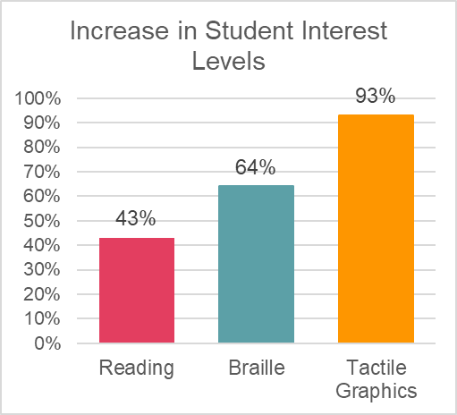
What We've Learned So Far, cont. 2
Increased engagement
Over 70% of students using Monarch said it made classes more enjoyable
Since introducing Monarch 43% of students are more interested in reading, 64% in braille, and 93% in TG

Slide 27
What We've Learned So Far, cont. 3
Hurdles for educators
School network connections
Learning alongside the student
Shift from their tried-and-true approaches for teaching

Slide 28
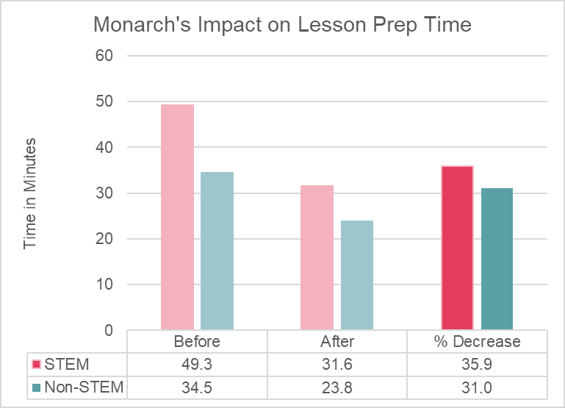
What We've Learned So Far, cont. 4
Educator successes
70% of Educators incorporated Monarch into their curriculum
These educators reported a 31-36% decrease in lesson prep time

Slide 29
What We've Learned So Far, cont. 5
Big ideas!
Additional levels of zoom for tactile graphics
More games, plus online gaming
"I want a braille display that is...as big as a wall so I can feel really, really, really big maps and see if I can train my whole arm to read braille." – 9th grader in Vermont

Slide 30
How to Stay Informed
Sign up for the Monarch Monitor newsletter
https://www.aph.org/contact-us/subscribe/

Slide 31
Monarch RISE Project
Resources for Innovation, Skills, and Employment

Slide 32

Erin Sigmund
Project Director – Monarch RISE Project

Slide 33
Monarch RISE Project Statement:
Braille access has long been recognized as critical for individuals who are Blind, Deaf-Blind, or have Other Visual Impairments in achieving and maintaining competitive integrated employment (CIE). The Monarch RISE Project is creating and empowering a sustainable community of Monarch users who can independently share strategies and success stories to advance their own and others’ success in preparing for, achieving, maintaining, and progressing in CIE.

Slide 34
Monarch RISE Project Theory of Change:
If we provide Monarchs paired with intentional, targeted training and hands-on support first to services professionals (AT Trainers, VR Counselors, University staff, etc.) and after to individuals who are Blind, Deaf-Blind, and have other Visual Impairments
then those individuals will achieve or progress in CIE by increasing their ability to present information effectively, collaborate inclusively with colleagues and produce high-quality work efficiently
because they will be equipped with the knowledge, tools, skills, and confidence needed to effectively use the Monarch in competitive workplace environments as part of a supportive community that shares strategies, solves challenges, and celebrates success.

Slide 35
Monarch RISE Project Goals
Distribute Monarchs and accompanying training activities
Support individuals in achieving CIE (can include part-time or seasonal employment and self-employment)
Create Monarch RISE public and participant community webpages
Launch at least one Monarch app for CIE
Identify how the Monarch and/or accompanying training activities enable individuals to achieve, maintain, and progress in CIE
Identify at least six targeted improvements to Monarch and/or accompanying trainings to promote CIE outcomes

Slide 36
Monarch RISE Project: Phase 1
Audience: Professionals and Mentors
Blindness Services Professionals (refers clients and students)
Blind, Competitively Employed Professionals (serves as mentors)
Timing: Summer 2025 – Ongoing

Slide 37
RISE Current Phase: Professionals Snapshot
Blind Professionals (25) Careers:
Accessibility
Customer Service
Engineering
K-12 and Special Education
Law
Marketing
Medical Counselling
Psychotherapy
Travel
Software Engineering
Research

Slide 38
Monarch RISE Project: Phase 2
Audience: Higher Ed and Early Career CIE Seekers
Early Career (2-5 years career experience) Individuals
College and University Students
Graduate and Post-Grad Students
Timing: Target Training Start Fall 2026

Slide 39
Monarch RISE Project: Phase 3
Audience: CIE Seekers
Transition-Aged Students
Adults
Deaf-Blind Individuals
Timing: Target Training Start Winter 2027

Slide 40
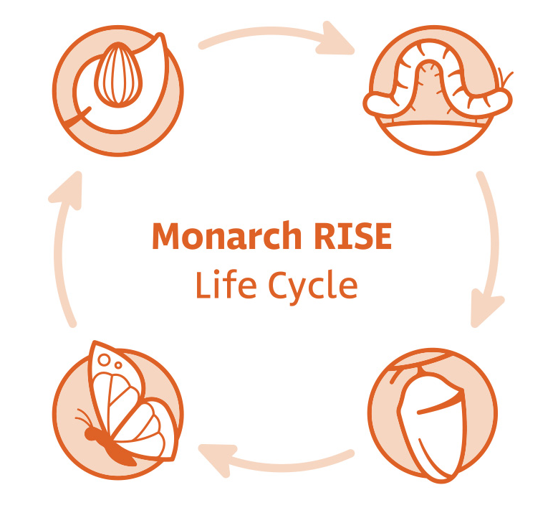
RISE Project Activities
Egg Stage: Project Intake and Onboarding
Caterpillar Stage: Asynchronous Tech Training on Monarch
Chrysalis Stage: Synchronous CIE and Monarch Trainings
Butterfly Stage: Ongoing Opportunities for Community

Slide 41

Professional Quote from Intake and Onboarding
“As a STEM professional, I believe that the Monarch has the potential to be a very useful tool for me and so many others working in, or studying in, STEM professionals. I look forward to learning, providing useful feedback, and mentoring up-and-coming STEM (and other) job seekers.”
– Blind Professional from Connecticut

Slide 42

Professional Quote from Asynchronous Tech Training
“The Monarch has the potential to bridge a gap we’ve been trying to close for years: not just access to information, but access to workflow.”
– Field Professional from New York

Slide 43

Professional Quote from Synchronous CIE and Monarch Training
A great resource talked about was Touch Mapper. I have used this site before to create 3D renders that help clients better understand street views, but I had not considered using it with the Monarch. I will definitely be checking that out as soon as possible. I also loved how shortcut keys can be used to navigate a graphic, as that feature can be very helpful when teaching clients different ways to explore tactile graphics.”
– Field Professional from Florida

Slide 44

Stay Informed: Monarch RISE Project
Creating and empowering a sustainable community of adult Monarch users to advance success in preparing for, achieving, maintaining, and progressing in competitive integrated employment (CIE).​
RISE Phase 1: Professionals: Ongoing​
RISE Phase 2: Early Career and Higher Ed CIE Seekers: ~ Fall 2026 ​
RISE Phase 3: Transition-Aged Students, Adults, and Deaf-Blind CIE Seekers: ~ Winter 2027 ​This project was funded by U.S. Department of Education under Grant Number #H421F240052. For more information, contact American Printing House for the Blind at RISE@aph.org.​
"I'm excited to be part of something that advances real access for blind users. As a legally blind TVI and parent of a blind child, I see both the gaps and the potential. [The Monarch RISE Project] gives me a chance to help shape tools that actually meet real needs in education, rehab, and daily life."
- TVI/CATIS/COMS/CVRT from Missouri

Slide 45
Monarch Support

Slide 46
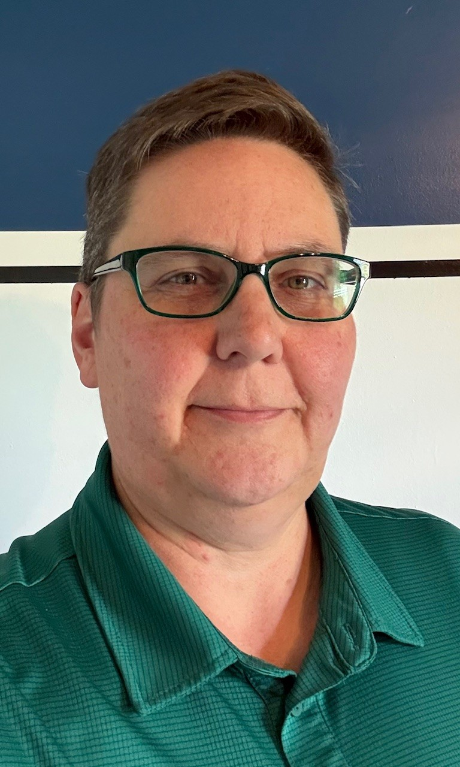
Who we are
Erin Fulkerson, Director Customer Experience

Slide 47
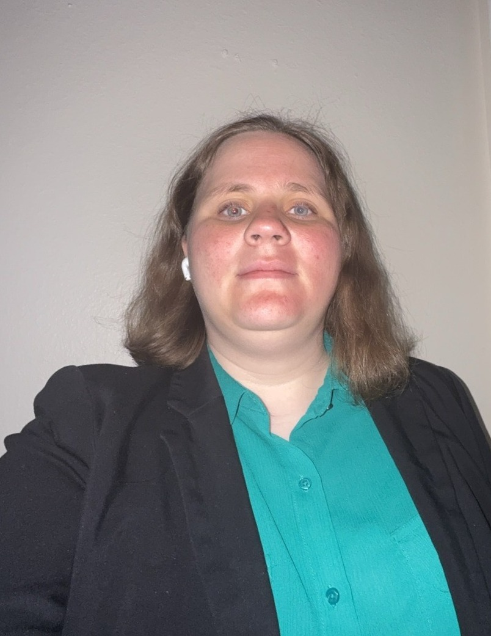
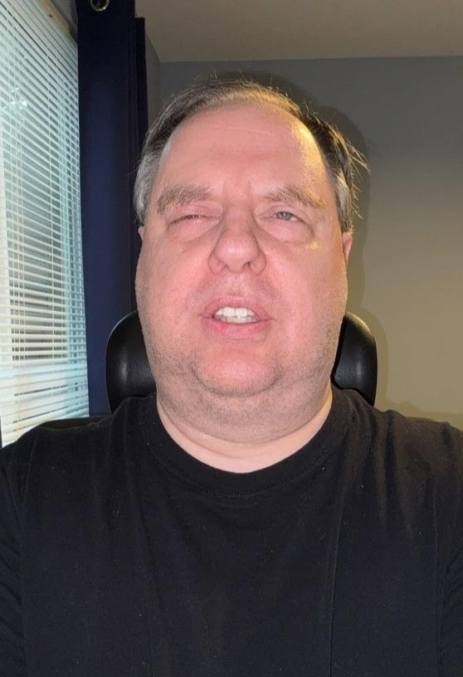
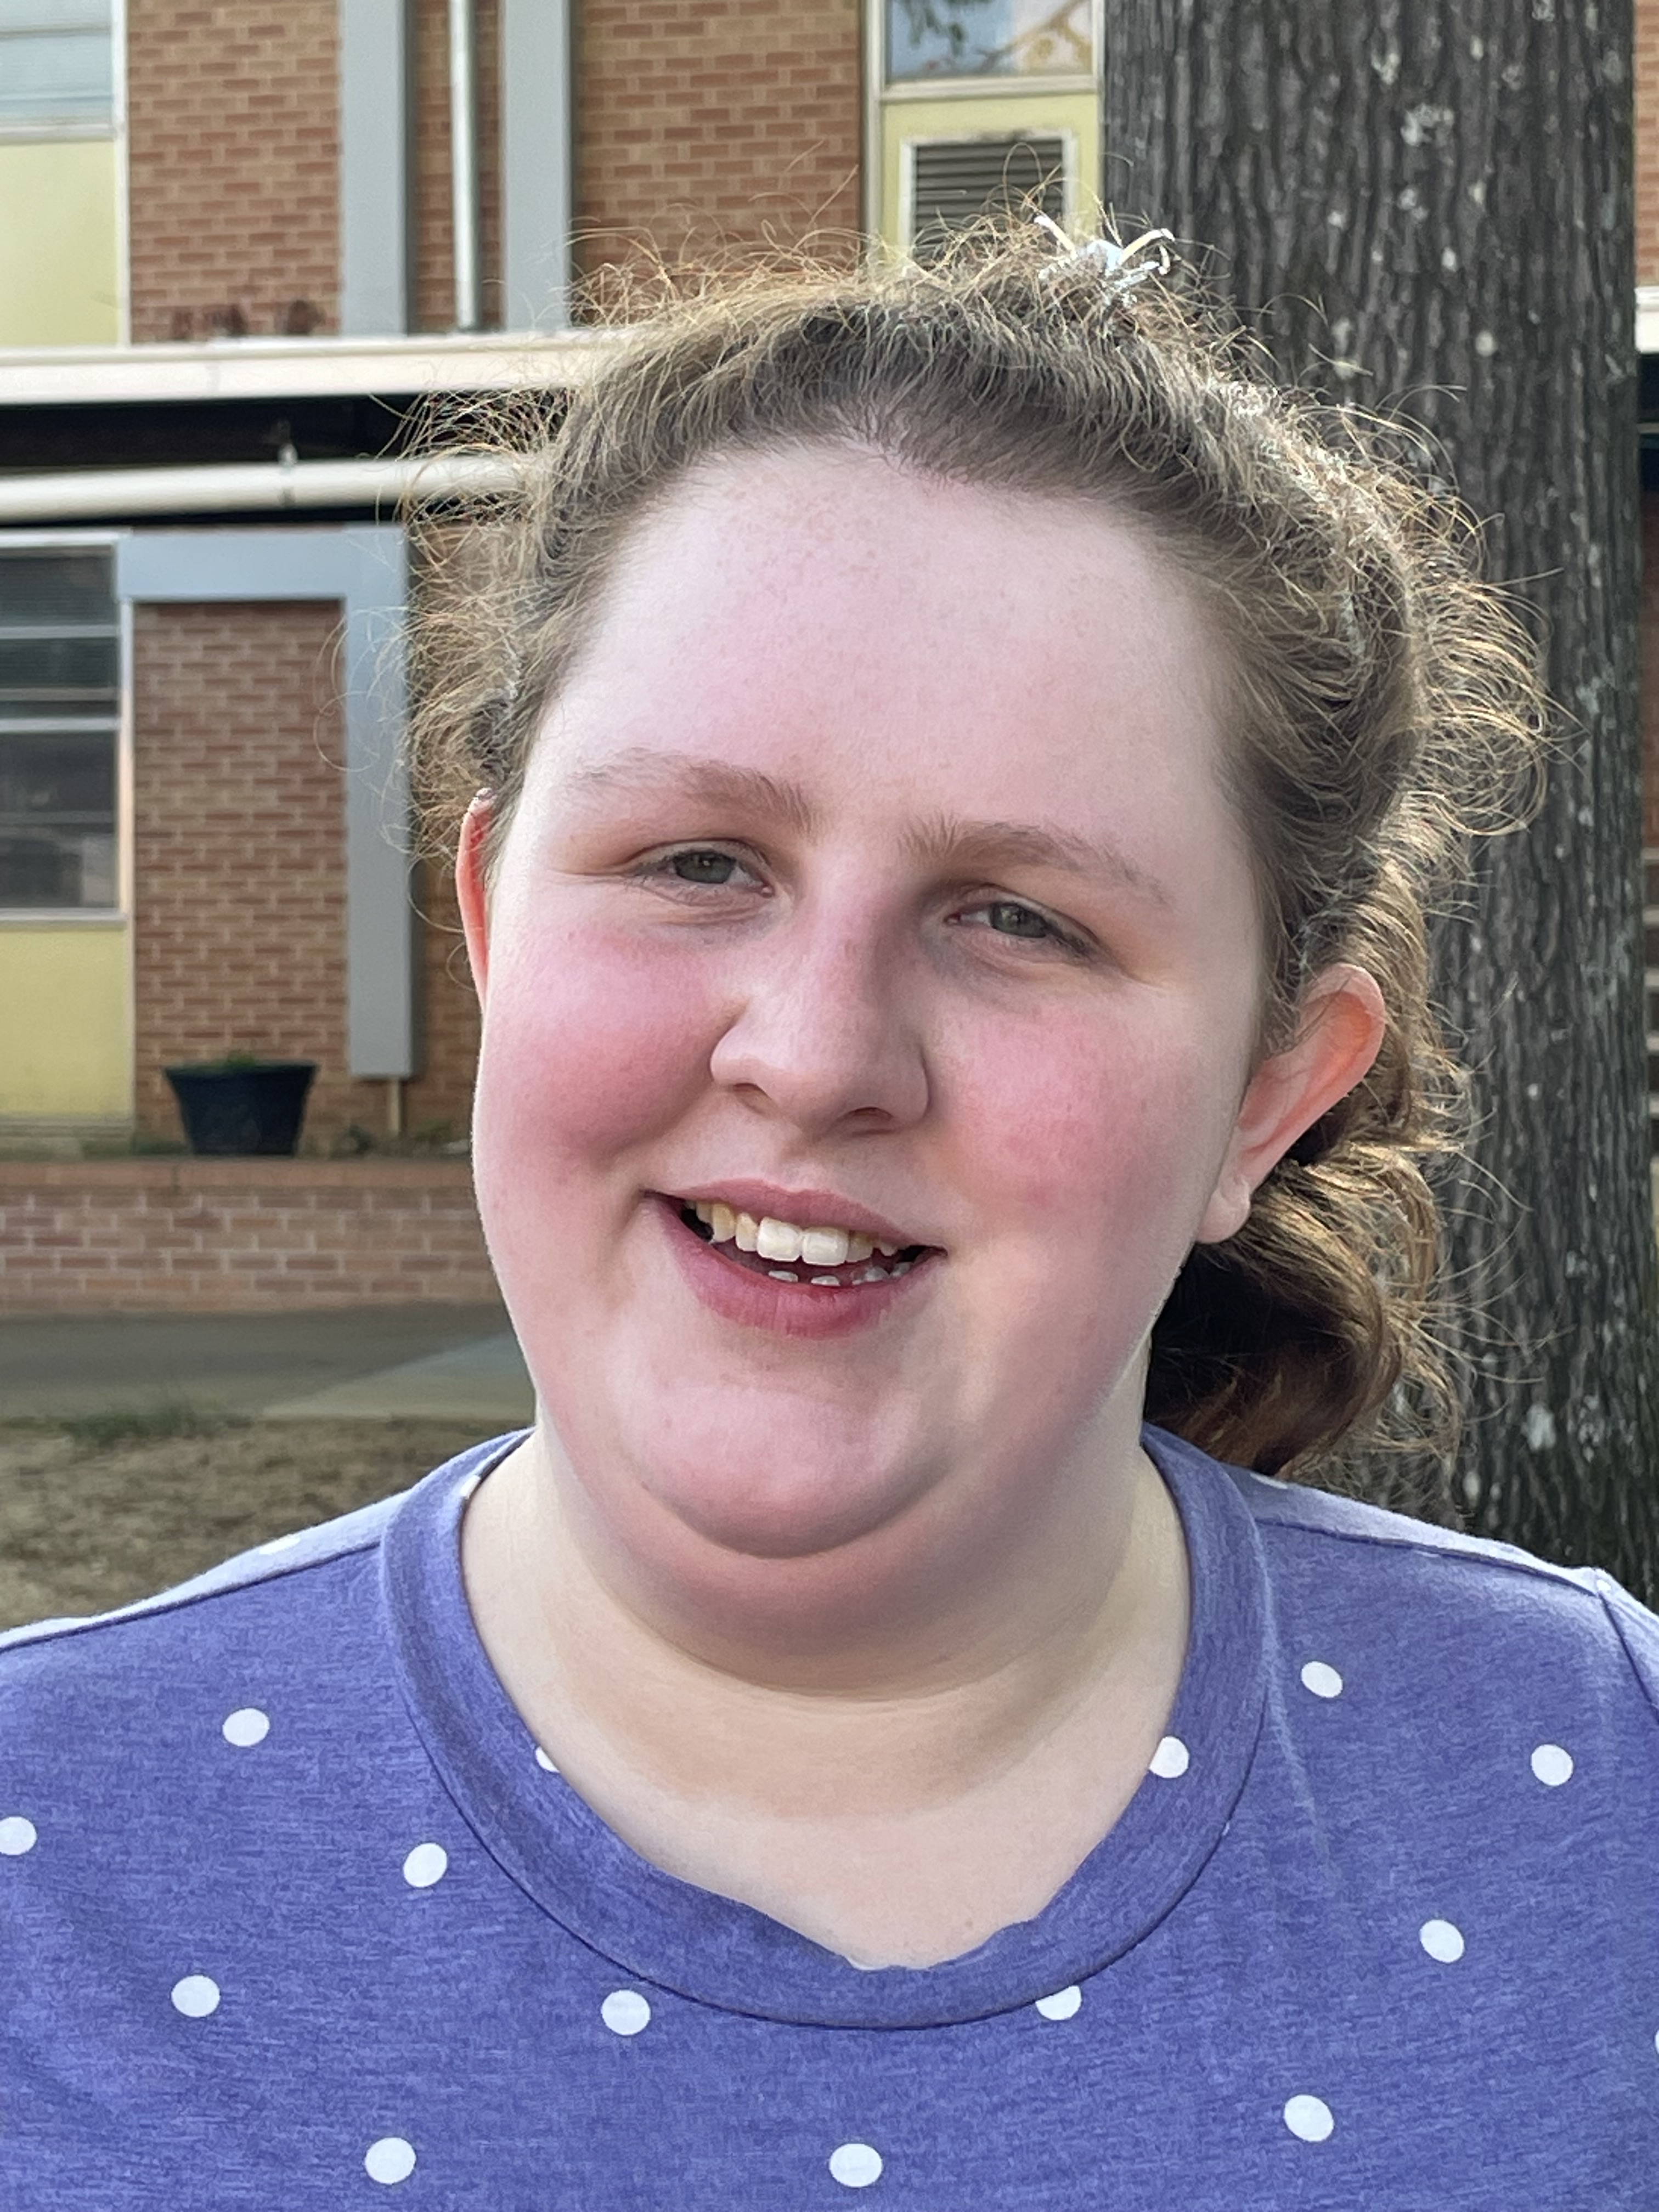
Who we are, cont.
Amber Messmer, Customer Experience Technical Support Supervisor
Matt Bittinger, Customer Experience Monarch Support Specialist
Alyssa Erven, Customer Experience Technical Support Specialist

Slide 48
White Glove Customer Experience
Dedicated email and phone number for direct Monarch support.
monarchsupport@aph.org
833-447-8444
Premium customer service focused on delivering exceptional experiences as you get to know and use the Monarch.
Personalized attention
Meticulous care
Comprehensive support

Slide 49
THANK YOU!

