Slide 1

Shaping the dot experience together

Slide 2
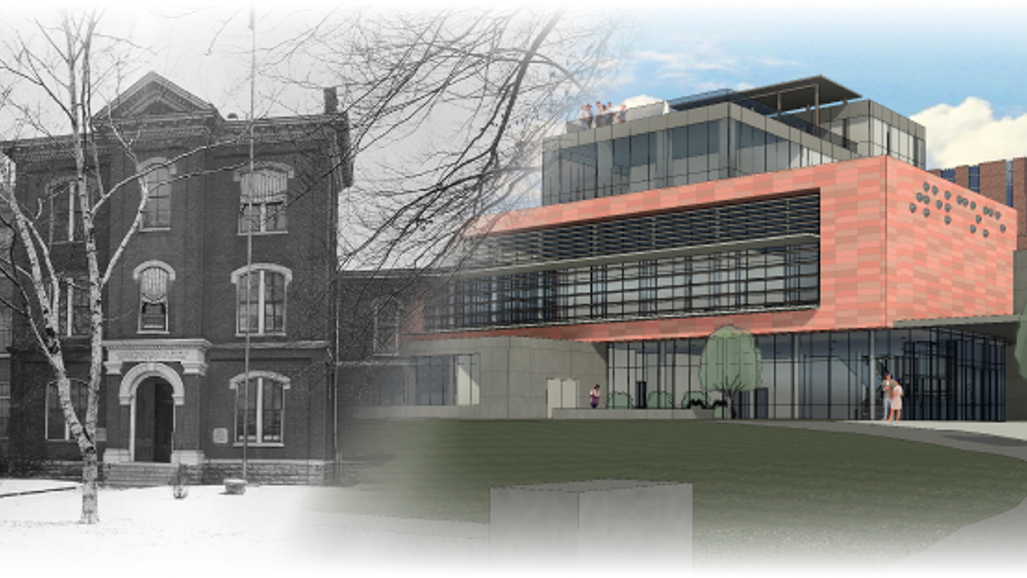
Original APH Building with rendering of Future Building

Slide 3
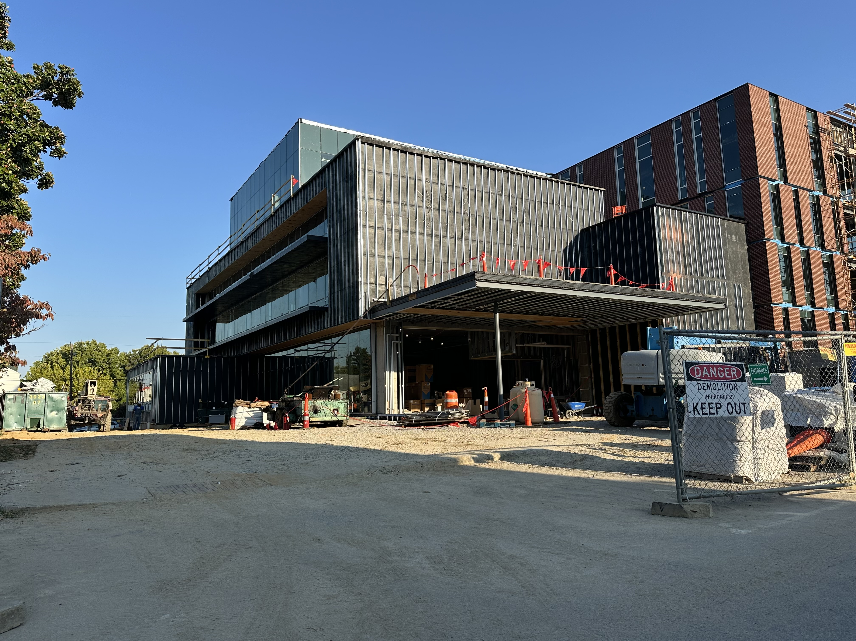
Current construction photo of front of APH building

Slide 4
Mission Statement
To change perspectives about blindness and empower individual action toward a world that welcomes everyone.

Slide 5
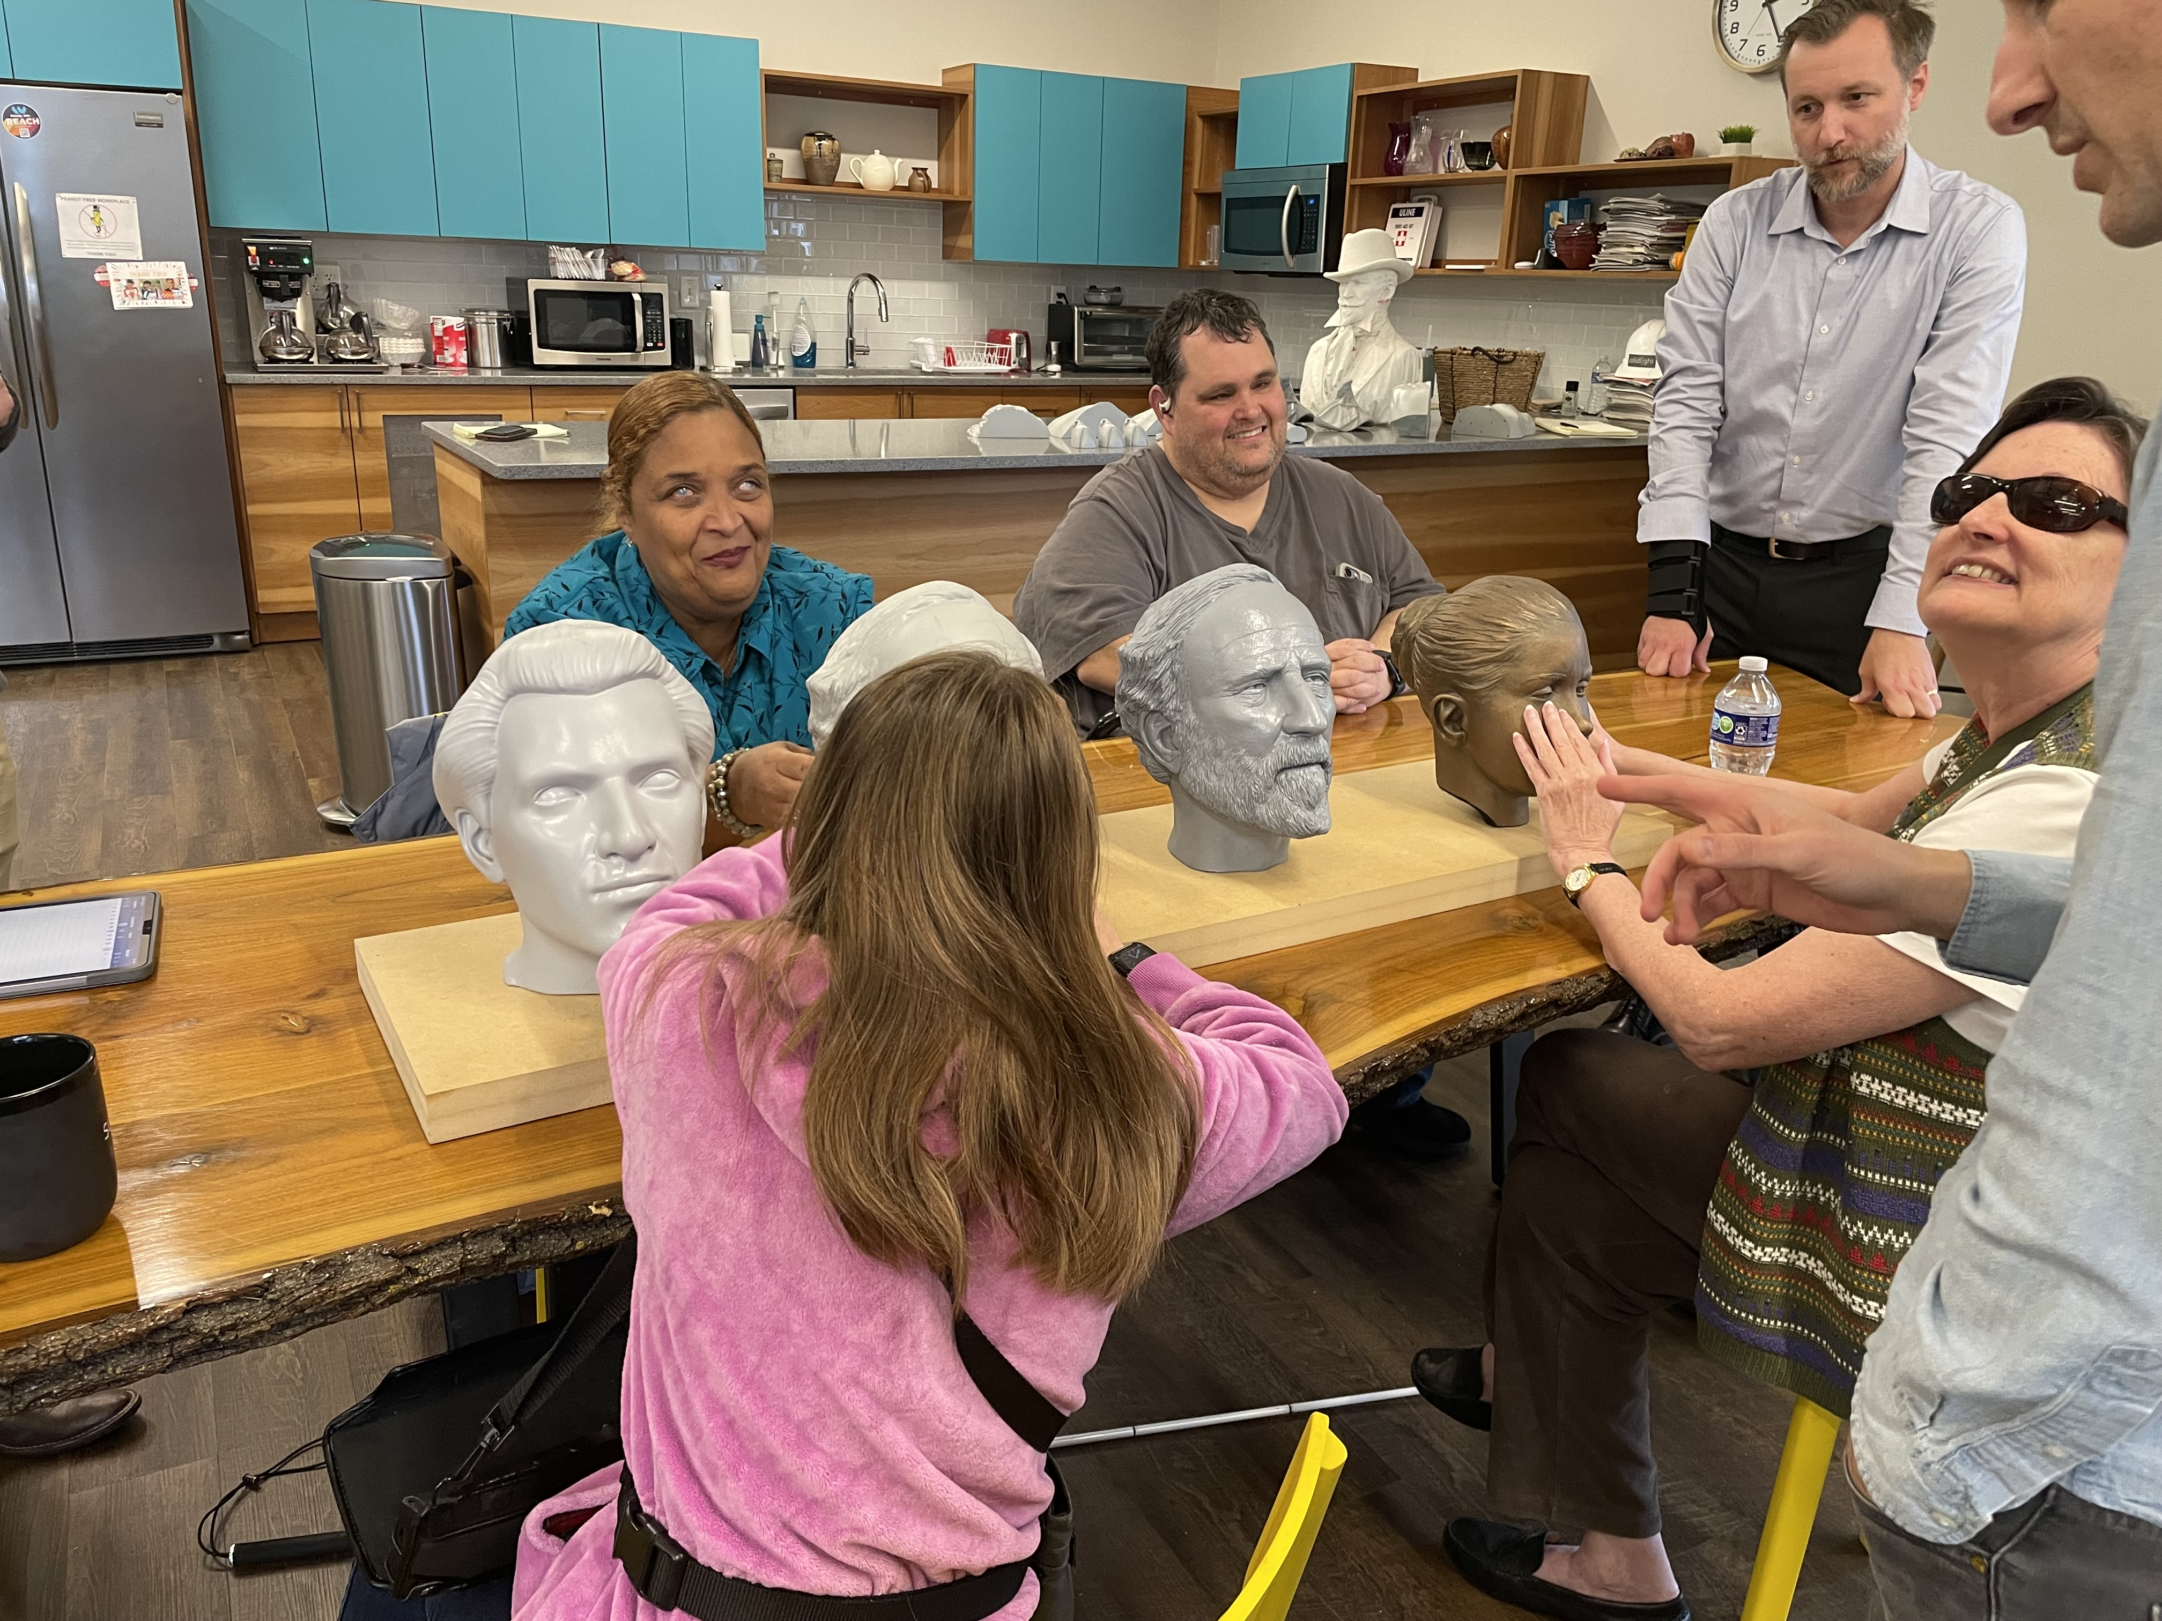
Focus group with ceramic heads on table
Notes:
Replace w/ pic of Mary and Danielle if found

Slide 6
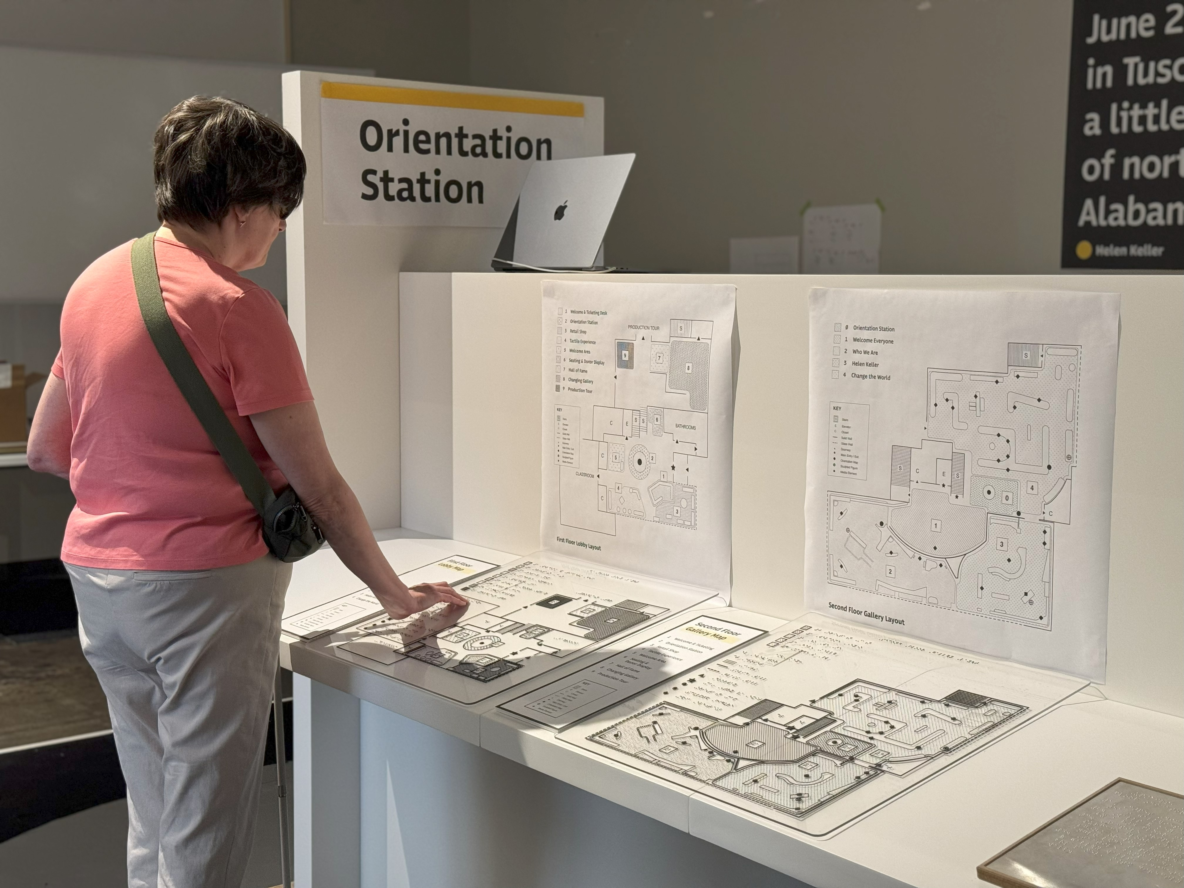
Person reading a tactile map on display

Slide 7
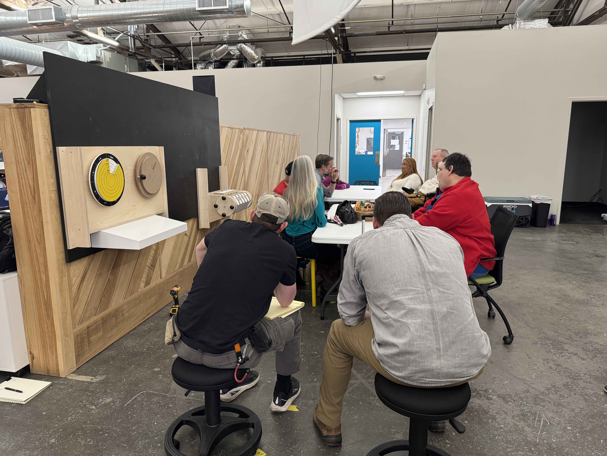
Focus group

Slide 8
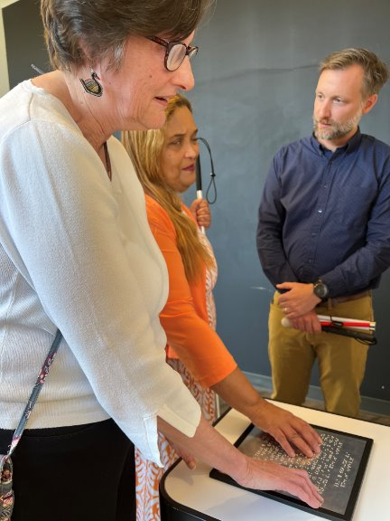
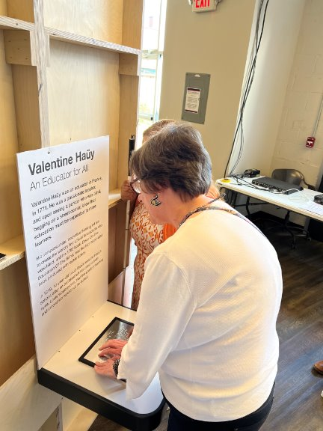
Braille plates near display

Slide 9

ACVREP Submission www.aphhive.org
Enter Hive with QR code
Select sign-in
Click “Event Certificate Request”
Enter opening and closing codes
Click “Validate Codes”
Notes:
Review slide

Slide 10
THANK YOU!

