Slide 1

Thrive with the APH ConnectCenter
Annual Meeting 2025

Slide 2
APH ConnectCenter Mission
Our mission is to empower people toward greater independence and lifelong success by providing free curated information and resources to assist children, parents, job seekers, and adults who are blind or low vision.

Slide 3
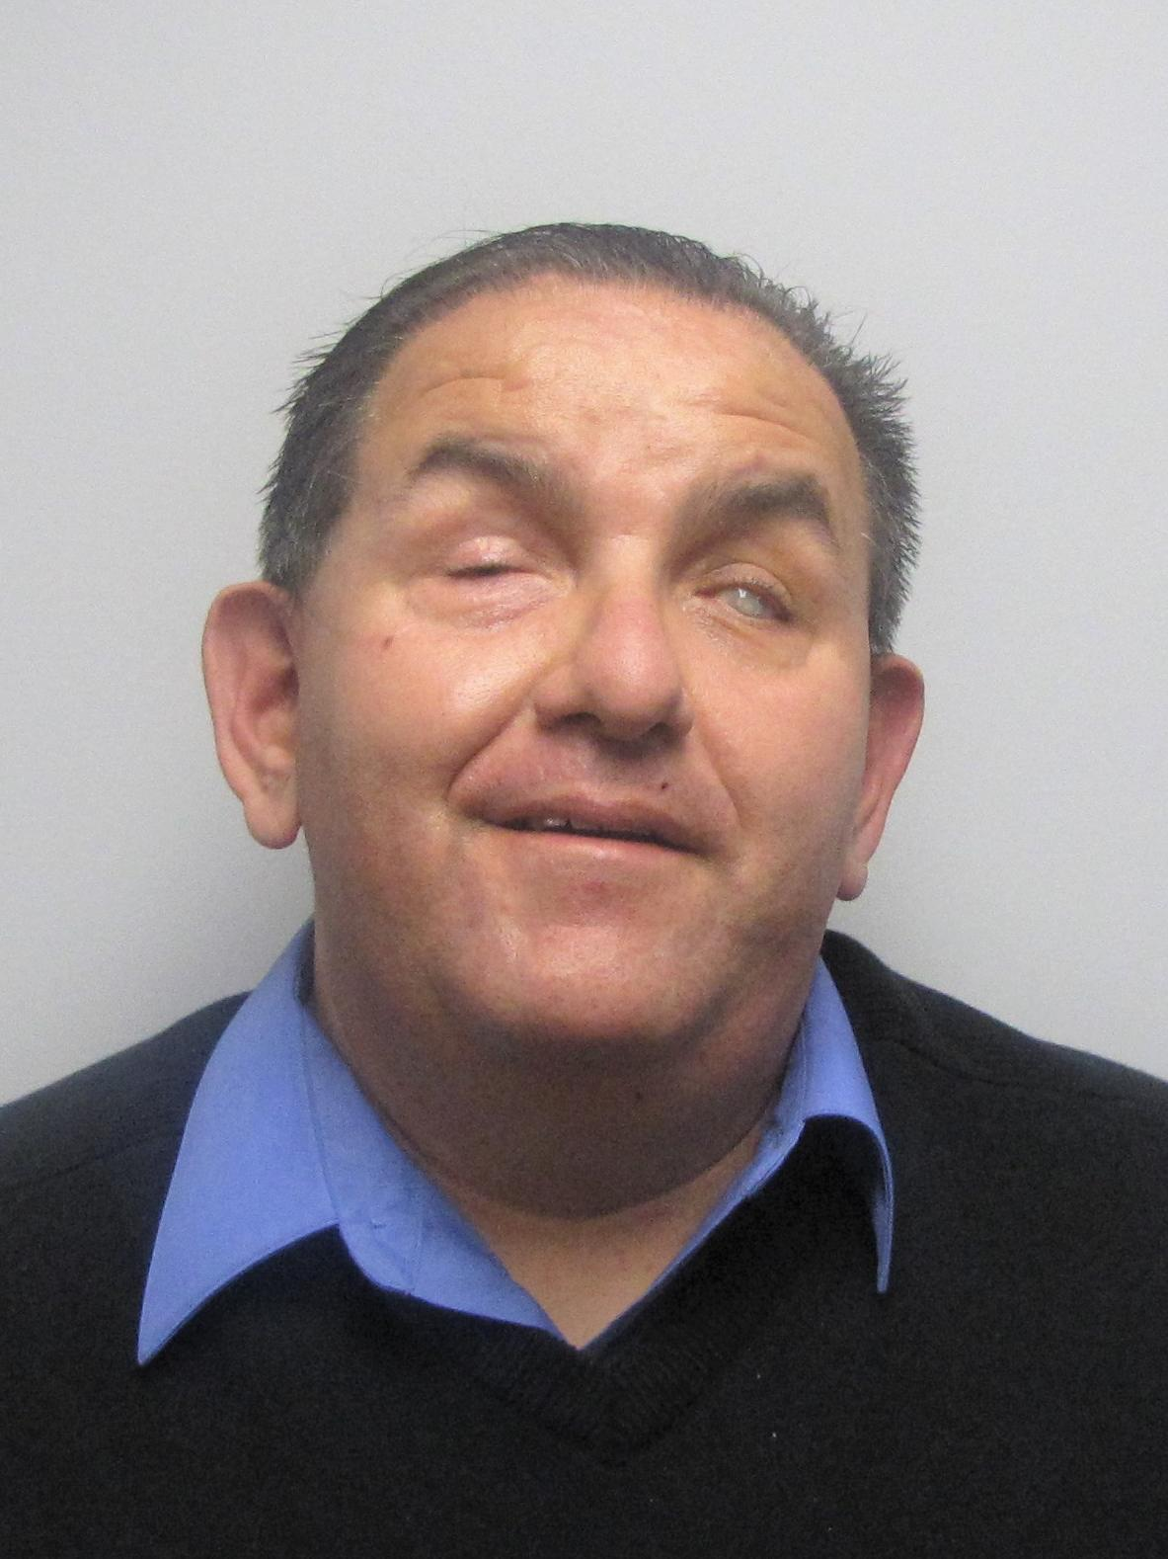
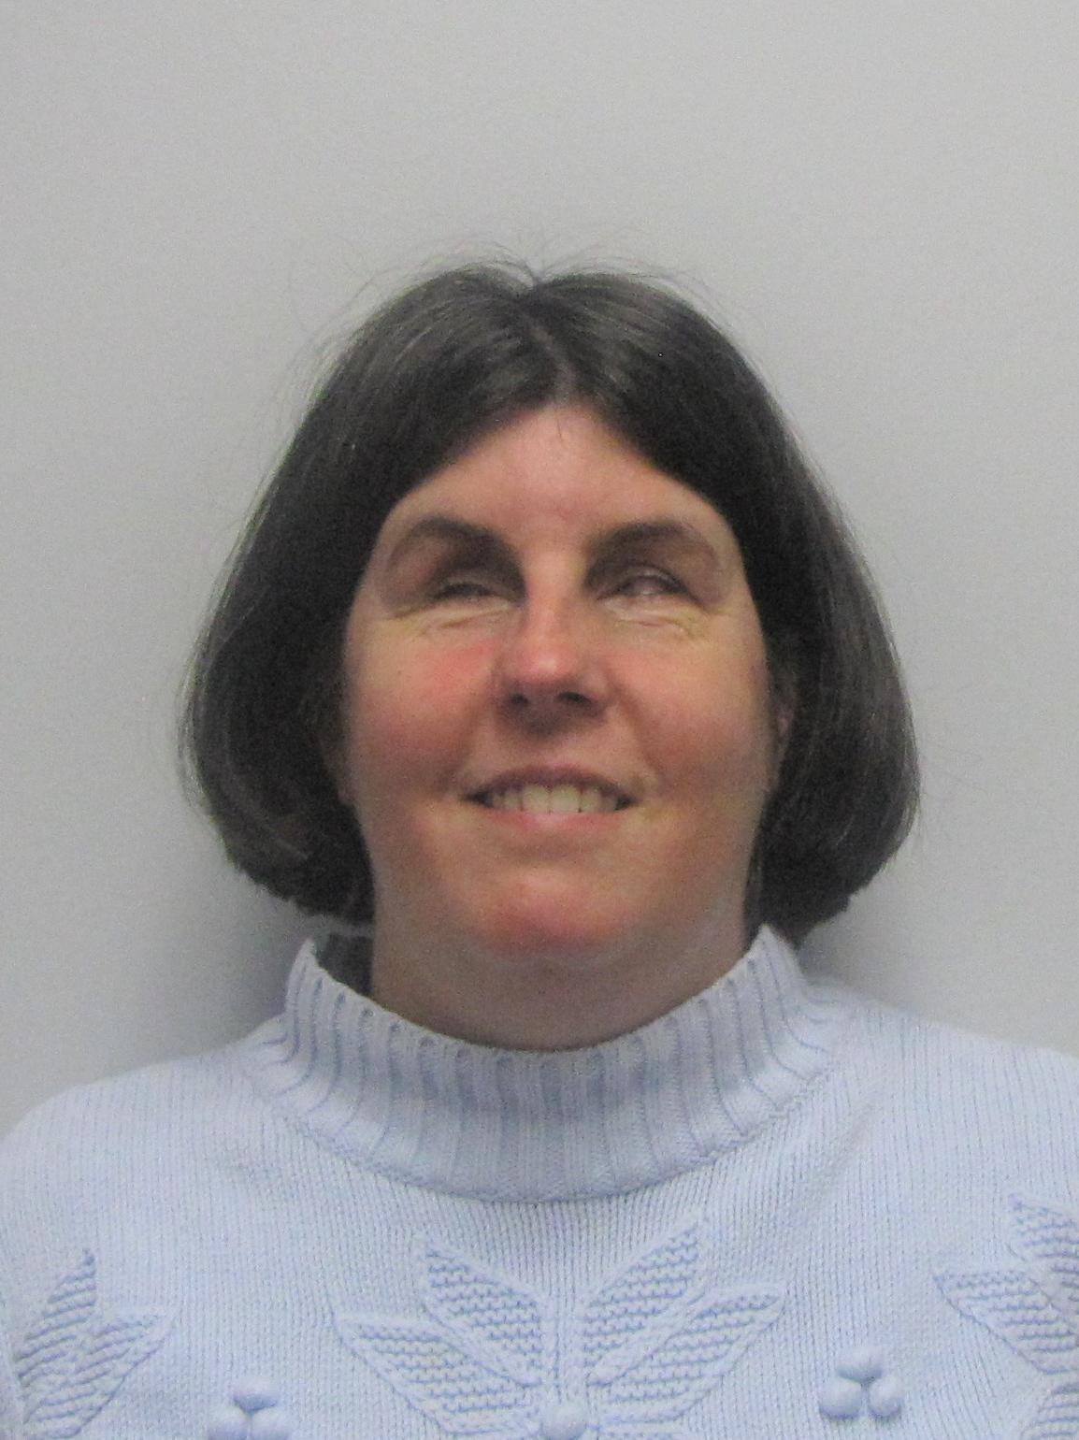
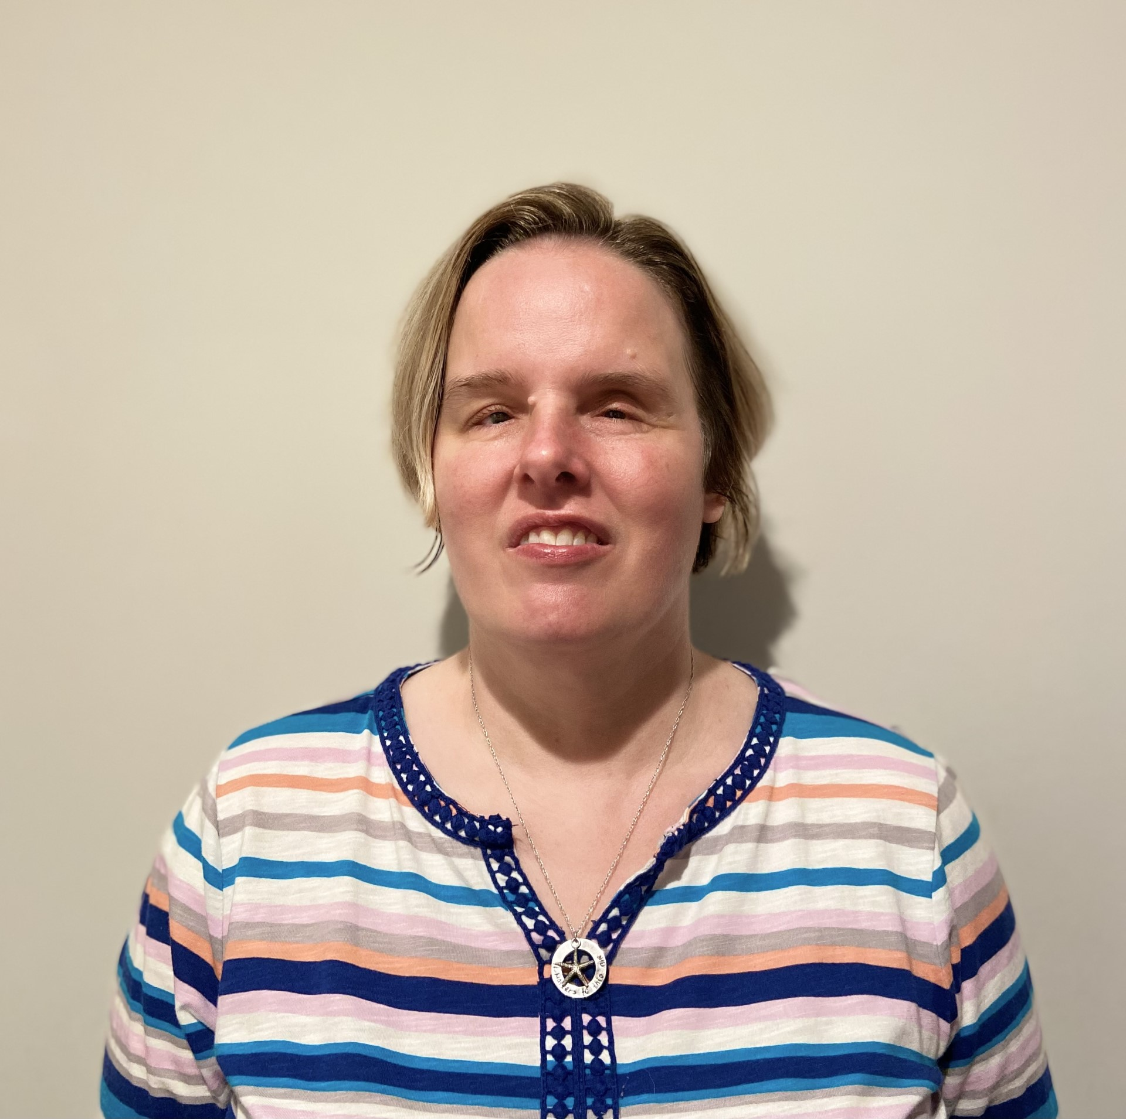
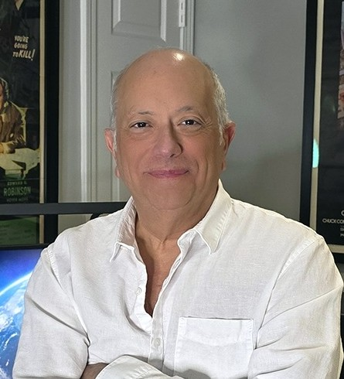
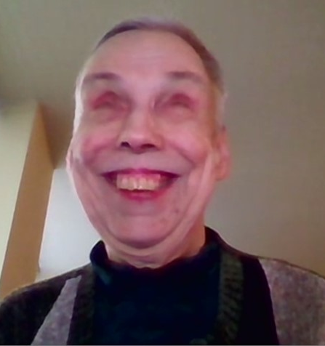
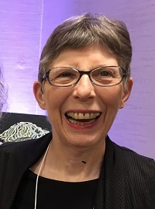
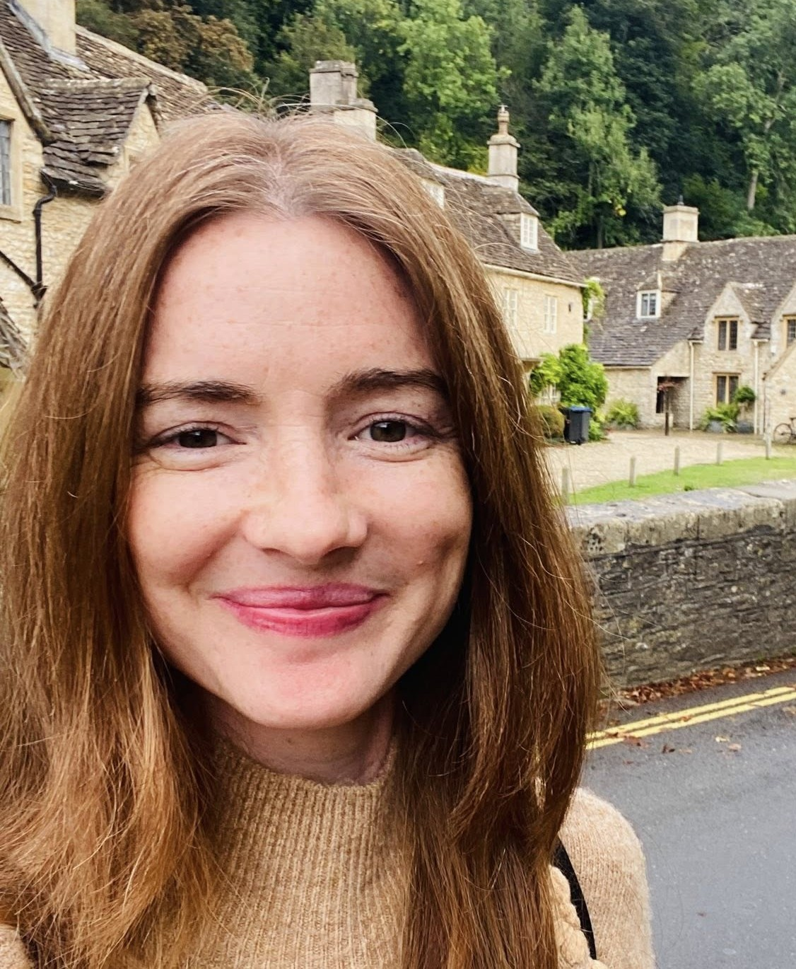
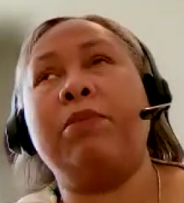
APH ConnectCenter Team
Richard Rueda
Katie Frederick
Lori Scharff
Tony Susnick
Sharon Hughey
Pris Rogers
Shannon Carollo
Empish Thomas

Slide 4
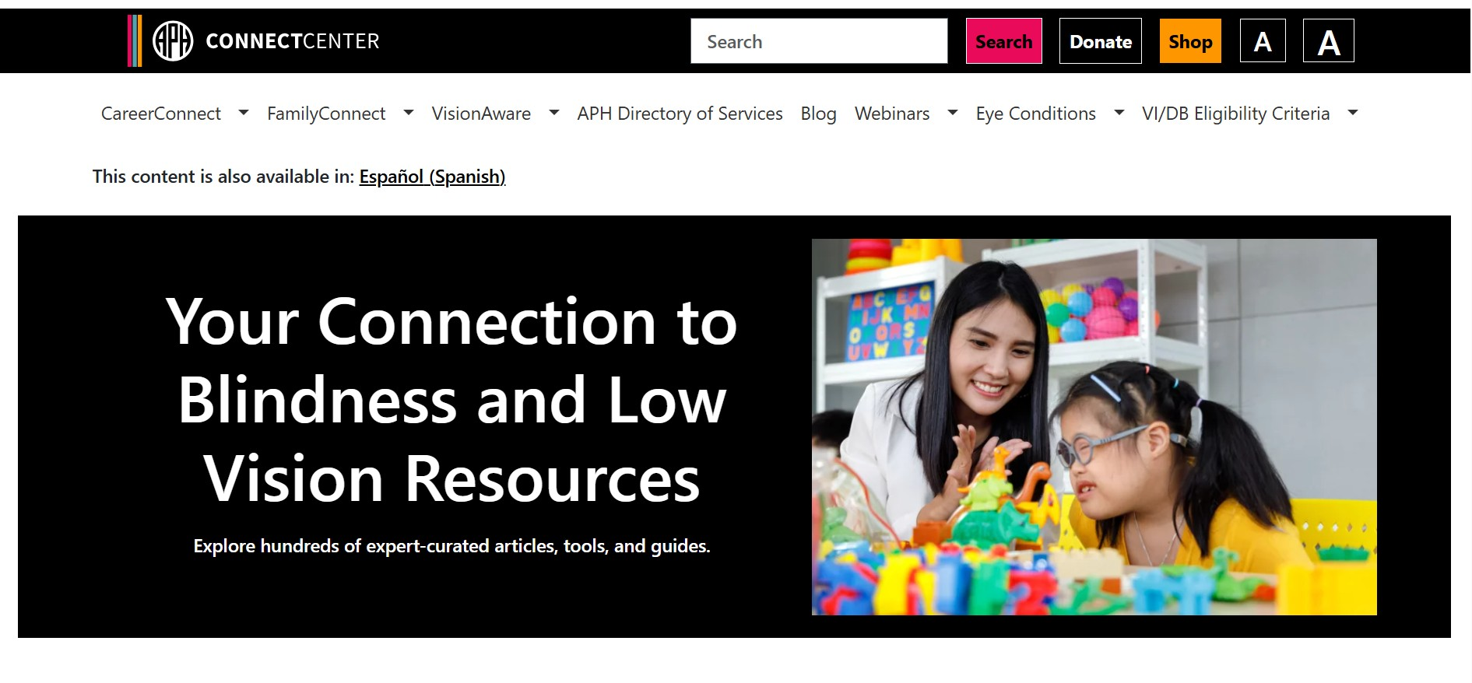
APH ConnectCenter Home Page

Slide 5
careerconnect

Slide 6
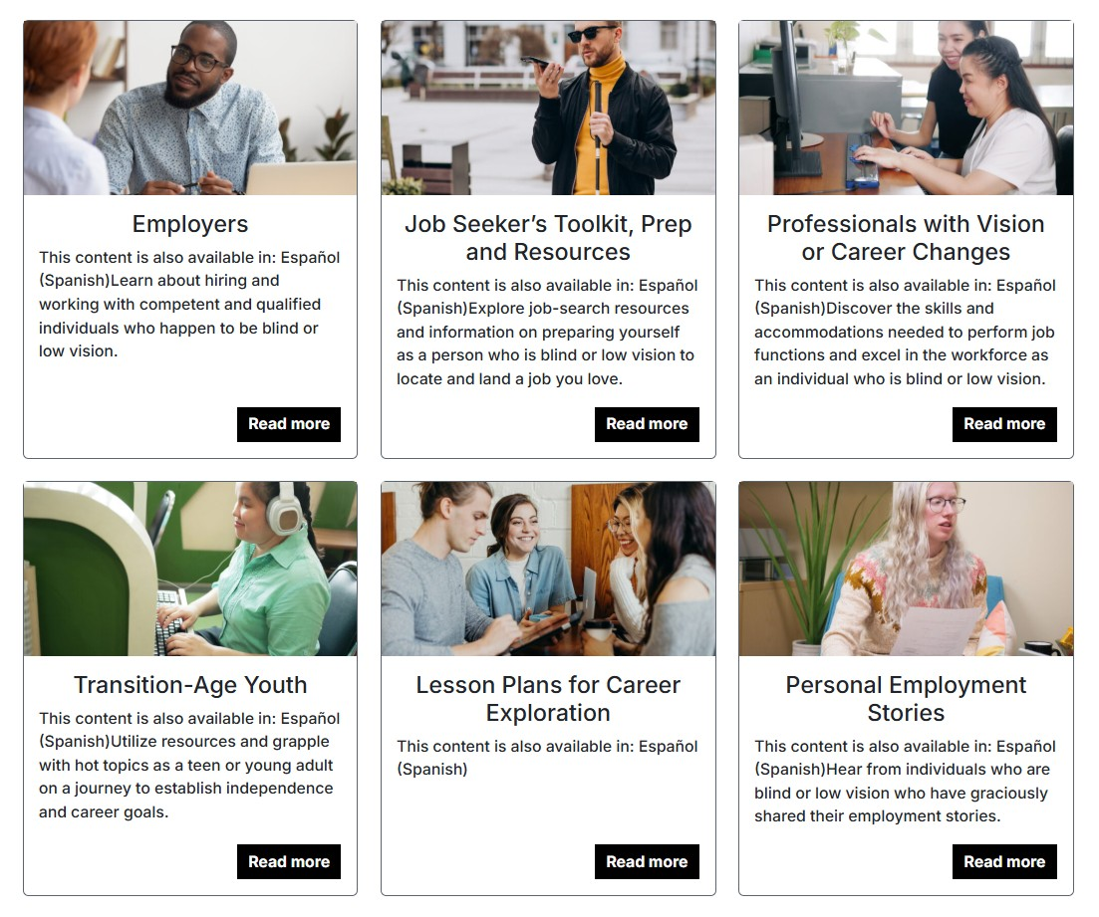

APH CareerConnect

Slide 7
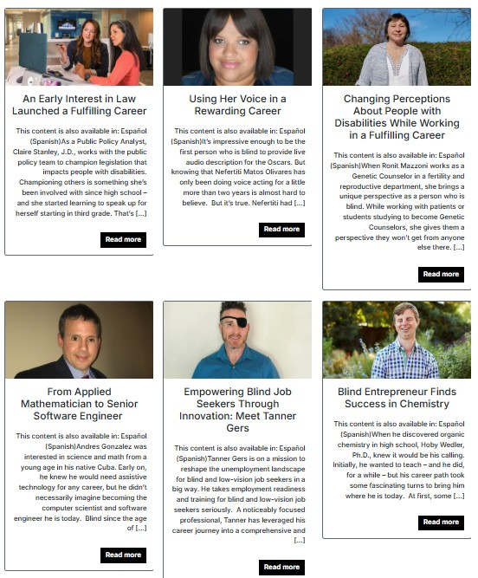
Career Conversations

Slide 8
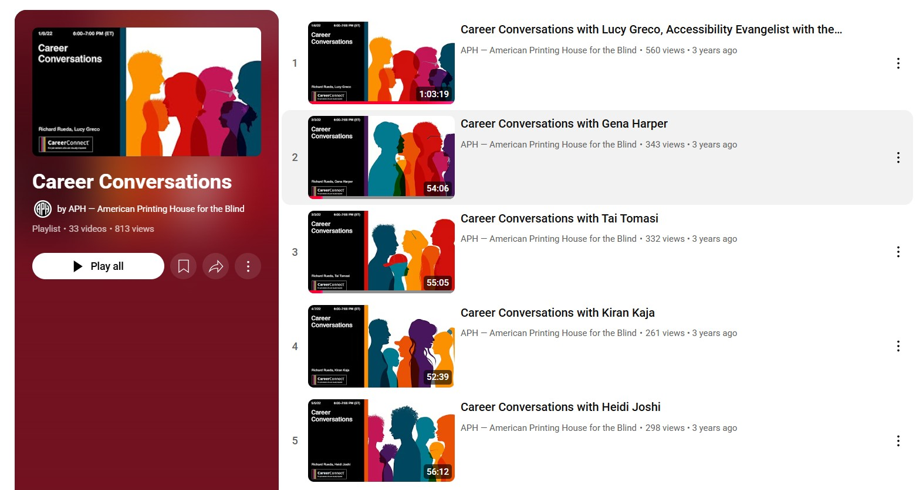
YouTube CareerConversations

Slide 9
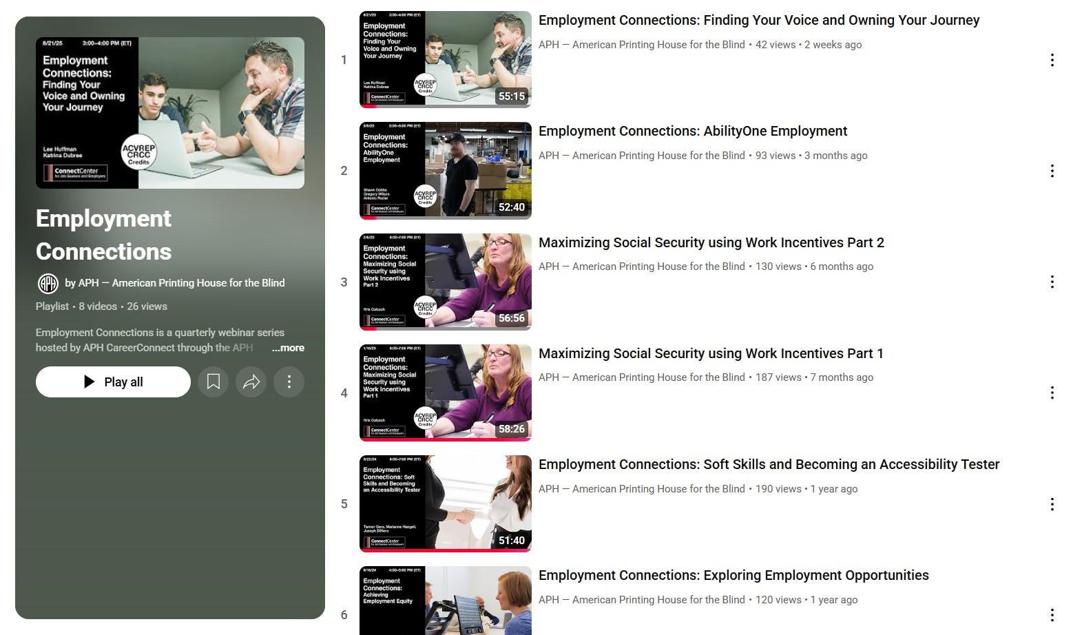
YouTube Employment Connections

Slide 10
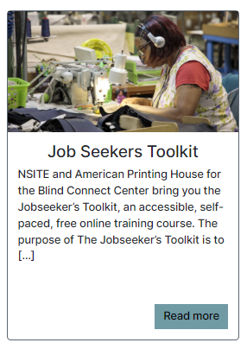
Job Seekers Toolkit

Slide 11
Job Seekers Toolkit Courses
Self-Awareness: Helps individuals explore their strengths and career aspirations.
Career Exploration: Offers targeted tools and resources to discover fulfilling career paths.
Employment Process: Provides clear guidance on navigating applications, interviews, and beyond.
The Interview: Equips students and clients with effective interview strategies.
Maintaining Employment: Offers valuable techniques for success in the workplace.

Slide 12
Familyconnect

Slide 13
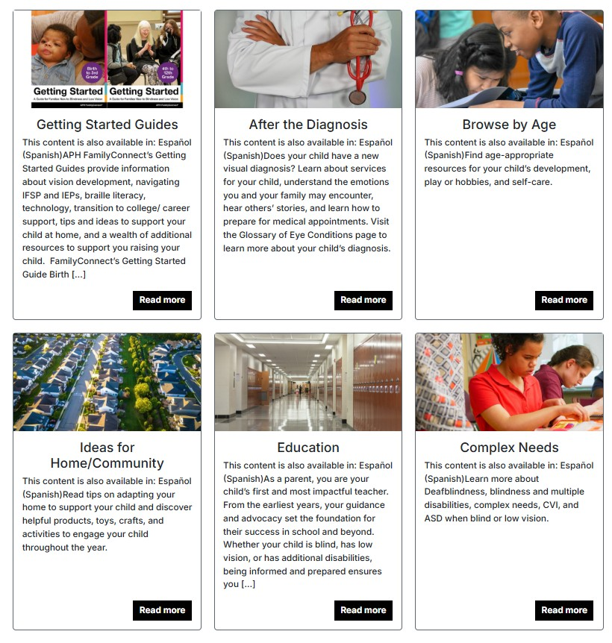
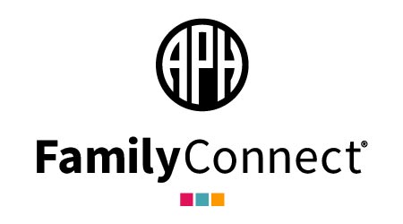
APH FamilyConnect

Slide 14
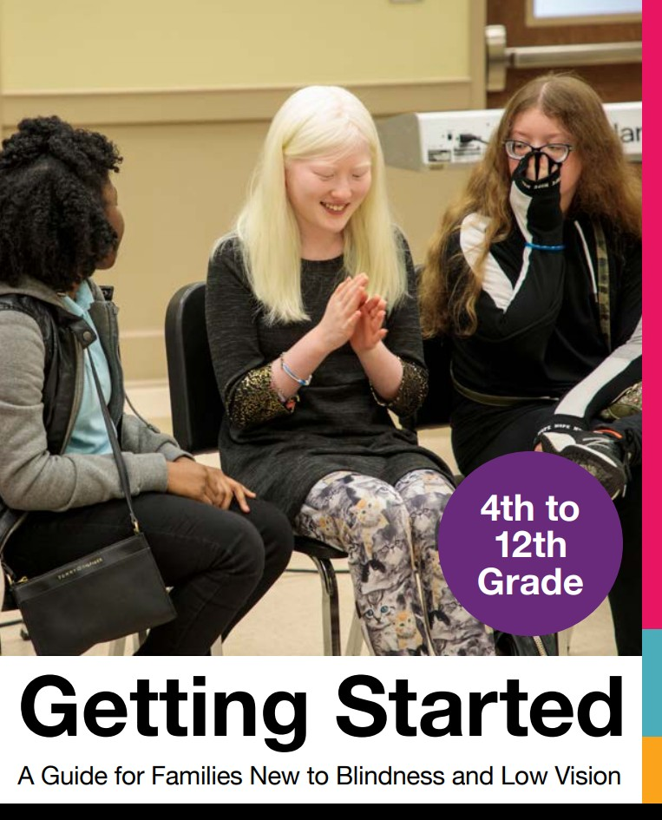
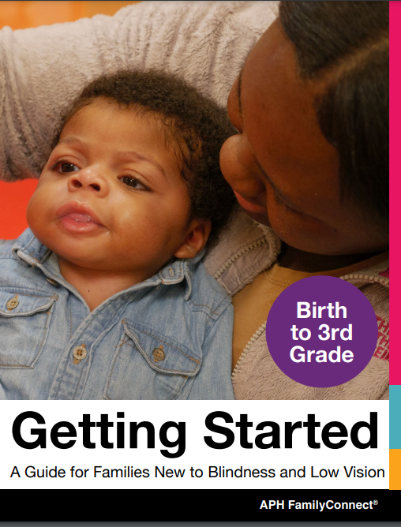
Getting Started Guides
Covers many topics from eye care professionals, IFSPs, IEPs, at home activities and adaptions, and many links to additional resources

Slide 15
visionaware

Slide 16
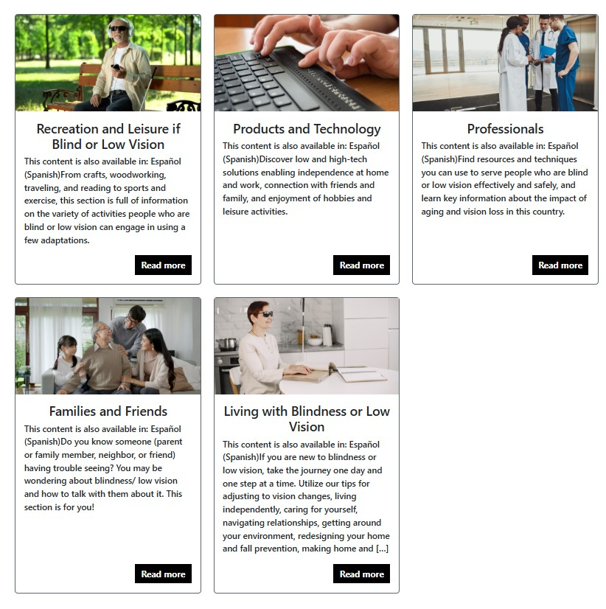

VisionAware Home Page

Slide 17
VisionAware Continued
Getting Started Guide (available in hardcopy print or downloadable PDF) — tips for people new to vision loss
Family Members Help and Support—information about adjusting to blindness and low vision
Support Groups and Other Resources—importance of support groups and connecting
Daily Living Skills—learning to live with blindness/low vision including reading
Eye Health—Understanding eye health, low vision, eye exams
Redesigning Your Home and Fall Prevention—making home modifications, etc.
Families, Friends and Professionals —Blindness and low vision information, Aging 101, understanding vision rehabilitation
Resources—Listing of helpful resources

Slide 18
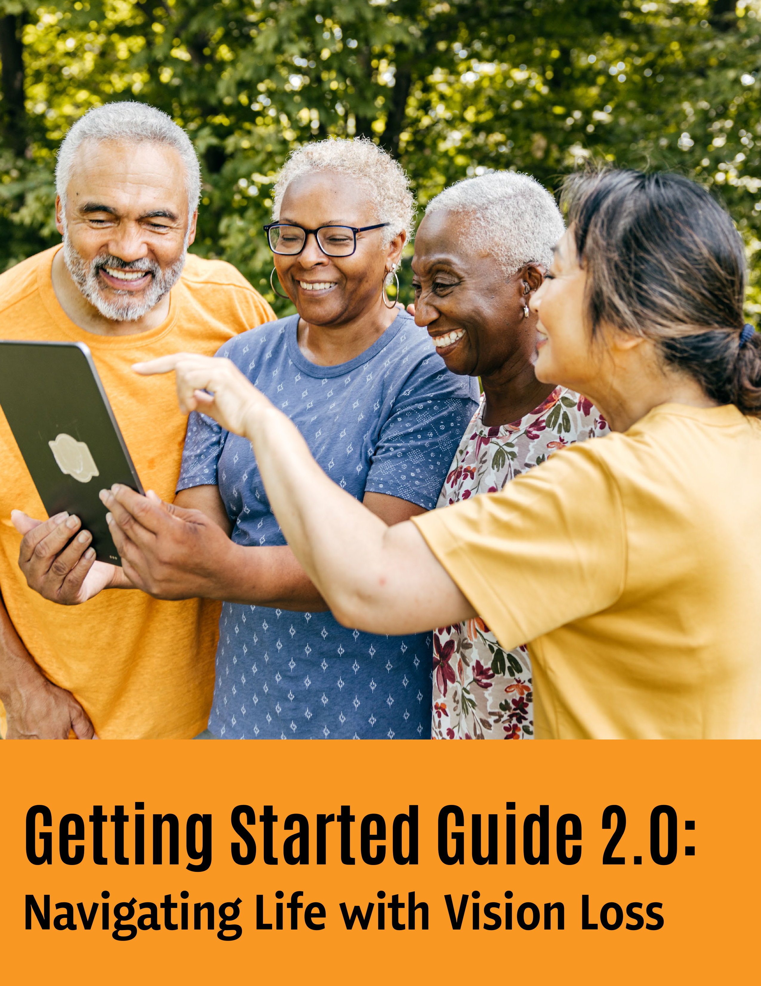
VisionAware Getting Stared Guide

Slide 19
INFORMATION AND REFERRAL (800) 232-5463 Email: ConnectCenter@aph.org
Technology Questions
Low Vision Assessments
Local and State Resources for a Child
Scholarship and Funding Needs
Family Member Losing Vision
Help Getting a Job
Braille and Low vision Resources
Making Hobbies Accessible

Slide 20
Connecting the Dots: How SEO Helps the APH ConnectCenter Reach the Right Audience
Notes:
“How many of you Googled something today?”
“How many of you clicked the first result without scrolling?” “How many of you just read what came up in AI and didn’t even visit a site?”
“How many of you looked at more than the first page?”
“Every time you search, click, or even just pause on a webpage, companies are quietly paying attention. They track what you search for, how long you stay, what you hover over, and even what device you’re using.
This invisible data shapes what you see next. If you search ‘best running shoes,’ entire teams of marketers are already competing to get their page in front of you. That’s SEO — Search Engine Optimization — and it’s how they win your attention.”

Slide 21
Who am I and what do I do?
I manage the APH ConnectCenter website (so it doesn’t break, or worse… look and act like it’s from 1998).
Main mission: Make sure our content shows up when people go looking for it.

Slide 22
What is SEO?
SEO: Making Google Notice Us (Without Bribing Them)
SEO = Search Engine Optimization → A fancy way of saying: “How to get our stuff to show up when people search for it.”
Without SEO, our content is like a best-selling book stuck on the bottom shelf of a library… in the wrong section.
With SEO, we tell Google: “Hey, we’ve got what people need — put us on the top shelf!”

Slide 23
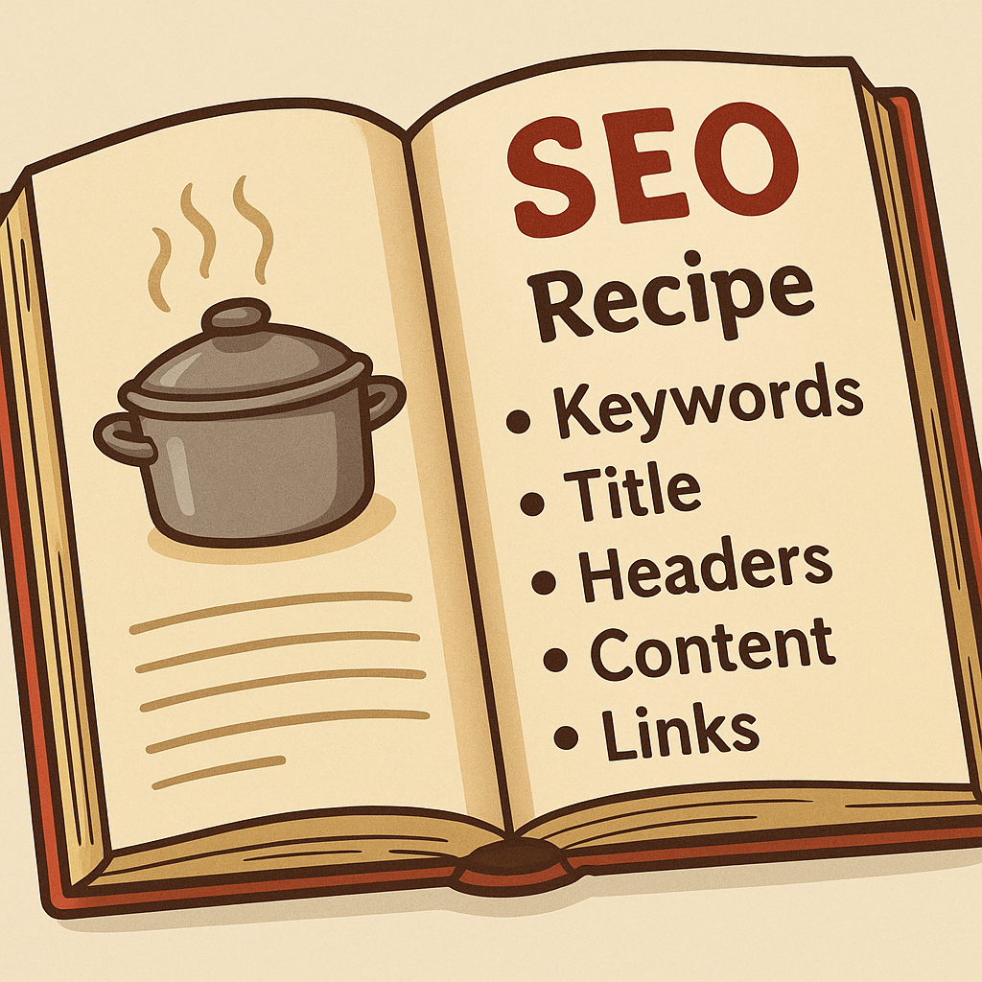
Our SEO Weekly Process
Step 1: Meet with content managers → decide what topics/ideas to cover.
Step 2: Use SEO tools → We will get into this shortly.
Step 3: SEO Recipe Sprinkle in the right keywords, titles, and headers → like seasoning a recipe.
Step 4: Publish → track views & see where we land on Google.
Reality check: Not everything gets thousands of views (we serve a niche — and that’s okay!).

Slide 24
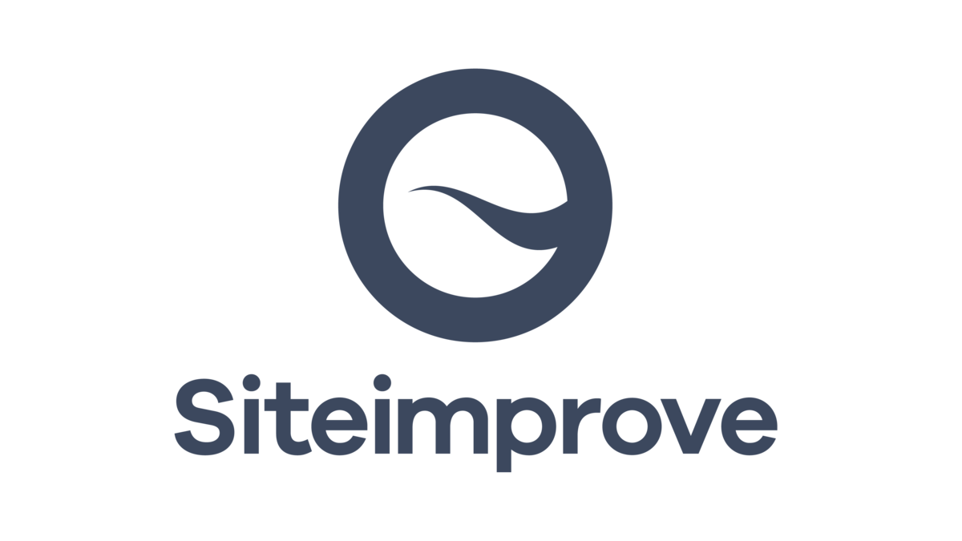

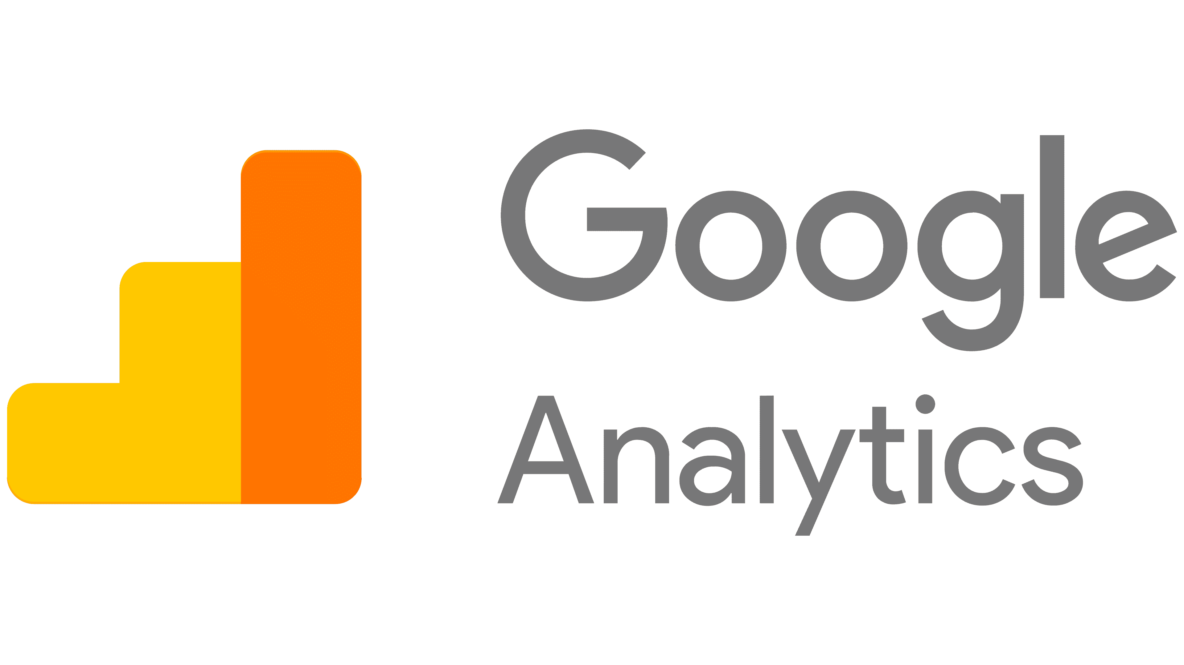
Tools We Use

Slide 25

How Accessibility and SEO Support Each Other
Text alternatives for images (alt text)
Clear heading structure
Descriptive link text
Keyboard-friendly navigation
Search engines rely on structured, well-labeled content — which happens to be exactly what accessibility provides.
How They Work Together
Accessible content is easier for search engines to read. For example, alt text and proper headings help screen readers and also help search engines understand your content.
Improved site structure benefits everyone. Clear navigation and logical page hierarchy improve user experience and boost SEO.
Faster, cleaner pages help all users. Reducing clutter and making content more readable improves accessibility and raises search rankings.

Slide 26
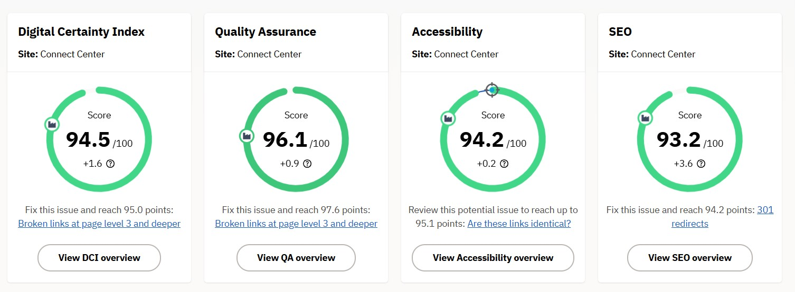
SiteImprove

Slide 27

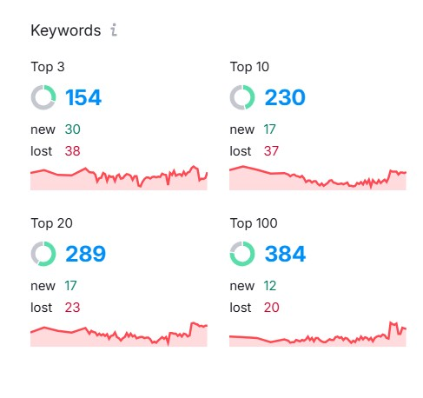
SEMRush
All-in-one digital marketing tool that helps us
research keywords, track rankings, analyze competitors, and optimize our website’s SEO and content strategy.

Slide 28
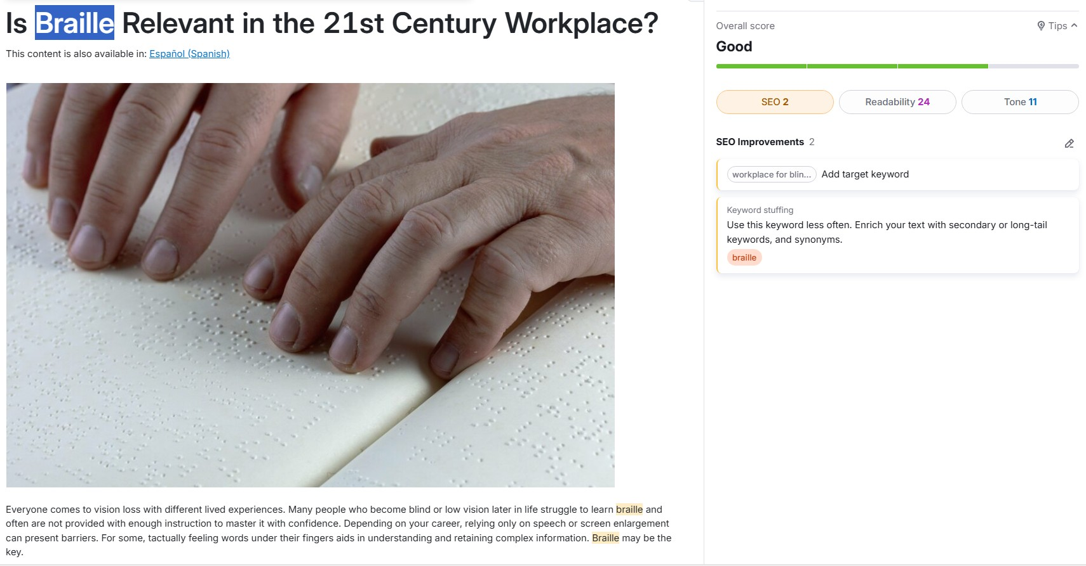
SEMRush Example

Slide 29
More about SEMRush
Organic Traffic Insights Reveals the exact keywords and phrases driving visitors to our site — even down to individual pages.
SEO Content Template & Brief Generator Transforms a simple topic idea into a full content plan: competitor examples, ideal word count, target keywords, and a suggested outline.
Keyword Gap Analysis Uncovers valuable keywords our competitors aren’t targeting — giving us fresh ideas for articles and blog posts.
Position Tracking Monitors our keyword rankings over time, showing how our content performs and where we’re gaining or losing visibility.

Slide 30
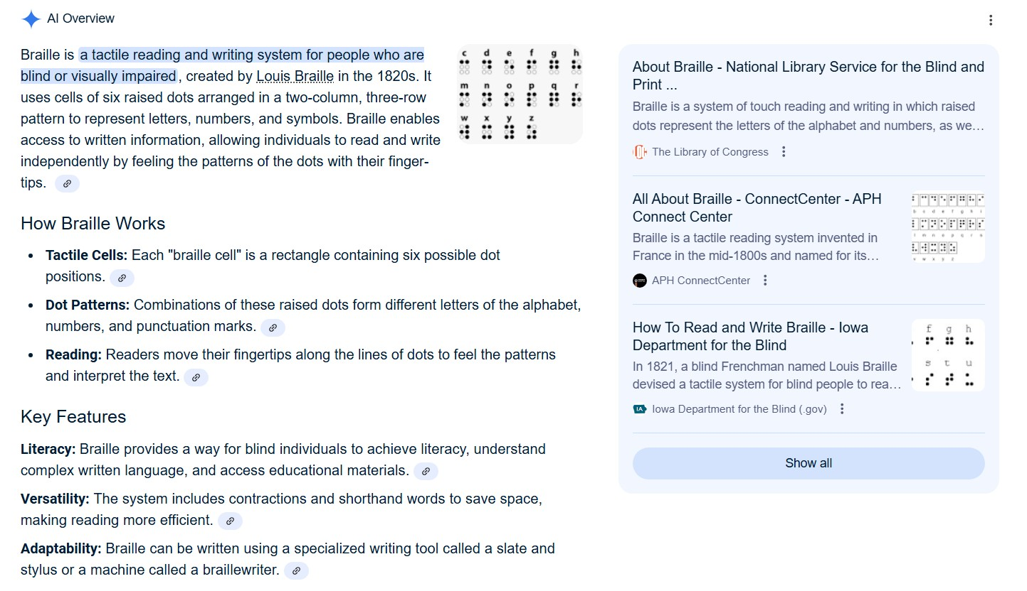
Our Top Rankins

Slide 31
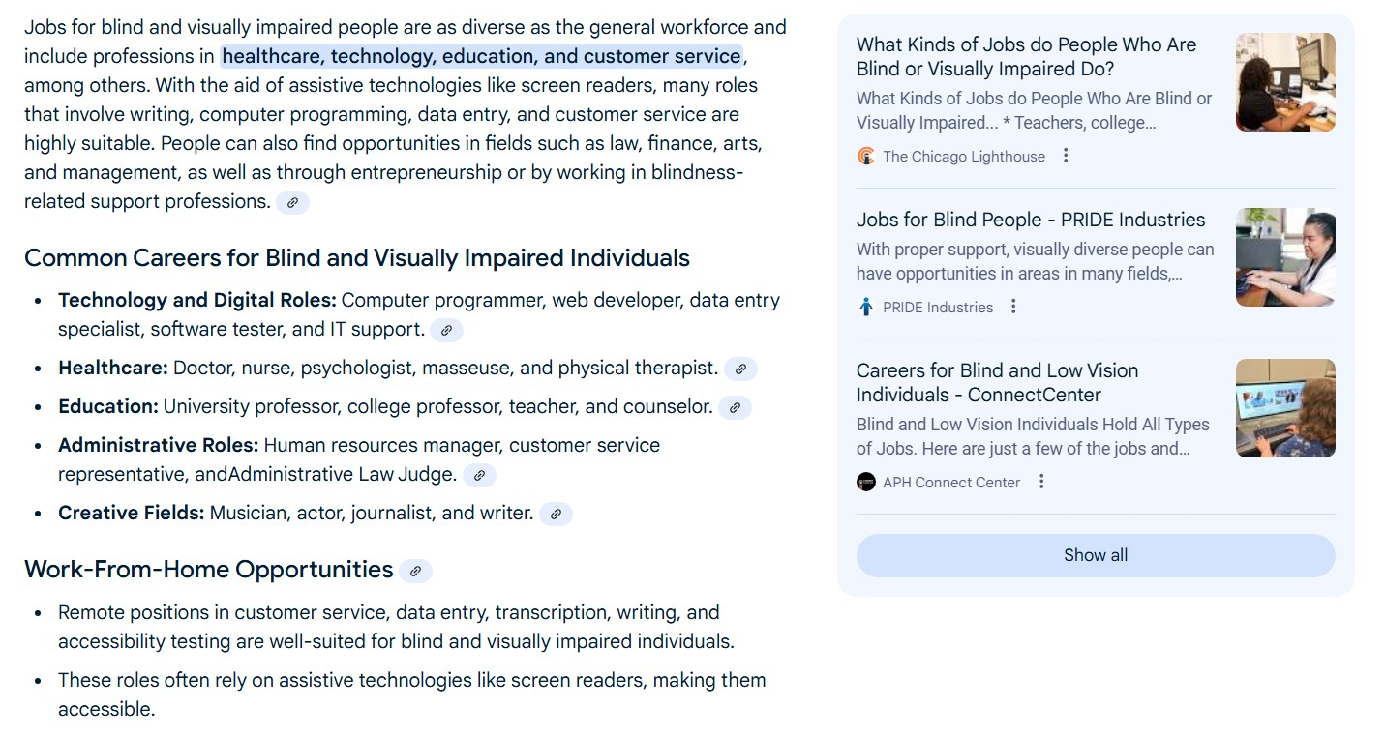
Jobs for Blind People

Slide 32
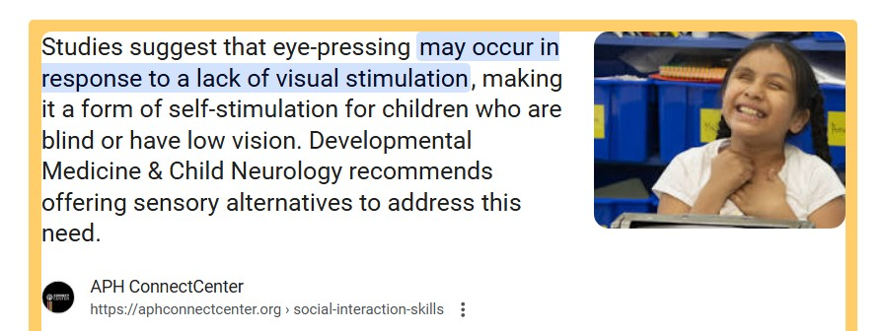
Featured Snippet

Slide 33
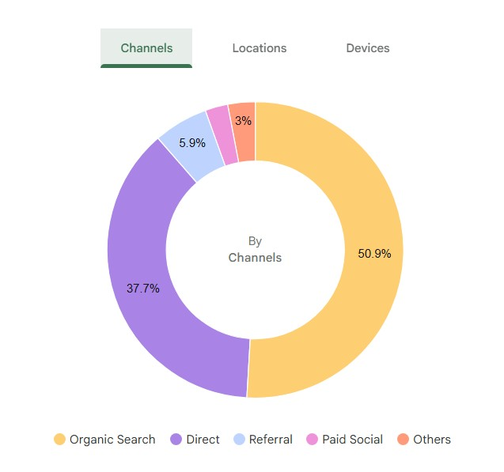
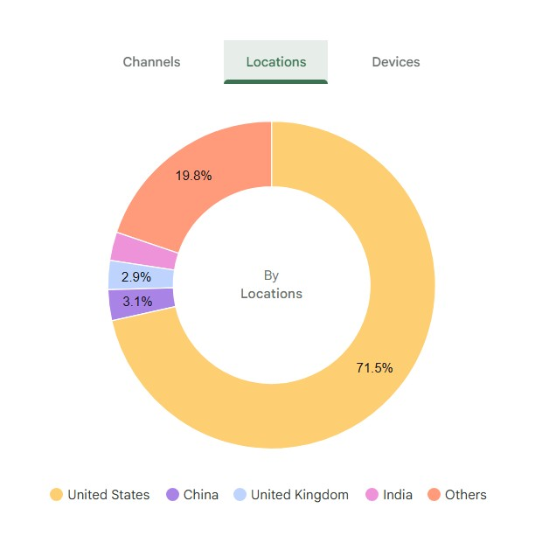
Google Analytics Channels & Locations

Slide 34
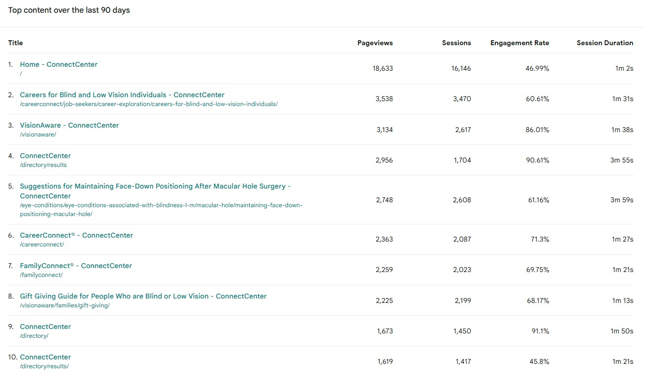
Google Analytics Top Content

Slide 35
The Moving Target…
SEO is always changing — just when we figure it out, Google changes the rules. (I attend monthly meetings on newest SEO updates)
Now with AI searches, Google sometimes gives answers without people even clicking our page.
But our goal stays the same: Get the right info to the right people, even if it’s just a few who need it most.

Slide 36
Questions?

Slide 37
APH ConnectCenter Partnerships
Partnerships underscore the importance of our well respected and nationally recognized work.
From internship opportunities, to blog and article contributions, we value our collaborations with like minded organizations and agencies wanting to improve the lives, livelihood and independence of blind and low vision persons and families.

Slide 38
Our Partnerships
Guide Dogs for the Blind (Careers & Canine Connections)
National Center on Deafblindness
Perkins School for the Blind
LEAP – Lean, Earn and Prosper
NSITE
Seattle Lighthouse
Visions – Services for the Blind
Visually Impaired Preschool Program (VIPS)
Blind Early Services of Tennessee (BEST)
Anchor Center for Blind Children
Penrickton Center for Blind Children
APH FamilyConnect Parent Advisory Board Members
CareerConnect Professional/Student Advisory Committees
Individual Families, Peers, and Professionals
National Eye Institute
EmpowerVI with Vanderbilt University
Together Achieving Dreams Foundation

Slide 39
APH ConnectCenter Contacts
The APH Information & Referral Hotline
1-800-232-5463 (U.S and Canada) staffed M-F 8:00-8:00 PM EST
Email: connectcenter@aph.org
Follow us on:
Facebook: @VisionAware, @CCForJobSeekers, @FamilyConnect
X @APHConnectCenter YouTube: APHConnectCenter
LinkedIn: American Printing House
Instagram: @AmericanPrintingHouse
Pinterest: @AmericanPrintingHouse

Slide 40
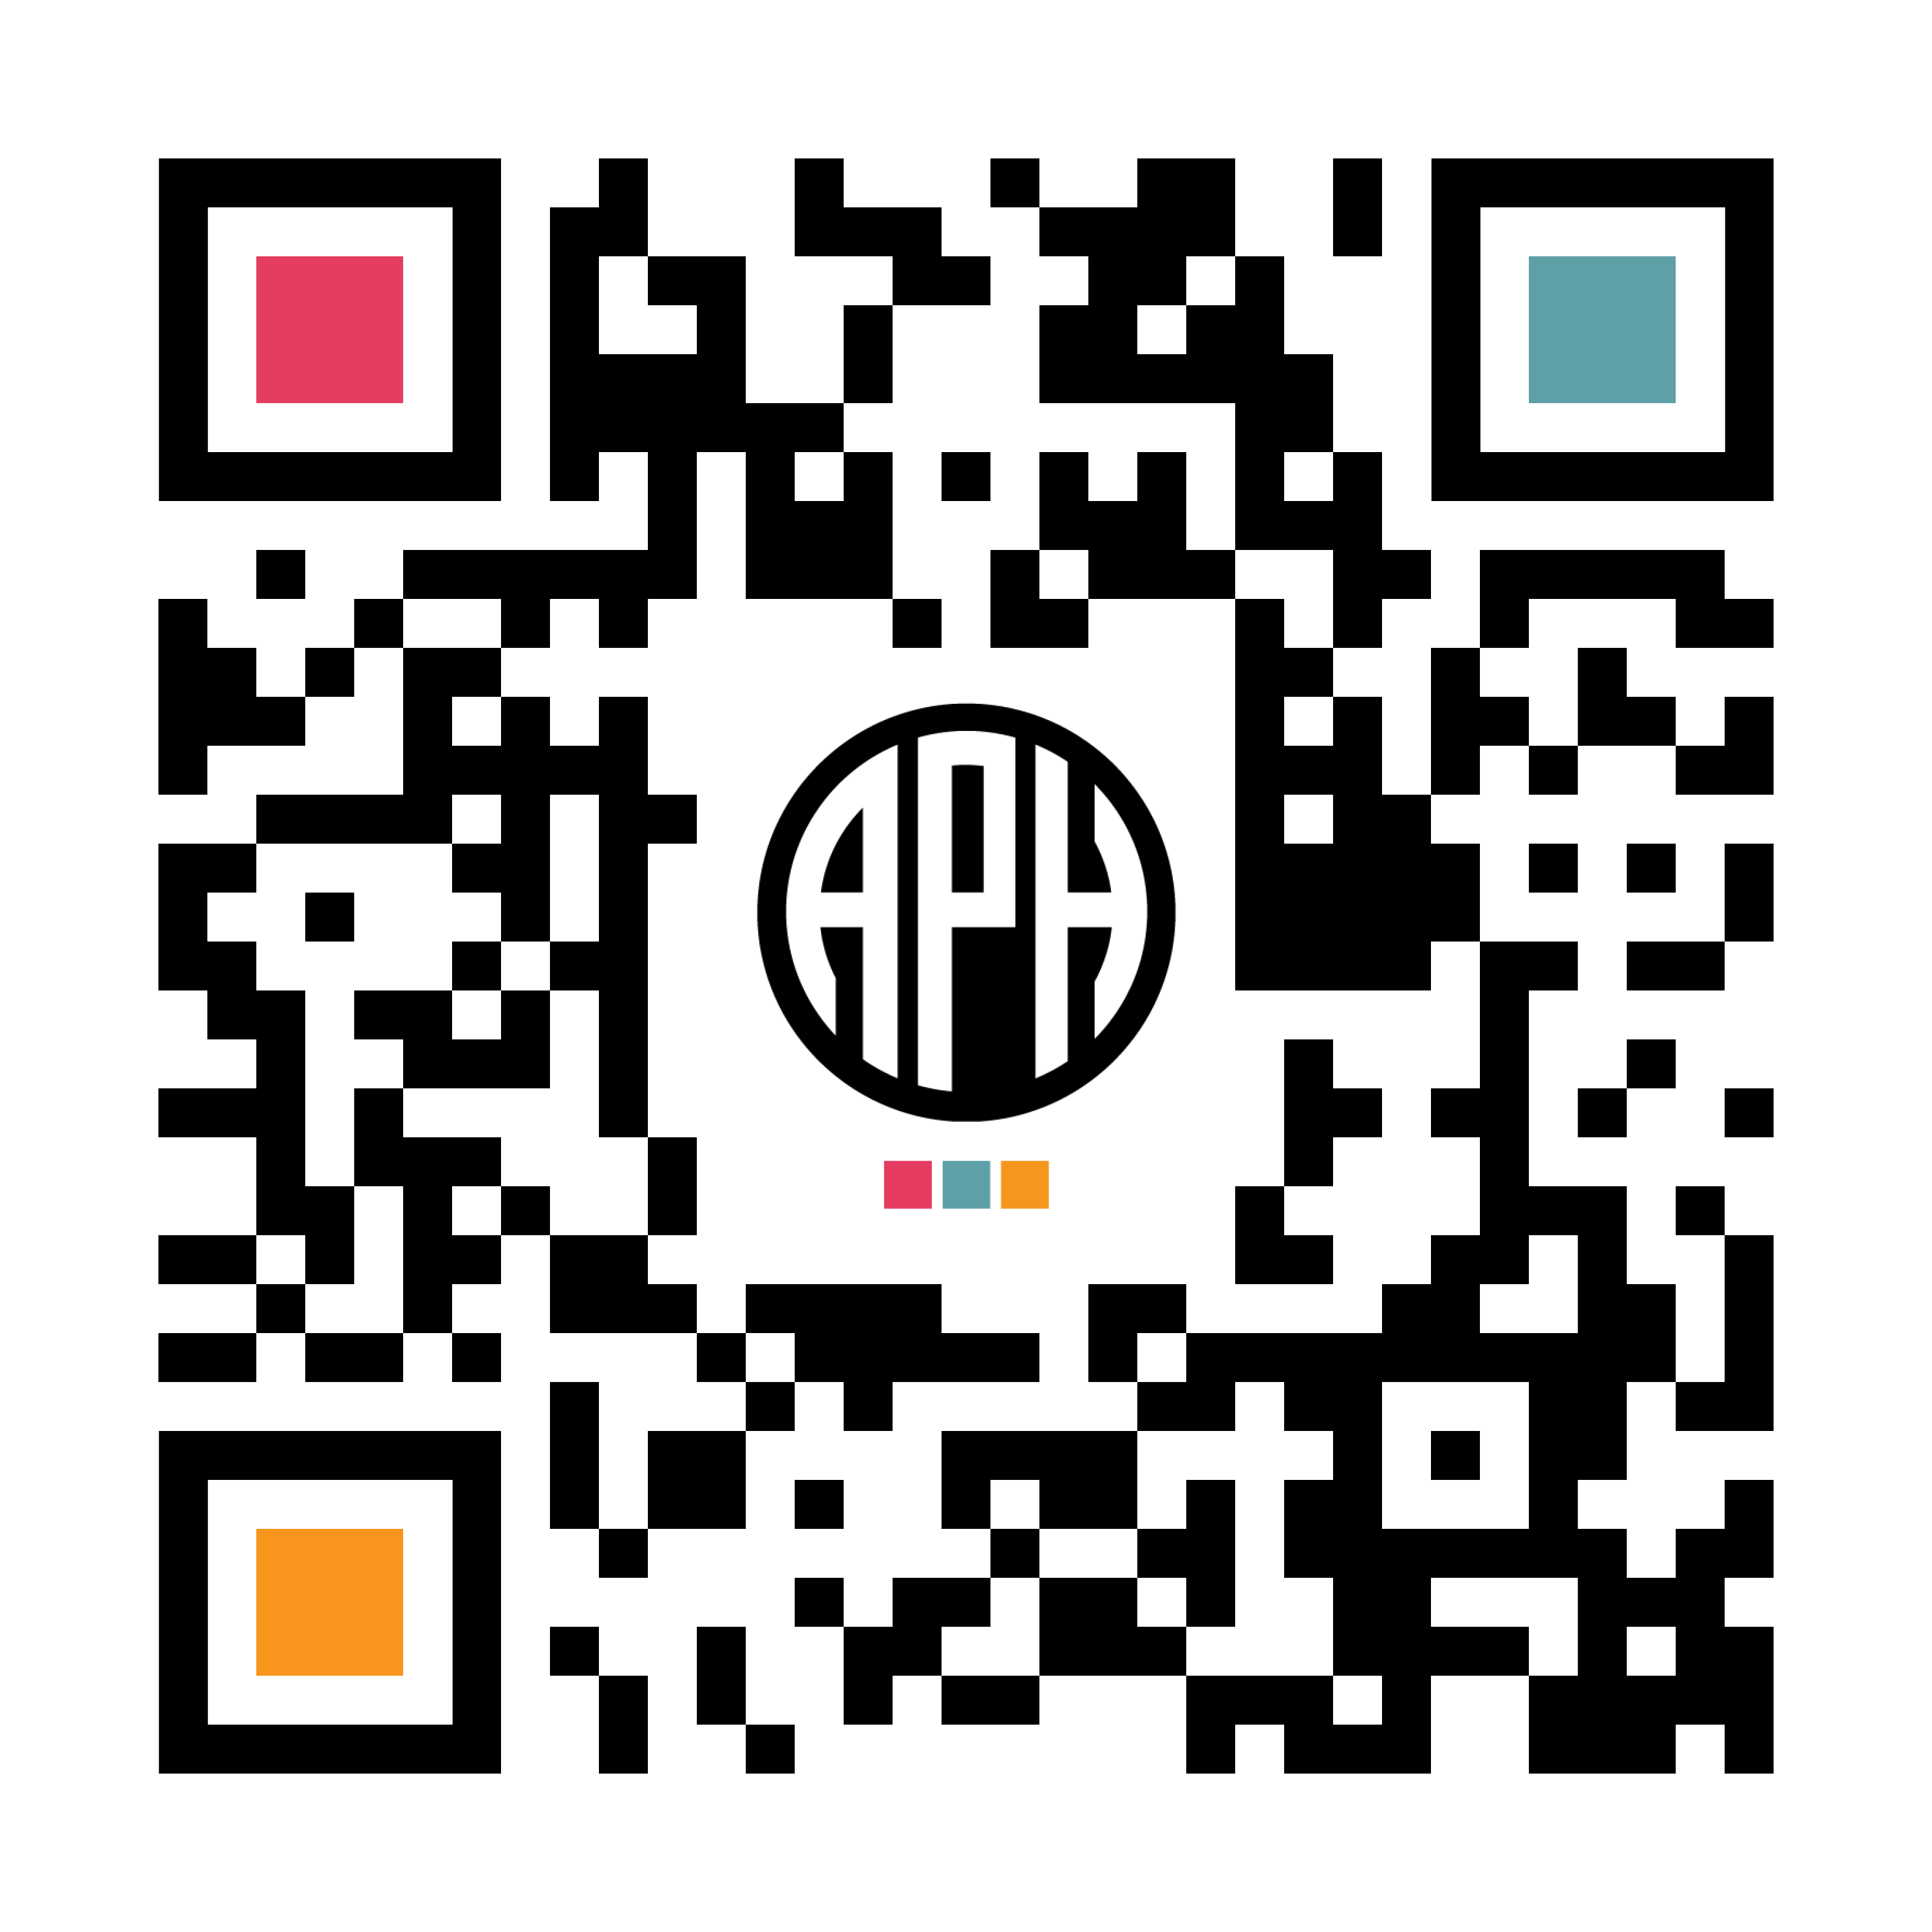
ACVREP Submission www.aphhive.org
Enter Hive with QR code
Select sign-in
Click “Event Certificate Request”
Enter opening and closing codes
Click “Validate Codes”
Notes:
Review slide

Slide 41
THANK YOU!

