Slide 1
Braille Brain 101:
Introduction to Units, Lessons, and Navigation
Notes:
Layout: Title Slide

Slide 2
Presenters
Notes:
Layout: Section Header

Slide 3

Cheryl Kamei-Hannan
Professor
Program Coordinator of the Ed. Sp. Credential and MA Program in Visual Impairment and Blindness, Division of Special Education and Counseling
Cal State University

Slide 4

Sarah Welch
Braille Technology Product Manager
American Printing House f/t Blind

Slide 5
Learning Objectives
Understand the purpose, structure, and major components of Braille Brain, including units, lessons, and learning paths.
Identify how instructors, paraprofessionals, and learners can access and navigate key features of Braille Brain.
Demonstrate how to begin using an introductory unit or lesson within their instructional planning.
Notes:
Layout: Title and Content

Slide 6
Please put questions into the chat at any time.
Notes:
Layout: Section Header

Slide 7
Introduction to Braille Brain
Notes:
Layout: Section Header

Slide 8
Quick Facts
Free!
Website Based
Lesson Progression saved locally on your device
Designed for learners with existing literacy skills
Fully Accessible and can use with screen reader or refreshable braille display
Covers UEB Literary, UEB Math and Nemeth
Notes:
Layout: Title and Content

Slide 9
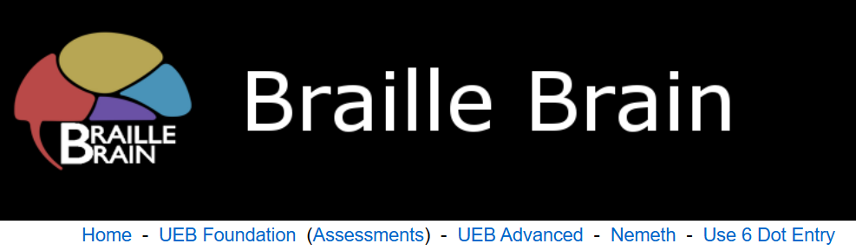
Braille Brain Header
Home
UEB Foundation
(Assessments)
UEB Advanced
Nemeth
Use 6 Dot Entry
Notes:
The header for Braille Brain is found on every page for ease of navigation.

Slide 10
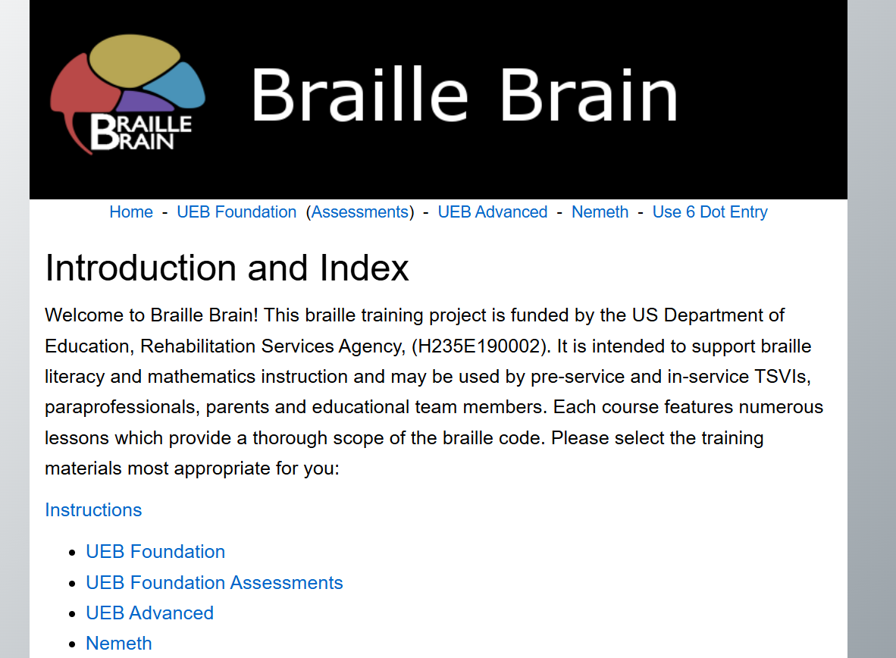
Braille Brain Homepage
Instructions
About Braille Brain
Notes:
Layout: Two Content

Slide 11
History of Braille Brain
Notes:
Layout: Section Header

Slide 12
Current Day
Collaboration between California State University Los Angeles and American Printing House for the Blind
Sponsored by the US Department of Education, Rehabilitation Services Administration (H235E190002)
Notes:
Layout: Title and Content

Slide 13
Origins
Braille Brain, Kim Blackwell
Writing Adventure Time app (Songkhao, 2019)
Reading Adventure Time app (Kamei-Hannan, et. Al, 2020)
Notes:
Layout: Title and Content

Slide 14
Key People
Notes:
Layout: Section Header

Slide 15
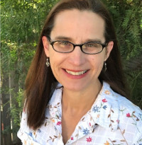
Kim Blackwell
Lead Curriculum Writer

Slide 16
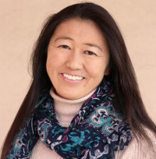
Cheryl Kamei-Hannan
Lead Researcher

Slide 17

Gina Michell
Lead Researcher

Slide 18
Additional Content Authors
Frances Mary D’Andrea
Rachel Schles
Jonathan Hooper
Lauren Hanner
David “Rusty” Perez
Anita Yasuda
Erika Priser
Martha Castiglia
Notes:
Layout: Title and Content

Slide 19
Sections in Braille Brain
Notes:
Layout: Section Header

Slide 20
UEB Foundation
First section in Braille Brain
21 Units
Ranges from Braille Alphabet to Contractions
Where beginners should start
Units have different activities including Reading Workout, Writing Workout,
Notes:
Layout: Title and Content

Slide 21
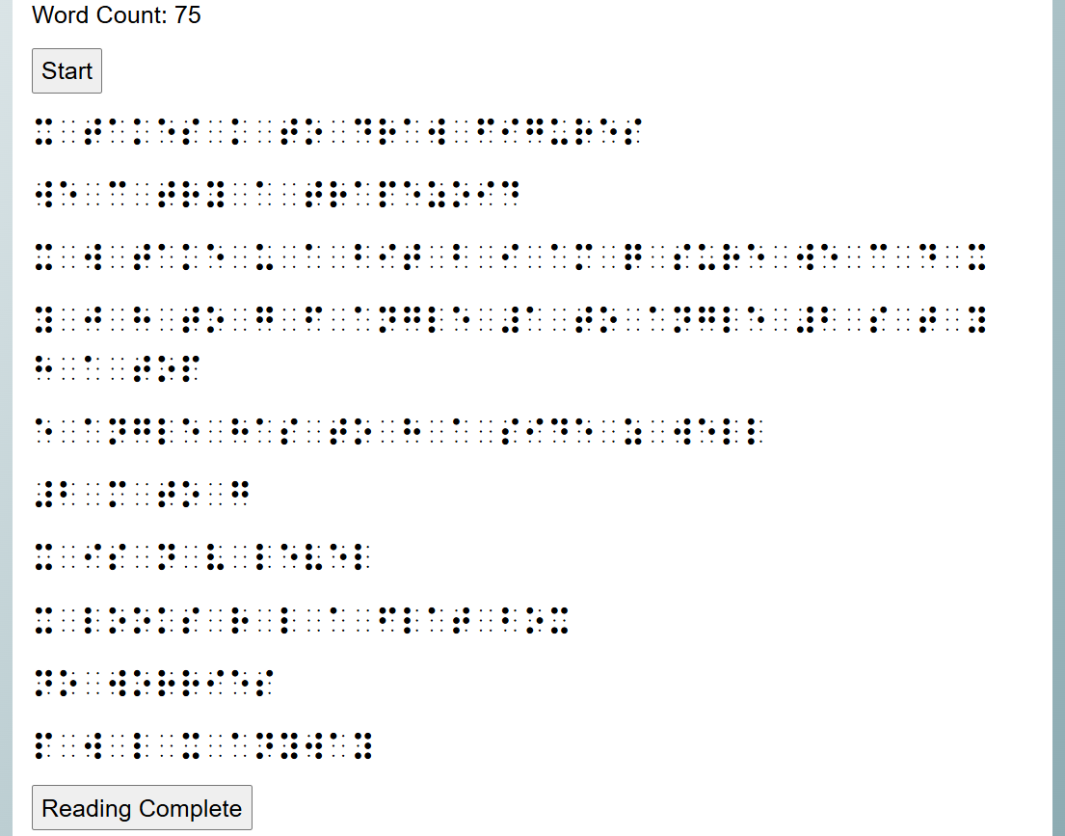
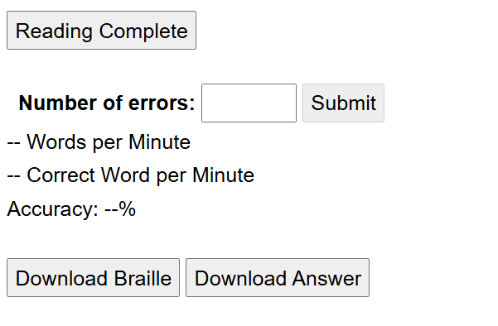
Reading Workout Example
Gives word count
Select start button, when finished select the reading complete button
Input the number of errors, and it displays the accuracy
Can download document to emboss
Notes:
Layout: Custom Layout

Slide 22
UEB Advanced
UEB Math advanced topics
13 Units
Usually a lesson followed by multiple-choice practice
Includes topics such as complex fractions and sine, cosine, and tangent
Notes:
Layout: Title and Content

Slide 23
Nemeth
21 units
Usually a lesson followed by multiple-choice questions
Covers topics including Nemeth code switch indicator, spatial math, and set notation
Notes:
Layout: Title and Content

Slide 24
UEB Foundation Assessment
Can be used by teachers to inform them of learner’s skills
Sorted into reading levels from Pre-Pre-Kindergarten to Grade 12
Contains long passages, short passages, word lists, dictation, and multiple choice
Notes:
Layout: Title and Content

Slide 25
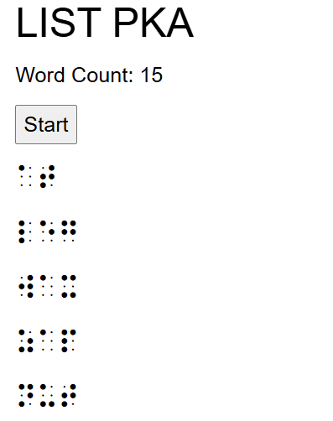
Word Lists
Sources for pre-K through sixth grade include:
  Fry’s word list of high frequency words
  New Jersey Tiered System of Support sample Phonics/Word Analysis Scope and Sequence
  Wilson Reading System®
  Middle School Vocabulary List
  Secondary Vocabulary List
Notes:
Layout: Two Content

Slide 26
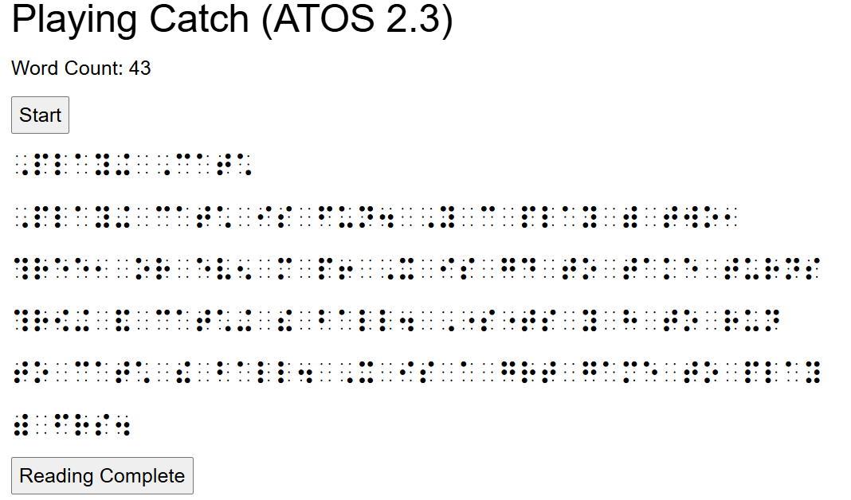
Long and Short Passages
Uses ATOS readability scale
Passages from team of educational consultants
5 comprehension questions for each passage aligned to common core state standards
Notes:
Layout: Two Content

Slide 27
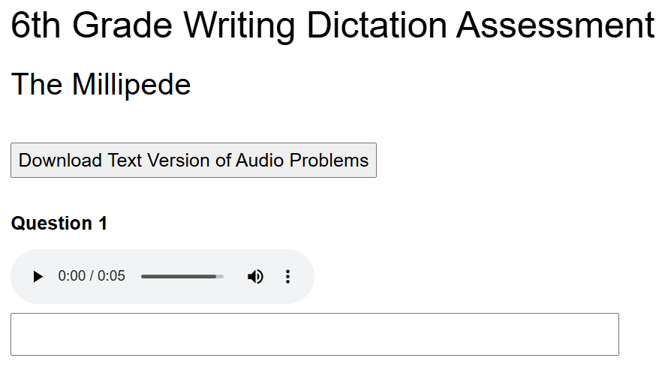
Dictation
Tests spelling and progressively increases in difficulty
Upper levels include sentences and short passages
Writing dictation leveled according to common core standards
Notes:
Layout: Two Content

Slide 28
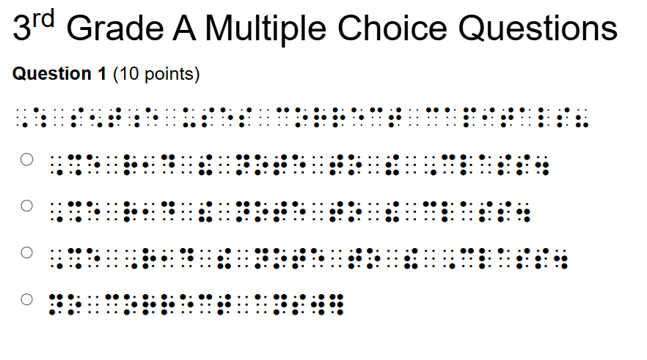
Multiple Choice
Additional questions developed to test knowledge of rules governing specific braille contractions
Braille contractions controlled and aligned with grade level expectations for vocabulary and sight words
Notes:
Layout: Two Content

Slide 29
How to incorporate Braille Brain?
Notes:
Layout: Section Header

Slide 30
Any additional questions?
Notes:
Layout: Section Header

Slide 31
Contact information
Cheryl Kamei-Hannan ckameih@exchange.calstatela.edu
Sarah Welch swelch@aph.org
Notes:
Layout: Comparison

Slide 32
Thank you!
Notes:
Layout: Section Header

