Slide 1
Building Mathematical Mastery with APH Tools
A Grade-Level Roadmap

Slide 2

Dr. Leanne Grillot
Senior Director of Outreach Services

Slide 3

Dr. Li Zhou
Math Product Manger

Slide 4
Learning Objectives
Participants will identify and describe at least three APH math products for each grade band, including both tangible and digital options, and explain their instructional applications.
Participants will use grade band and math domain frameworks to develop an instructional plan incorporating appropriate APH math products.
Participants will analyze how selected APH math products align with the Principles and Standards for School Mathematics Domains or Common Core State Standards such as Number Sense, Geometry, and Algebraic Thinking.
Participants will evaluate student needs and Federal Quota considerations to select APH math products that support targeted student growth.
Notes:
Leanne

Slide 5
Standards-Based Math Instruction
Notes:
Leanne

Slide 6
Two Ways of Organizing and Describing the Core Content of School Mathematics
Principles and Standards for School Mathematics (PSSM)
National Council of Teachers of Mathematics (NCTM, 2000)
Common Core State Standards for Mathematics (CCSSM)
National Governors Association Center for Best Practices and Council of Chief State School Officers (NGAC and CCSSO, 2010)
Notes:
Leanne
Principles and Standards for School Mathematics (PSSM) are guidelines produced by the National Council of Teachers of Mathematics (NCTM) in 2000, setting forth recommendations for mathematics educators.^{[1][2]} They form a national vision for preschool through twelfth grade mathematics education in the US and Canada. It is the primary model for standards-based mathematics.
The NCTM employed a consensus process that involved classroom teachers, mathematicians, and educational researchers. A total of 48 individuals are listed in the document as having contributed, led by Joan Ferrini-Mundy and including Barbara Reys, Alan H. Schoenfeld and Douglas Clements. The resulting document sets forth a set of six principles (Equity, Curriculum, Teaching, Learning, Assessment, and Technology) that describe NCTM's recommended framework for mathematics programs, and ten general strands or standards that cut across the school mathematics curriculum. These strands are divided into mathematics content (Number and Operations, Algebra, Geometry, Measurement, and Data Analysis and Probability) and processes (Problem Solving, Reasoning and Proof, Communication, Connections, and Representation). Specific expectations for student learning are described for ranges of grades (preschool to 2, 3 to 5, 6 to 8, and 9 to 12).

Slide 7
K-8 Mathematics
NCTM
Numbers and Operations
Algebra
Geometry
Measurement
Statistics and Probability
CCSSM
Counting and Cardinality
Operations and Algebraic Thinking
Number and Operations in Base Ten
Number and Operations–Fractions
Measurement and Data
Geometry
Ratios and Proportional Relationships
The Number System
Expressions and Equations
Functions
Statistics and Probability
Notes:
Leanne

Slide 8
High School Mathematics
NCTM
Numbers
Algebra
Geometry
Statistics and Probability
Ratios and Proportions
Expressions and Equations
Functions
Trigonometry
Calculus
Discrete Mathematics
CCSSM
Number and Quantity
Algebra
Functions
Modeling
Geometry
Statistics and Probability
Notes:
Leanne

Slide 9
NCTM Focal Points and APH Tools for Access
Notes:
Leanne
NCTM identifies three major mathematical concepts, skills, or understandings for each grade level, Kindergarten through 8th grade. These are the areas of focus or emphasis at that grade level. The curriculum focal points and their connections can be used as the foundation for mathematics learning in that grade and for extended understandings in subsequent grades. Let’s examine a few while also exploring the APH tools available to give our students access.

Slide 10
Grade Band: K-2
Key Domains: Counting & Cardinality, Operations in Base Ten, Geometry
Notes:
Leanne

Slide 11
Kindergarten Focal Points (student age: 5 or 6 years old)
Focal Points | Related Content Standard | Simple Example
Representing, comparing, and ordering whole numbers and joining and separating sets | Number and Operations | There are 2 toy cars, and a friend gives 3 more. How many cars are there now?
Describing shapes and space | Geometry | How do you know this is a square?
Ordering objects by measurable attributes | Measurement | Measure each item. Which one is the longest?
Notes:
Leanne

Slide 12
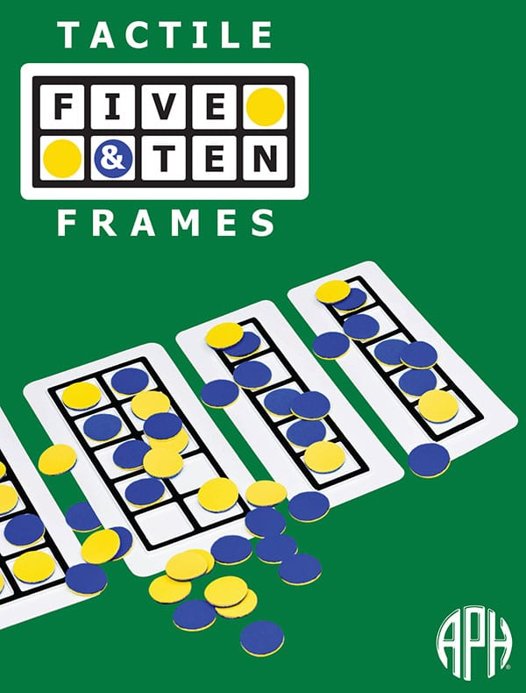
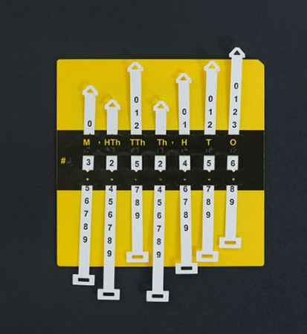
Highlight: Kindergarten
Five and Ten Frames
Hundred Board and manipulatives
Place Value Setter
Ruler
Notes:
Leanne
* Tactile Five and Ten Frames
* Hundred Board and manipulatives
* Place Value Setter
Ruler
Focal Points
Related Content Standard
Simple Example
Representing, comparing, and ordering whole numbers and joining and separating sets
Number and Operations
There are 2 toy cars, and a friend gives 3 more. How many cars are there now?
Describing shapes and space
Geometry
How do you know this is a square?
Ordering objects by measurable attributes
Measurement
Measure each item. Which one is the longest?

Slide 13
First Grade Focal Points (student age: 6 or 7 years old)
Focal Points | Related Content Standard | Simple Example
Developing an understanding of whole-number relationships, including grouping by tens and ones. | Number and Operations, Algebra | What numbers do you say when you count by fives?
Developing an understanding of addition and subtraction | Number and Operations, Algebra | Given the numbers 7, 4, and 11, what are the four related addition and subtraction sentences that form this fact family?
Identifying and comparing attributes | Measurement | Using this graph, which fruit is most popular?

Slide 14
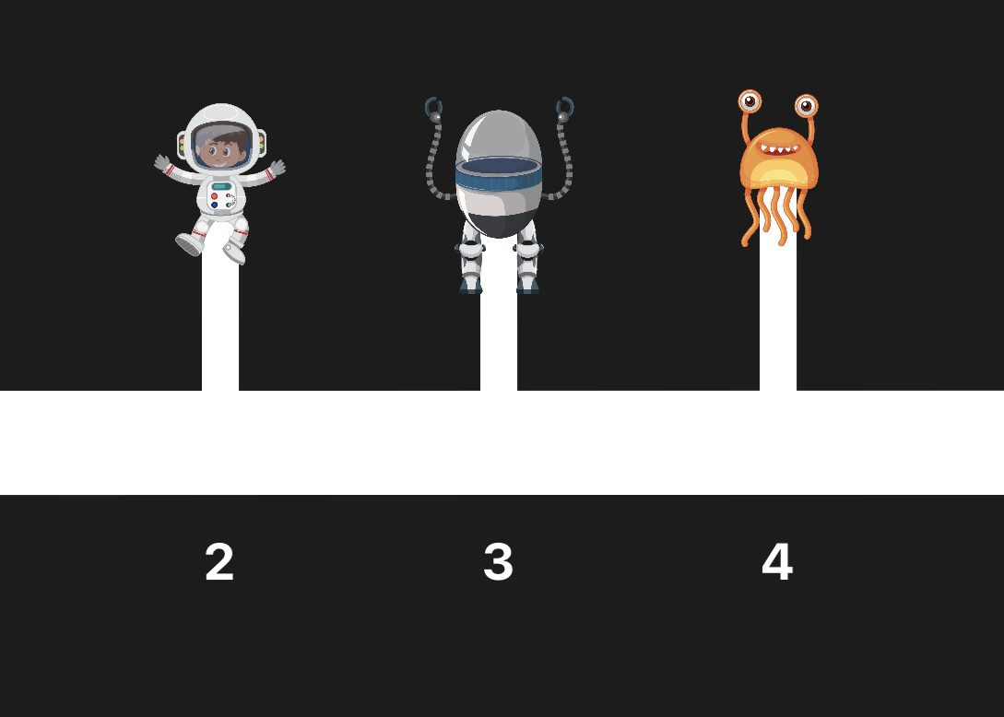
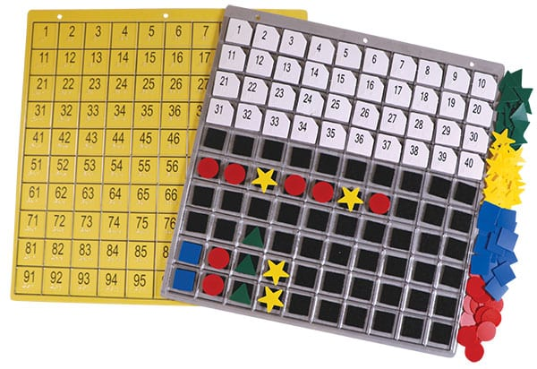
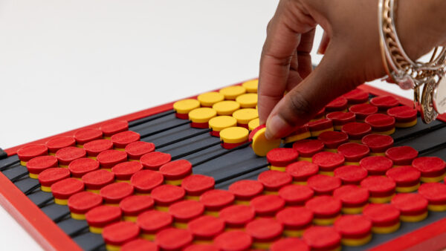
APH Products for K-2
Notes:
Leanne
Cosmic Number Line (App) (video)
Visualizes integers, rational numbers, and algebraic relationships.
Hundreds Board
Develops counting, skip counting, and place value skills.
Abacus
Supports basic computation and tactile representation of numbers.
Math Drill Flashcards
Builds fluency with addition and subtraction facts.

Slide 15
Grade Band: 3-5
Key Domains: Operations & Algebraic Thinking, Fractions, Measurement & Data, Geometry
Notes:
Leanne

Slide 16
Fourth Grade Focal Points (student age: 9 or 10 years old)
Focal Points | Related Content Standard | Simple Example
Developing quick recall of multiplication facts and related division facts and fluency with whole number multiplication | Number and Operations, Algebra | An auditorium has 26 rows of 89 seats. How many seats are there?
Developing an understanding of decimals, including the connections between fractions and decimals | Number and Operations | Draw a picture of 0.2. What fraction is this?
Developing an understanding of area and determining the areas of two-dimensional shapes | Measurement | How could we find the area of this L-shaped room?
Notes:
Leanne

Slide 17
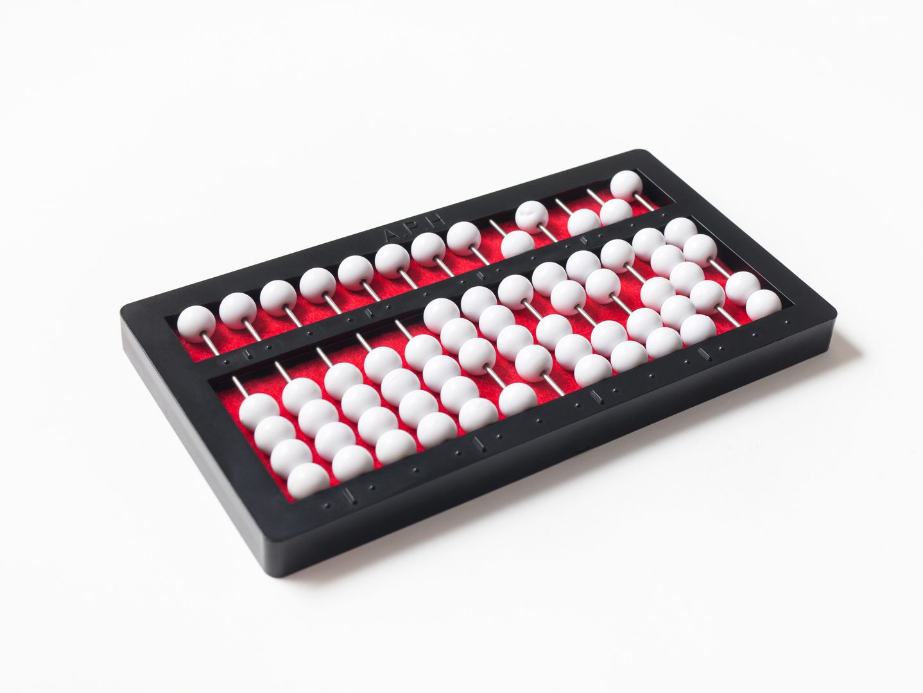

Highlight: Fourth Grade
Abacus
Abacus App
Geometros
Flip-Over Concepts Books: Fractions
Notes:
Leanne
* Abacus
* Abacus App (video)
* Geometros
* Flip-Over Concepts Books: Fractions
Focal Points
Related Content Standard
Simple Example
Developing quick recall of multiplication facts and related division facts and fluency with whole number multiplication
Number and Operations, Algebra
An auditorium has 26 rows of 89 seats. How many seats are there?
Developing an understanding of decimals, including the connections between fractions and decimals
Number and Operations
Draw a picture of 0.2. What fraction is this?
Developing an understanding of area and determining the areas of two-dimensional shapes
Measurement
How could we find the area of this L-shaped room?

Slide 18
Third Grade Focal Points (student age: 8 or 9 years old)
Focal Points | Related Content Standard | Simple Example
Developing an understanding of multiplication and division | Number and Operations, Algebra | If you know that 7 groups of 8 chairs make 56 chairs, what is the answer to 56 ÷ 7?
Using fractions to describe parts of wholes and parts of sets | Number and Operations, Algebra | "There are 12 students on the playground. 6 of them are wearing red shirts. What fraction of the students are wearing red shirts? Draw a picture to show your answer.
Describing and analyzing properties of two- and three-dimensional geometric figures | Geometry, Measurement | Find the area of a rectangle when given the graphic array of 4 squares across and 6 squares down.

Slide 19
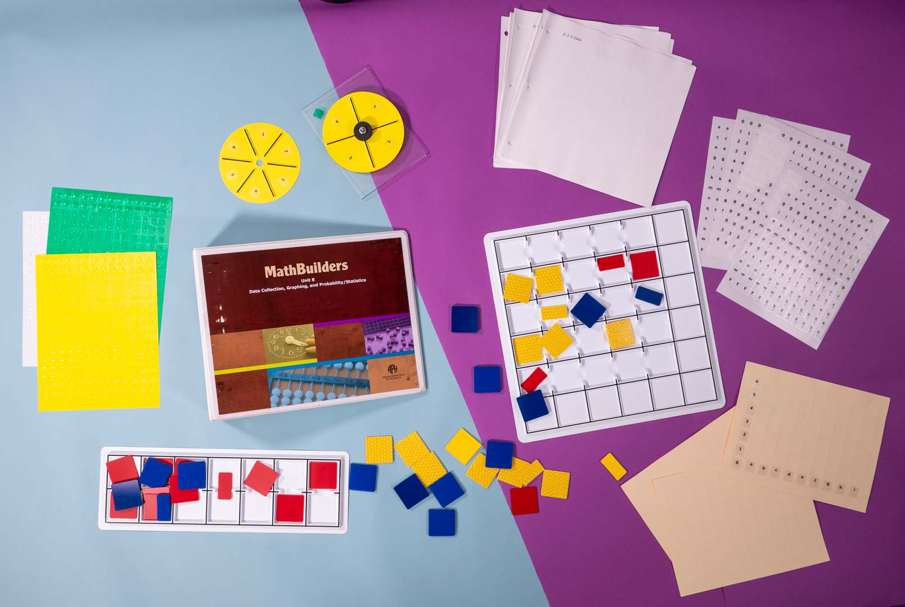
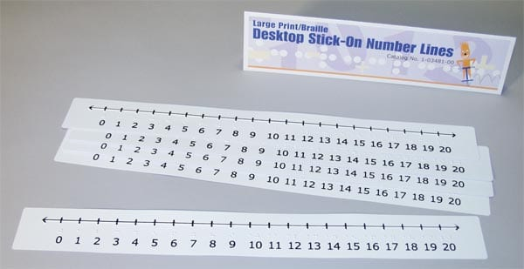
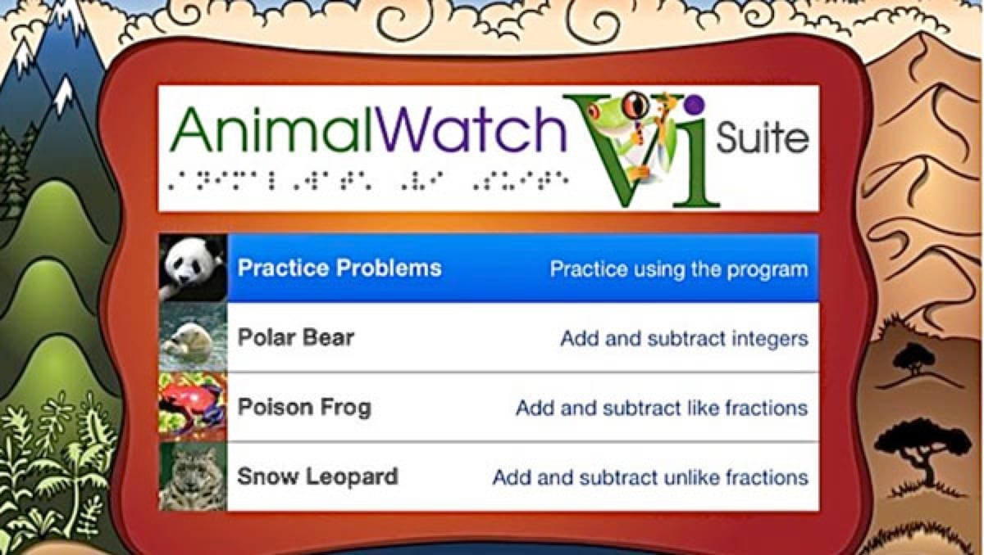
APH Products for Grades 3-5
Notes:
Leanne
Fraction Flip-Over Concept Books
Helps students visualize, compare, and manipulate fractions.
Geometro
Introduces geometric shapes and spatial reasoning.
Abacus
Supports multi-digit computation and concept development.
Graph Benders
Builds understanding of early graphing concepts and data collection.

Slide 20
Grade Band: 6-8
Key Domains: Ratios & Proportional Relationships, Expressions & Equations, Geometry
Notes:
Li

Slide 21
Eighth Grade Focal Points (student age: 13 or 14 years old)
Focal Points | Related Content Standard | Simple Example
Analyzing and representing linear functions and solving linear equations and systems of linear equations | Algebra | The equation y = 4x + 4 shows the cost y of washing x windows. How much more will it cost each time I add 2 more windows to the job?
Using geometric characteristics and properties to solve problems | Geometry, Measurement | Car A starts at the point (-3, 2) and drives at a constant rate, heading towards the point (5, 10). Car B starts at the point (6, -4) and drives at a constant rate, also heading towards the point (3, 4). What is the total distance between their starting points?
Analyzing and summarizing data sets | Data Analysis, Number and Operations, Algebra | What is the median price in this list? Does the median change if I lower the most expensive price?
Notes:
Li

Slide 22
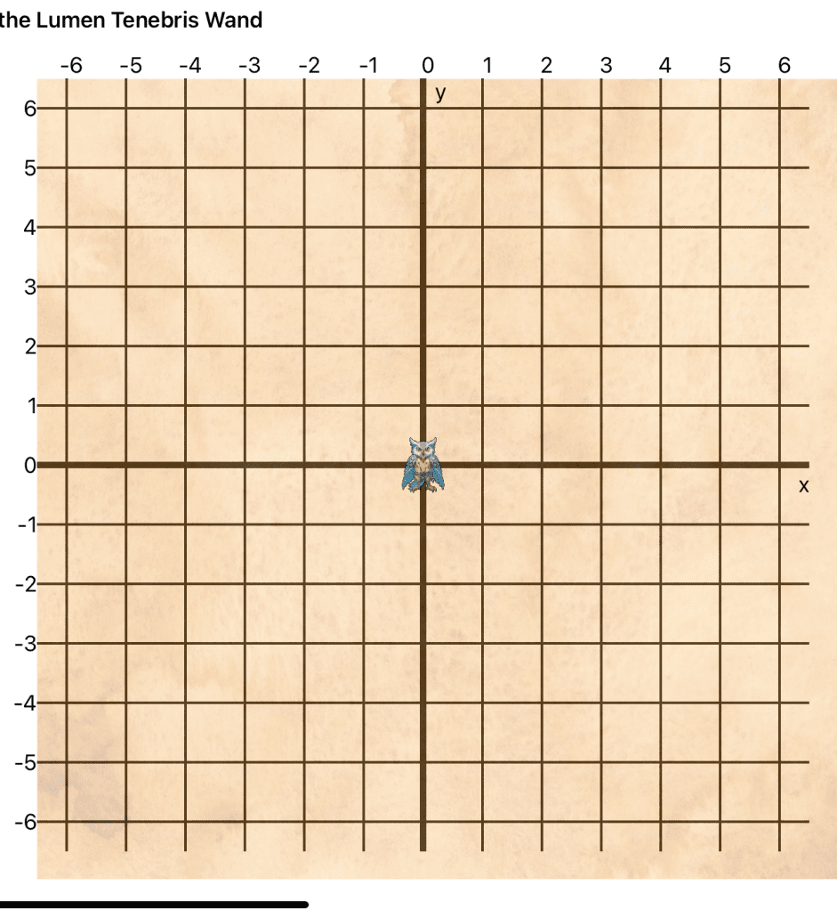
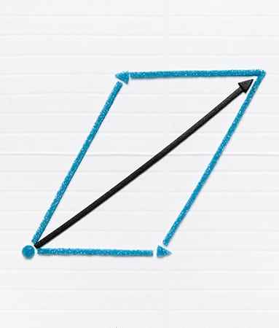
Highlight: Eighth Grade
Tactile Algebra Tiles
Cedric’s Cartesian Quest
Graph Benders
APH Graph Sheets
Notes:
Li
* Tactile Algebra Tiles
* Cedric’s Cartesian Quest (video)
* Graph Benders
* APH Graph Sheets

Slide 23
Sixth Grade Focal Points (student age: 11 or 12 years old)
Focal Points | Related Content Standard | Simple Example
Connecting ratio and rate to multiplication and division. | Number and Operations, Algebra | If 5 items cost $3.75 and all items are the same price, how much do 12 items cost?
Using common procedures to multiply and divide fractions and decimals efficiently and accurately. | Fractions and Decimals | A recipe uses 3/4 cup of sugar for one batch of cookies. How much sugar is needed to make 3 batches?
Writing mathematical expressions and equations that correspond to given situations. | Expressions and Equations | A gym charges a $15 monthly fee plus $5 per visit. Write an expression for the total cost if a person visits the gym x times in a month.

Slide 24
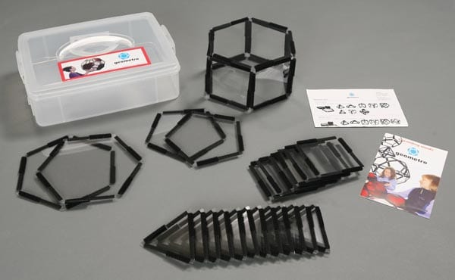
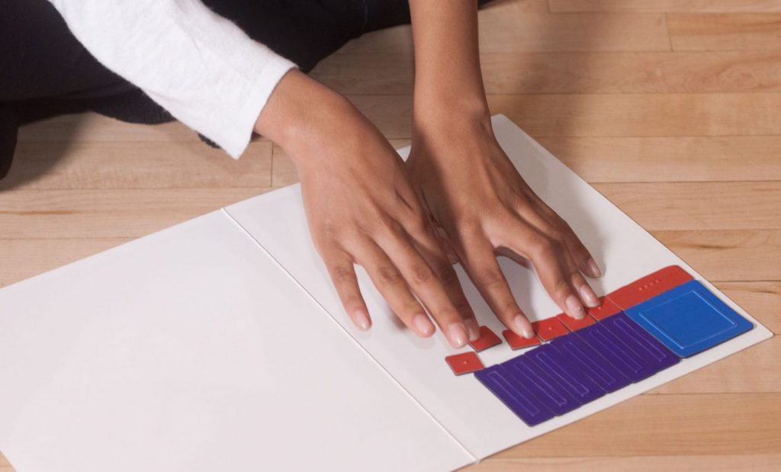
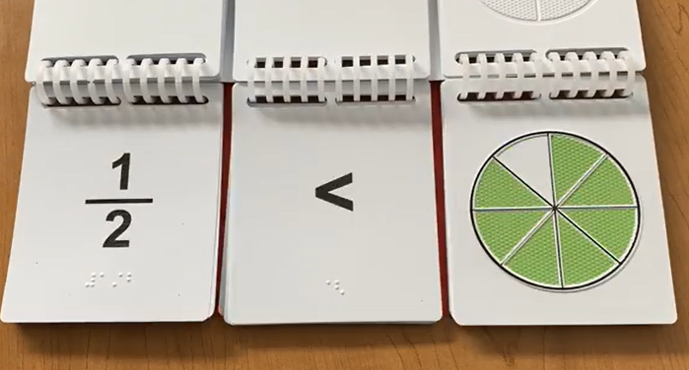
APH Products for Middle School
Notes:
Li
Fraction Flip-Over Concept Books
Reinforces fractional concepts and equivalence.
Graph Benders
Expands into coordinate graphing and slope.
Cedric’s Cartesian Quest (App) (video)
Gamified exploration of the coordinate plane.
Geometro
Builds understanding of 3D shapes and transformations.

Slide 25
Grade Band: 9-12
Key Domains: Algebra, Functions, Geometry, Statistics & Probability
Notes:
Li

Slide 26
High School Content Strands (student age: 15 or 16 years old)
Focal Points | Related Content Standard | Simple Example
Create equations in two or more variables to represent relationships between quantities. | Algebra | A gym charges $30 per month plus $5 per class. Let m = months and c = classes. Write an equation for the total cost.
Use coordinates to prove simple geometric theorems algebraically. | Geometry, Measurement | The points A (1, 2), B (5, 2), and C (3, 6) form a triangle. Use coordinates to show that two sides have the same length.
Interpret the slope (rate of change) and the intercept (constant term) of a linear model in the context of the data. | Data Analysis, Number and Operations, Algebra | A taxi ride costs $3 plus $2.50 per mile: y = 2.5x + 3. What do the slope and intercept mean here?
Notes:
Li

Slide 27
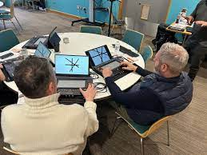
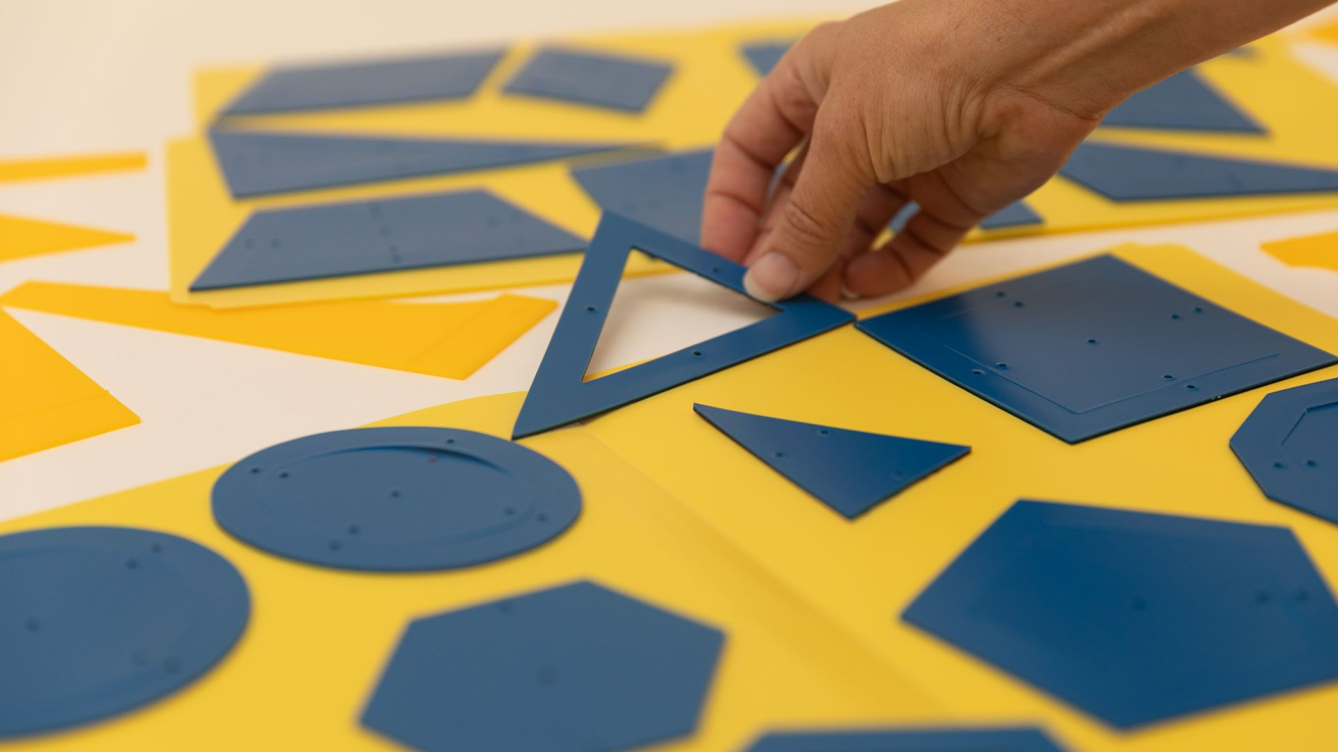
Highlight: High School
Geometric Drawing Stencils
Draftsman Tactile Drawing Board
Algebra on the Monarch (video)
AnyMath
Notes:
Li
* Geometric Drawing Stencils
* Draftsman Tactile Drawing Board
* Algebra on the Monarch (video)
* AnyMath

Slide 28
High School Content Strands (student age: 17 or 18 years old)
Focal Points | Related Content Standard | Simple Example
Solve systems of equations | Algebra | Solve the system: x + y = 10 and 2x + y = 14.
Make geometric constructions | Geometry, Measurement | Draw a circle. Use a protractor to mark equal arcs: connect 3 points for an equilateral triangle, 4 for a square, 6 for a hexagon.
Summarize, represent, and interpret data on two categorical and quantitative variables | Data Analysis, Number and Operations, Algebra | Data: (1, 65), (2, 70), (3, 78), (4, 85). Plot points. As study time increases, test scores increase.

Slide 29
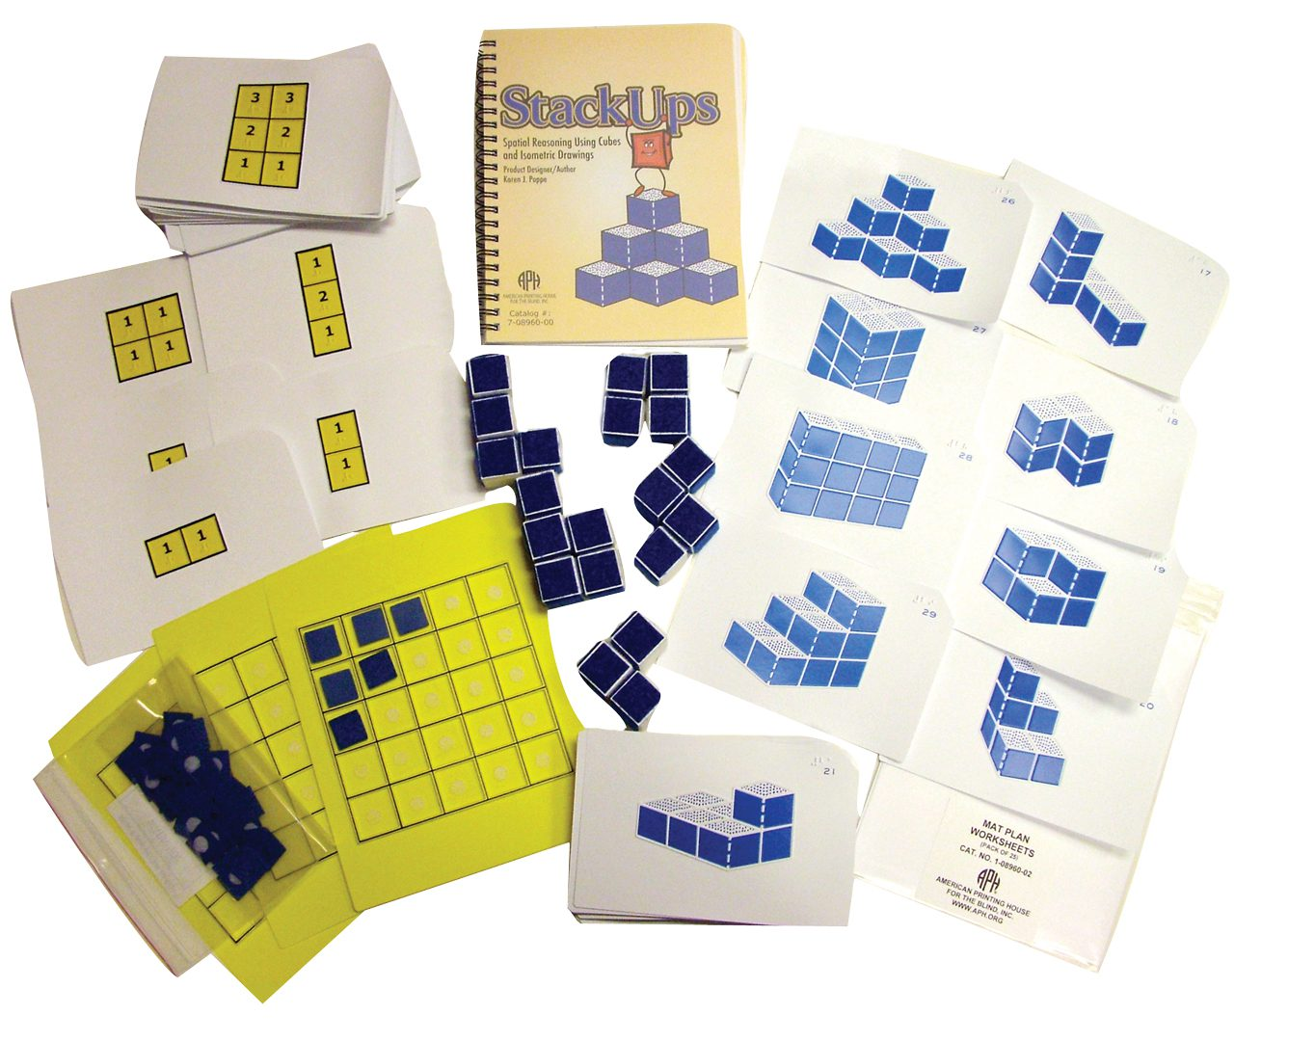
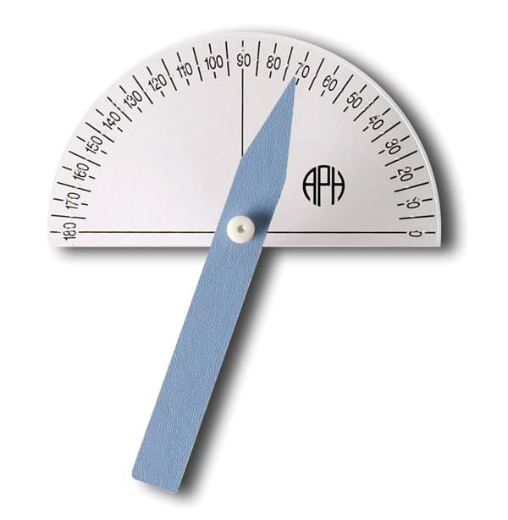
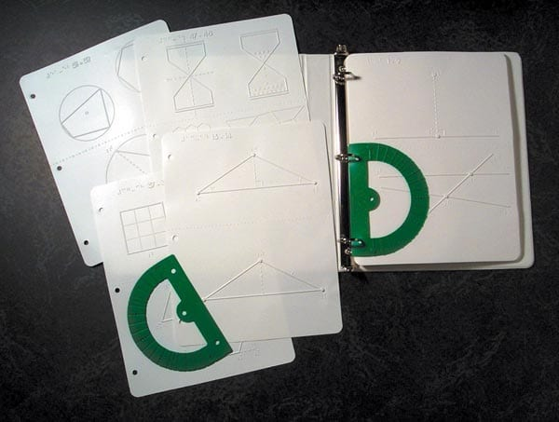
APH Products for High School
Notes:
Li
Cedric’s Cartesian Quest (App)
Extends into algebraic graphing and spatial reasoning.
Graph Benders
Used for data modeling and analyzing slope/intercepts.
Abacus
Supports algebraic thinking and multi-step computation.

Slide 30
Building Mathematical Mastery with APH Tools
Leanne Grillot, lgrillot@aph.org
Li Zhou, lzhou@aph.org

