Slide 1
From Diagnosis to Employment
Supporting Learners Who Are Blind or Deafblind Across the Lifespan

Slide 2
Today’s Focus: Practical Tools You Can Use Immediately
Identify where gaps commonly occur across the lifespan
Look at curated tools that can reinforce your instruction
Discuss where these resources align with IEP, IFSP, and transition goals

Slide 3
Live Poll: Who Do You Primarily Serve?
Options:
Early childhood
K–8
Transition-age
Adults
Deafblind across ages
University/teacher prep

Slide 4

The Shared Challenge Across Our Field

Slide 5

The Moment After the Meeting: “Where Do They Go Next?”
What reinforces conversation?
Who supports the parent at 10 p.m.?
What supports the student who needs repetition?

Slide 6

A Lifespan Continuum We All Recognize

Slide 7

Where Systems Break Down
Diagnosis to early intervention
Elementary to middle school
High school to adult services
School to workforce systems
Late-Onset vision loss with no clear referral path

Slide 8

The Professional Reality: Limited Time, Expanding Needs
Teach specialized skills
Support families
Coordinate services
Address social-emotional needs
Prepare for employment
Document it all

Slide 9
Where ConnectCenter Fits
Reinforce instruction
Provide reliable next steps
Support structured transition
Address adult adjustment

Slide 10

Three Pillars Across the Lifespan
Pillar 1: Families & Early Support
Pillar 2: Adjustment & Independence
Pillar 3: Transition & Employment

Slide 11
Families and Early Childhood

Slide 12
Live Poll: When Do Families Feel Most Overwhelmed?
Poll options:
Immediately after diagnosis
During IFSP development
At first IEP
During school transitions
When thinking about long-term outcomes

Slide 13
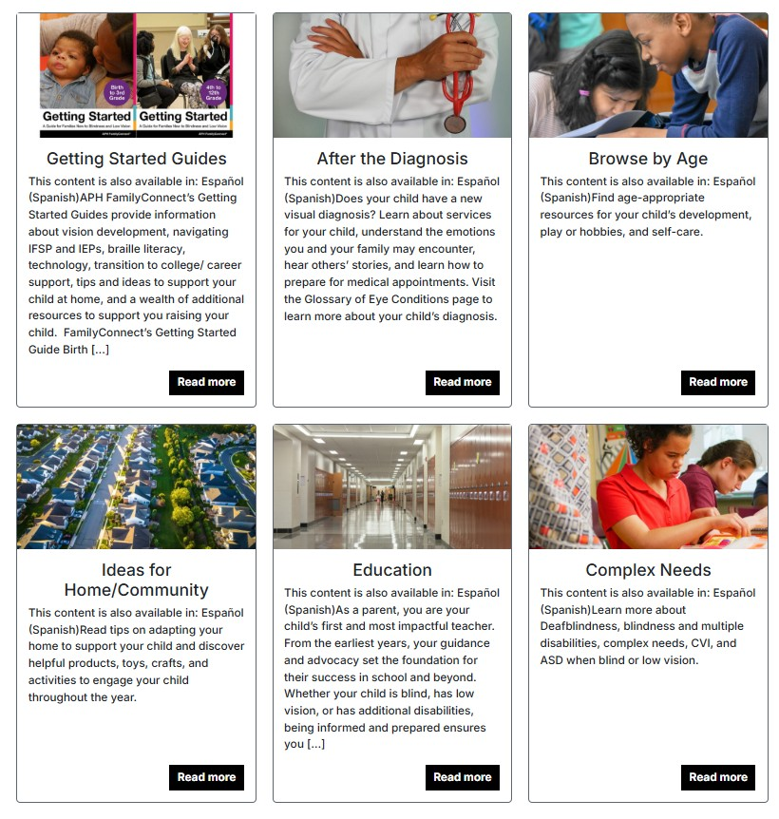
FamilyConnect Reinforces:
Understanding eye conditions
Navigating IFSPs and IEPs
Home-based adaptations
Early literacy foundations

Slide 14
Starting Points: What to Share First
A Getting Started pathway
One resource aligned to your discussion
One follow-up that reinforces a skill

Slide 15
Case Example: From Diagnosis to First IEP
Reinforce terminology
Reduce misinformation
Encourage informed questions
Build confidence during meetings

Slide 16

Early Literacy Engagement: Where BrailleBug Fits
Playful braille exposure
Early literacy engagement
Motivation and normalization
Family-friendly access

Slide 17

Reinforcement — Not Replacement
Reinforces instruction
Extends conversations beyond meetings
Supports repetition and review
Provides reliable, revisit-able language

Slide 18
Adjustment, Identity, and Independence

Slide 19
Live Poll: What Prompts Adult Referrals Most Often?
Poll options:
Sudden vision loss
Progressive vision changes
Exit from school services
Family request for support
Social isolation
Independent living concerns

Slide 20
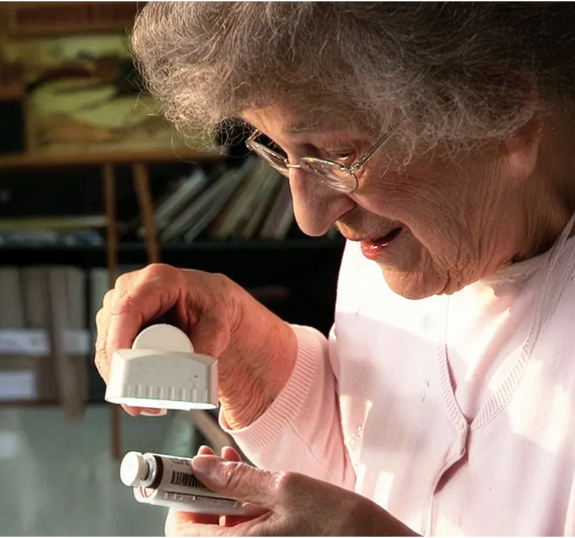
VisionAware in Practice: Addressing Real-Life Adjustment
Understanding vision loss
Daily living strategies
Emotional adjustment
Community and support connections
Orientation to rehabilitation services

Slide 21
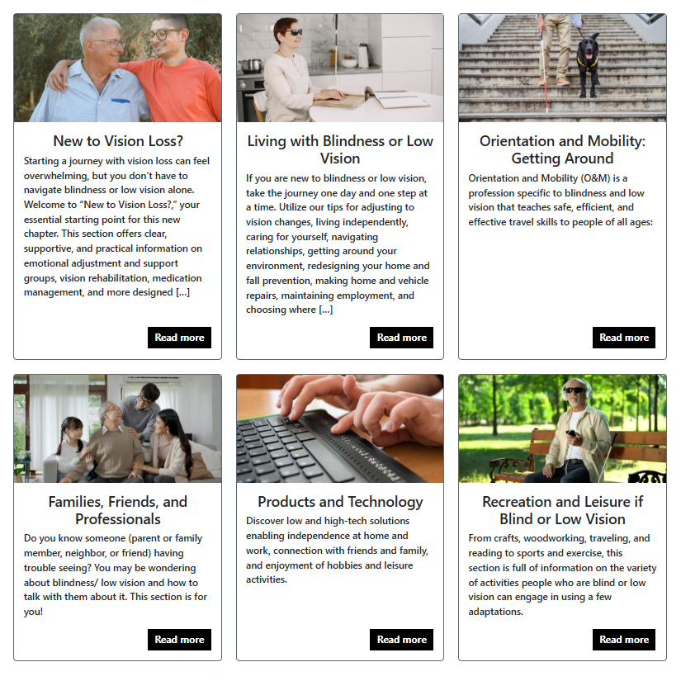
Daily Living Skills Beyond the School Setting
Practical daily living strategies
Home environment modifications
Accessible reading options
Environmental adaptations

Slide 22

Isolation, Identity, and Community Connection
Support group information
Lived experiences and perspectives
Adjustment guidance
Community connection pathways

Slide 23
Deafblind Considerations
Transfers Well
Independent living strategies
Environmental adaptations
Emotional adjustment themes
Requires Adaptation
Communication access
Technology navigation
Group participation
Peer connection models

Slide 24
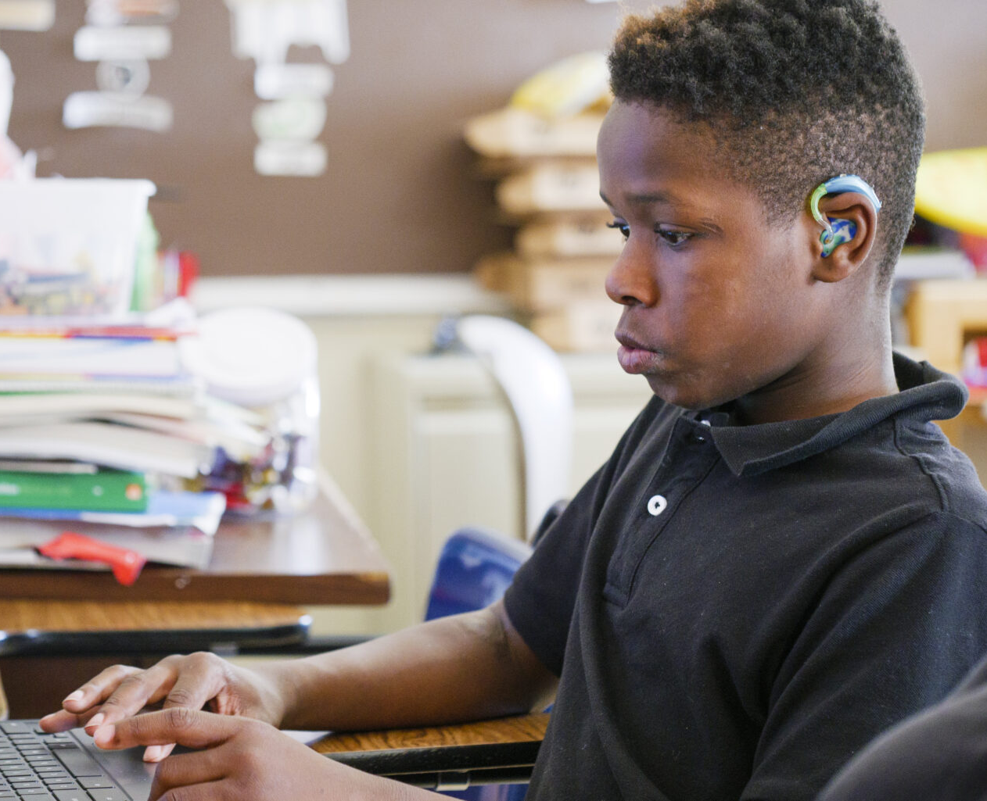
Supporting Families of Deafblind Learners
Clarify service pathways
Reinforce consistent terminology
Support informed advocacy
Build confidence during transitions

Slide 25
Transition and Employment

Slide 26
Live Poll: Your Biggest Transition Challenge
Poll options:
Student motivation
Family expectations
Employer engagement
Instructional time
Self-advocacy development
VR Coordination

Slide 27

The Transition Gap
Goals are written.
Implementation is uneven.
Explore career interests.
Develop self-advocacy.
Prepare for competitive employment.

Slide 28
CareerConnect as Instructional Infrastructure
Supports structured instruction
Facilitates small-group discussion
Provides between-session reinforcement
Aligns with Pre-ETS focus areas

Slide 29
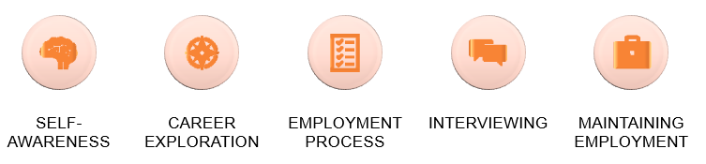
Five Developmental Areas:

Slide 30
Alignment With Pre-ETS and IEP Transition Planning
Measurable postsecondary employment goals
Self-determination instruction
Workplace readiness training
Independent living preparation

Slide 31

Building Self-Determination and Self-Advocacy
Practice disability disclosure
Request appropriate accommodations
Articulate strengths
Navigate workplace communication

Slide 32

Career Exploration Without Geographic Limits
Expands exposure to varied career paths
Features professionals who are blind
Introduces nontraditional roles

Slide 33
Interviewing and Workplace Readiness
Clear communication
Professional etiquette
Workplace problem-solving
Understanding employer expectations
Responding to feedback

Slide 34

Sustaining Employment Requires:
Executive functioning
Adaptability
Communication skills
Self-regulation
Workplace problem-solving

Slide 35

Career Conversations: Video as a Teaching Tool
Set purpose (what to listen/notice)
Play a short segment
Ask 2 or 3 focused questions
End with 1 application step

Slide 36
Integration Without Added workLoad

Slide 37
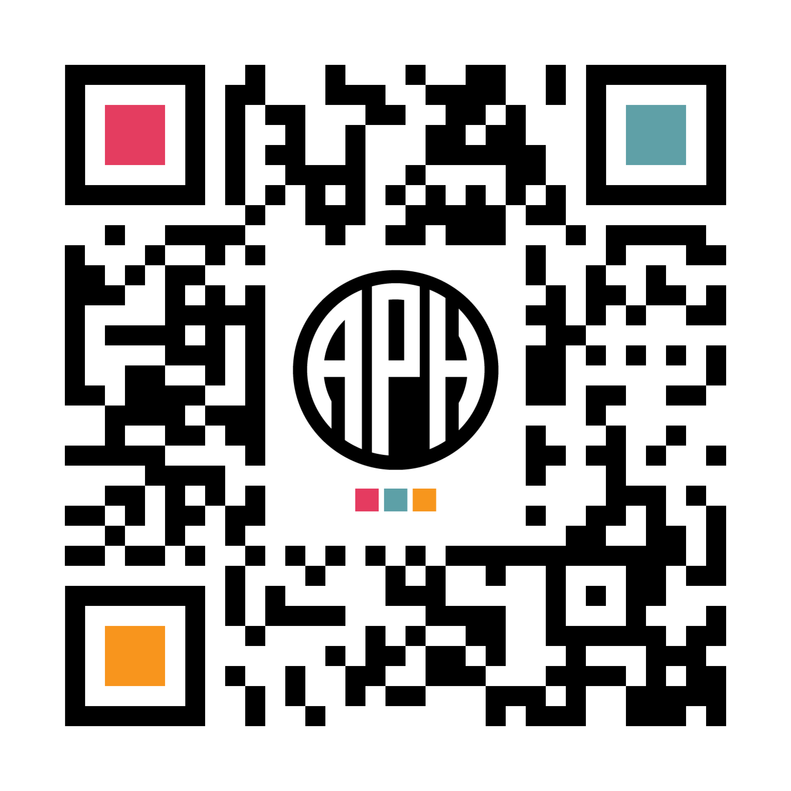
When to Use What
Need | Resource
Family understanding | FamilyConnect
Adult adjustment | VisionAware
Transition skill development | CareerConnect
Early literacy engagement | BrailleBug

Slide 38
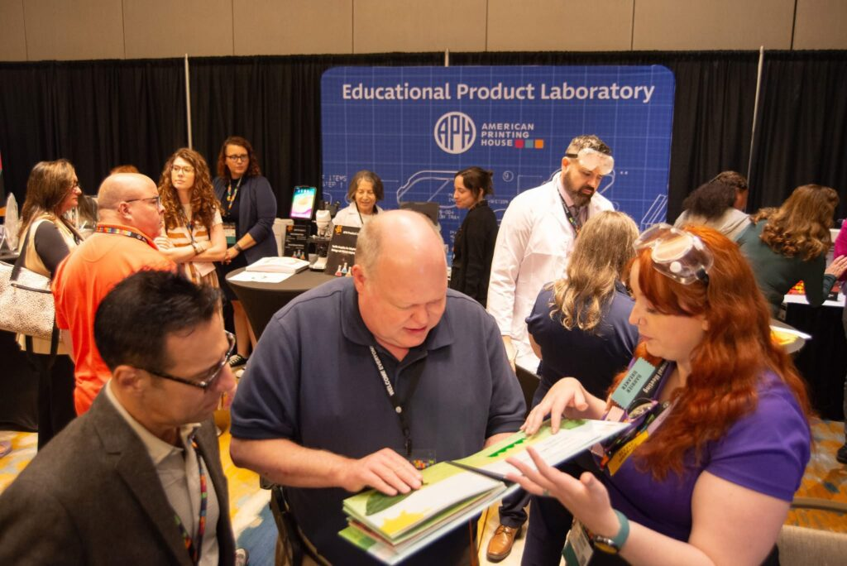
Field-Informed Development
Advisory input
Professional feedback
Field partnerships
Ongoing evaluation

Slide 39

Focusing on Usefulness Over Volume

Slide 40
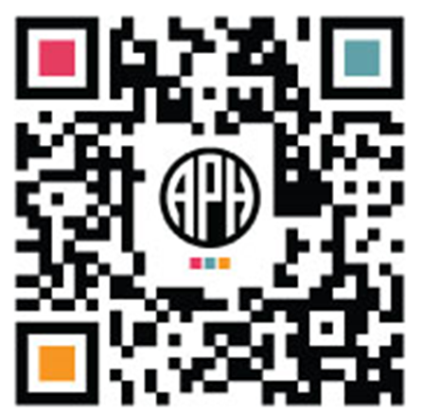
Where APH Hive Fits
Professional learning
Structured instructional modules
Facilitator-guided pathways
Skill development support

Slide 41
Next Steps
Refinement based on real-world use
Strengthening transition alignment
Clarity over volume
Continued professional input

Slide 42
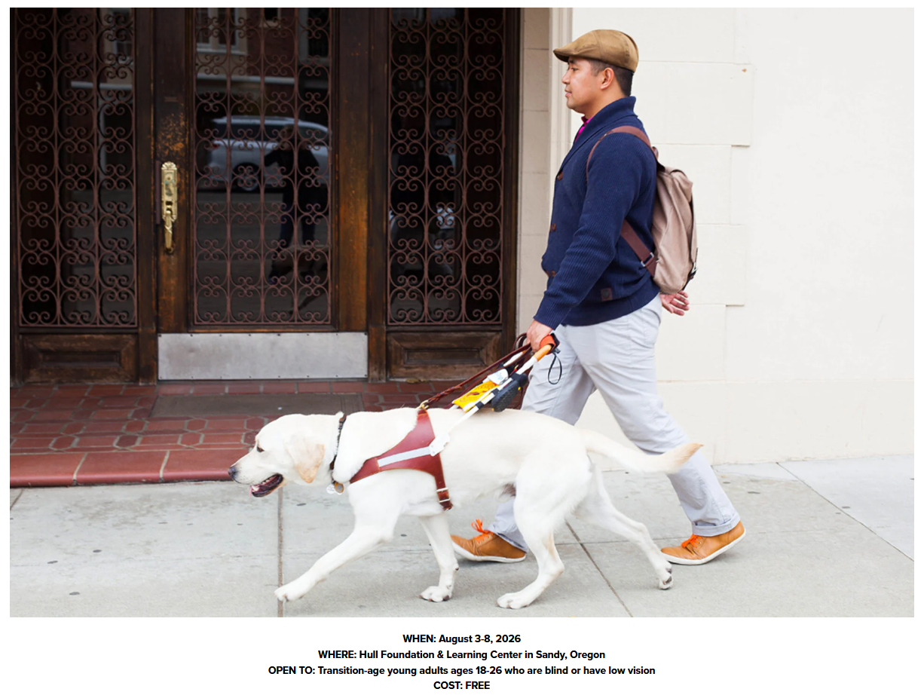
Careers & Canine Connections

Slide 43
Q&A + Collaboration
Where does this align with your work?
Where are there gaps?
What would increase usefulness in your setting?

Slide 44
From Diagnosis to Employment
Supporting Learners Who Are Blind or Deafblind Across the Lifespan
connectcenter@aph.org

